Slide 1
Implementation Object Linking and Embedding for Processes Control Unified Architecture Specification on Secure Device
The future standard for communication and information modeling in automation
Yuankui Wang

Slide 2
Agenda
Introduction and Motivation
OPC Unified Architecture Specification
Smart Card Technology
Application Scenario
Goals
Time Lines
Reference

Slide 3
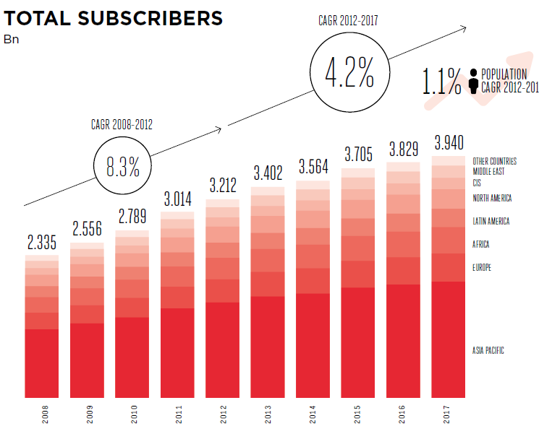
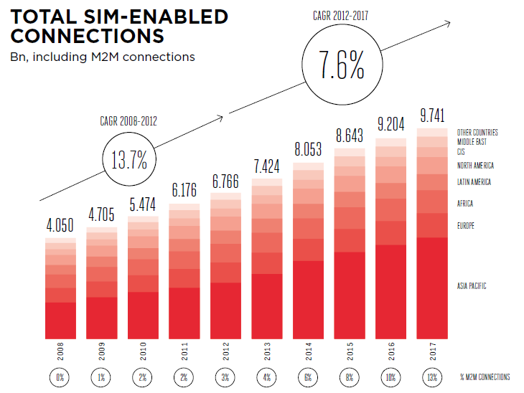
Introduction and Motivation
3.402 billion mobile subscribers in 2013 = half population on the earth
There are still many people who would appreciate the social economic benefits of mobile technology
There exits a huge opportunity for future growth
700 million expected to be added by 2017

Slide 4
Introduction and Motivation
The global market has grown by 13.7% since 2008
The total sim-enable connections in 2012 reaches 7 billion
Additional 2 billion connection projected to be added by 2017
Firms in many industry sectors now employing M2M applications to boost productivity and open new markets

Slide 5
Introduction and Motivation
Mobile is a vibrant and evolving industry at the heart of daily life
Mobile inter-connects the users’ world in spheres such as automotive, utilities, health, education, financial transactions and more
With the help of mobile, users are enjoying more and more mobility
24/7 monitored home security
Remote access control
Manage thermostat, light and etc.

Slide 6
Introduction and Motivation
Mobility in industry and business world is also a critical asset, which can not only increase efficiency and productivity but also drive new revenue generation and competitive advantage.
With mobility people, processes and assets can be always connected, be optimized on the go

Slide 7

Introduction and Motivation
Common Interface
In industry M2M area, over 22,000 products supplied by over 3,200 vendor
Security guarantee
Different communication environment
Variant data complexity
User authentication
User authorization
Message secure
Etc.

Slide 8
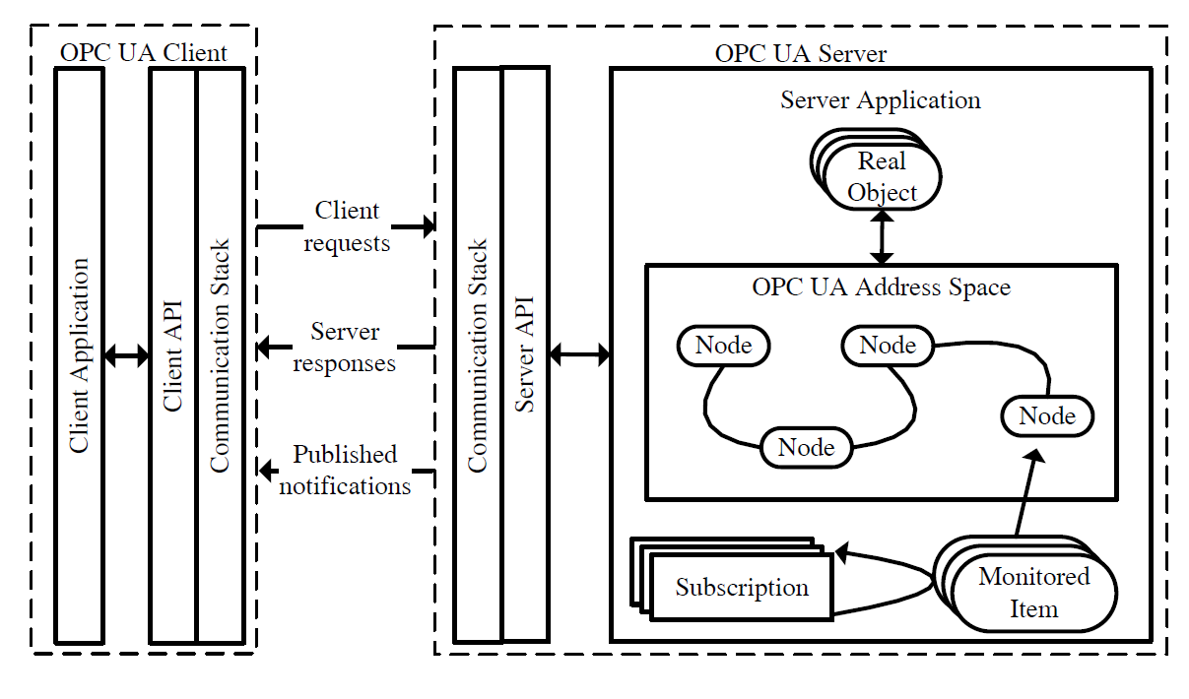
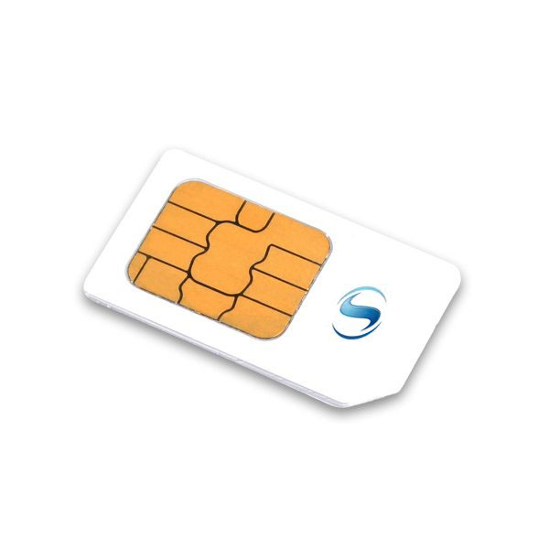
OPC UA meets Smart Cards
Smart Card / UICC: Well-established security token in many domains
OPC UA: Communication standard for industrial automation

Slide 9
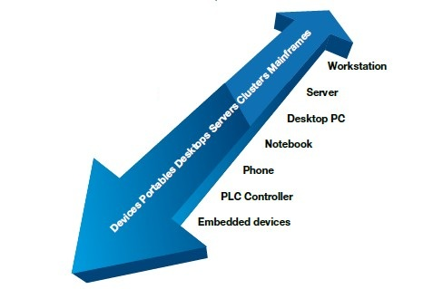
OPC Unified Architecture Specification
OPC UA is the M2M communication protocol
Platform independent data communication
Standardized communication via internet and firewalls
Protection against unauthorized access
Availability and reliability
SOA architecture
Object oriented meta model
Simplification by unification

Slide 10
Smart Card Technology
Finance, Communication, personal identification, payment
APDU based communication between card and CAD
Self-containment structure
Security token
Process cryptographic algorithms on hardware
Applications:
Cybercash
Sending personal data
Buy gasoline at gasoline station
….

Slide 11
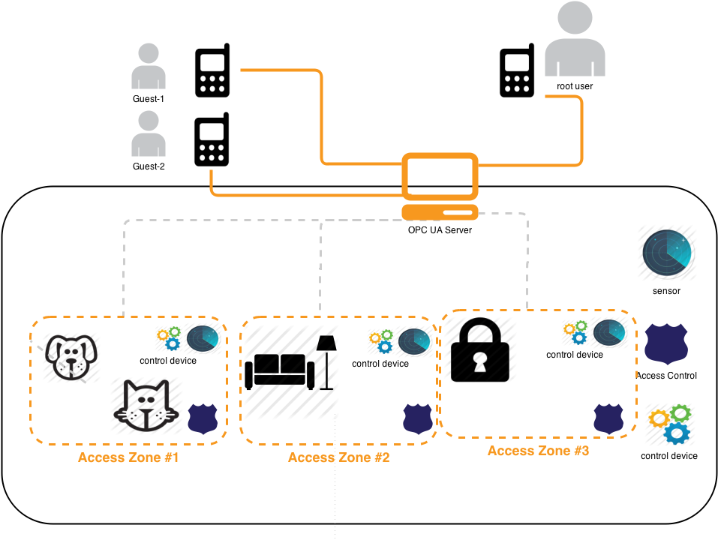
Application Scenario
OPC UA Server:
Sensor
control devices
access control locks
OPC UA Clients:
phones
OPC UA Server/Clients:
central controller

Slide 12
Application Scenario
sensor:
measure environment variables : luminance, temperature…
Inform central controller
Connected through inner network
Control device:
In charge of opening windows, giving pet water and etc
Taken command from UA Server
Connected through inner network

Slide 13
Application Scenario
Access control lock
Digital lock
only allows authenticated phone user with access rights
different locks have different policies
Send alarm when illegal access
Connected through inner network
Phone user:
Smart Phone
UICC smart Card
Installation of Client application
Root user = house owner
Guest user = neighbor etc…
Parameterized control devices through server
Connected through open network

Slide 14
Application Scenario
Central Controller
Embedded device with chip card
Chip card = security token
Take date from sensor
Take subscriptions from phone user
Inform phone user based on subscription
Parameterize control device based on phone user command
Auditing

Slide 15
Focus on Security
Confidentiality
Integrity
Application authentication
User authentication
User authorization
Traceability
Availability
Secure messaging with smart card
APDU secure communication

Slide 16
Objectives
develop OPC UA communication stack on UICC smart card using Java
Create communication between client/server application
Serialization
Message secure
Design basic OPC UA server application
Design android app as OPC UA client at the cell phone user side
Simulate OTA server that manage communication between smart card and OPC UA server application
Combine OPC UA with smart card and analyzing the performance of secure policies under different conditions.

Slide 17
Time Line
State-of-the-Art and Literature Review
Design of communication stack on UICC smart card
OPC UA client/server specification and prototyping
Deployment
Integration and test
Analysis of different possible security policies
Performance analysis for secure protocols

Slide 18
Rerferences
[1] GSMA: The Mobile Economy 2013
[2]Sanjay J.Pooen: How Mobility is Changing the World
[3]OPC UA specification 1-11
[4]Jahanzaib Imtiaz and Juegen Jasperneite, Scalability of OPC-UA Down to the Chip Level Enables "Internet of Things“
[5]Stefan-Helmut Leitner and Wolfgang Mahnk: Opc ua-service-oriented architecture for industrial applications
[6]Wolfgang Mahnke, Stefan-Helmut Leitner:OPC Unified Architecture
[7]Wolfgang Rankl und Wolfgang Eng: Handbuch der chipkarten - 5. deutsche auflage. (2008)

Slide 19
Thank you! Question?

Slide 20
OPC UA Client Server Architecture

Slide 21
OPC UA Client Server Architecture
Client Application: Java Phone APP
Supported client functions:
Query
Authentication
Authorization and etc…
Communication stack: developed on smart card, used to realize communication with OPC UA server.
Important user credential information like: encryption keys and certificates are saved on card.
Client API: Translate App instructions into Application Protocol Date Unit (APDU) formats.

Slide 22
OPC UA Client Server Architecture
Real Object: Field devices, abstract date.
Node: Real Objects are represented by Nodes.
Address Space: Information that can be viewed by OPC UA clients
Subscription: Client can subscript particular information
Monitored Item: manage subscripted Nodes.
Server API: Translate Server application instructions
Communication Stack: realize commutation with OPC UA client

