Slide 1

Implementation Object Linking and Embedding for Process Control Unified Architecture Specification With Smart Card Technology for secure application and service
The future standard for communication and information modeling in automation
Yuankui Wang

Slide 2
Agenda
Demo
Secure Analyses

Slide 3



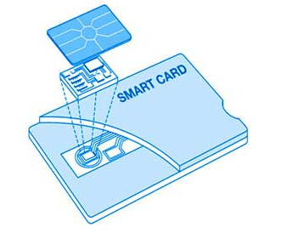
Scenario Explanation
Case-1
Case-1
OTA and PKI
Notes:
http://www.google.de/imgres?imgurl=http%3A%2F%2Fwww.andreonicards.com%2Fimages%2Fcontactsmartcard1.jpg&imgrefurl=http%3A%2F%2Fwww.andreonicards.com%2Fcontactcards.htm&h=293&w=350&tbnid=x2BNI6hifzNcEM%3A&zoom=1&docid=eYurWjaqIAPFeM&hl=zh-CN&ei=Tpf5U5OrJMT17AbZ8oHQDA&tbm=isch&iact=rc&uact=3&dur=774&page=1&start=0&ndsp=46&ved=0CCgQrQMwAA
http://www.google.de/imgres?imgurl=http%3A%2F%2Fsawvideo.com%2Fsites%2Fsawvideo%2Ffiles%2Fuploads%2Fsmartphone.jpg&imgrefurl=http%3A%2F%2Fsawvideo.com%2Fresources%2Fworkshop%2Fscheduled%2Fexperimental-smartphone-video-0&h=640&w=640&tbnid=X-INBfXVBeyj3M%3A&zoom=1&docid=dNUx6CIGPI5atM&hl=zh-CN&ei=vZf5U919qaniBPqmgcgL&tbm=isch&iact=rc&uact=3&dur=3756&page=1&start=0&ndsp=44&ved=0CEgQrQMwCg

Slide 4
Demo Case 1
Participant
UICC card
Appelt
Jacade
Universal Test Environment provided by Morphe
TC1 Open Channel Triggered by SMS
TC2 Exchange R-APDU and C-APDU
TC3 Close Channel
SiMBiOS LTE Product
Theoretical support
GP RAM over HTTP
TLS 1.2
Public key infrastructure

Slide 5
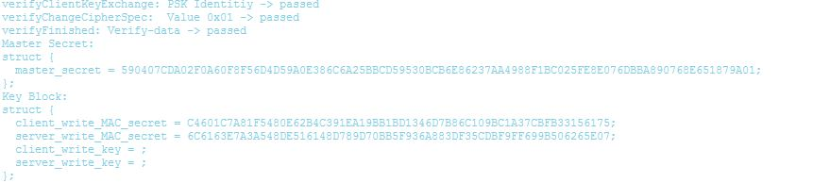
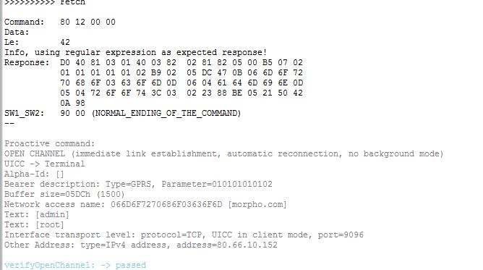
Demo Case 1

Slide 6
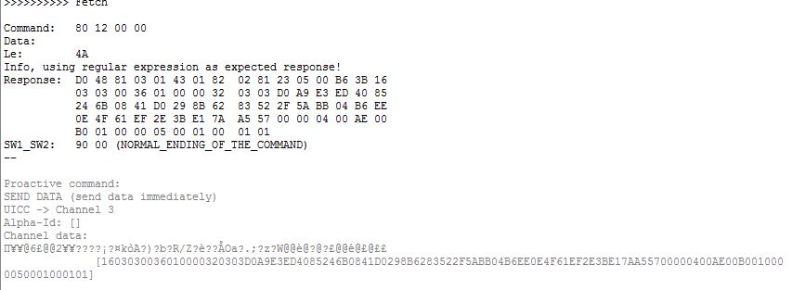
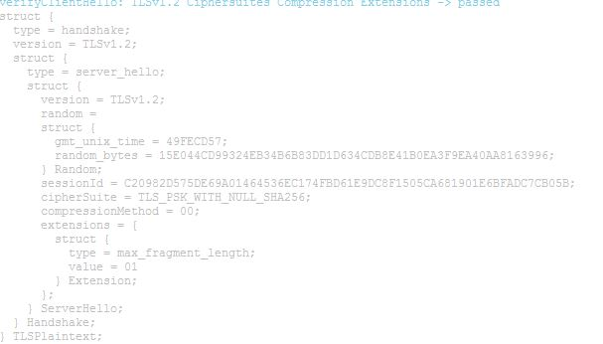
Demo Case 1

Slide 7
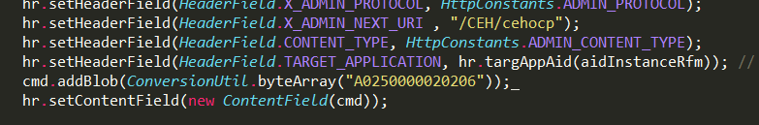


Demo Case 1

Slide 8
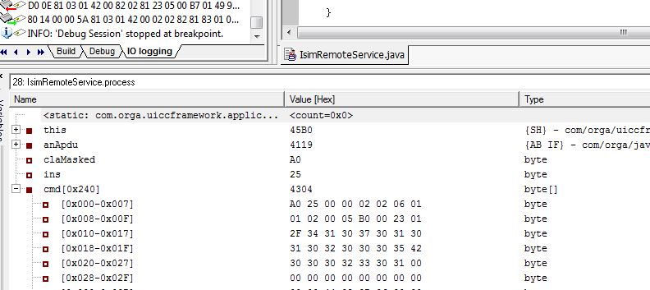
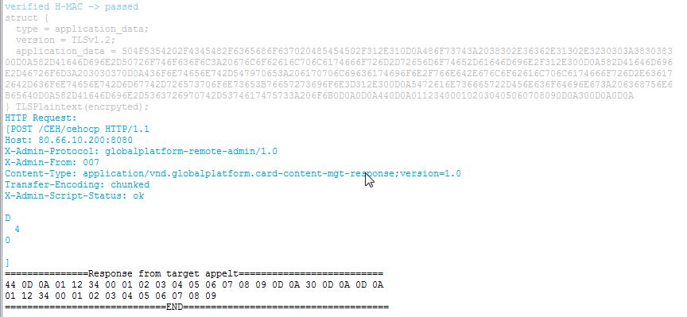
Demo Case 1

Slide 9
Demo Case 2
Participant
UICC card
Smart Home Applet
Android APP
Jacade and Eclipse IDE with Android Development Tools
SiMBiOS LTE Product
Web Sever
Apache 2.4.9
PHP 5.5.12
MySQL
Theoretical support
OpenMobileAPI
GP Secure Element access control

Slide 10
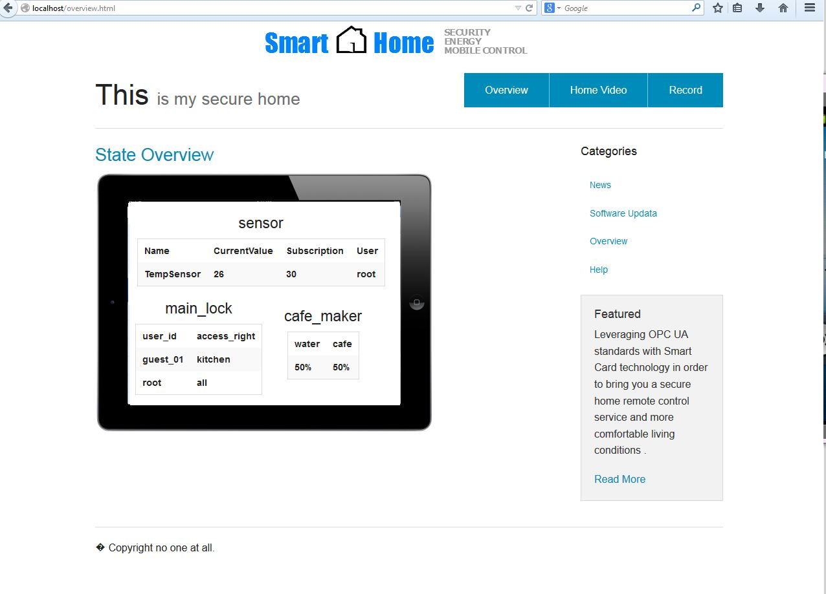
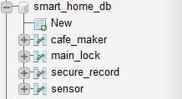
Demo Case 2

Slide 11
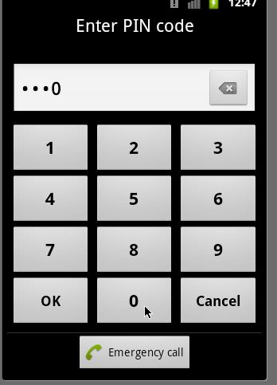
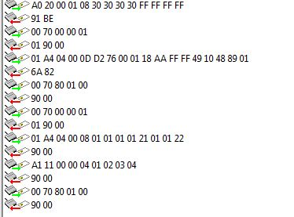
Demo Case 2

Slide 12
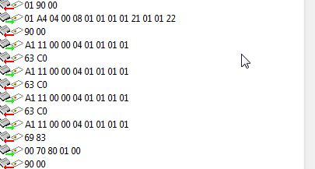
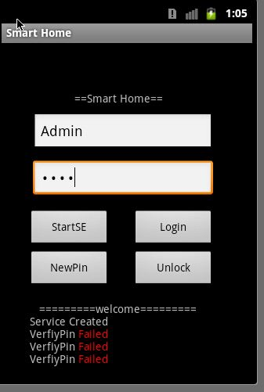
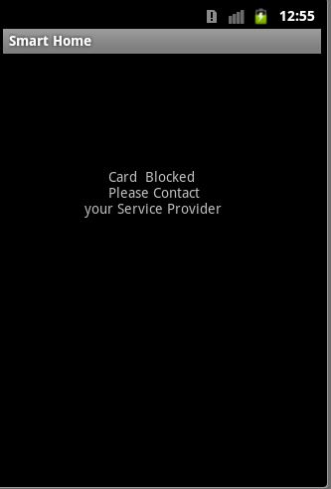
Demo Case 2

Slide 13
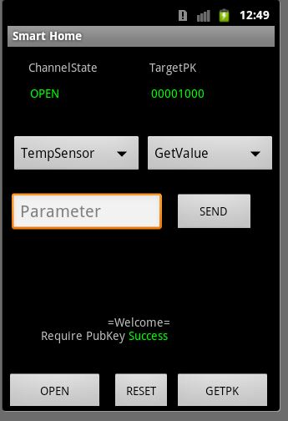
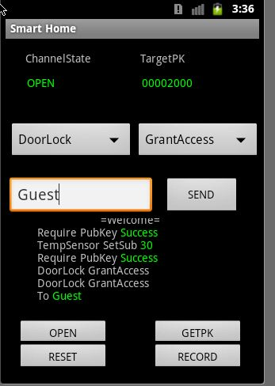
Demo Case 2

Slide 14
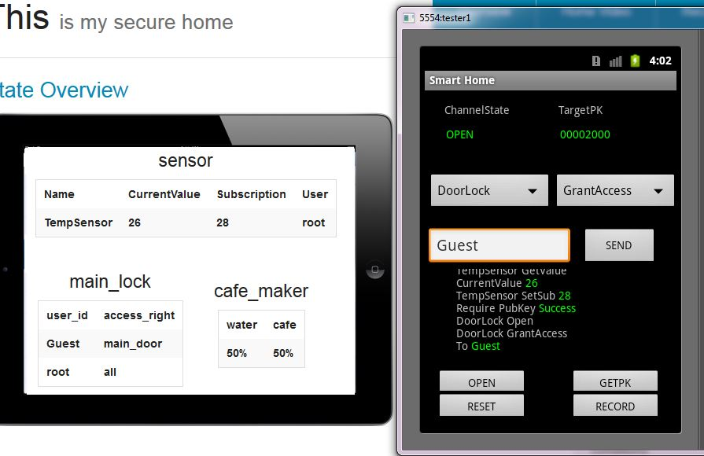
Demo Case 2

Slide 15
Secure Analyses
Smart Home System Secure Compromise
User Credential Compromise
Theft of UICC/Phone
PIN Brute force attack
APP PWD Brute force attack
Sniffing attack
Plaintext Credential phishing
Authentication key phishing and cryptanalysis
Man in the middle attack
Replay attack
Masquerade attack
App profiling
Malicious user
Server profiling
Try counter
Block phone
PKI guarantee
TLS 1.2
PKI
Session-id
Seq#
SE access control
Openmobile Api

Slide 16
Secure Analyses
Smart Home System Secure Compromise
Data Modification
Eavesdropping
DoS attack
OTA server DoS
Smart Home device DoS
Msg checksum
signature
Encryption support
Msg sending rate control/min process

Slide 17
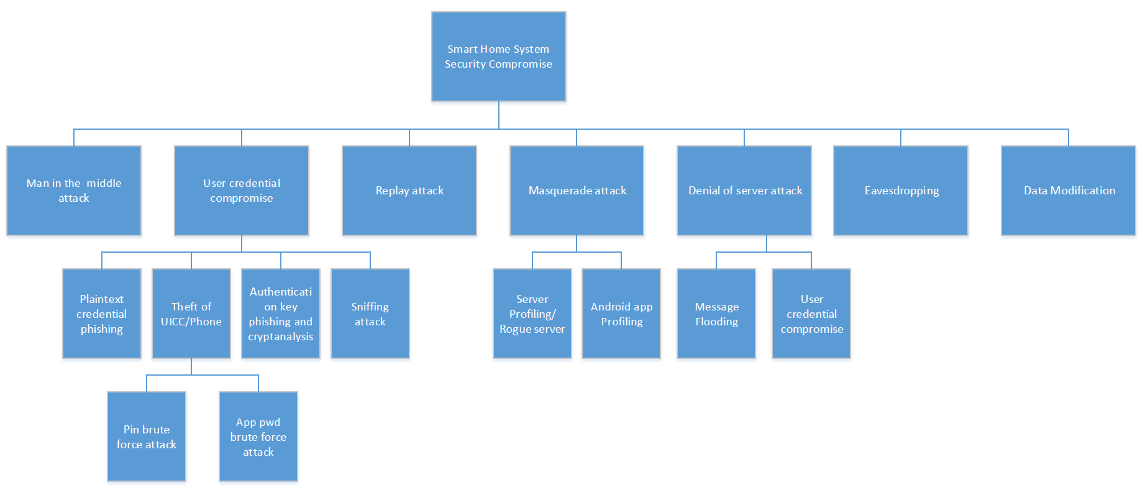
Attack tree overview

Slide 18
Thank you! Question?

