Slide 1
Implementation Object Linking and Embedding for Processes Control Unified Architecture Specification on Secure Device
The future standard for communication and information modeling in automation
Yuankui Wang

Slide 2
Agenda
Introduction and Motivation
OPC Unified Architecture Specification
Smart Card Technology
Application Scenario
Goals
Time Lines
Reference

Slide 3
Introduction and Motivation
In industry automation world, Machine-to-Machine technology is widely applied.
Exchange gather information during collaborative machining process
motion control in legacy networks
Over 22,000 products supplied by over 3,200 vendors
Normal automation systems designed not only for fixed requirements
Shorter product life-cycles and changing market conditions
Crucial: system interconnectivity, common interface for communication, security

Slide 4
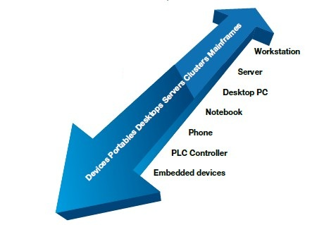
OPC Unified Architecture Specification
OPC UA is the M2M communication protocol
Platform independent data communication
Standardized communication via internet and firewalls
Protection against unauthorized access
Availability and reliability
SOA architecture
Object oriented meta model
Simplification by unification

Slide 5
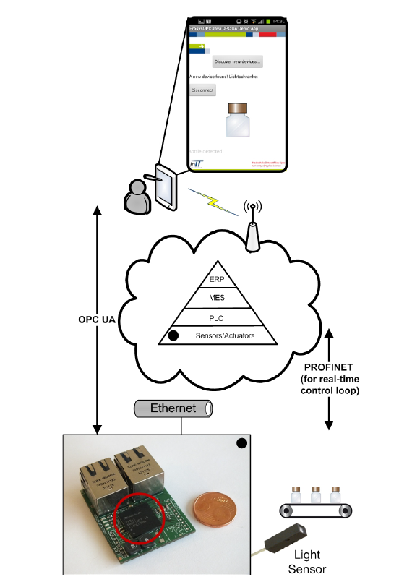
Using Case from Lemgo Smart Factory
conveyor belt, bottles, pick-place robot, field device with light sensor
Bottle picked from (x,y), passed for other processing
OPC UA Server = Controller
OPC UA Clients = robot, remote device and sensor
Controller communicates with the remote device over TCP/IP
Controller instructs the movement of robot using real time channel
OPC UA Server functions + micro TCP/IP stack
= 15KB

Slide 6
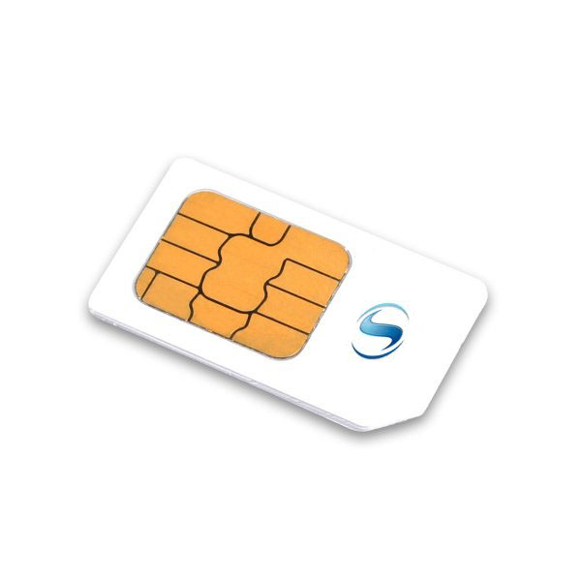
Smart Card Technology
Finance, Communication, personal identification, payment
APDU based communication between card and CAD
Self-containment structure
Security token
Process cryptographic algorithms on hardware
Applications:
Cybercash
Sending personal data
Buy gasoline at gasoline station
….

Slide 7
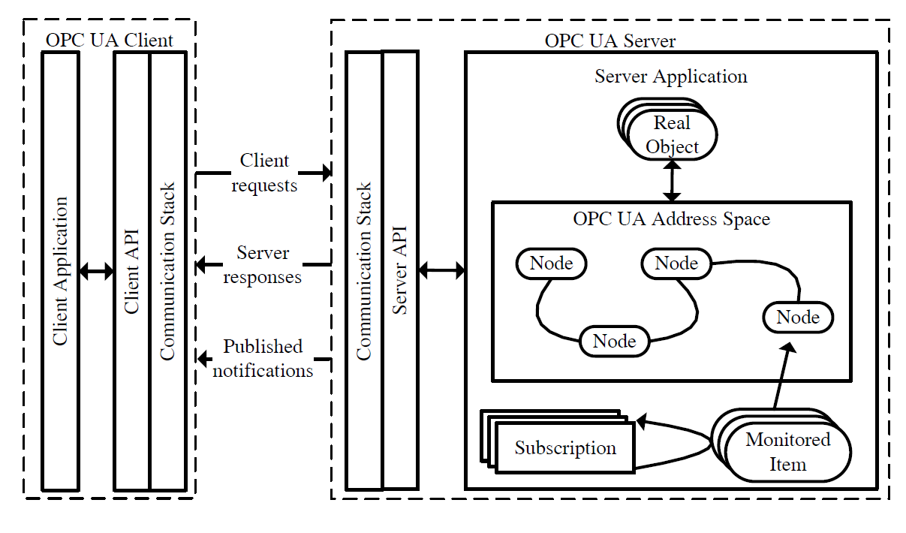
OPC UA meets Smart Cards

Slide 8
OPC UA Client Server Architecture

Slide 9
OPC UA Client Server Architecture
Client Application: Java Phone APP
Supported client functions:
Query
Authentication
Authorization and etc…
Communication stack: developed on smart card, used to realize communication with OPC UA server.
Important user credential information like: encryption keys and certificates are saved on card.
Client API: Translate App instructions into Application Protocol Date Unit (APDU) formats.

Slide 10
OPC UA Client Server Architecture
Real Object: Field devices, abstract date.
Node: Real Objects are represented by Nodes.
Address Space: Information that can be viewed by OPC UA clients
Subscription: Client can subscript particular information
Monitored Item: manage subscripted Nodes.
Server API: Translate Server application instructions
Communication Stack: realize commutation with OPC UA client

Slide 11
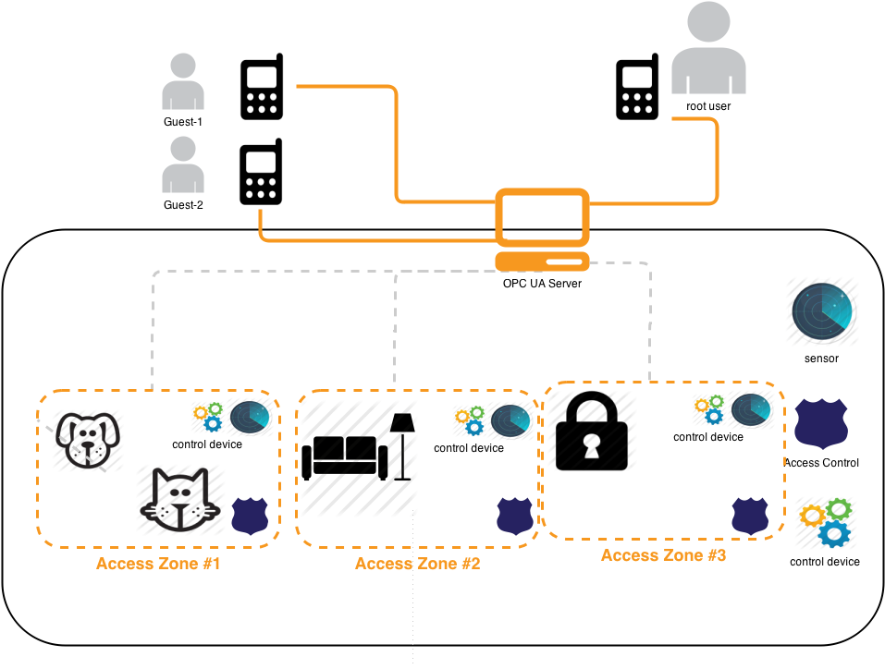
Application Scenario
OPC UA Server:
Central Controller
OPC UA Clients:
Sensors
control devices
access control locks
phones
s

Slide 12
Application Scenario
sensor:
measure environment variables : luminance, temperature…
Inform controller
Connected through inner network
Control device:
In charge of opening windows, giving pet water and etc
Taken command from UA Server
Connected through inner network

Slide 13
Application Scenario
Access control lock
Digital lock
only allows phone user with enough authority
different locks have different policies
Send alarm when illegal access
Connected through inner network
Phone user:
Smart Phone
UICC smart Card
Installation of Client application
Root user = house owner
Guest user = neighbor etc…
Parameterized control devices through server
Connected through open network

Slide 14
Application Scenario
Central Controller
Embedded device with chip card
Chip card = security token
Take date from sensor
Take subscriptions from phone user
Inform phone user based on subscription
Parameterize control device based on phone user command
Auditing

Slide 15
Focus on Security direction
Confidentiality
Integrity
Application authentication
User authentication
User authorization
Traceability
Availability
Secure messaging with smart card
APDU secure communication

Slide 16
Goals
Learning highlight features from OPC UA protocols
Studying OPC UA security mechanisms
Learning Smart card technology and security
Building communication stack on UICC smart card using Java
Combination OPC UA with smart card and analyzing the performance of secure policies under different conditions. I.e. different network quality, different date complexity and etc…

Slide 17
Time Lines
Finding Reference
OPC UA client/server construction
Designing communication stack on UICC smart card
Deployment
Combination test and debugging
Analyze different possible secure policies
Analyze the performance of secure protocols

Slide 18
Rerferences
OPC UA specification 1-11
Jahanzaib Imtiaz and Juegen Jasperneite, Scalability of OPC-UA Down to the Chip Level Enables "Internet of Things“
Stefan-Helmut Leitner and Wolfgang Mahnk: Opc ua-service-oriented architecture for industrial applications
Wolfgang Mahnke, Stefan-Helmut Leitner:OPC Unified Architecture
Wolfgang Rankl und Wolfgang Eng: Handbuch der chipkarten - 5. deutsche auflage. (2008)

Slide 19
Thank you! Question?

