Slide 1
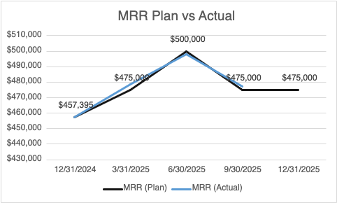
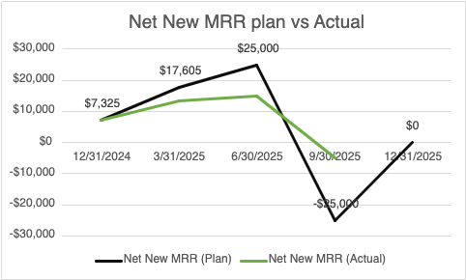

[Slide take-away as Title]
  What Occurred
  [ ] Achieved MRR Target
  Outperformed Net New MRR Target
  New Logo Acquisition
  Why
[Insert main value propositions that you bring to the table, e.g. experience with similar issues]
[Insert main value propositions]
…
[Insert main value propositions that you bring to the table, e.g. experience with similar issues]
[Insert main value propositions]
…
[Insert main value propositions that you bring to the table, e.g. experience with similar issues]
[Insert main value propositions]
…
Like to file

Slide 2
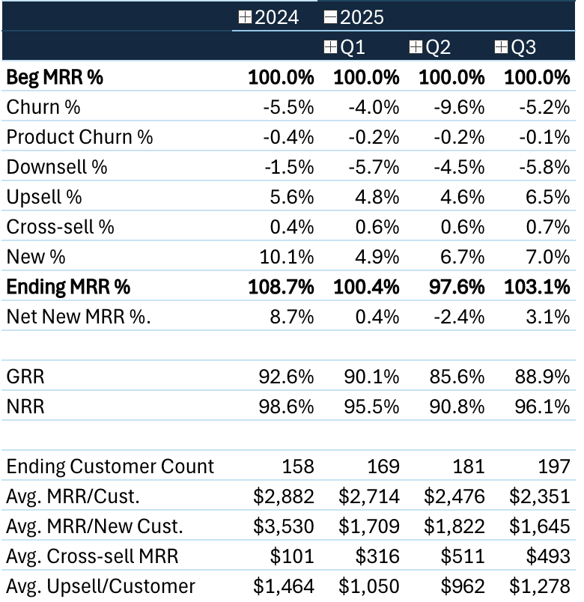
[Slide take-away as Title]
[Key takeaway/conclusion in bold text]
[Supporting arguments for key takeaway/conclusion in bullet points]
[Supporting arguments for key takeaway/conclusion in bullet points]
[Supporting arguments for key takeaway/conclusion in bullet points]
[Key takeaway/conclusion in bold text]
[Supporting arguments for key takeaway/conclusion in bullet points]
[Supporting arguments for key takeaway/conclusion in bullet points]
[Supporting arguments for key takeaway/conclusion in bullet points]
[Key takeaway/conclusion in bold text]
[Supporting arguments for key takeaway/conclusion in bullet points]
[Supporting arguments for key takeaway/conclusion in bullet points]
[Supporting arguments for key takeaway/conclusion in bullet points]
[Final conclusion/recommendation in bold text]
1
2
3

Slide 3
Market A [key takeaway]
[Insert description of situation in industry, client segment, market or whatever area is relevant for client’s situation]
[Insert description of situation in industry, client segment, market or whatever area is relevant for client’s situation]
[Insert description of situation in industry, client segment, market or whatever area is relevant for client’s situation]
[Insert complications and/or changes in situation]
We believe [Client] can [insert aspiration].
Footnote: 1. xx
Source: xx

Slide 4
Market B [key takeaway]]
[Insert description of situation in industry, client segment, market or whatever area is relevant for client’s situation]
[Insert description of situation in industry, client segment, market or whatever area is relevant for client’s situation]
[Insert description of situation in industry, client segment, market or whatever area is relevant for client’s situation]
[Insert complications and/or changes in situation]
We believe [Client] can [insert aspiration].
Footnote: 1. xx
Source: xx

Slide 5
Market C [key take-away]
[Insert description of situation in industry, client segment, market or whatever area is relevant for client’s situation]
[Insert description of situation in industry, client segment, market or whatever area is relevant for client’s situation]
[Insert description of situation in industry, client segment, market or whatever area is relevant for client’s situation]
[Insert complications and/or changes in situation]
We believe [Client] can [insert aspiration].
Footnote: 1. xx
Source: xx

Slide 6
Customer Persona's
03

Slide 7
Persona’s
ICP 1
ICP 2
ICP 3
ICP 4
Mkt.. A
Mkt. A
Mkt. B
Mkt. B
Mkt. C
Mkt. C
  [Insert potential cost reduction lever e.g. Software licence optimization]
  [Insert potential cost reduction lever]
  [Insert potential cost reduction lever]
  …
  [Insert potential cost reduction lever]
  [Insert potential cost reduction lever]
  [Insert potential cost reduction lever]
  …
  [Insert potential cost reduction lever]
  [Insert potential cost reduction lever]
  [Insert potential cost reduction lever]
  …
  [Insert potential cost reduction lever]
  [Insert potential cost reduction lever]
  [Insert potential cost reduction lever]
  …
  [Insert potential cost reduction lever]
  [Insert potential cost reduction lever]
  [Insert potential cost reduction lever]
  …
  [Insert potential cost reduction lever]
  [Insert potential cost reduction lever]
  [Insert potential cost reduction lever]
  …
xx-xx%
Expansion potential
xx-xx%
Expansion potential
xx-xx%
Expansion potential
xx-xx%
Expansion potential
xx-xx%
Expansion potential
xx-xx%
Expansion potential
  Complexity
  Complexity
  Complexity
  Complexity
  Complexity
  Complexity
  Time to impact
  Time to impact
  Time to impact
  Time to impact
  Time to impact
  Time to impact
Source: xx

Slide 8




Event Triggers
Funding Event
Hiring
Technographic triggers
International Expansion
Earnings Release 4
M&A event. 1
Series C raise. 2
Series B raise. 6
Hiring >10
Hiring >5
Hiring >2
Hiring in 1 in Sales
SFDC
HubSpot
Great Britain
Ireland
EUR
MENA
APAC
LATAM
Source: xx

Slide 9
Voice of Customer
04

Slide 10
Purchase decision quotes
[Insert timeframe]
[Insert timeframe]
[Insert timeframe]
[Insert timeframe]
Subscription
Product 1
Product 2
Product 3
Mkt. A
insert "why a customer purchased"
insert "why a customer did NOT purchase"
insert "why a customer purchased"
insert "why a customer did NOT purchase"
insert "why a customer purchased"
insert "why a customer did NOT purchase"
Insert "why a customer purchased"
insert "why a customer did NOT purchase"
Mkt. B
insert "why a customer purchased"
insert "why a customer did NOT purchase"
insert "why a customer purchased"
insert "why a customer did NOT purchase"
insert "why a customer purchased"
insert "why a customer did NOT purchase"
insert "why a customer purchased"
insert "why a customer did NOT purchase"
Mkt. C
insert "why a customer purchased"
insert "why a customer did NOT purchase"
[Iinsert "why a customer purchased"
insert "why a customer did NOT purchase"
insert "why a customer purchased"
insert "why a customer did NOT purchase"
insert "why a customer purchased"
insert "why a customer did NOT purchase"
Source: xx

Slide 11




Expansion Playbook
  Implementation
  & Early Wins
  2. Mid-Year Review
  3. Event Invites
  4. Renewal
  window
Guiding principles
  xx weeks
  xx weeks
  xx weeks
  xx weeks
  [Insert guiding principle e.g., Co-create solutions with local teams to build engagement]
  [Insert key actions or project tracks e.g., Translate strategy into key marketing capabilities required to create growth]
  [Insert key actions or project tracks]
  …
  [Insert key actions or project tracks e.g., Identify and assess capability gaps across units and teams]
  [Insert key actions or project tracks]
  …
  [Insert key actions or project tracks e.g., Analyze and assess potential ways to close capability gaps]
  [Insert key actions or project tracks]
  …
  [Insert key actions or project tracks e.g., Create and evaluate overall implementation plan]
  [Insert key actions or project tracks]
  …
  [Insert guiding principle for project]
  [Insert guiding principle for project]
  [Insert main deliverables e.g., Capability framework]
  …
  [Insert main deliverables e.g., Gap assessment]
  …
  [Insert main deliverables e.g., Prioritized actions]
  …
  [Insert main deliverables e.g., Implementation plan]
  …
  [Insert guiding principle for project]
Source: xx

Slide 12
Monthly Business Review
[Subtitle, date]
Sep 2025

