Slide 1
CrowdTruth
Crowdsourced fact-checking
Tom Lemberg and Will Sun

Slide 2
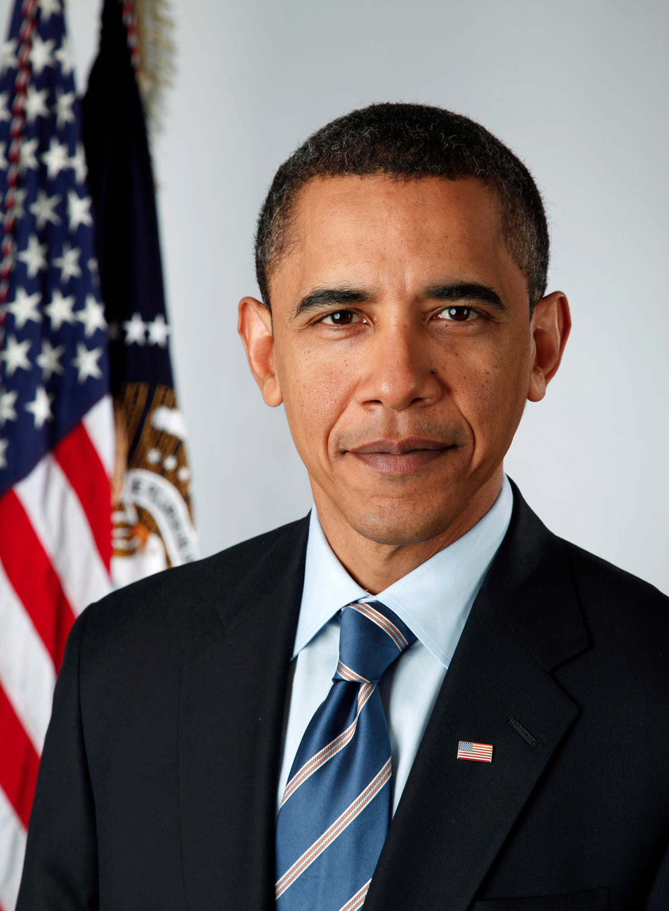
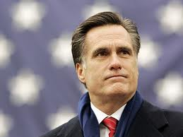
v.

Slide 3
Identify
(3-5 facts)
Verify facts
(3x)
(for each fact, up to 5 facts)
Source
(3x)
Source
(3x)
Source
(3x)
Vote
(3x)
Vote
(3x)
Vote
(3x)
Process

Slide 4
Demo

Slide 5
Lessons Learned
Accuracy
Instructions
Threshold
Quantity
Cost
Speed
Duplicates
Secondary sources

