Slide 1
Dark Energy Autonomous Search
LLM proposal agents coupled to a deterministic modified-gravity validation pipeline
600
5
DES-SN
initial attempts per agent
proposal models compared
+ DESI DR2 BAO
Ranked only by real Solver χ², not by LLM preference
from main8_cmp600_final.tex
01
Notes:
Open with the central claim: the LLM proposes, but the physics code decides. The deck is a readable version of the paper, not a replacement for the derivations.

Slide 2
Why automate the search?
Modified gravity has a huge legal-looking theory space; most candidates are not physically usable.
The challenge
Search goal
•
Many covariant Lagrangians generate higher-time-derivative FLRW equations.
Find models that are simultaneously legal, runnable, constraint-preserving, and competitive in χ².
•
Many surviving branches fail numerically or violate the Friedmann constraint.
•
A visually elegant operator list is not useful unless it fits real DES-SN + DESI BAO data.
The LLM is a proposal policy. The physics pipeline is the judge.
AI modified gravity search
02
Notes:
This slide should make the setup approachable: the task is not asking an LLM to invent physics by itself; it is steering a hard validation pipeline through a large search space.

Slide 3
The discovery loop
Every candidate is isolated, validated, scored, and written back to current-loop memory.
01
02
03
04
05
LLM proposal
→
Grammar + EOM
→
Builder
→
Solver
→
Memory
operator set + scalar family + parameters
legal tokens + FLRW higher-derivative cancellation
dimensionless numerical system
DES-SN + DESI BAO χ² and diagnostics
learn from successes and failures
Key guardrail: historical Solver winners are not used as proposal memory in cold-start runs.
Only current-loop feedback changes the next proposal distribution.
AI modified gravity search
03
Notes:
Walk left to right. Emphasize that this is why the benchmark is meaningful: different LLMs see the same deterministic downstream checks.

Slide 4
The score is intentionally simple
A candidate wins only if the deterministic Solver produces a lower DES-SN + DESI DR2 BAO χ².
χ² = 1645.28
χ² ≈ 1637.95
χ² ≈ 1946.87
fixed ΛCDM reference
best open-search result
best non-EH branch
same likelihood
about 7.3 lower
diagnostic, not competitive
Interpretation
•
Lower χ² means a better background-distance fit.
•
AIC/BIC are recorded, but the paper ranks by total χ².
•
Accepted means background-level viability, not full perturbative or covariant viability.
AI modified gravity search
04
Notes:
Use this slide to avoid confusion about the leaderboard: the headline result is a background-likelihood comparison, not a final theory-of-everything claim.

Slide 5
Matched agent benchmark
Five proposal models were compared under the same grammar, sampler, scheduler, and Solver.
Proposal model | Provider | Role in comparison
GPT-5.5 | OpenAI | fast, competitive baseline
Claude Opus 4.8 | Anthropic | best speed-quality compromise
Gemini 3.1 Pro | Google | strong open-search optimum
Qwen 3.7 Plus | Alibaba | strongest non-EH hit count
DeepSeek V4 Pro | Alibaba | best and densest open-search basin
600
initial theory attempts each
2
sectors: open-search and non-EH
AI modified gravity search
05
Notes:
The table can be read as the experimental design. Same pipeline, different proposal policy.

Slide 6
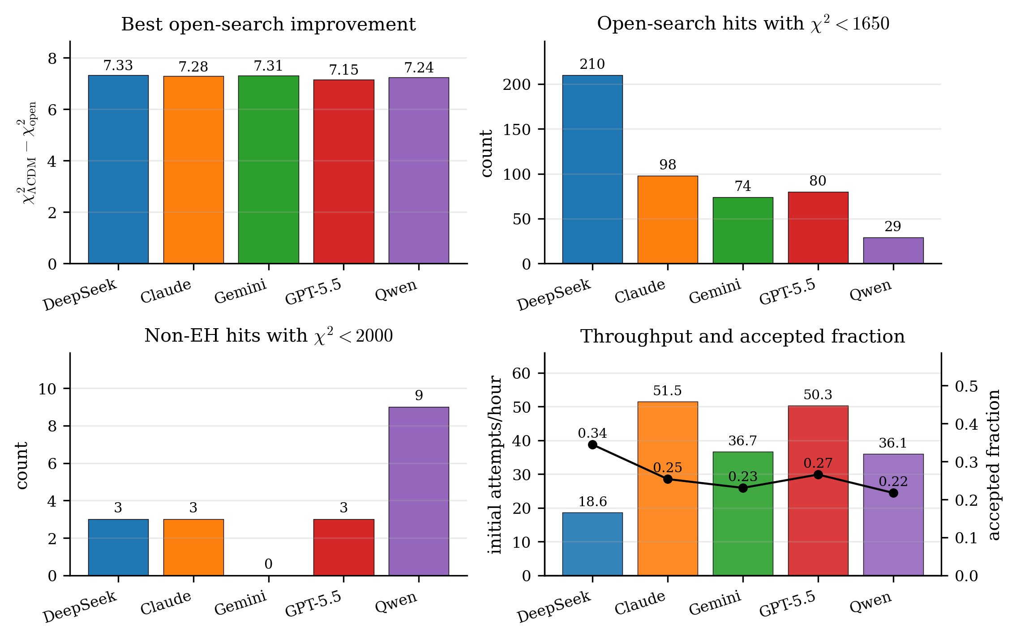
All agents find the same open-search basin
The best open-search fits cluster near χ² ≈ 1638, about seven units below fixed ΛCDM.
Read this as four axes
Global
all five improve ΛCDM by Δχ² ≈ 7
Depth
DeepSeek gives the most χ² < 1650 hits
New physics
Qwen gives the most non-EH hits
Efficiency
Claude and GPT-5.5 are fastest
AI modified gravity search
06
Notes:
This is the main benchmark picture. Point out that the best single χ² values are close, while behavior across the run differs strongly.

Slide 7
The single-number leaderboard hides different skills
Global optimum, new-physics search, speed, and acceptance rate do not rank agents the same way.
Agent | Best χ² | Open <1650 | non-EH <2000 | Attempts/hr | Accept
DeepSeek | 1637.953 | 210 | 3 | 18.6 | 0.345
Claude | 1637.995 | 98 | 3 | 51.5 | 0.254
Gemini | 1637.969 | 74 | 0 | 36.7 | 0.231
GPT-5.5 | 1638.130 | 80 | 3 | 50.3 | 0.266
Qwen | 1638.035 | 29 | 9 | 36.1 | 0.217
Takeaway
DeepSeek wins on best and density; Claude/GPT-5.5 win on speed; Qwen is the strongest non-EH explorer in this matched run.
AI modified gravity search
07
Notes:
This is the slide to answer: which model is best? The honest answer is objective-dependent.

Slide 8
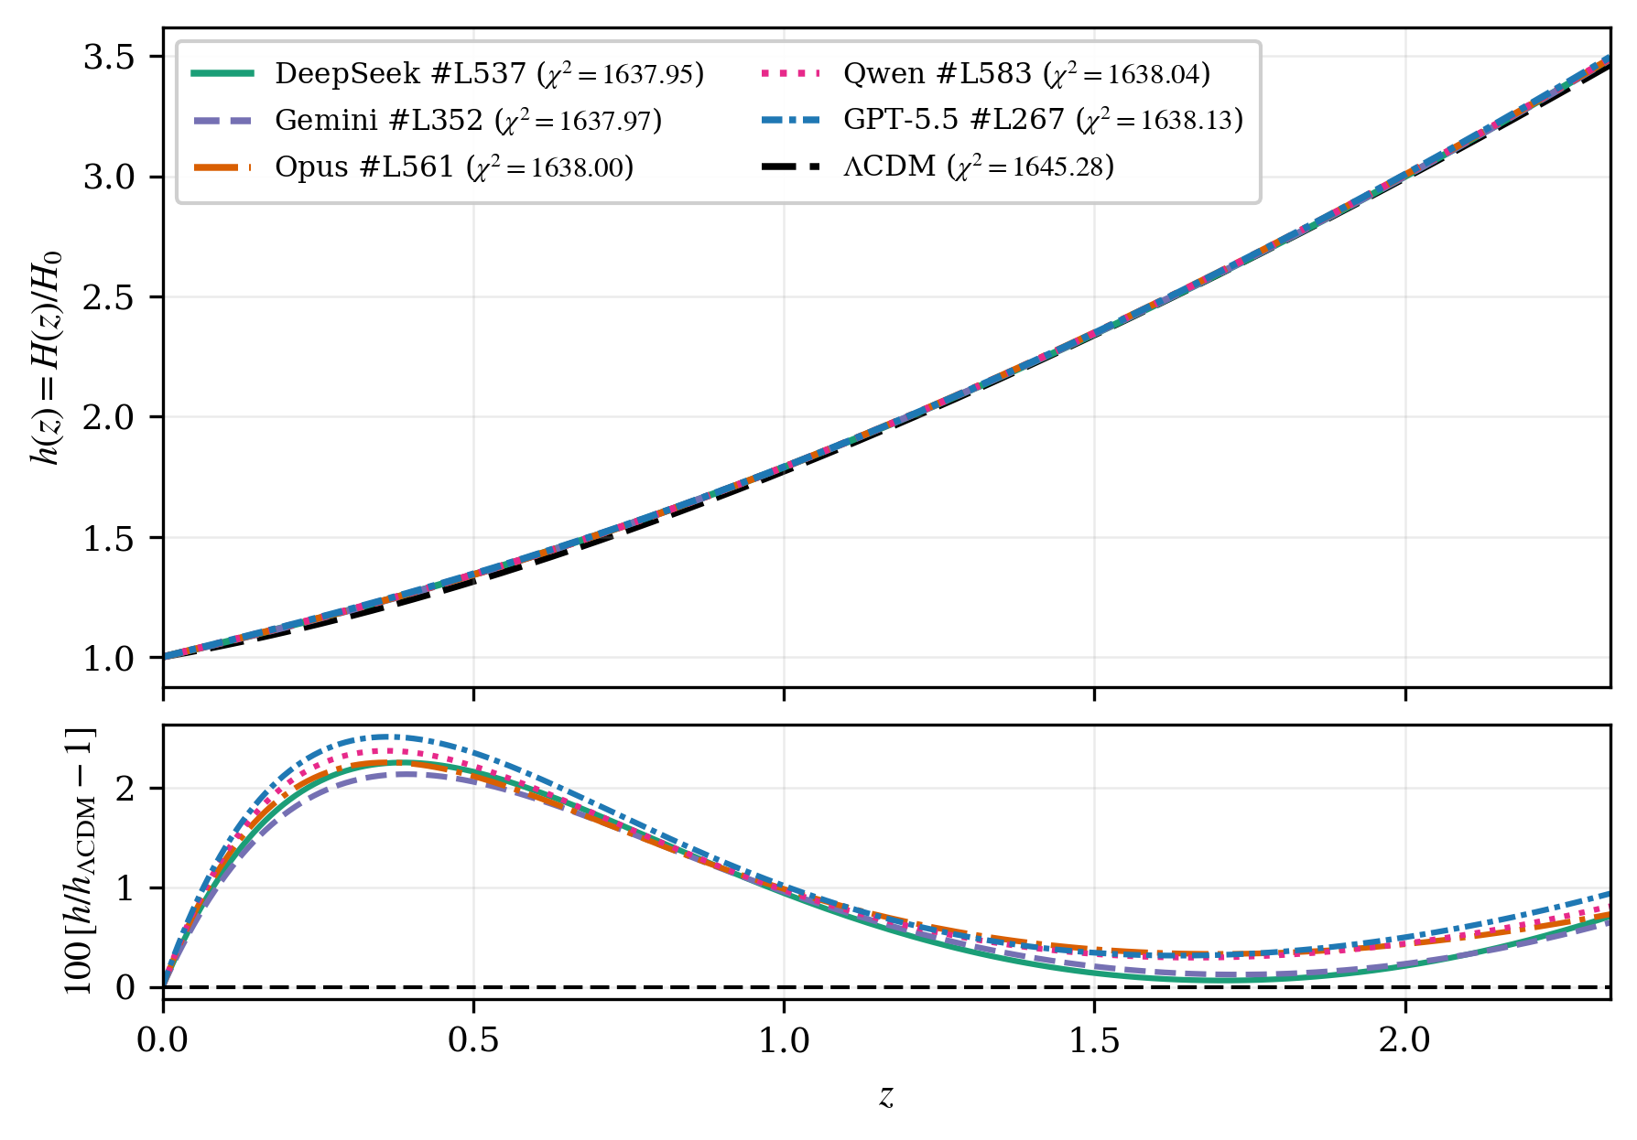
The best expansion histories are nearly degenerate
Different agents discover slightly different Lagrangians that reproduce very similar H(z).
Physics message
Close to ΛCDM
The best curves are almost on top of the reference.
Percent-level residuals
Most of the statistical gain lives in small deviations.
Not unique yet
Background data cannot select one covariant operator identity.
AI modified gravity search
08
Notes:
Use this to make the result intuitive: the agents are not finding wildly different cosmologies; they are finding a narrow family of expansion histories.

Slide 9
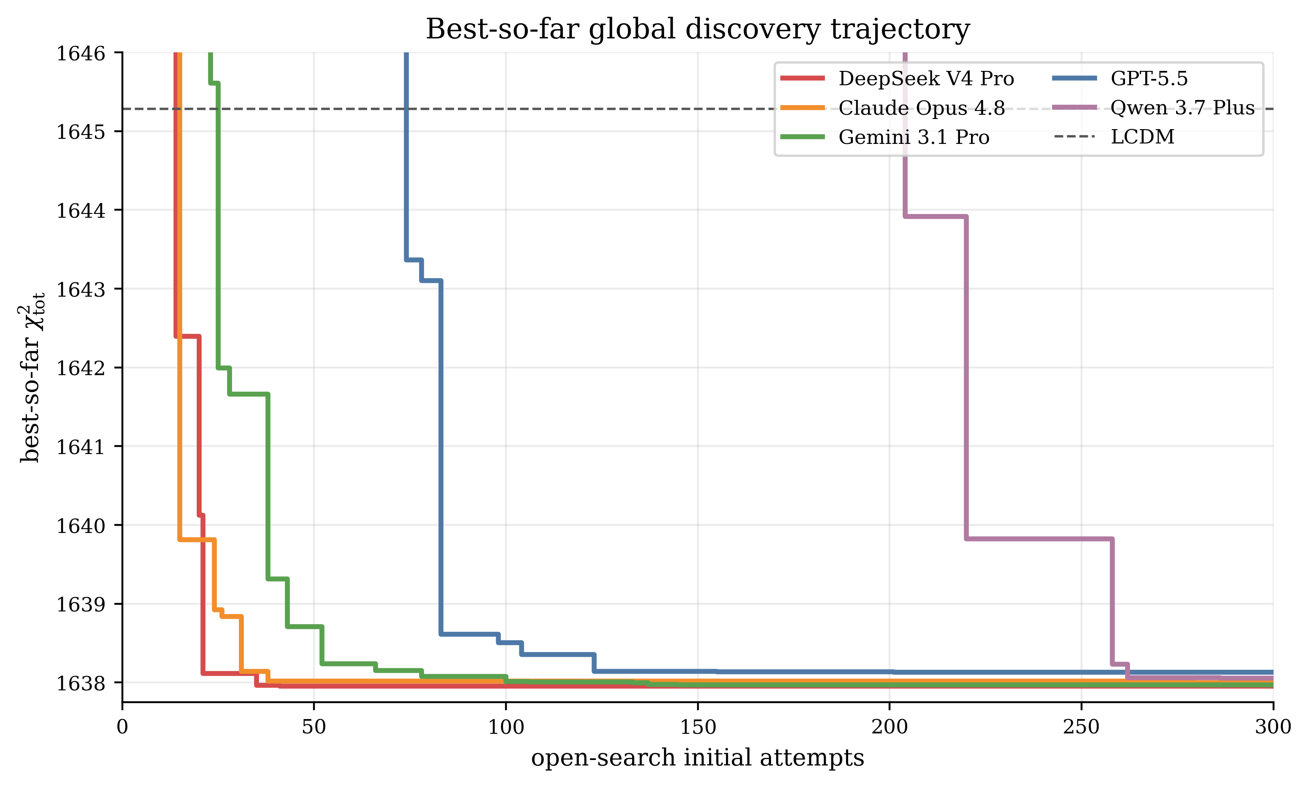
How quickly do agents find the basin?
Best-so-far curves show exploitation speed, not just final χ².
What to notice
•
Several agents cross the ΛCDM line early.
•
Most of the gain is achieved in the first 100 open-search attempts.
•
Qwen improves later and is less stable in open search.
AI modified gravity search
09
Notes:
This is useful in a talk because it shows learning and search dynamics rather than only final ranks.

Slide 10
Open-search result: a high-quality EH-anchored basin
The agents rediscover scalar dark-energy backgrounds with optional curvature corrections.
Representative operator motifs
How to say it carefully
R + scalar sector
•
Low χ² is real at the background level.
•
But many representatives are nearly equivalent on FLRW.
R + φ₂ Riemann²
•
Active higher-curvature claims need perturbation and EFT-control checks.
R + φ₁φ₂ R²
AI modified gravity search
10
Notes:
Avoid overclaiming. The safe statement is that the open-search sector finds an EH-anchored dark-energy basin, not a unique final modified-gravity theory.

Slide 11
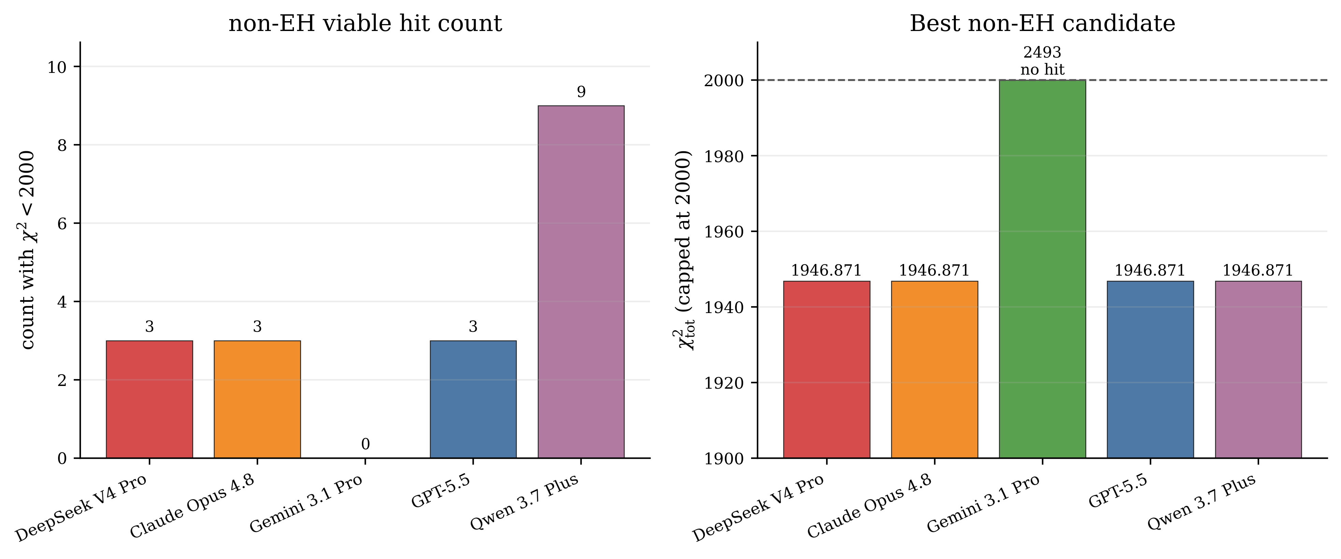
The non-EH sector is the hard new-physics test
Removing the bare Einstein-Hilbert R anchor makes the fit dramatically harder.
Result
•
Four agents repeatedly find a branch near χ² ≈ 1946.87.
•
Qwen finds the most non-EH hits below χ² < 2000.
•
This is much better than the generic non-EH failure plateau, but still worse than ΛCDM.
AI modified gravity search
11
Notes:
This slide frames non-EH as a diagnostic search: interesting because it is repeated and runnable, but not currently competitive.

Slide 12
What did the new-physics search find?
The repeated non-EH branch is curvature-coupled, φ₂-dominated, and background-runnable.
Common branch
Interpretation
•
It proves the search can find non-EH runnable structures.
φ₂ R_{μν}R^{μν} + φ₂ R_{μνρσ}R^{μνρσ}
•
It is not a viable replacement for the EH-anchored basin in this likelihood.
+ scalar-sector terms and coefficient restrictions
•
Future runs should test perturbations and operator redundancy before assigning physical meaning.
AI modified gravity search
12
Notes:
This is the most careful way to discuss the non-EH result: repeated and scientifically useful, but not good enough yet.

Slide 13
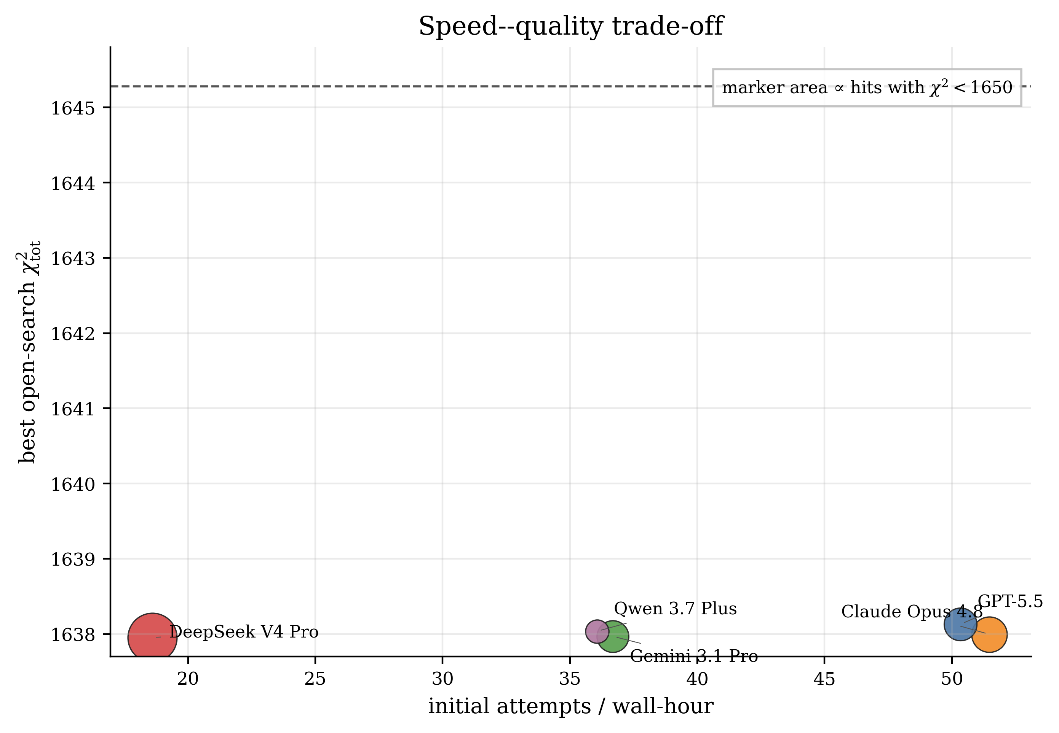
Speed and quality separate the agents
The fastest agent is not necessarily the densest high-quality searcher.
Operational readout
Fastest
Claude and GPT-5.5 give the best wall-clock throughput.
Densest basin
DeepSeek finds the strongest cluster of high-quality open-search hits, but slowly.
Choice depends on objective
Use speed, depth, and new-physics hits as separate axes.
AI modified gravity search
13
Notes:
This slide is useful for planning future cluster runs. It justifies comparing by axes instead of a single leaderboard.

Slide 14
Acceptance rate is a robustness metric
It tells us how often proposals reach a runnable background, not whether the theory is final.
0.345
0.266
9
DeepSeek accepted fraction
GPT-5.5 accepted fraction
Qwen non-EH hit count
highest overall
fast + competitive
best new-physics count
Why it matters
•
High acceptance improves learning because more attempts produce Solver feedback.
•
Low χ² remains the primary scientific ranking.
•
A low acceptance rate can still be useful if surviving candidates are diverse or rare.
AI modified gravity search
14
Notes:
This slide connects to the paper's robustness/stability axis and prevents acceptance rate from being overinterpreted.

Slide 15
What is not proven yet?
The current pipeline is a background-level discovery filter, not a full covariant viability proof.
Perturbations
Structure growth
Gravity tests
Operator audit
kinetic matrix, sound speeds, gradient stability
weak lensing, RSD, growth data
GW propagation and local screening
remove FLRW-equivalent representatives
Main safe conclusion
The benchmark is already useful as a reproducible comparison of proposal policies, but physics claims require the next validation layers.
AI modified gravity search
15
Notes:
End the limitations before the final takeaway. This keeps the conclusion credible.

Slide 16
Take-home message
1
AI proposal agents can reliably rediscover the best EH-anchored dark-energy basin under a deterministic physics pipeline.
2
The deliberately non-EH new-physics sector is much harder, but it produces repeated, runnable curvature-coupled branches.
3
A useful benchmark should report global optimum, new-physics hits, speed, robustness, and acceptance rate together.
AI modified gravity search
16
Notes:
Close with the three claims. They are strong, but still honest about the limits of the present background-only run.

