Slide 1






c1/work node
internal hub
k0/pbs server
external hub
k1/login server
k2/login server
x1/storage server

Slide 2
pbs server
sshd, ypserv, torque server maui/torque scheld, dhcp, dns, pdsh
login server
sshd, ypbind,
storage
sshd, nfs, intel compiler, openmpi, module
work node
torque mom

Slide 3
file system 配置
front-end
swap
/boot 放kernel
/usr 放程式
/
back-end
swap
/boot 放kernel
/usr 放程式
/
/scratch or /tmp 執行程式的暫存目錄
filer server
swap
/boot 放kernel
/usr 放程式
/
/home or /work 執行程式的暫存目錄

Slide 4
檔案權限
ls: 顯示檔案資訊
ls -la
chmod: 修改檔案權限
chmod 644 檔案
id: 顯示使用者資訊
id 使用者
chown: 修改檔案擁有者及群組
chown 使用者.群組 檔案

Slide 5
ssh 無密碼 _{for linux}
產生key
使用ssh-keygen指令，在~/.ssh產生
id_rsa.pub為public key
id_rsa為private key
設定public key
將id_rsa.pub內容複製到authorized_keys
登入
使用ssh -i private_key account@host

Slide 6
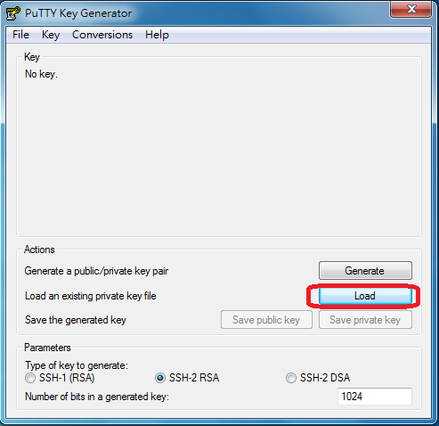
ssh 無密碼 _{for windows}
下載puttygen.exe

Slide 7
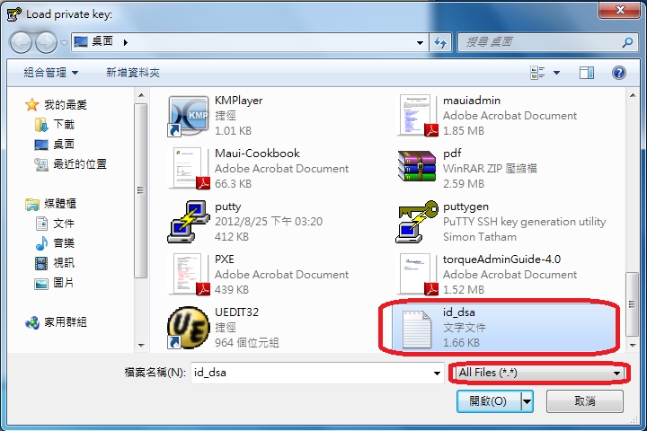
ssh 無密碼 _{for windows}
從e-mail下載id_dsa
選擇id_dsa並開啟

Slide 8
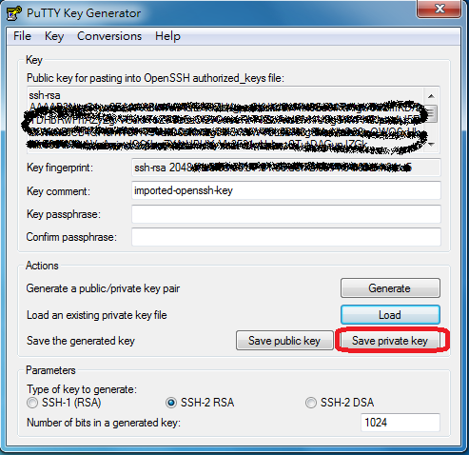
ssh 無密碼 _{for windows}
點選Save private key

Slide 9
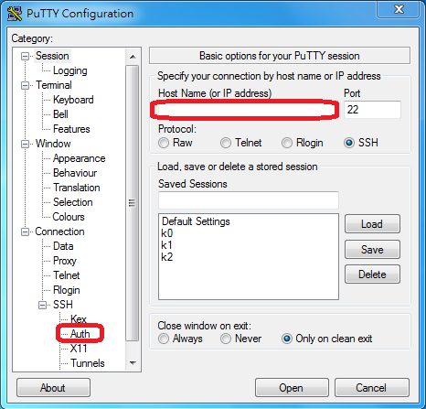
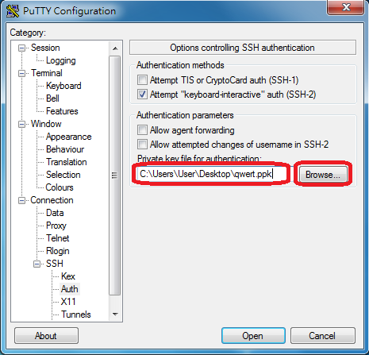
ssh 無密碼 _{for windows}

Slide 10
sshd 設定 _{for front-end}
/etc/ssh/sshd_config
PermitRootLogin no
#禁止Root登入
PasswordAuthentication no
#禁止使用密碼登入
ChallengeResponseAuthentication no
#禁止變換認證方式

Slide 11
sshd 設定 _{for back-end}
/etc/ssh/sshd_config
RhostsRSAAuthentication yes #使用rsa認證
HostbasedAuthentication yes #使用hostbased認證
IgnoreUserKnownHosts yes #不使用使用者自定host
IgnoreRhosts yes #不使用使用者自定 rhost
/etc/hosts.equiv
echo client >> /etc/hosts.equiv
/etc/ssh/ssh_known_hosts
ssh-keyscan -trsa client >> /etc/ssh/ssh_known_hosts

Slide 12
ssh 設定 _{for back-end}
/etc/ssh/ssh_config
HostbasedAuthentication yes
RhostsRSAAuthentication yes
StrictHostKeyChecking no
EnableSSHKeysign yes
ssh-keysign
chmod u+s /usr/lib64/ssh/ssh-keysign

Slide 13
rpm 套件安裝
安裝
rpm -ivh pkg.rpm
移除
rpm -e pkg
查詢
rpm -qa
rpm -ql pkg
rpm -qf path

Slide 14
rpmbuild
/usr/src/packages
#到SOURCES目錄內將要rpmbuild的檔案複製到此再解壓縮
ls *.spec #有spec檔才能直接rpmbuild
rpmbuild –ta 套件壓縮檔
#安裝過程如有缺少套件再用zypper安裝

Slide 15
zypper 套件安裝
libapr-1.so.0()(64bit) is needed by libganglia-3.6.0-1.x86_64
libconfuse.so.0()(64bit) is needed by libganglia-3.6.0-1.x86_64
zypper in libapr1
zypper in libconfuse0
/etc/zypp/repos.d
repository
yast repositories #設定套件來源
zypper lr #顯示套件來源
package
zypper in pkg #安裝套件
zypper se pkg #搜尋套件
zypper rm pkg #移除套件

Slide 16
pdsh使用
/etc/machines
pdsh
pdsh -a cmd #所有主機執行cmd
pdsh -w host cmd #指定host執行cmd
pdcp
pdcp -a src dst #所有主機複製src到dst
pdcp -w host src dst #指定host複製src到dst

Slide 17
解tar(壓縮檔)
tar xf 欲解壓縮檔案 –C 目標目錄
#解tar
tar zxf 欲解壓縮檔案 –C 目標目錄
#解tar.tgz壓縮檔

Slide 18
vi
normal mode
x #刪除字元
dd #刪除整列
u #回復上一個動作
gg #到頂端
G #到底端
ctrl+b #往上
ctrl+f #往下
i #切換為insert mode
: #切換為command mode

Slide 19
vi
insert mode
可輸入任意文字
Esc #回到normal mode
command mode
w #寫入
q #離開
! #強制
wq!可混合用

Slide 20
DNS Server
/var/lib/named/master
0.168.192.in-addr.arpa #反解
; private network下
101.0.168.192.in-addr.arpa. IN PTR i01.site.
site #正解
; private network下
i01 IN A 192.168.0.101
/etc/init.d/named restart #重啟服務

Slide 21
DNS Client
/etc/resolv.conf
domain site
nameserver 192.168.0.1

Slide 22
torque install
k0
torque, torque-server, torque-devel
torque-scheduler/可用maui取代
k1、k2
torque, torque-devel
back-end(i01~i25)
torque, torque-client, torque-devel
fs1、fs2
不需要

Slide 23
torque _{for front-end(k0 only)}
/var/spool/torque/server_priv/nodes #設定檔
i01 np=8
........,etc
i25 np=8
qmgr #指令
create node i01
set node i01 np=8
active i01
print node
quit
/etc/init.d/pbs_server restart #重啟服務

Slide 24
torque _{for back-end(i01~i25)}
/var/spool/torque/server_name
k0.site
/var/spool/torque/mom_priv/config
$pbsserver k0.site
/etc/init.d/pbs_mom restart #重啟服務

Slide 25
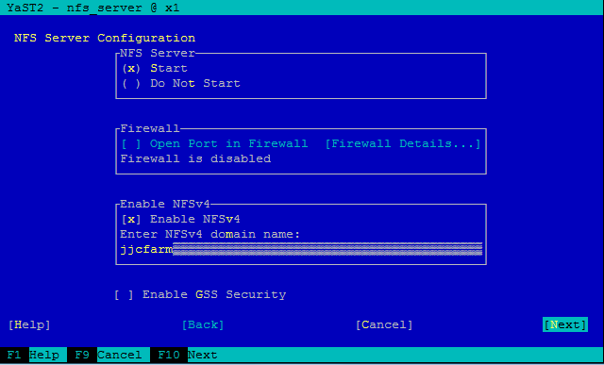
NFS Server
yast
Network Services
NFS Server

Slide 26
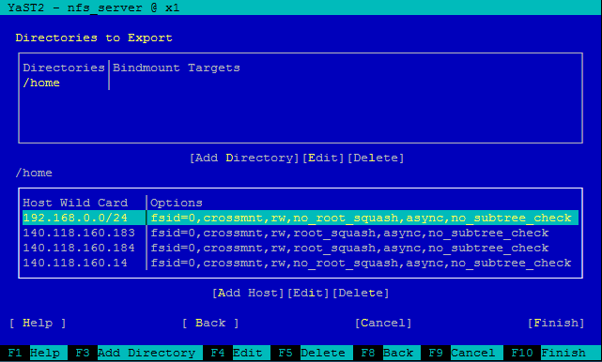
NFS Server

Slide 27
NFS Server 設定檔
/etc/exports
/home 192.168.0.0/24(fsid=0,crossmnt,rw,no_root_squash,async,no_subtree_check) 140.118.160.183(fsid=0,crossmnt,rw,root_squash,async,no_subtree_check) 140.118.160.184(fsid=0,crossmnt,rw,root_squash,async,no_subtree_check) 140.118.160.14(fsid=0,crossmnt,rw,no_root_squash,async,no_subtree_check)

Slide 28
NFS Server 設定檔
/etc/exports
/work 192.168.0.0/24(fsid=0,crossmnt,rw,no_root_squash,async,no_subtree_check) 140.118.160.183(fsid=0,crossmnt,rw,no_root_squash,async,no_subtree_check) 140.118.160.184(fsid=0,crossmnt,rw,no_root_squash,async,no_subtree_check)

Slide 29
NFS Server restart
/etc/init.d/nfsserver restart #重啟服務

Slide 30
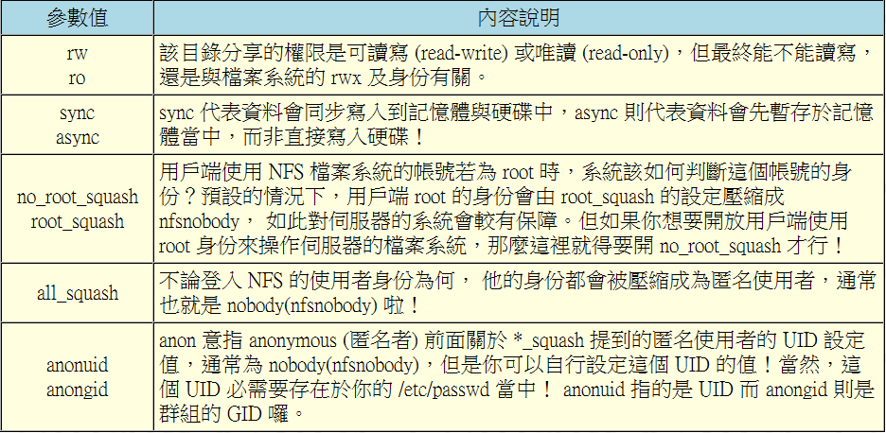
NFS Server參數說明

Slide 31
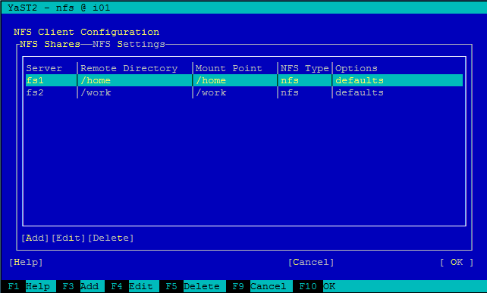
NFS Client
yast
Network Services
NFS Client

Slide 32
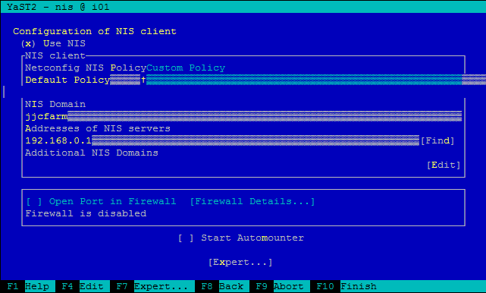
NIS Client
yast
Network Services
NIS Client

Slide 33
NFS & NIS client restart
/etc/init.d/nfs restart #NFS client重啟服務
/etc/init.d/ypbind restart #NIS client重啟服務

Slide 34
開機掛載/開機載入
/etc/inittab #開機載入
id:3:initdefault: #3:關閉 5:開啟 Xwindow
/etc/fstab #開機掛載
fs1:/home /home nfs defaults 0 0
fs2:/work /work nfs defaults 0 0

Slide 35
磁碟指令
df –h #查看磁碟分割與NFS掛載
showmount -e hostname
#查看hostname是否有export nfs server
mount -t nfs fs1:/home /home
#將fs1:/home 掛到本機的/home
mount -t nfs fs2:/work /work
#將fs2:/work 掛到本機的/work

Slide 36
SuSE Linux Enterprise Server Software
Patterns
Development
C/C++ compiler and tools (全裝)

Slide 37
SuSE Linux Enterprise Server Software
Search
ypserv (全裝)
ypbind (全裝)
ssh (全裝)
nfs
nfs-kernel server
dhcp
ISC client
ISC server
bind
domain name system

Slide 38
SuSE Linux Enterprise Server Software
Search
gcc (全裝)
bash (全裝)
tcsh (全裝)
findutils (全裝)

Slide 39
磁碟分割規畫_{for front-end(k0、k1、k2)}
sda
sda1 /boot 512MB ext3 (primary)
剩下的sda與sdb做LVM為vg00
vg00
lv00 swap 2GB
lv01 /usr 40GB btrfs
lv02 / 95GB btrfs

Slide 40
磁碟分割規畫_{for front-end(fs1)}
sda (320GB)
sda1 /boot 512MB ext3 (primary)
sda2 swap 16GB (primary)
sda3 / 50GB btrfs (primary)
sda4 maximum (extend)
sda5 /usr 150GB btrfs
sdb(2TB)、sdc(2TB)做軟體RAID0為md0
md0
md0 /home maximum btrfs

Slide 41
磁碟分割規畫_{for front-end(fs2)}
sda (320GB)
sda1 /boot 512MB ext3 (primary)
sda2 swap 16GB (primary)
sda3 / 50GB btrfs (primary)
sda4 maximum (extend)
sda5 /usr 150GB btrfs
兩顆SCSI硬碟做硬體RAID0
sdb
sdb1 /work maximum btrfs

Slide 42
磁碟分割規畫_{for back-end(i01~i25)}
sda
sda1 /boot 512MB ext3 (primary)
sda2 swap 24GB (primary)
sda3 / 30GB btrfs (primary)
sda4 maximum (extend)
sda5 /usr 30GB btrfs
sda6 /tmp maximum btrfs

Slide 43
intel compiler install
intel網站(non-commercial software development)下載compiler
解壓縮下載檔案
執行./install.sh，開始安裝
licesne安裝於$Intel/licesnes目錄下

Slide 44
intel compiler configuration
for SH/BASH
#!/bin/sh
source /opt/intel/Compiler/11.1/059/bin/iccvars.sh intel64
source /opt/intel/Compiler/11.1/059/bin/ifortvars.sh intel64
source /opt/intel/mkl/10.2.2.025/tools/environment/mklvarsem64t.sh
for CSH/TCSH
#!/bin/csh
source /opt/intel/Compiler/11.1/059/bin/iccvars.csh intel64
source /opt/intel/Compiler/11.1/059/bin/ifortvars.csh intel64
source /opt/intel/mkl/10.2.2.025/tools/environment/mklvarsem64t.csh

Slide 45
PGI compiler install
pgi網站下載compiler(30天試用)
解壓縮下檔案
執行./install開始安裝
使用環境變數LM_LICENSE_FILE設定license

Slide 46
PGI compiler configuration
for SH/BASH
#!/bin/sh
PGI=/opt/pgi
export PATH=$PGI/linux86-64/9.0/bin:$PATH
export MANPATH=$MANPATH:$PGI/linux86-64/9.0/man
export LM_LICENSE_FILE=$LM_LICENSE_FILE:$PGI/license.dat
for CSH/TCSH
#!/bin/csh
setenv PGI /opt/pgi
set path ($PGI/linux86-64/9.0/bin $path)
setenv MANPATH ($MANPATH $PGI/linux86_64/9.0/man)
setenv LM_LICENSE_FILE ($PGI/licnse.dat $LM_LICESNCE_FILE)
Notes:
寫成script

Slide 47
C
#include <stdio.h>
void main () {
printf ("Hi, C\n");
}

Slide 48
Fortran77
write(*,*) "Hi"
end

Slide 49
Fortran90
program main
write(*,*) "Hi, Fortran90"
stop
end

Slide 50
程式編譯指令(C語言)
產生obj檔(不可執行)
icc -c a.c #從原始語言檔產生obj檔
gcc -c a.c #從原始語言檔產生obj檔
產生out檔(可執行)
icc a.c #從原始語言檔產生out檔
gcc a.c #從原始語言檔產生out檔
./a.out #執行a.out

Slide 51
程式編譯指令(C語言)
產生exe檔(可執行)
icc a.o -o a.exe #從obj檔產生exe檔
gcc a.o -o a.exe #從obj檔產生exe檔
icc a.c -o a.exe #從原始語言檔產生exe檔
gcc a.c -o a.exe #從原始語言檔產生exe檔
./a.exe #執行a.exe

Slide 52
程式編譯指令(Fortran語言)
產生out檔 (可執行)
ifort a.f90 #從原始語言檔產生out檔
pgf90 a.f90 #從原始語言檔產生out檔
pgf77 a.f #從原始語言檔產生out檔
./a.out #執行a.out

Slide 53
檢查環境變數是否生效
which icc
/opt/intel/Compiler/11.1/059/bin/intel64/icc
which gcc
/usr/bin/gcc
which ifort
/opt/intel/Compiler/11.1/059/bin/intel64/ifort
which pgf77
/opt/pgi/linux86-64/9.0/bin/pgf77
which pgf90
/opt/pgi/linux86-64/9.0/bin/pgf90

Slide 54
Gaussian09 compile
將Gaussian09解壓縮至/tmp下
設定Compiler環境變數
bin/tcsh #變換tcsh shell
setenv g09root /tmp/ #設定環境變數
cd $g09root/g09 #到g09目錄底下
bsd/install #產生gau-machine檔案
cd bsd/ #變換到bsd目錄底下

Slide 55
Gaussian09 compile
gcc -c fsplit.c #使用gcc編譯fsplit.c
cp fsplit.c fsplit.c.org
#原始檔案保留 創造同樣的檔案 但不同檔名
sed -i ‘s/getline/get_line/’ fsplit.c
#將fsplit.c內容中所有getline改成get_line
source bsd/g09.login #設定環境變數
./bsd/bldg09 >& make.log
#執行編譯並將訊息寫入make.log檔案
tail -f make.log #查看編譯情況

Slide 56
Gaussian09 configuration
編譯完成後進入/tmp/g09/bsd/
用vi編輯g09.profile (for bash)
在gr=$HOME前加入
export g09root=/tmp
export GAUSS_SCRDIR=/tmp/$USER
用vi編輯g09.login (for tcsh)
在if ($?g09root) then前加入
setenv g09root /tmp
setenv GAUSS_SCRDIR /tmp/$USER

Slide 57
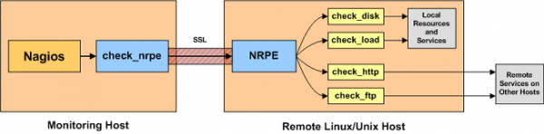
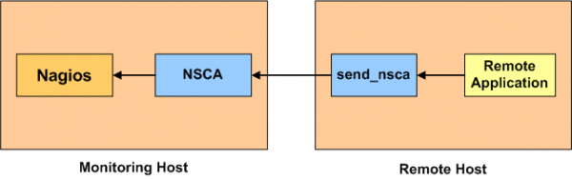
Remote monitoring
NPRE
NSCA

Slide 58
Nagios
Nagios Server:
Remote Host:
nagios
/etc/nagios/nagios.cfg
nagios-www
/etc/apache2/conf.d/nagios.conf
nagios-plugins
nagios-plugins-extras
nagios-plugins-nrpe
nagios-nsca
/etc/nagios/nsca.cfg
nagios-plugins
nagios-plugins-extras
nagios-nrpe
nagios-nsca-client
/etc/nagios/send_nsca.cfg
/etc/cron.d/nsca_cmd

