Slide 1

Evergreen Housing
Wes Swager

Slide 2
Business Problem
Evergreen Housing is a new house flipping startup looking to establish themselves in the east suburbs of Seattle, Washington.
In order to better assess whether additions which require construction are worthwhile, Evergreen Housing have requested input regarding which features will increase the value of homes and a model predicting pricing.
Notes:
House flipping is purchasing properties with the intent of selling them with the goal of making a profit.
In order to make a profit, most house flips involve improvements to the home which increase the value. However, the cost of these improvements must be accounted for, so earning a profit requires selling for more than the amount paid initially plus plus the cost of the improvements.
The most common improvements will be basic repairs and/or cosmetic renovations, however, for some properties Evergreen Housing may look to make more significant additions to the house via construction.

Slide 3

King County House Sales Data
Data associated with houses sold in King County, Washington between September 9, 2014 and January, 10, 2015.

Slide 4
Data Exploration and Cleaning
Remove Fields
Features not associated with the physical features of the home
Features which cannot be improved through construction
Redundant features
Define and Drop Outliers
Homes with more than six bedrooms - 0.28% of total data
Homes with more than four and one half bathrooms - 0.35% of total data
Homes with square footages greater than 4,000 - 3.21% of total data
Notes:
Features not associated with the physical features:
Date sold, If home was viewed, Average square footage of the surrounding homes
Features which cannot be improved through construction
Waterfront, Basement square footage, Zipcode

Slide 5
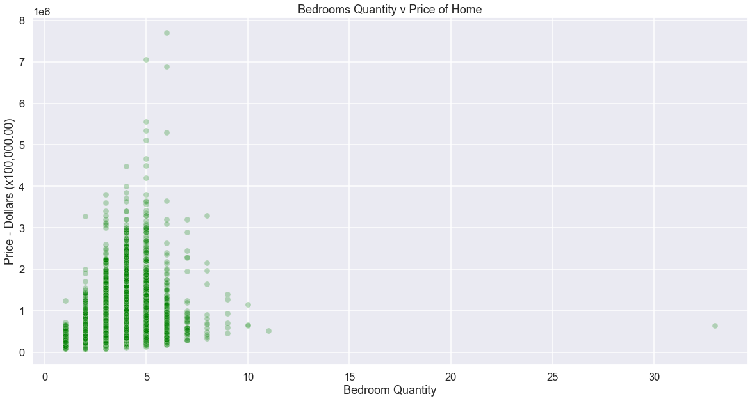
Example Feature Exploration

Slide 6
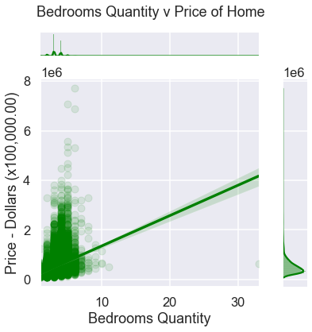
Example Feature Exploration

Slide 7
Modeling - Individual Features
Fit Each feature individually v price to a linear regression model to assess fit.
Conclusion: Drop Year the House was Built due to a poor fit to model, indicating little association with price.

Slide 8
Modeling: Analyze Fit and Refine Data
Fit to multiple linear regression model
Explore Removal of Additional Fields
Grade and Condition based on potential lack of statistical significance
Conclusion: Change discarded due worsening of overall model fit as a result

Slide 9
Modeling: Analyze Fit and Refine Data
Fit to multiple linear regression model
Explore Removal of Additional Fields
Floors based on potential excessive correlation with other features
Conclusion: Change discarded due worsening of overall model fit as a result

Slide 10
Modeling: Analyze Fit and Refine Data
Fit to multiple linear regression model
Define and drop Additional Outliers
Homes priced higher than $1,000,000.00 - 3.24% of total data
Conclusion: Change improved overall model fit

Slide 11
Final Model
The model indicated an average difference between predictions and actual pricing of $144,369.00.

Slide 12
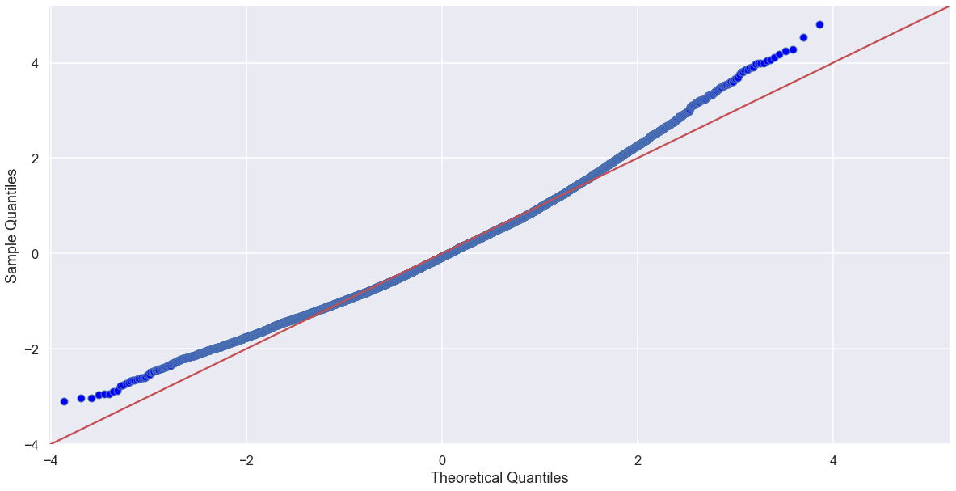
Final Model
The below visual of the model indicates that the model is performing relatively well within the middle two quartiles (middle 50%)
Notes:
Features lacking statistical significance: Grade, Condition
Features excessively correlated with other features: Floors (also, realistically floors will not be added with construction)
Additional Outliers: Price

Slide 13
Conclusions
The following features show a statistically significant relationship with increasing price of the home (in order of significance):
Square Footage of the Home
Number of Bathrooms
Number of Bedrooms

Slide 14
Additional Comments
While the grade from King County grading system showed some significance, it was only with higher graded homes; lower grades showed less significance.
This could indicate that construction improvements are more worthwhile with higher graded homes.
This could also indicate that seeking to improve a home’s ability to perform well with King County’s grading system is worthwhile.
However, more investigation is required before conclusions can be made.

Slide 15
Additional Conclusions
The condition feature did not show significance.
While this feature would seem to be similar to the King County grading system, the differing metrics must cause it to have less of a relationship toward price.
This would indicate that in making renovations for a home, the metrics associated with the King County grading system should be prioritized over the metrics for Condition.

Slide 16
Thank You
Email: westin.swager@lsventures.com
GitHub: @wswager
LinkedIn: linkedin.com/in/wes-swager-36a84a2a

