Slide 1


Milwaukee Rampage FC
Wes Swager

Slide 2
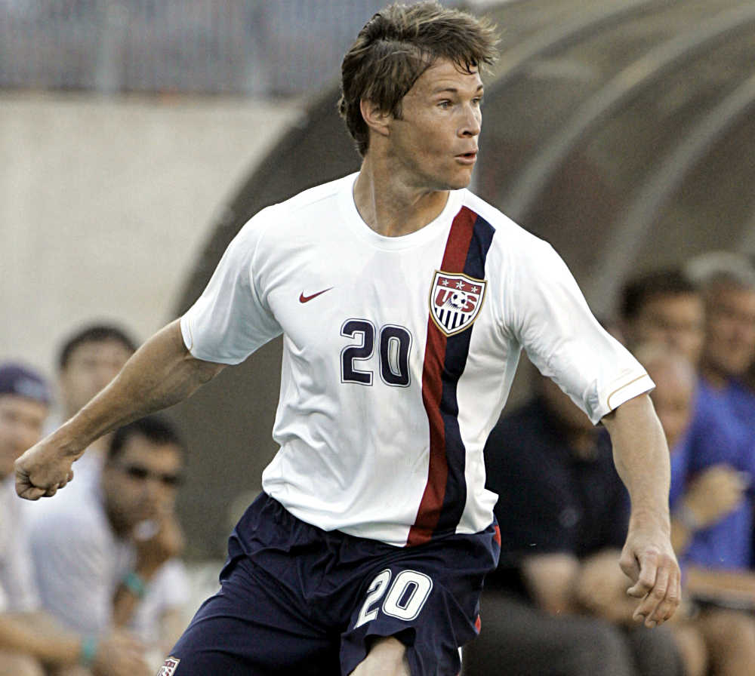

Milwaukee Rampage FC
Founded in 1993
Former second-tier men's professional team
1994-1996 United States Interregional Soccer League (USISL)
1996-2003 A-League
Notes:
Brian McBride, former US Men’s National team star, played with the Rampage during the 1993 season

Slide 3


Market
The Milwaukee market is well positioned to support a new professional soccer team
Chicago Red Stars - National Womens Soccer League (NWLS)
US Women’s Soccer 1st-Tier
Continuous operation since 2013

Slide 4


Market
The Milwaukee market is well positioned to support a new professional soccer team
Milwaukee Wave - Major Indoor Soccer League
Mens Indoor Soccer 1st-Tier
Continuous operation since 1984
Notes:
The Milwaukee Wave are the longest continuously running professional soccer team in the US

Slide 5
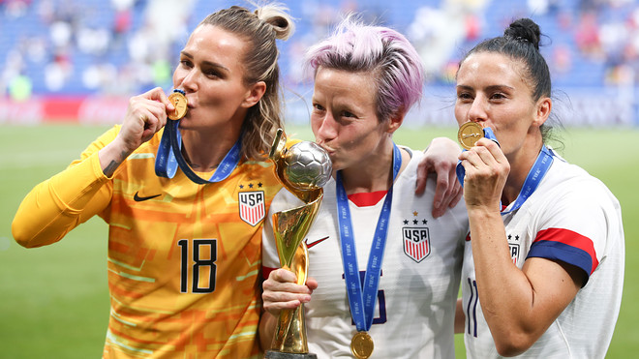

United Women’s Soccer (USL)
Notes:
The Rampage are looking to capitalize on the growth of women’s soccer within the US.
The US women’s national team consistently receives higher tv ratings than the US men’s national team
The NWSL is considered one of the top women’s club soccer leagues in the world

Slide 6
Expected Goals (xG)
xG is a commonly referred to metric within soccer used to represent the probability a scoring opportunity may result in a goal.
xG is not a standardized metric, and therefore various data science companies, betting organizations, and teams build their own proprietary models to predict xG.
Notes:
The Rampage are in the process of building their support staff and infrastructure and have prioritized a data science department as a means to maximize the teams efficacy in increasing the team’s goal-scoring, both as a means of improving match results, but, equally importantly, increasing the entertainment value, and, hopefully, as a result revenue

Slide 7
Expected Goals (xG)
Milwaukee Rampage FC have requested an xG model
Predict the likelihood of goals based on available historical data
Provide actionable recommendations which can be utilized on the training ground with players to increase the likelihood of scoring
Provide actionable insights on opponents through scouting which can be utilized in tactical planning

Slide 8

Data
The data used has been sourced from StatsBomb, a United Kingdom based football (soccer) data analytics company.
StatsBomb have provided free access to their proprietary dataset via GitHub: StatsBomb Open Data

Slide 9
Evaluation Metrics
Recall
Ratio of true positives; shots correctly identified as goals
ROC
True Positive Rate v False Positive Rate plotted on a curve with the score being the measurement of the the area under the curve
Accuracy
Ratio of shots correctly identified

Slide 10
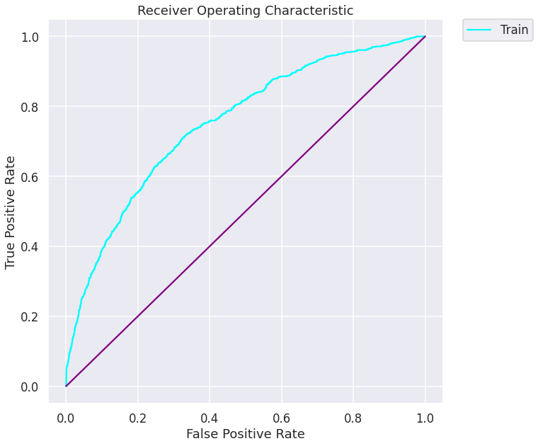
Random Trees Classifier Model
Recall
0.76
ROC
0.75
Accuracy
0.60

Slide 11
Random Trees Classifier Model
Count: 6104
Mean 0.10
Standard Deviation 0.14
Minimum 0
25% 0.02
50% 0.04
75% 0.12
Maximum 0.91
Notes:
xG is measured from 0-1 with 0 being no goal and 1 being goal

Slide 12
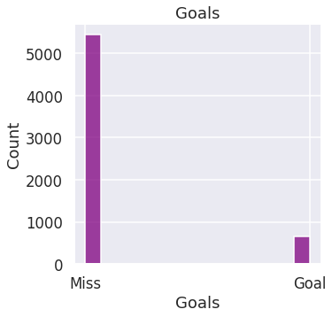
Random Trees Classifier Model
Ratio of Goals from Total Shot
10.91 %
Notes:
This is the baseline goal ratio from which to compare other features

Slide 13
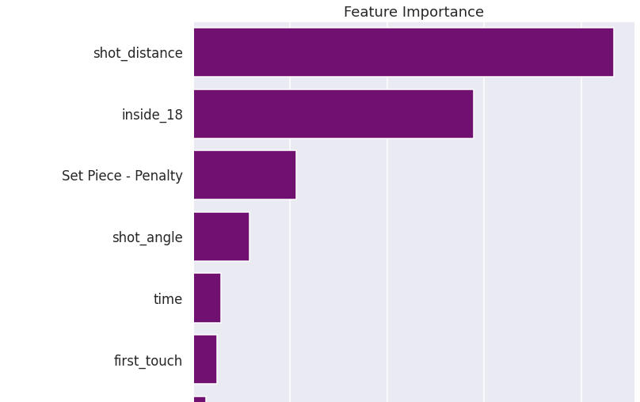
Feature Importance

Slide 14
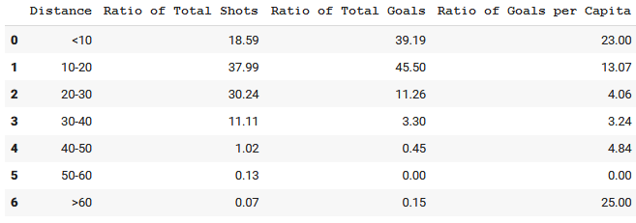
Shot Distance
Notes:
The ratio of shots skews toward 10-30yards, however, the ratio of goals skews toward 0-20yards.
Also, the ratio of goals per capita is significantly higher, as well as significantly higher than the baseline goal ration in the 0-20yard range

Slide 15
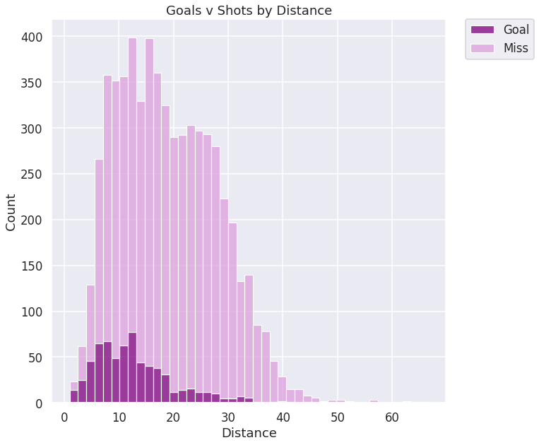
Shot Distance
Ratio of Shots Within 30-Yards
87.52 %
Ratio of Goals Within 20-Yards
84.83 %

Slide 16
Conclusion
Shots closer to goal have a higher likelihood of scoring
Shots closer to goal should be prioritized as a target in the team's player training and tactical planning

Slide 17
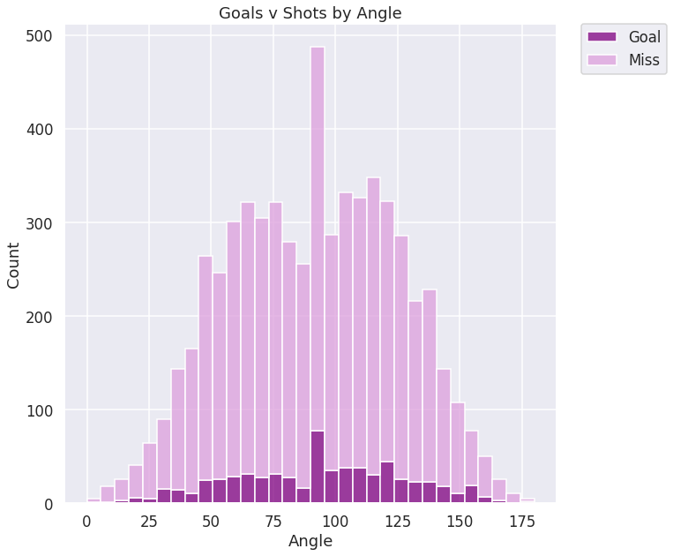
Shot Angle
Count 6104
Mean 91.02
Stand Deviation 33.91
Minimum 0.00
25% 64.65
50% 90.46
75% 116.99
Max 180.00

Slide 18
Shot Angle
Side Ratio Shot Ratio Goal
Right 46.66 9.48
Left 50.15 11.83
Notes:
A higher ratio of goals per capita are scored from the left
This is likely due to most players being right footed:
It is generally easier and more accurate to shoot with the inside-foot (right foot from the left)
It is generally easier and more accurate to cross with the outside-foot (right-foot from the right) and crosses typically are aimed across goal and finished on the opposite side

Slide 19
Shot Angle
Ratio of Total Shots within 45-Degrees
79.23 %
Ratio of Total Goals within 45-Degrees
78.08 %

Slide 20
Conclusion
Shots from angles approximately 20-degrees left of center have a higher likelihood of scoring.
Therefore shots from this area should be prioritized as a target in the team's player training and tactical planning.

Slide 21
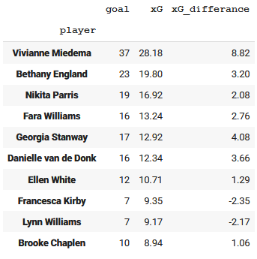
Apply to Players
If a player is over-scoring:
The player is an excellent finisher
Scoring goals from lesser chances
The player will experience a period of
under-scoring
Notes:
xG was applied to the original data
The data was then filtered to measure the accumulation of xG across shots per player, as well the accumulation of goals per player, and finally the difference between xG and actual goals

Slide 22
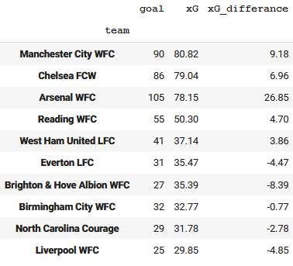
Apply to Players
If a team is over-scoring:
Finishers are over-performing
creators
Higher ratio of goals v quantity
and/or quality of chances
Team is likely to experience a period
of under-scoring
Notes:
The same xG, goal, and xG difference accumulations can be applied per team

Slide 23
Next Steps
Create a visual mapping shot location on a field diagram with a color-gradient for xG applied to shot points, visually indicating the distances and angles with the highest xG

Slide 24
Next Steps
Engineer a feature creating a triangle of vectors from the shot location to each post of the goal, and then mapping if opposition players were between the shot and goal at the time of the shot

Slide 25
Next Steps
Apply xG to match timestamp data, tracking accumulated xG throughout the match v the actual score and final outcome of the match

Slide 26
Next Steps
Extract more assist-specific features in order to develop an Expected Assist (xA) metric

Slide 27
Questions?

Slide 28
Email: westin.swager@lsventures.com
GitHub: @wswager
LinkedIn: linkedin.com/in/wes-swager-36a84a2a

