Slide 1


The Chiwaukee Group
Wes Swager

Slide 2
The Chiwaukee Group
A startup real estate development firm looking to capitalize on growth and business development in the geographic area between Chicago, Illinois and Milwaukee, Wisconsin, through investment in new residential projects.

Slide 3






Business Development
Notes:
Amazon - 2015 - New Distribution Center
Uline - 2010 - New Headquarters
2018 - New Distribution Center
Foxxconn - 2020 - New Manufacturing Plant
New Network Operations Center
Meijer Inc. - 2014 - New Distribution Center
Rust-Oleum Corp. - 2014 - New Distribution Center
Gordon Food Service - 2010 - New Distribution Center

Slide 4

Future Development
Marquette University Law School in Milwaukee has projected that the two metro areas will continue to merge into a single megaregion.
Notes:
They are currently conducting a running project mapping the interconnection of the two geographic and economic entities while working with policymakers to encourage and facilitate the process going forward.

Slide 5
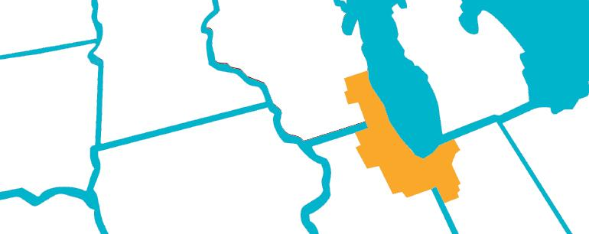
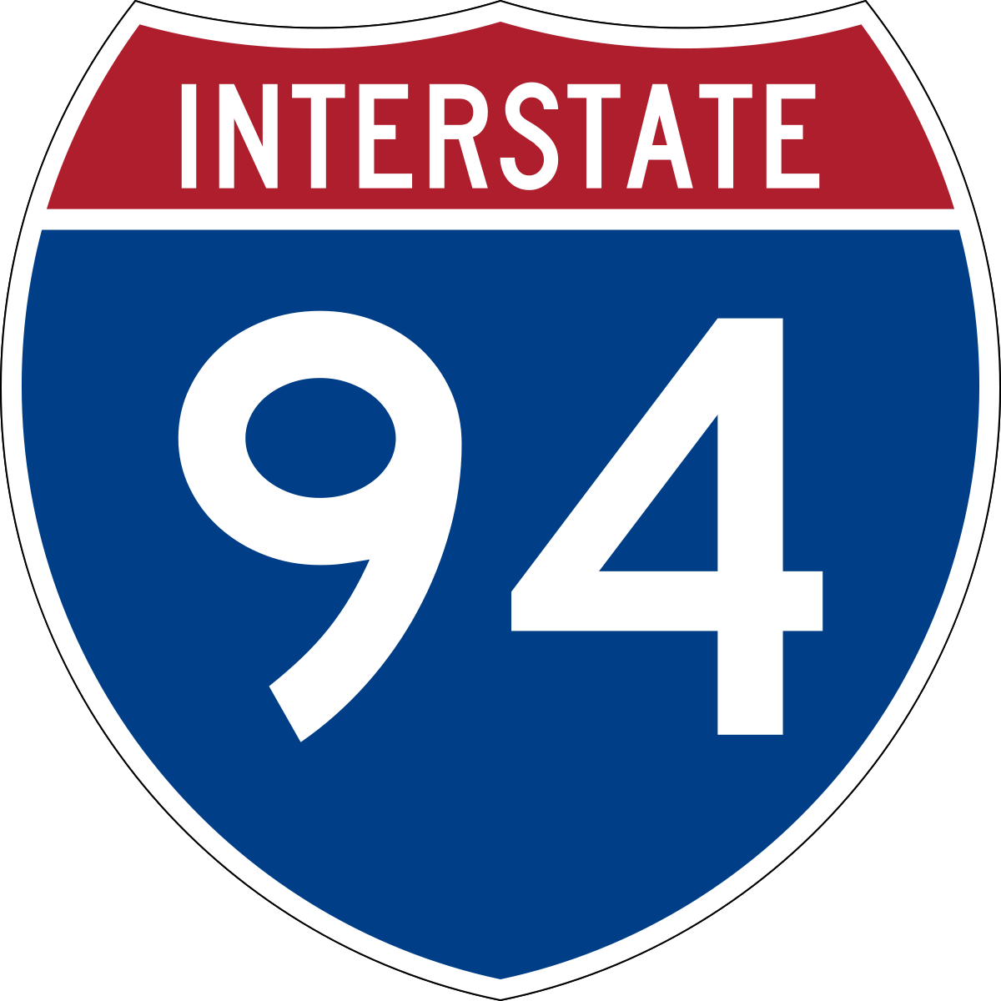

Connection
Notes:
The two cities are connected by a major interstate, I-94, as well as a train route, the Hiawatha Service, operated by Amtrak, which includes a stop in the city of Sturtevant in Racine County.

Slide 6
Business Problem
The Chiwaukee Group are specifically looking to target the counties located between Cook County, IL (Chicago) and Milwaukee County, WI:
Lake County, IL
Kenosha County, WI
Racine County, WI
The Chiwaukee Group have requested a recommendation of the top-five zipcodes within which to invest.

Slide 7
Parameters
Risk
Evaluated through Coefficient of Variance, ratio of the standard deviation to the mean, with an upper-limit set at 50%
Historic Return on Investment
Areas with prove return on investment, with a threshold of top 25% across the existing data’s timeframe
Expected Future Returns
Final recommendations will be based on future returns

Slide 8
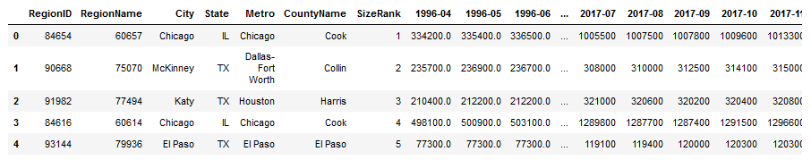
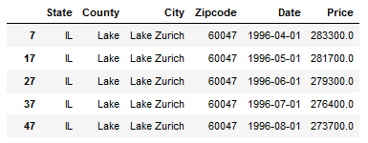
Data
Monthly median housing sales values between 1997 and 2017 downloaded from Zillow, an American online real estate marketplace.

Slide 9
Data
Working Zipcodes
60047 - Lake Zurich, IL
53142 - Kenosha, IL
53144 - Kenosha, IL
53158 - Pleasant Prairie, WI
53181 - Twin Lakes, WI
53108 - Caledonia, WI
53139 - Eagle Lake, WI
53404 - Racine, WI
53405 - Racine, WI
53185 - Waterford, WI
Notes:
Zipcodes following initial filtering by:
Location: located in Lake County, IL, Kenosha County, IL, or Racine County IL
Risk: Below the 50% coefficient of variance upper-limit
Historic Return on Investment: Above the top-25% threshold

Slide 10
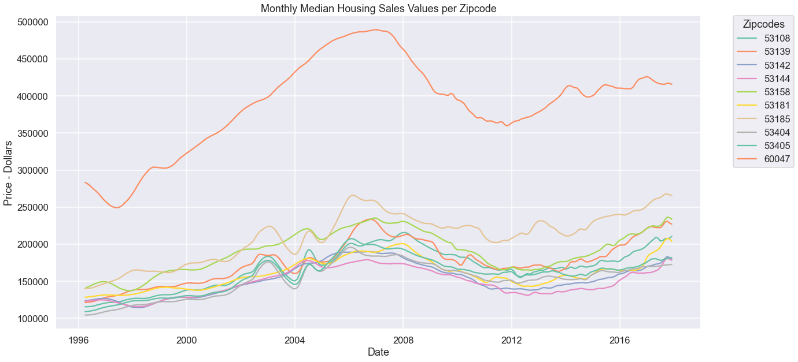
Data
Notes:
An upward trend is visible for all of the zipcodes beginning following the timeperiod in which the recent business development began, 2010-2014.

Slide 11
SARIMAX Model
Seasonal Auto Regressive Integrated Moving Average with Exogenous Factors
Time Series Model where each data point is associated with a time and the model predicts the next data based on statistical assessment of previous data.

Slide 12
Evaluation Metrics
Akaike Information Criterion (AIC)
A measurement error, comparing the model’s predictions to the actual data
Adds a penalty for complexity, higher complexity can increase the likelihood of overfitting, if a model too closely reflects the actual data it will be less accurate in predicting future results
Provides a standardized score which can be compared relative to other models
Used to evaluate potential SARIMAX modeling parameters in order to determine the best parameters for the final model

Slide 13
Evaluation Metrics
Root Mean Square Error (RMSE)
The standard deviation of the residuals of the model
A measure of how concentrated the actual data is around the model’s prediction
Used the assess the quality of fit of the final SARIMAX model

Slide 14
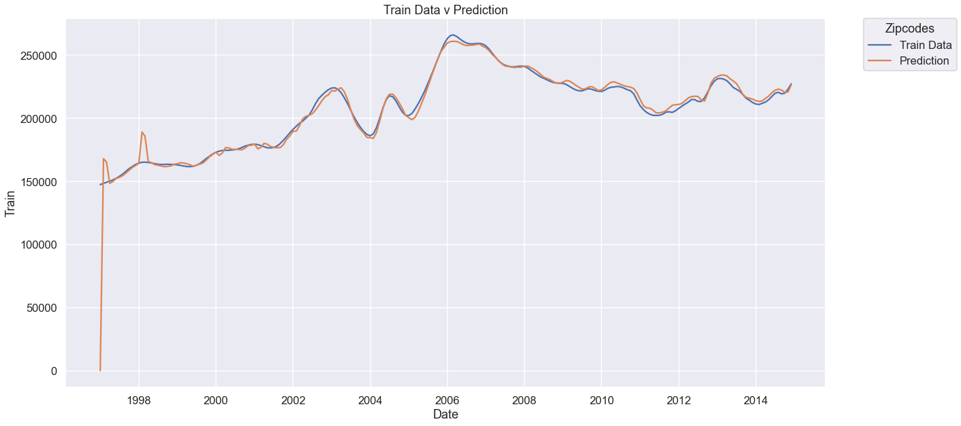
Modeling
Notes:
Ex

Slide 15
Top-Five Zipcodes
60047 - Waterford, WI
$149,388.39
53108 - Eagle Lake, WI
$86,574.04
53158 - Kenosha, WI
$44,133.74
53144 - Kenosha, WI
$39,968.79
53142 - Twin Lakes, WI
$38,127.55

Slide 16
Recommendations
Invest in in the area fifteen-to-twenty-five-miles West of Interstate-94, North of the Illinois border
Invest in the area within five-miles of Interstate-94 in Kenosha County
Discard interest in Illinois

Slide 17
Recommendations
Invest in in the area fifteen-to-twenty-five-miles West of Interstate-94, North of the Illinois border
3 of the top-5zipcodes, including the top-2,are located sequentially, 15-25miles West of I94, from the north-most border of Racine County south to the IL border
Based on projections that Chicago and Milwaukee will continue to merge into a singular megaregion, it was anticipated that the area directly between, East of I-94 to Lake Michigan, containing cities Kenosha, Racine, and Oak Creek would have been one of the areas on the rise

Slide 18
Recommendations
Follow-Up Questions
Is the attraction to this area potentially associated with higher rated school system further separated from the cities?
Are the higher forecasted returns potentially being driven by specific, smaller geographic areas, weighting the average for the zipcode?
Is the growth of the area even connected with commuting access to Milwaukee and/or Chicago?
Notes:
Racine and Milwaukee cities have historically ranked among the worst school systems in the US
Nearby Lake Geneva has historically one of wealthiest areas in the Midwest
Are people looking for an area separated from the cities but still within commuting distance or is the growth of this area being driven be completed disassociated factors?

Slide 19
Recommendations
Invest in the area within 5miles of I94 in Kenosha County
The final 2 of the top-5zipcodes were more predictably the area directly surrounding the major business developments along I-94 in Kenosha.
This area would also have the most direct access to I-94 and the Hiawatha Train service stop for commuter access
Notes:
Both Milwaukee and Chicago are approximately 45minutes drive from this area
The Hiawatha train stop in Sturtevant, WI is 2miles from I94 in Racine County,, approximately 10-20minutes from this area

Slide 20
Recommendations
Follow-Up Questions
What is type of competition exists for the development residential projects in this area?
What types of residences are in-demand in this area?
Are people moving to this area for distribution center and manufacturing jobs or for commuter access to Milwaukee and/or Chicago?
Notes:
What type of socioeconomic profile is being drawn to the area by the business development?

Slide 21
Recommendations
Discard interest in Illinois
All five of the top-five zipcodes are all located in Wisconsin, not Lake County in Illinois

Slide 22
Recommendations
Follow-Up Questions
How big a factor is the significant discrepancy between state tax-rates in Wisconsin compared to Illinois?

Slide 23
Next Steps
Additional research can be performed regarding factors such as:
Tax Rates
Interest Rates
School District Ratings
Crime Rates
Median Household Incomes
Additional modeling types can be utilized in the analysis of further data types

Slide 24
Next Steps
Polling can be performed with current residents, with specific emphasis on people who moved to the area recently, to gather further data regarding personal driving factors potentially not captured by available statistics

Slide 25
Next Steps
Further research can be performed narrowing the geographic range within the top zipcodes to attempt to discover more specifically which areas The Chiwaukee Group should look to invest in

Slide 26

Questions?
Email: westin.swager@lsventures.com
GitHub: @wswager
LinkedIn: linkedin.com/in/wes-swager-36a84a2a

