Slide 1

$ git tag –a v1.0 –m “Git Good”

Slide 2
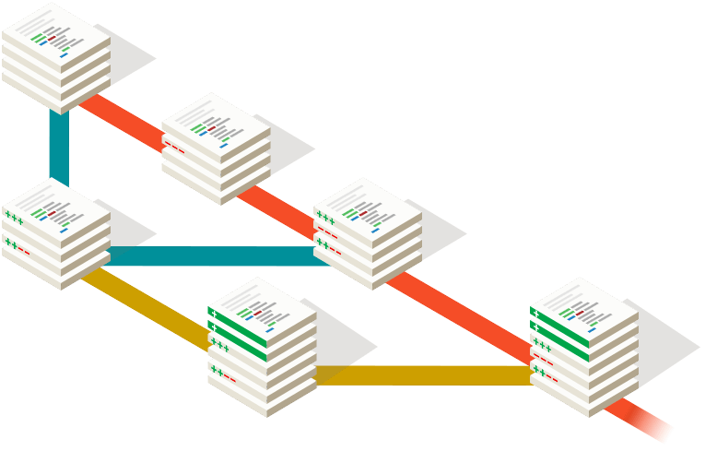
$ git status
What is Git?
The basics!
Rebase vs Merge

Slide 3
$ git help -a
It’s a VCS but better!
Not based on diffs
Basically, a mini filesystem
Everything is checksummed!
Remote repos are the same as local repos?
What really is GitHub, GitLab, etc?
SSH vs HTTP, should I use one or the other?

Slide 4
$ git commit –m “chore: git good”

