Slide 1

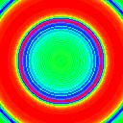
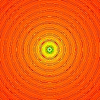
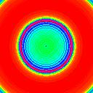
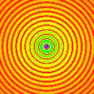
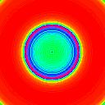







$$δ(r_{i},ρ)$$
$$δ_{F}(r_{i},ρ)$$
$$G(x,y,\hat{z},ω)$$
$$r_{i}=68$$
$$\hat{G}(r_{i},\hat{z},ω)$$
2D FT
…
…
…
$$r_{i}=30$$
…
…
…
$$r_{i}=10$$

