Slide 1

IEOR 222 Final Project
Shengying Wang
Department of Statistics, UC Berkeley
December 10 2014

Slide 2
Outline of this presentation
Project framework
Strategies
Results
Conclusions

Slide 3
Project framework
Fit a single decision tree to obtain the effect of each market feature by a tree diagram.
Fit random forests to obtain test accuracy and time costs to compete with SVMs.
Fit random forests to study the feature importance and compare with Lasso.
Predict spread crossing for different time intervals by random forests and SVM to test robustness.

Slide 4
Strategies
Data Attributes
Different situations

Slide 5
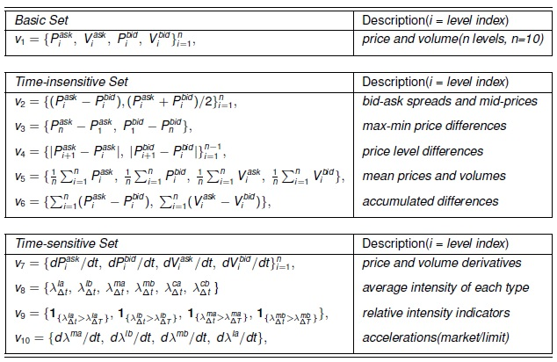
Data Attributes (based on Kercheval and Zhang’s work)
One can design his/her own feature sets.

Slide 6
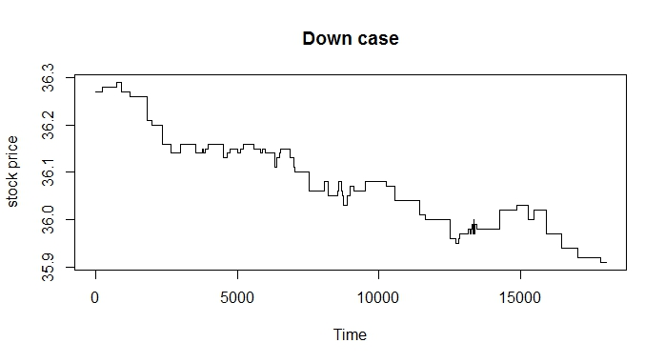
Different situations
Situation1: up and stationary
Situation2: down and stationary
Situation3: up, down and stationary

Slide 7
Sample Stock
Tractor Supply Company (up case)
DuPont (down case)
Exxon Mobil (regular case)

Slide 8
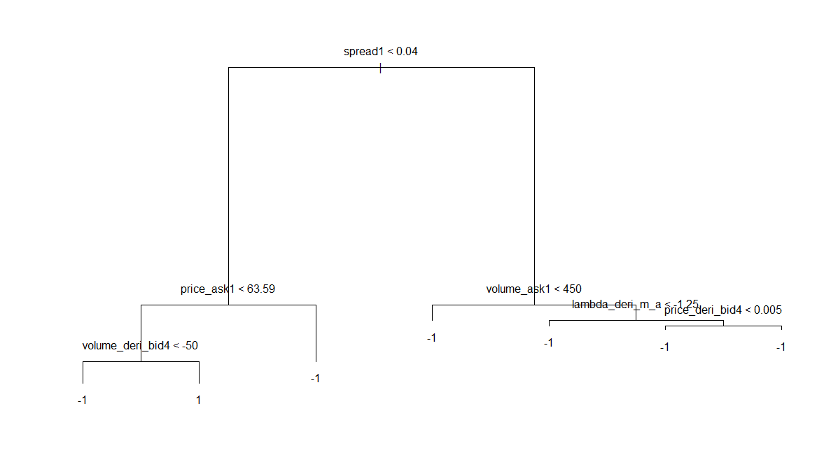
Single Tree
Stationary: -1 Up: 1
In “up case”, spread is the most significant feature.

Slide 9

Random Forests
Right: sample prediction table calculated from training data
1: up
0: stationary
All the classifiers give the similar results in general.
It is easy to make mistake classifying spread-crossings as stationary state.

Slide 10
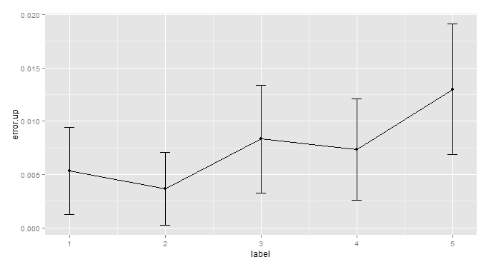
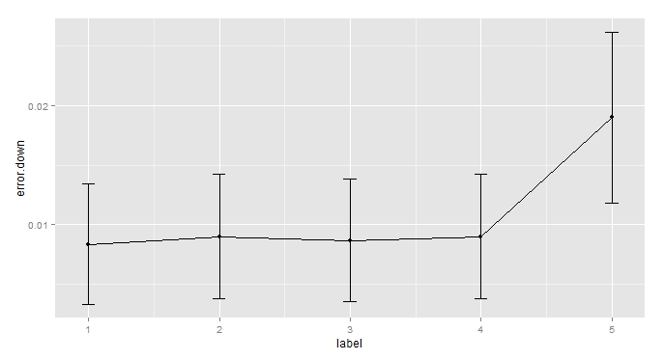
Accuracy (10-fold Cross Validation)
1: simple RF 2:complex RF 3:linear SVM 4:cubic SVM 5:radial SVM
Random forests are competitive.
Need to deal with over-fitting issues.

Slide 11
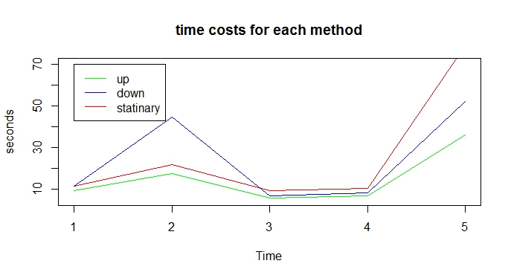
Time Costs
1: RF (50 trees) 2:RF (200 trees) 3:linear SVM 4:cubic SVM 5:radial SVM
Random forests cost more time to run.
Two-class problems save time for SVMs.

Slide 12
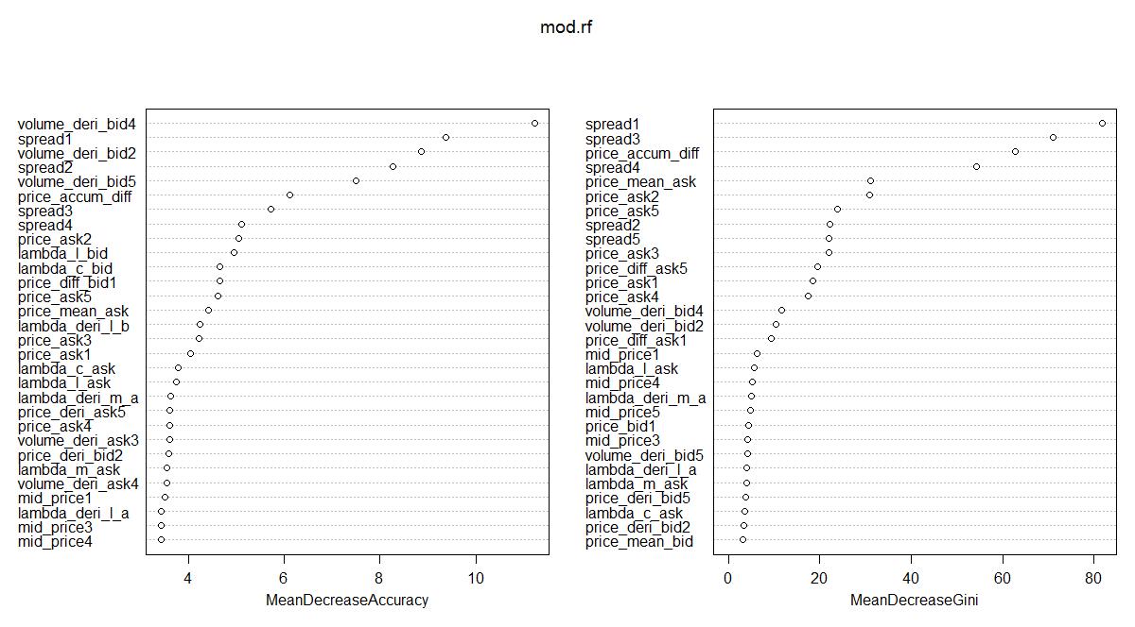
Feature Importance
Most of features don’t have much contribution.

Slide 13
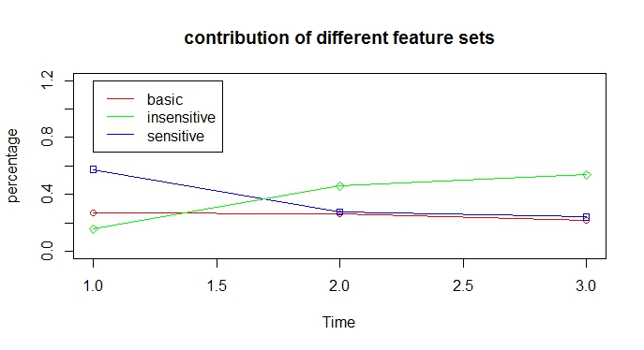
Feature Importance
All of those three feature sets make differences.
1: “Up” case 2: “Down” case 3: “Regular” case

Slide 14
Feature Importance
top 10 features from random forests vs top 5 features from Lasso
Sample1 (up case):
Random forests
Lasso
Sample2 (down case):
Random forests
Lasso

Slide 15
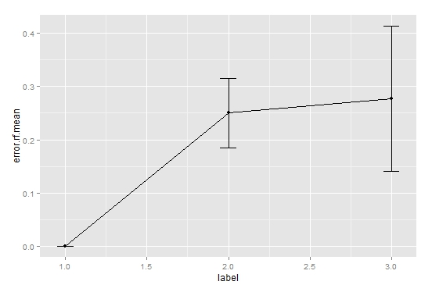
Robustness Study
Build random forests models with 1500 observations and test for new observations in next 1, 5 and 10 seconds. Repeat for 10 times.
Generally, the test error is getting larger when increasing the time period for prediction. The variance is increasing as well.

Slide 16
Robustness Study
We divide 3000 observations within 3 minutes into 4 subsets in the order of time. Then we fit random forests model to each subset with 750 observations to get top ten features.
We do obtain some robustness since most of the top ten features are about price, volume and arrival rates. But the order is changing all the time.

Slide 17
Conclusions
Trees gives clear interpretation.
The prediction results and time costs obtained by Random Forests are competitive.
All of those three sets of feature make contributions. Basic sets are more stable. Lasso may give different feature selection results.
Models are not robust, with large variance in terms of prediction. But it is robust for feature importance in a short time period within a couple minutes.

Slide 18
Problems and Feature Work
Get optimal number of time steps to be predicted.
Build feature selection methods to improve models in terms of prediction accuracy and time cost.
Deal with correlation among features.
The response variable y (the spread crossing metric as up, down and stationary) may not be independent.
Traditional cross validation methods no longer work.

Slide 19
Thank you.

