Slide 1
Application Lifecycle
The Circle of Life

Slide 2
`
A collection of:
Activities
Layouts
Resources

Slide 3
Separation
Each app runs in a sandbox, all by itself
You can use an Intent to start a different Activity. That Activity can be in another App.
When an Activity is started onCreate is called.

Slide 4
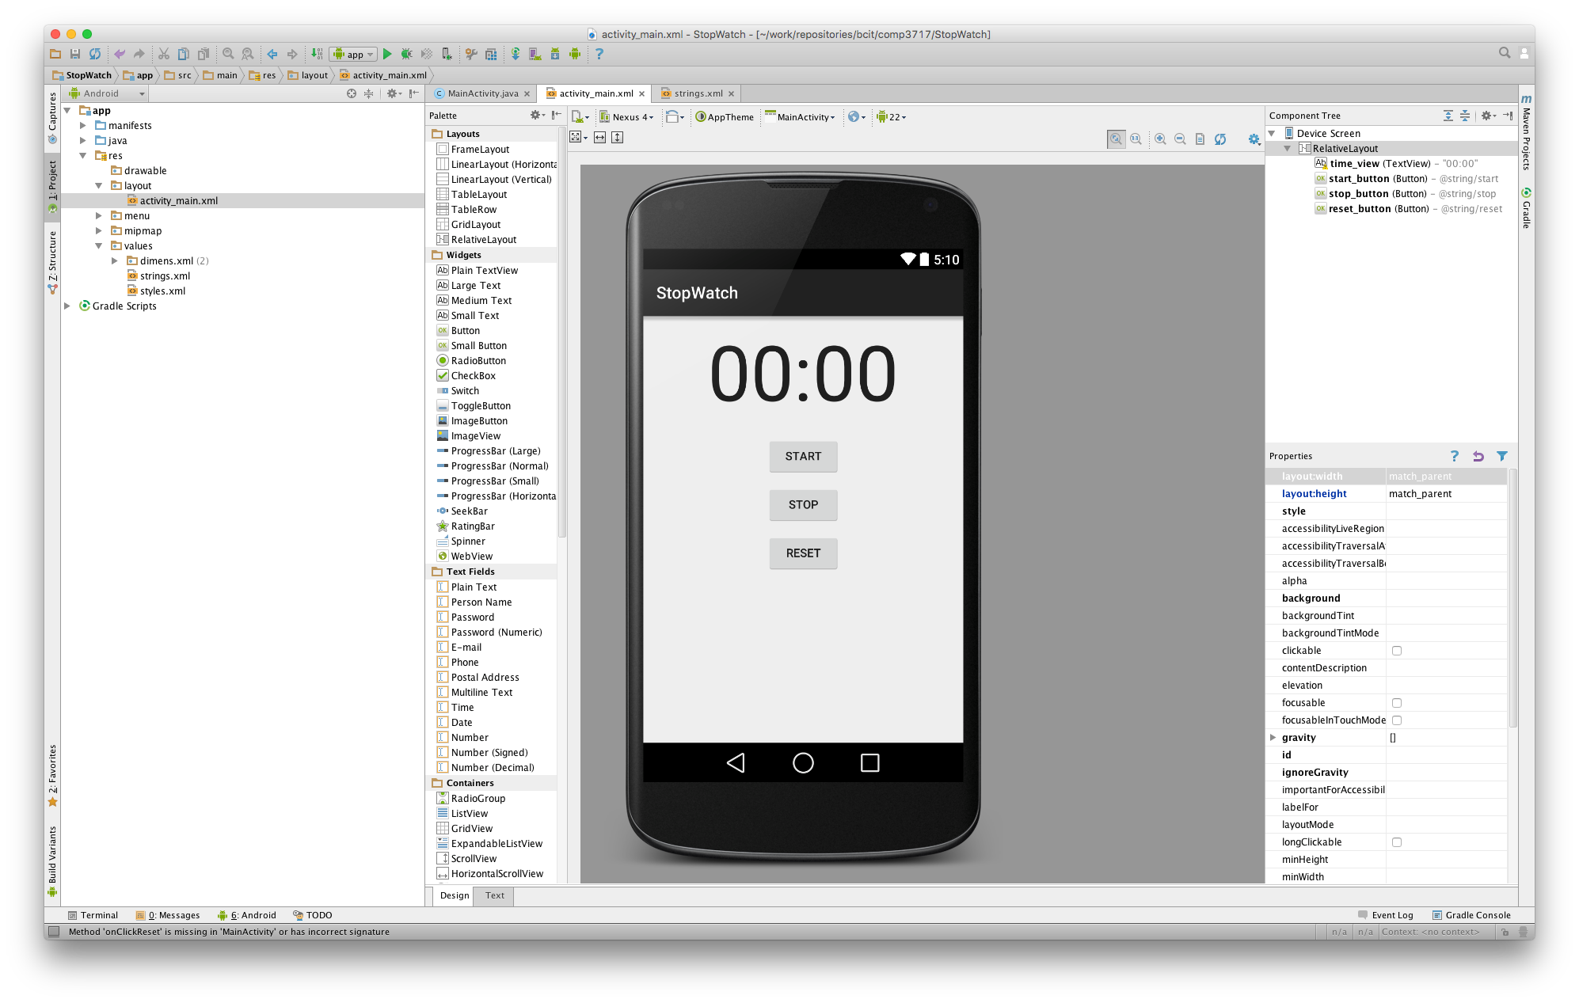

Slide 5
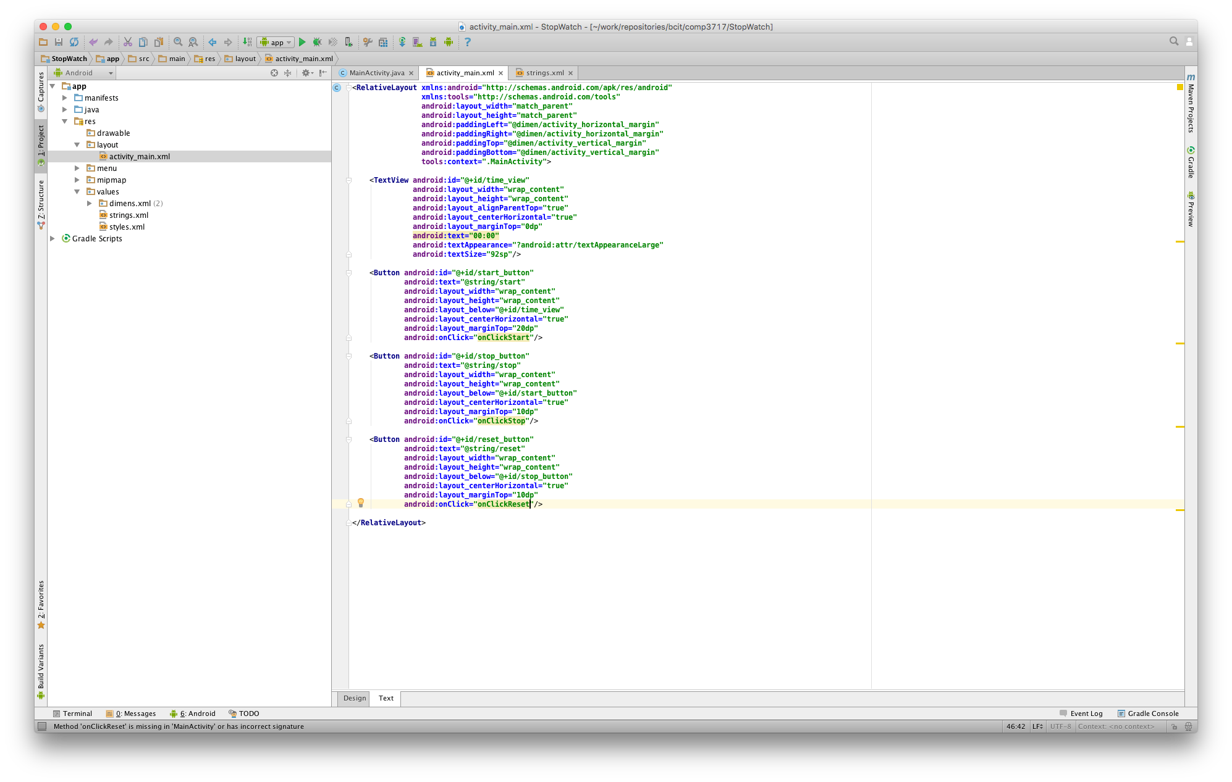

Slide 6
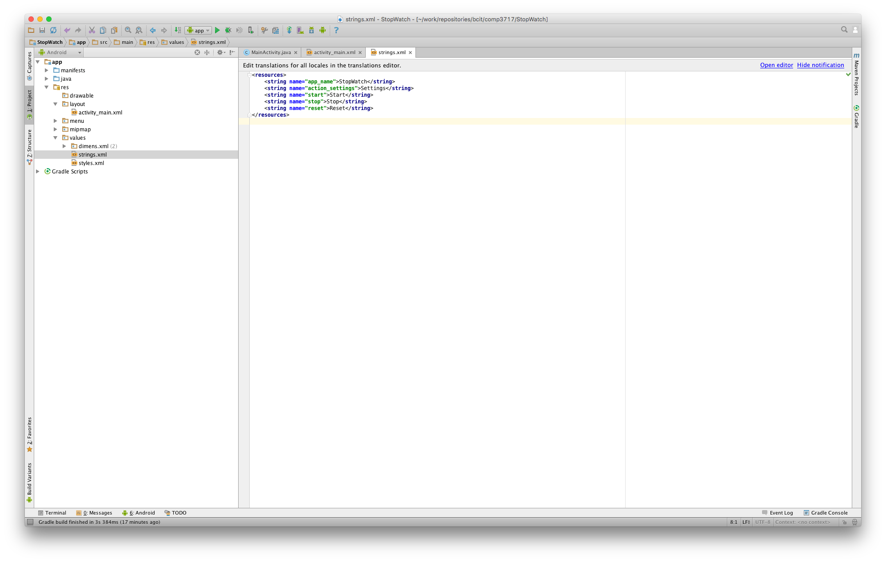

Slide 7
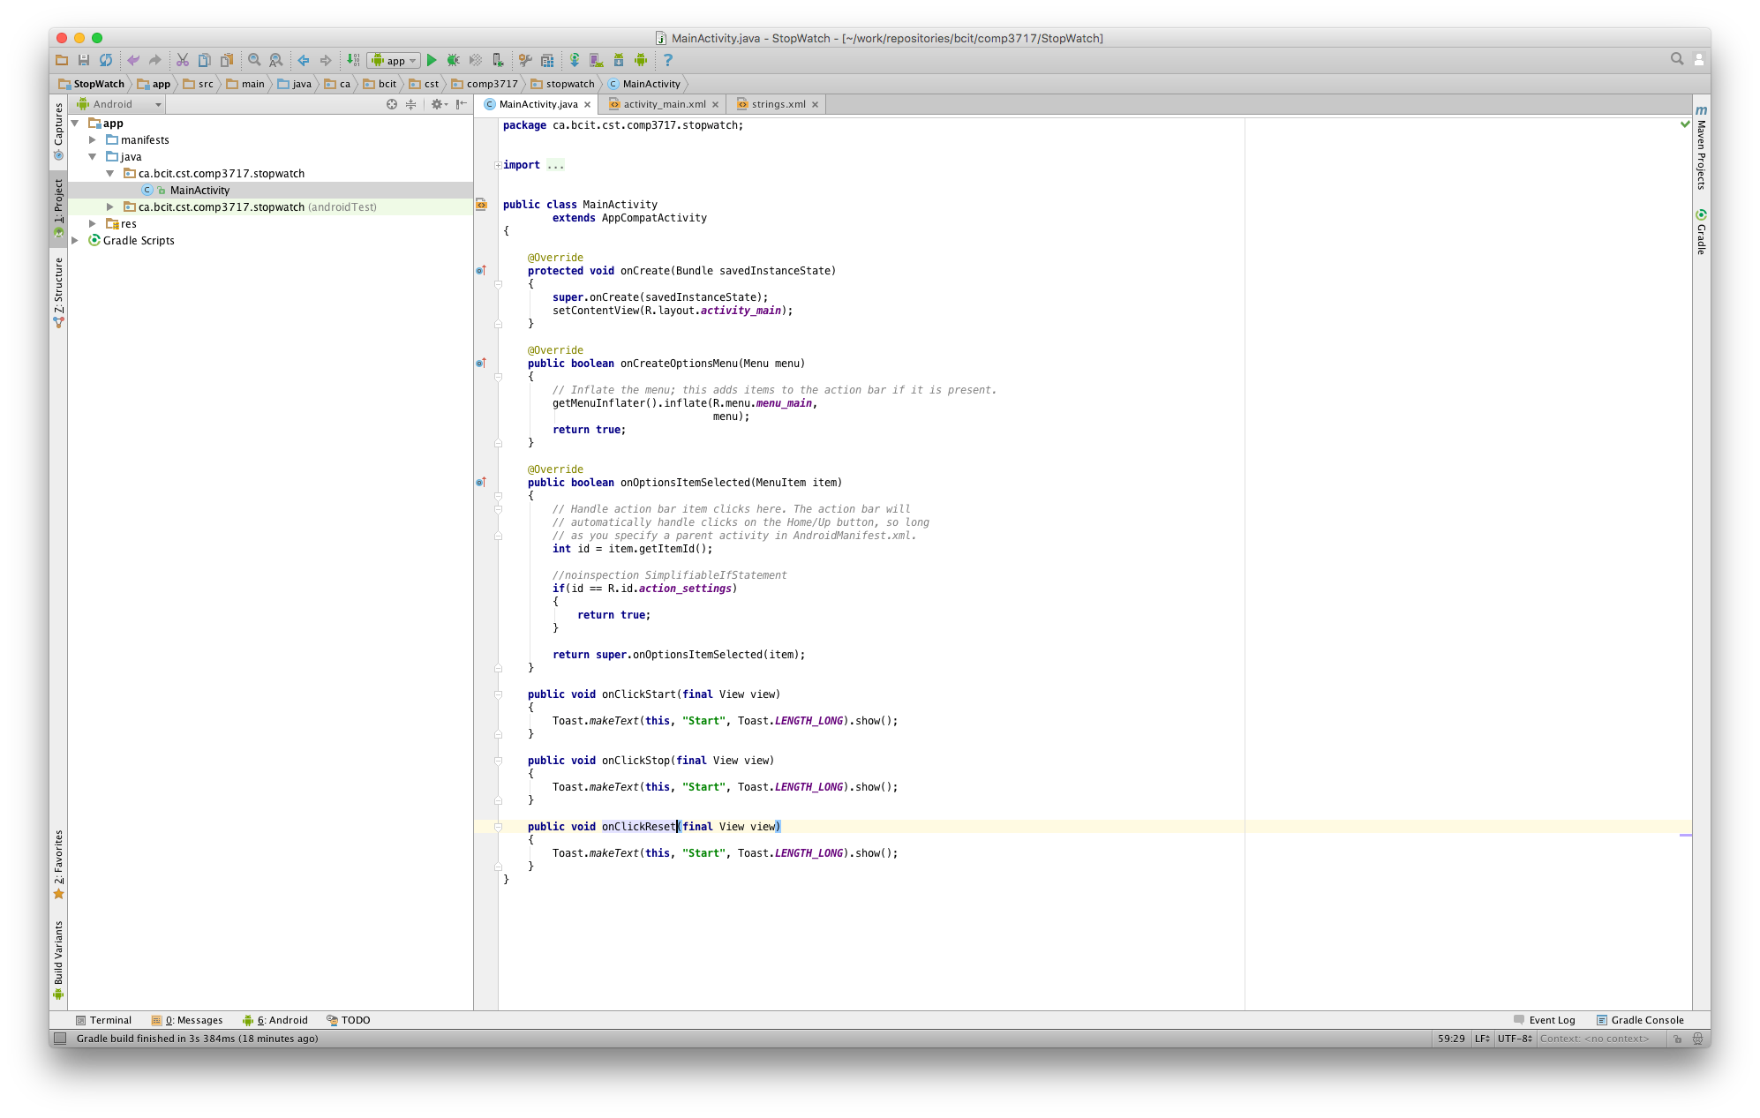

Slide 8
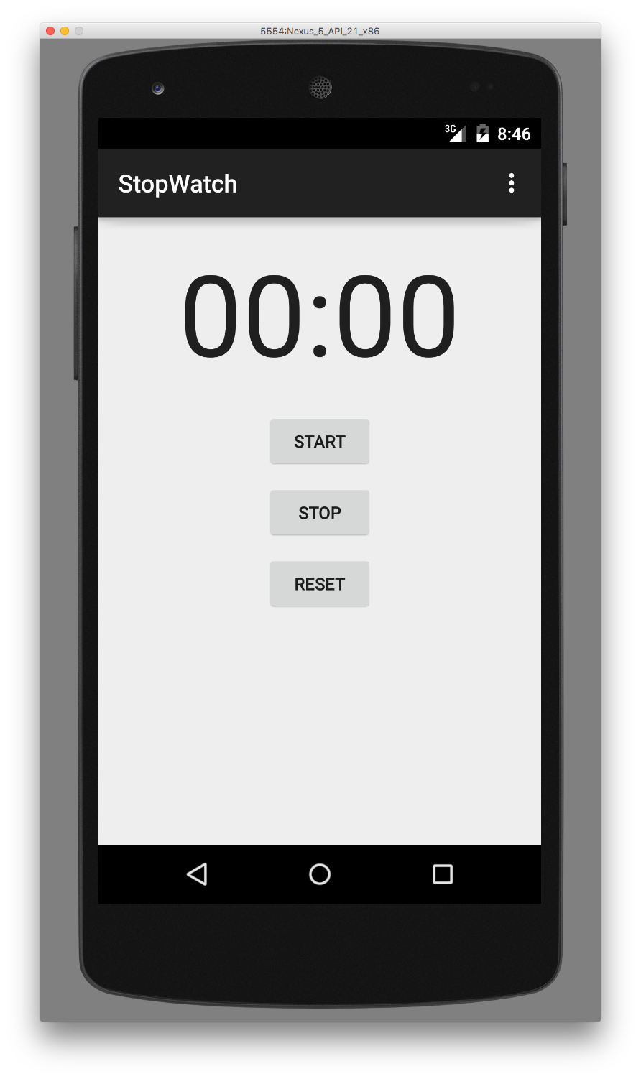

Slide 9
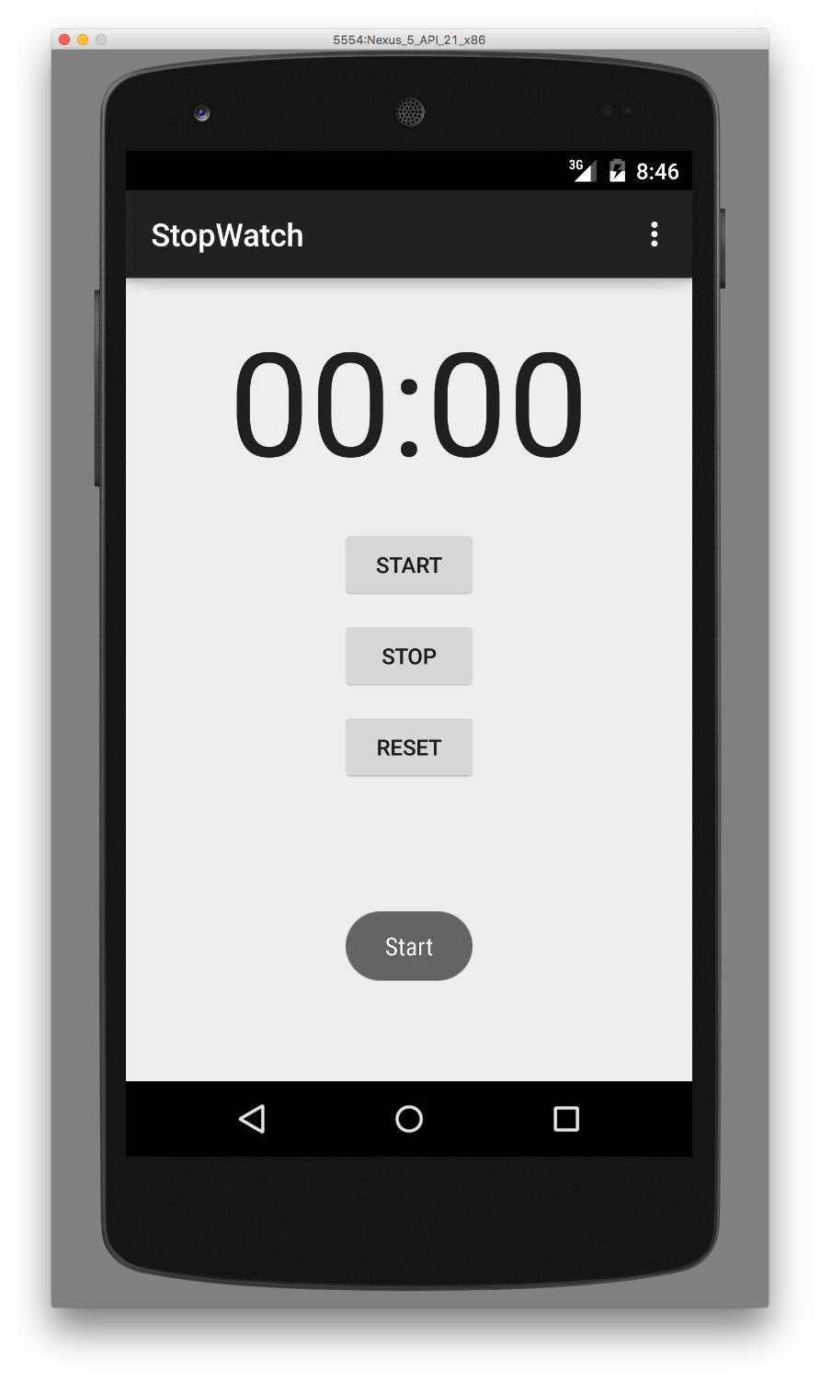

Slide 10


Slide 11


Slide 12
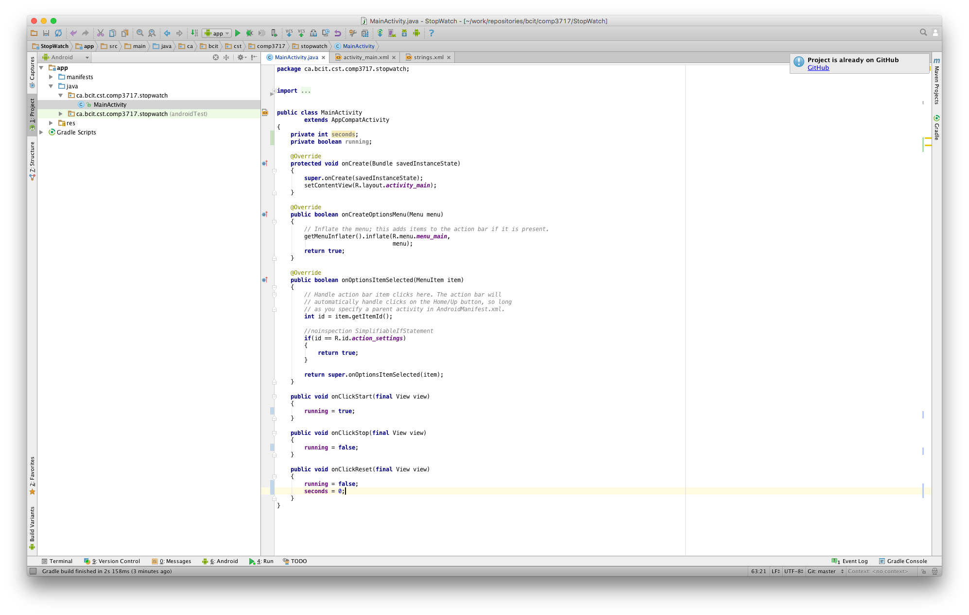

Slide 13
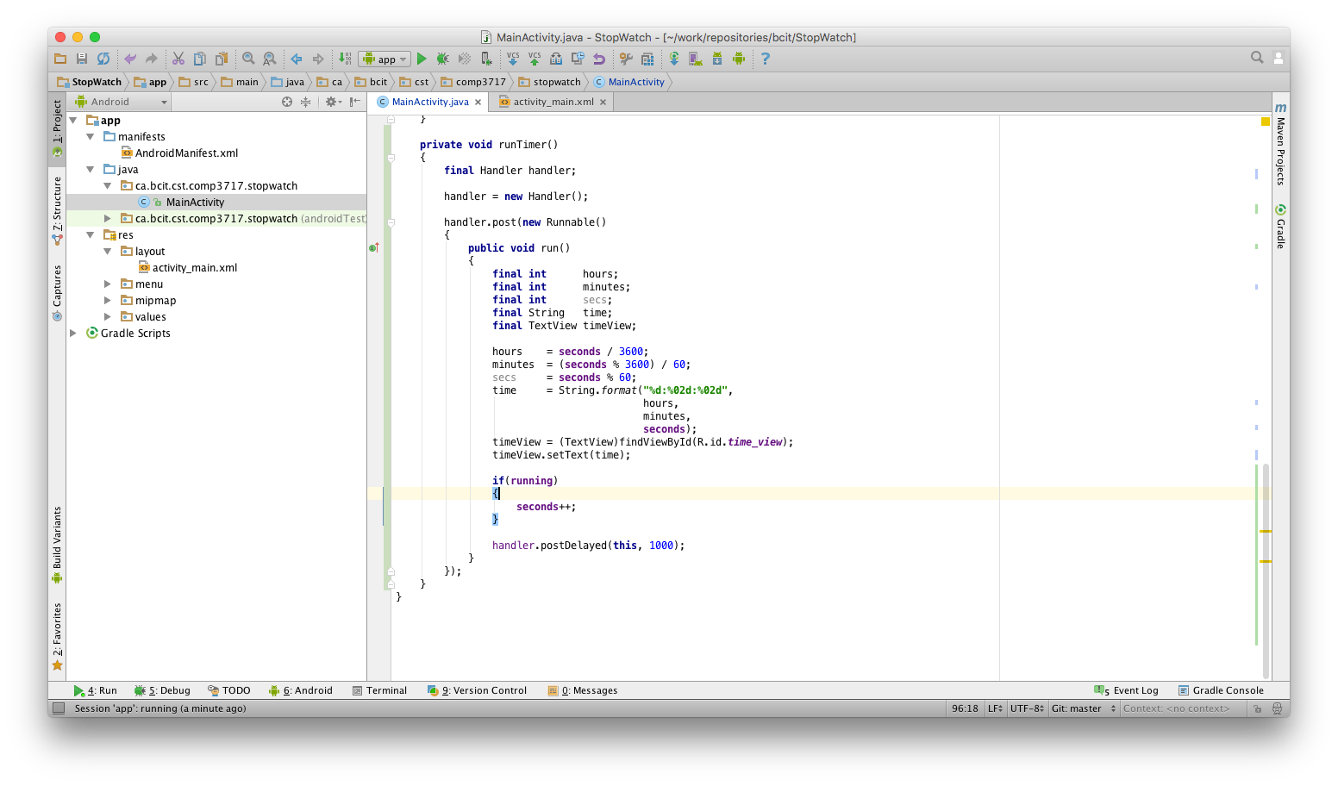

Slide 14
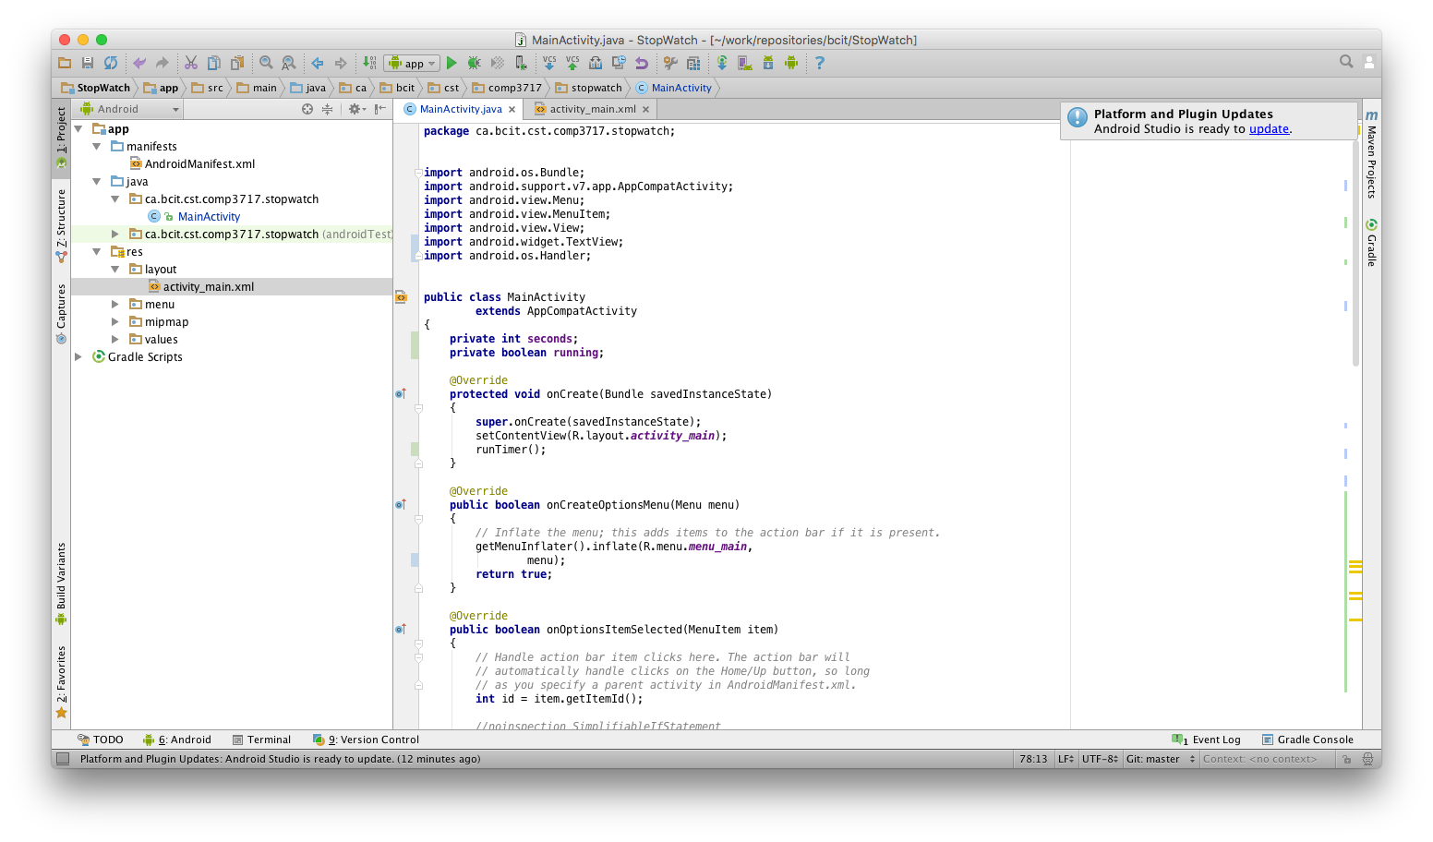

Slide 15
Basic Lifecycle
Activity Launched
onCreate
Activity Running
onDestroy
Activity Destroyed

