Slide 1
COMP3717
Introduction

Slide 2
Contacting Me
D’Arcy Smith
SW2-301
ds.bcit@gmail.com
604-431-4904
Office Hours: Fridays 10:30-2:20, email anytime.

Slide 3
What This Course is About
Android Application Development on mobile and tablet platforms
You will create a number of small Android apps as *individual* homework assignments
You will build, package and “publish” an Android application as a *group* assignment

Slide 4
Expectations of You
You will be on time (lecture and lab)
You will actively participate (lecture, lab, project)
You will manage your time effectively
You will ask questions!

Slide 5
Expectations of Me
I will be on time (lecture and lab)
I will be available to answer questions
I will offer guidance and help

Slide 6
Resources
Book: Head First Android Development (optional)
Stack Overflow (go make an account if you haven’t already - I must see it in lab this week)
Google Android Training (http://developer.android.com/training/index.html)
Android Discuss (https://groups.google.com/d/forum/android-discuss)
Search engine of your choice :-)

Slide 7
Weekly Schedule
Lectures Tuesday / Thursday
First lab of the week is Tuesday morning
Last lab of the week is Friday afternoon
Homework will be given out during Monday lecture, due Sunday.

Slide 8
Quizes (0%)
NO QUIZZES!

Slide 9
Labs (10%)
Labs will be small programming challenges, I’ll try to relate them to the homework
If you practice out of class time for an hour after each lecture that will go a long way to helping you in lab
Labs are 0 or 1 - it works or it does not.

Slide 10
Assignments (20%)
Homework assignments
Due Sunday but checked in lab

Slide 11
Group Project (30%)
You will have a 3-person team project (must be in your set, teams of 2 allowed only if unable to have teams of 3 in a set - at most 2 groups of 2 per set)
You will use Scrum to manage the project (more on this later)
You will provide a working copy of your project each week.
Peer evaluation at the end

Slide 12
Exams (40%)
Midterm and final are both 20%
You must pass both of them on average to pass the course

Slide 13
Project Scrum
This does not apply until the project starts!
Milestones each week with demo on a device
You will put your current build on share in by 10:00 pm the night before your lab.
Slack and Asana are good tools to use
GitHub or BitBucket (both git, spend some time learning how to use version control!!!!)
Team will hand in a printed status report at the start of lab
Not as onerous as it sounds :-)

Slide 14
Tools
Eclipse
Android Studio (https://developer.android.com/sdk/installing/studio.html) (1.5.1 is the current version)
Make sure that your entire project team is using the same version of Android Studio (just a good practise and could avoid some issues)

Slide 15
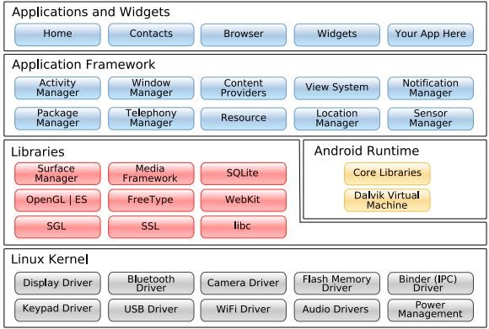
What is Android?
Mobile Operating System
Modified Linux

Slide 16
Devices
Smartphones (and not so smart phones)
Tablets
E-readers
Netbooks
MP4 players
Internet TV
Wearables (watches, Google Glass, etc…)

Slide 17
Homework
Install Android Studio
Get Hello World running
Play around, learn some stuff, have fun!
Create a stack overflow account for the next lab (this is for marks)

