Slide 1
Activities
Basis of User Interaction

Slide 2
Terms
An Application consists of a window that contains the user interface
An application can have zero or more Activities
Usually an application has at least one Activity
Fragments are mini-activities that can be grouped together to form an Activity
Intents are how Activities communicate

Slide 3
Basics
An Activity is a screen
Layouts define what each screen looks like
A layout is usually defined in XML
What an activity does is (generally) defined in Java code.

Slide 4
Quick Summary
A simple app has one activity and one layout
The activity specifies how the app should interact with the user.
The layout controls the app appearance

Slide 5
Basic Activity
package ca.bcit.activity101;
import android.app.Activity;
import android.os.Bundle;
public class Activity101 extends Activity
{
@Override
protected void onCreate(Bundle savedInstanceState)
{
super.onCreate(savedInstanceState);
setContentView(R.layout.activity_activity101);
}
}

Slide 6
Styles and Themes
Activities occupy the entire screen by default
Dialogs do not
android:theme="@android:style/Theme.Dialog" >

Slide 7
Hiding Activity Title
@Override
public void onCreate(Bundle savedInstanceState)
{
super.onCreate(savedInstanceState);
//---hides the title bar
requestWindowFeature(Window.FEATURE_NO_TITLE);
setContentView(R.layout.activity_activity202);
}

Slide 8
@Override
http://docs.oracle.com/javase/tutorial/java/IandI/override.html
When overriding a method, you might want to use the @Override annotation that instructs the compiler that you intend to override a method in the superclass. If, for some reason, the compiler detects that the method does not exist in one of the superclasses, then it will generate an error.

Slide 9
Beer App
A simple app that will show how interactions work
I will put the code on github

Slide 10
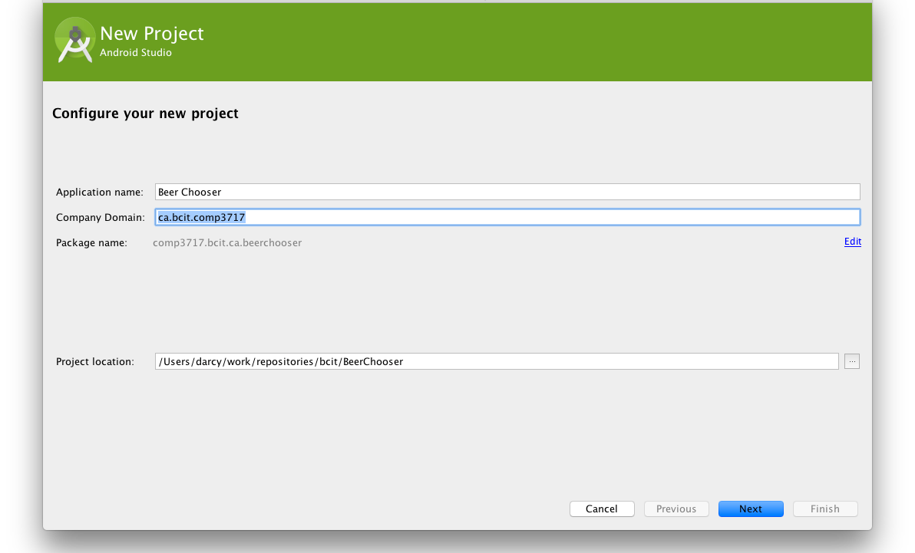

Slide 11
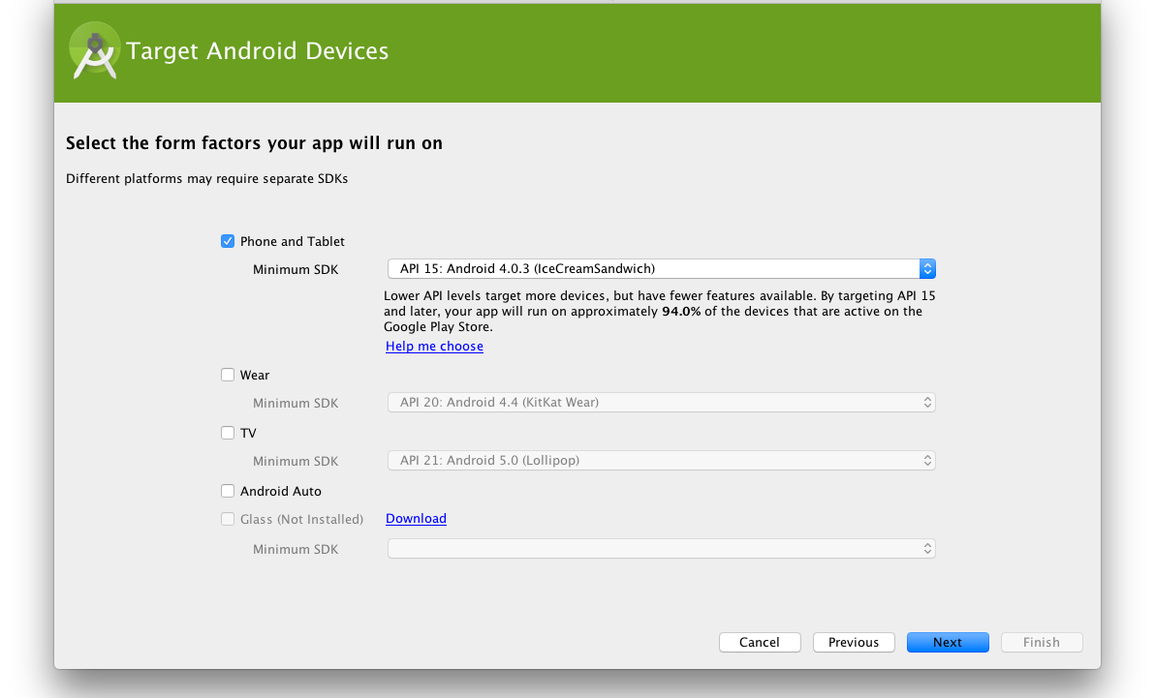

Slide 12
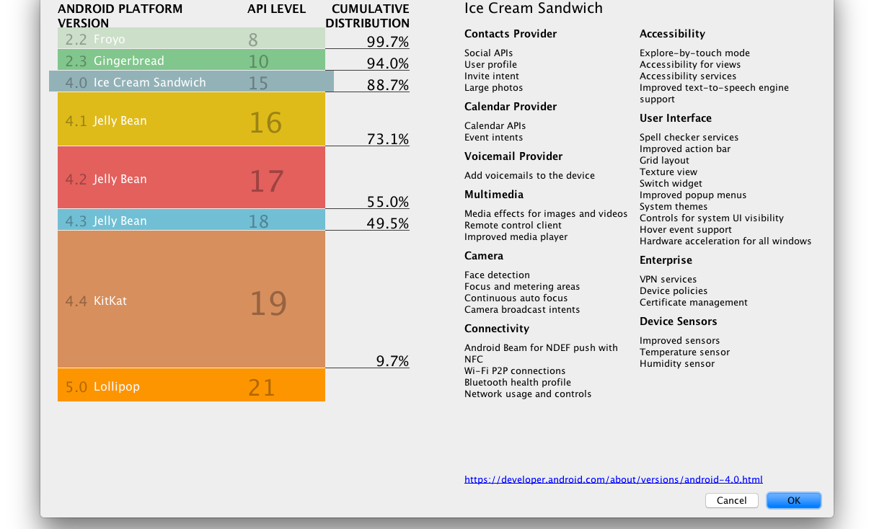

Slide 13
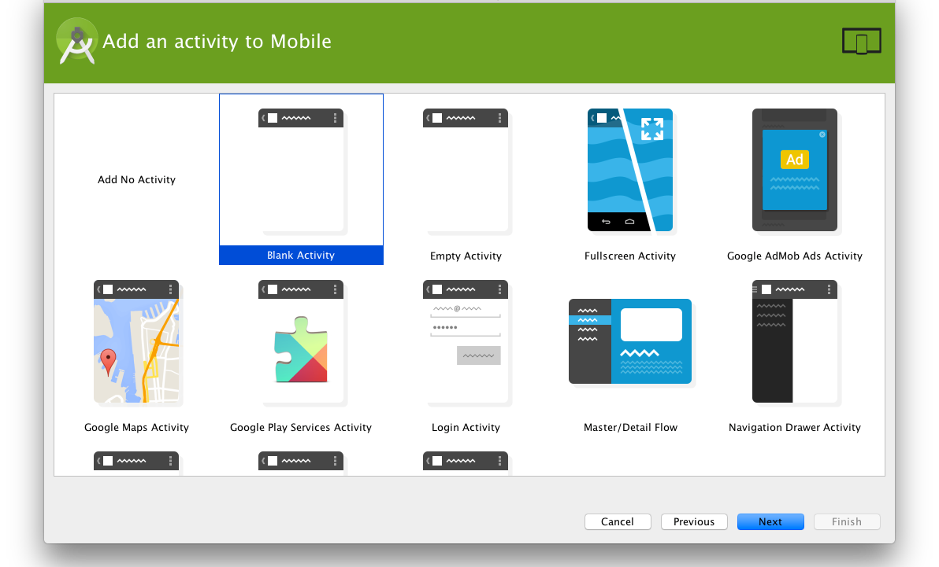

Slide 14
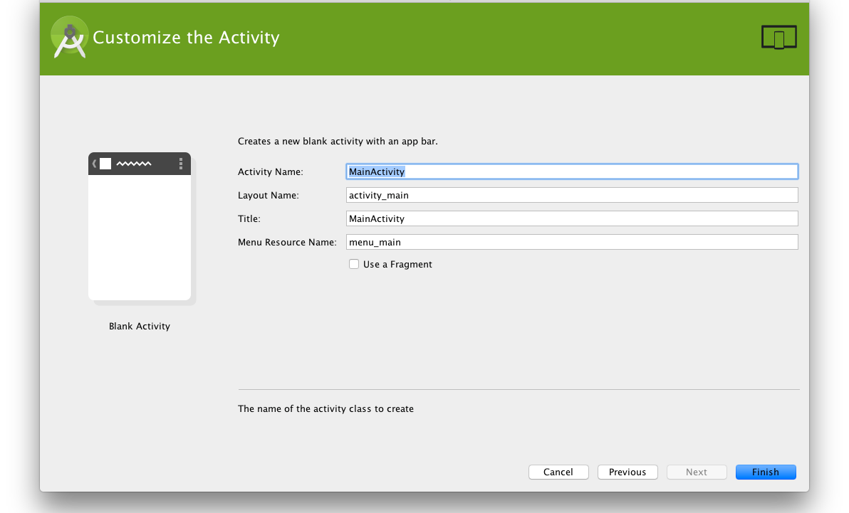

Slide 16
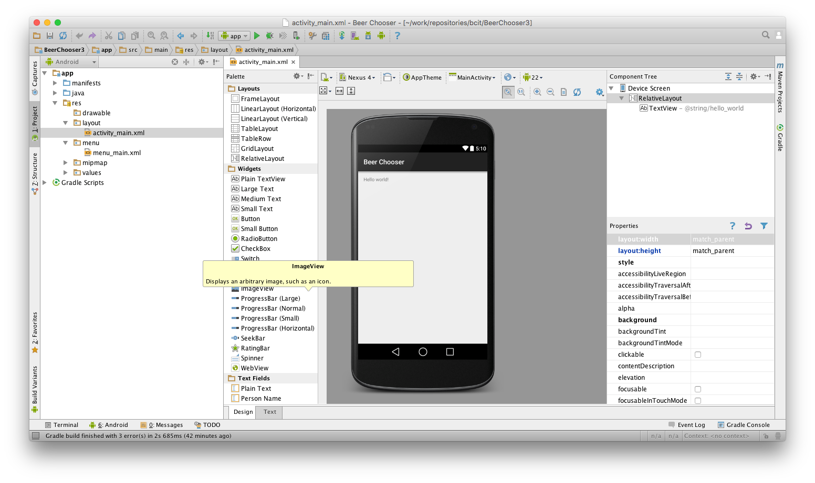

Slide 17
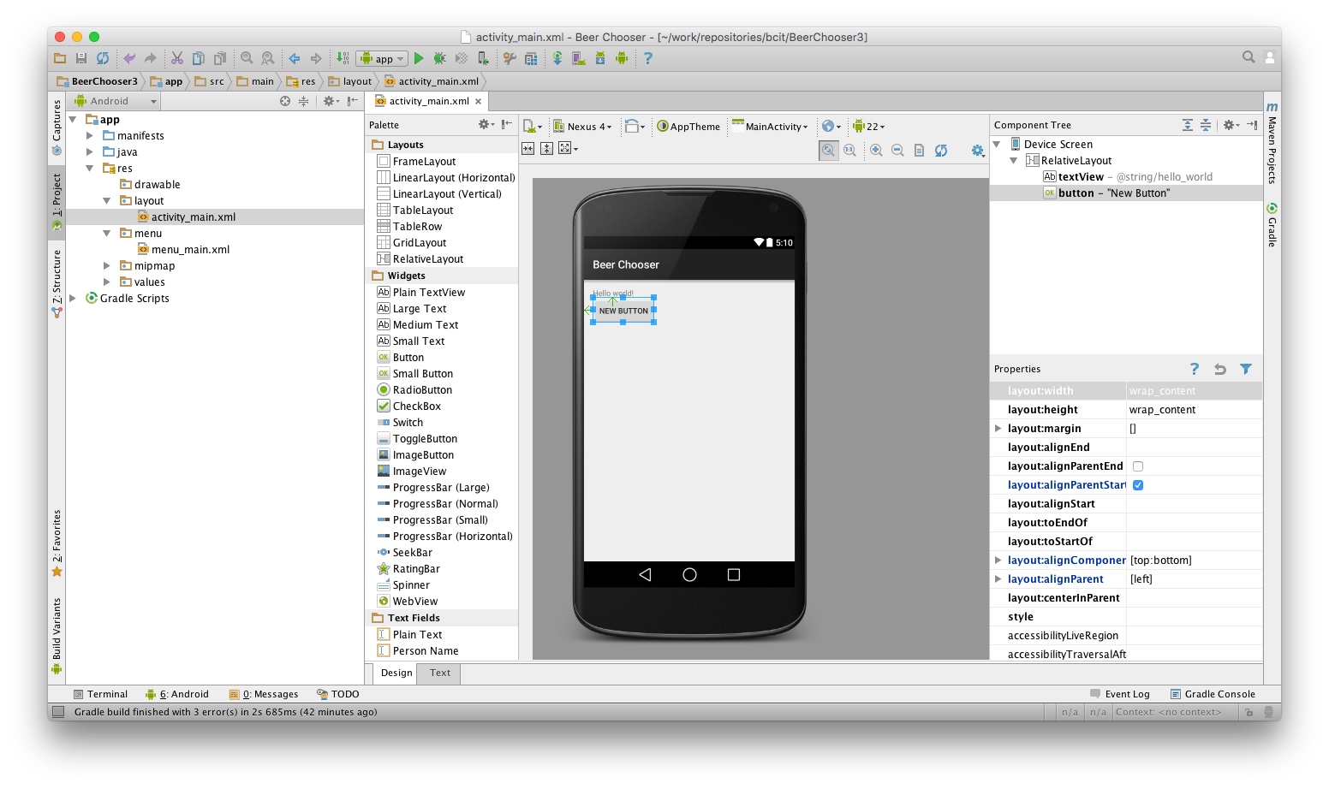

Slide 18
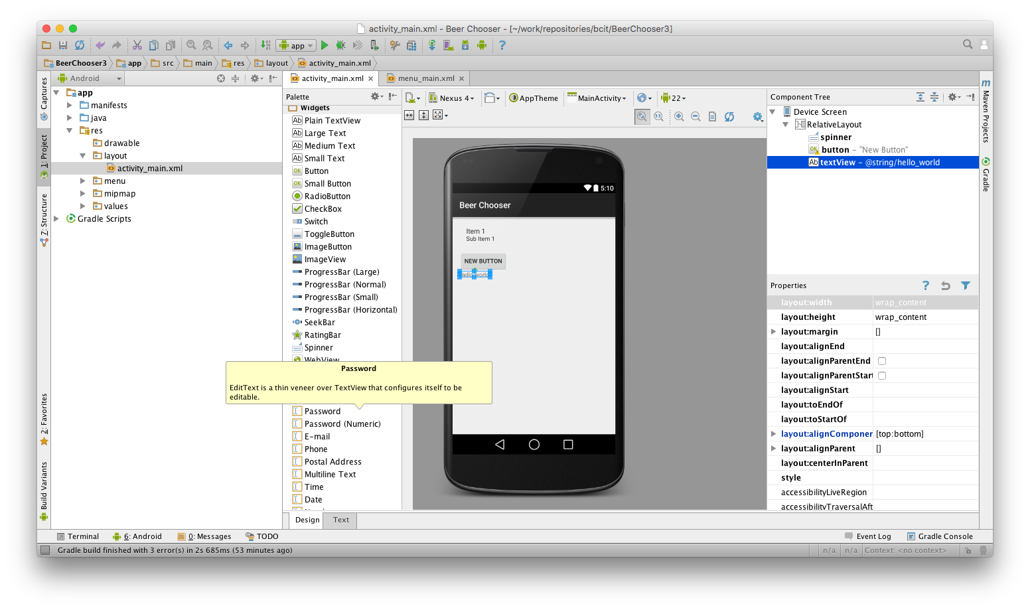

Slide 19
<Spinner android:layout_width="wrap_content" android:layout_height="wrap_content" android:id="@+id/spinner" android:layout_alignParentLeft="true" android:layout_alignParentStart="true" /> <Button android:layout_width="wrap_content" android:layout_height="wrap_content" android:text="New Button" android:id="@+id/button" android:layout_below="@+id/spinner" android:layout_alignParentLeft="true" android:layout_alignParentStart="true" /> <TextView
android:text="@string/hello_world"
android:layout_width="wrap_content" android:layout_height="wrap_content" android:id="@+id/textView" android:layout_below="@+id/button" />

Slide 20
Controls
Button and TextView are both subclasses of View.
A View occupies a rectangular area on the screen and is responsible for drawing and event handling.

Slide 21
<Spinner android:layout_width="wrap_content" android:layout_height="wrap_content" android:id="@+id/colour" android:layout_alignParentLeft="true" android:layout_alignParentStart="true" /> <Button android:layout_width="wrap_content" android:layout_height="wrap_content" android:text="@string/find_beer" android:id="@+id/find_beer" android:layout_below="@+id/colour" android:layout_alignParentLeft="true" android:layout_alignParentStart="true" /> <TextView android:text="@string/brands" android:layout_width="wrap_content" android:layout_height="wrap_content" android:id="@+id/textView" android:layout_below="@+id/find_beer" />

Slide 22
<resources> <string name="app_name">Beer Chooser</string> <string name="hello_world">Hello world!</string> <string name="find_beer">Find Beer</string> <string name="brands">Brands</string> <string name="action_settings">Settings</string> </resources>

Slide 23
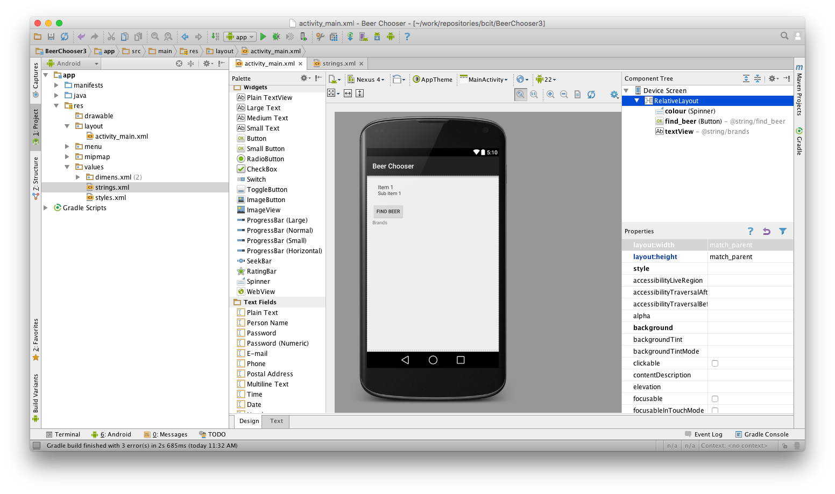

Slide 24
<resources> <string name="app_name">Beer Chooser</string> <string name="hello_world">Hello world!</string> <string name="find_beer">Find Beer</string> <string name="brands">Brands</string> <string-array name="beer_colours"> <item>light</item> <item>amber</item> <item>brown</item> <item>dark</item> </string-array> </resources>

Slide 25
<Spinner android:layout_width="wrap_content" android:layout_height="wrap_content" android:entries="@array/beer_colours" android:id="@+id/colour" android:layout_alignParentLeft="true" android:layout_alignParentStart="true" android:layout_alignParentTop="true" />

Slide 26
<Button android:layout_width="wrap_content" android:layout_height="wrap_content" android:text="@string/find_beer" android:id="@+id/find_beer" android:layout_below="@id/colour" android:layout_alignParentLeft="true" android:layout_alignParentStart="true" android:onClick="onClickFindBeer"/>

Slide 27
public class MainActivity extends AppCompatActivity { @Override protected void onCreate(Bundle savedInstanceState) { super.onCreate(savedInstanceState); setContentView(R.layout.activity_main); } public void onClickFindBeer(final View view) { Log.d("MainActivity", "Button Pressed!"); } }

Slide 28
public void onClickFindBeer(final View view) { final TextView brands; final Spinner colour; final String beerType; brands = (TextView)findViewById(R.id.brands); colour = (Spinner)findViewById(R.id.colour); beerType = String.valueOf(colour.getSelectedItem()); brands.setText(beerType); }

Slide 29
Question
An Android app can have how many Activities?

