Slide 1
Maps

Slide 2
Resources
https://developers.google.com/maps/documentation/android-api/start#step_2_install_the_google_play_services_sdk
http://blog.teamtreehouse.com/beginners-guide-location-android

Slide 3
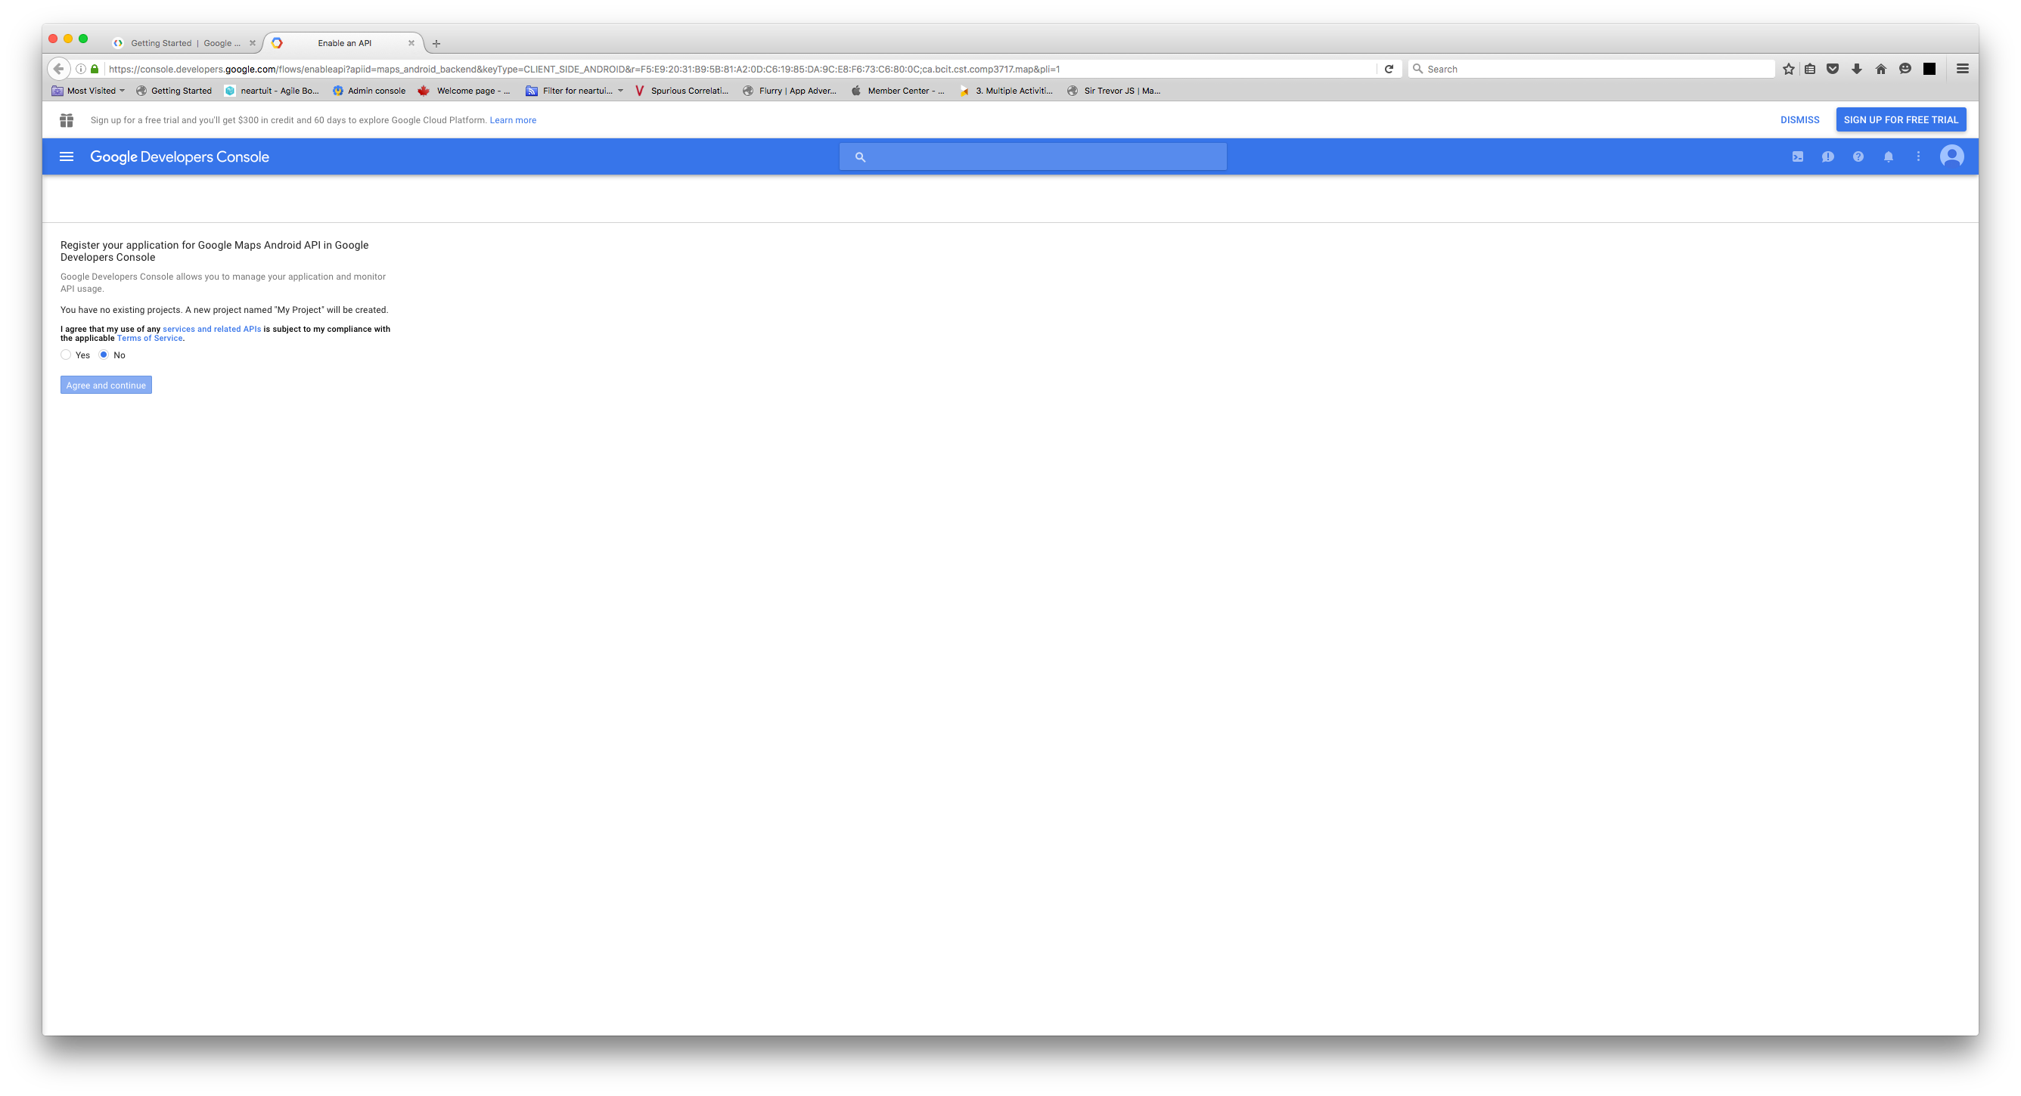

Slide 4
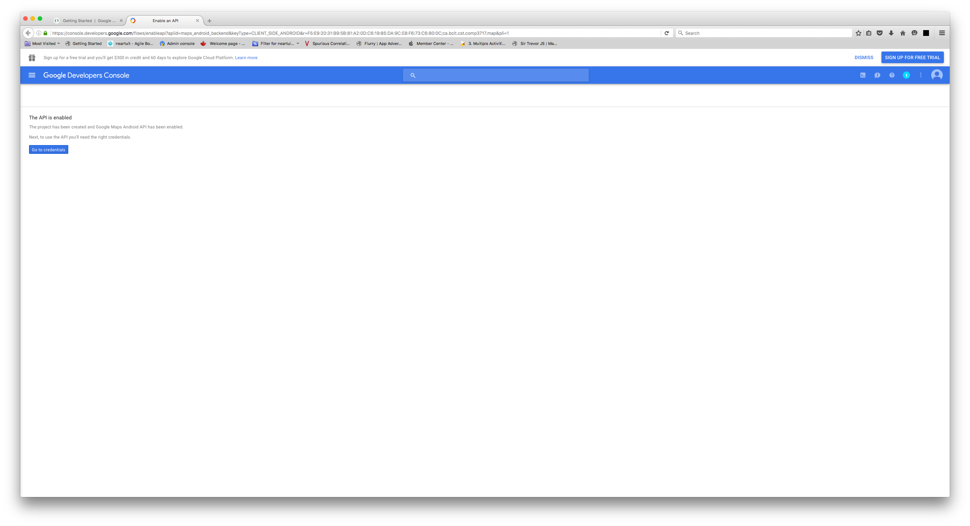

Slide 5
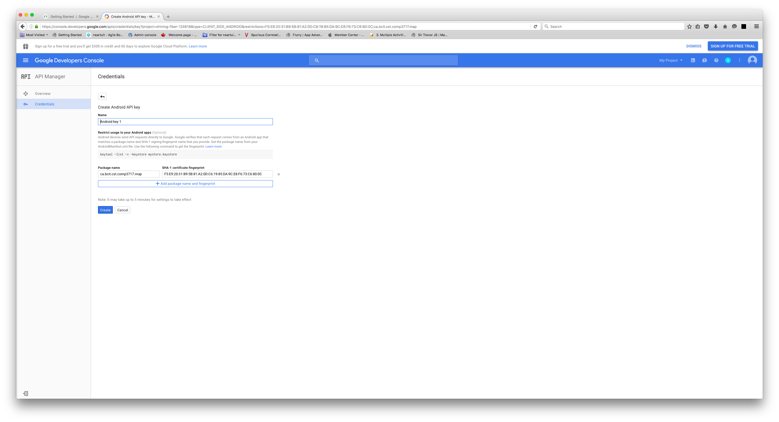

Slide 6
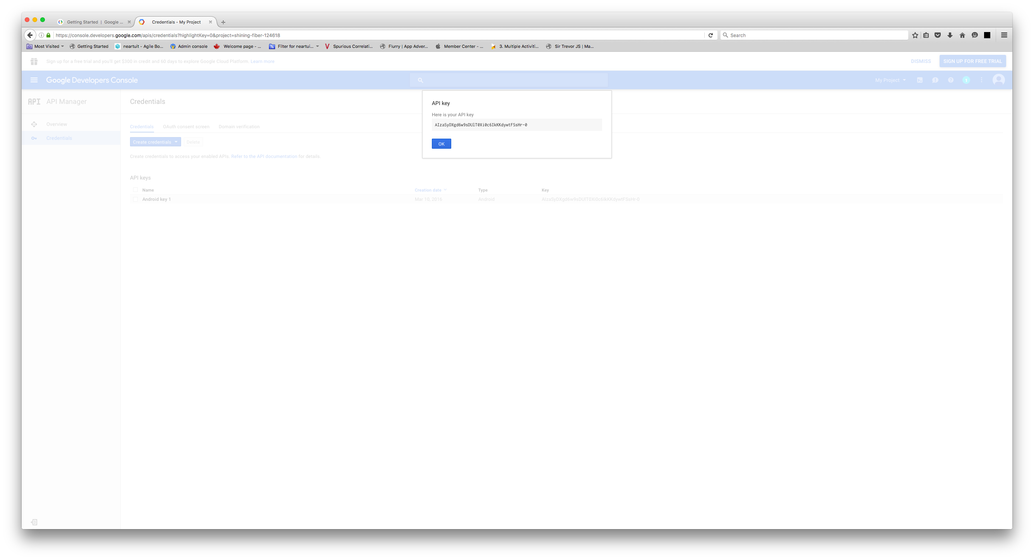

Slide 7
