Slide 1
Problem Statement
Let x1 = a matrix of m rows and n columns
Let x2 = another matrix of m rows and n columns
Let y be a function of x, such that y = f( x1, x2 ) = x1² + x2²
Can you, reproduce y WITHOUT knowing the function ?

Slide 2
Proposed Solution
Machine Learning can be used, to APPROXIMATE x1 & x2, to y.
Not exact solution, but reasonably accurate ESTIMATION.

Slide 3
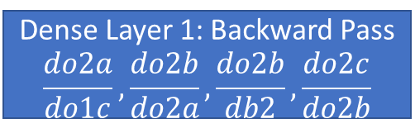
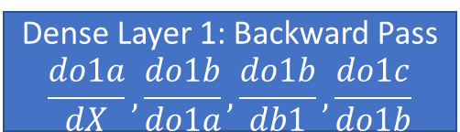
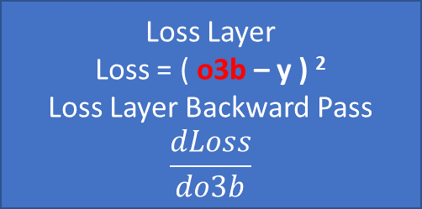
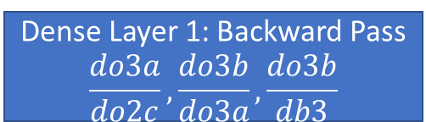
Rough Workflow 1: Forward Pass
Shuffle rows randomly
X_{raw}
Normalization
X = ( X_{raw} – average (X_{raw}) ) / standard deviation(X_{raw})
Y = (
X
Dense Layer 3: Forward Pass
o3a = o2c ● w3
o3b = o3a + b3
Dense Layer 2: Forward Pass
o2a = o1c ● w2
o2b = o2a + b2
o2c = tanh( o2b )
Dense Layer 1: Forward Pass
o1a = X ● w1
o1b = o1a + b1
o1c = tanh( o1b )
o2c
o1c
Dense Layer 1: Backward Pass
$$\frac{do3a}{do2c},\frac{do3b}{do3a},\frac{do3b}{db3}$$
Dense Layer 1: Backward Pass
$$\frac{do2a}{do1c},\frac{do2b}{do2a},\frac{do2b}{db2},\frac{do2c}{do2b}$$
Dense Layer 1: Backward Pass
$$\frac{do1a}{dX},\frac{do1b}{do1a},\frac{do1b}{db1},\frac{do1c}{do1b}$$
Loss Layer
Loss = ( o3b – y ) ²
Loss Layer Backward Pass
$$\frac{dLoss}{do3b}$$
Our goal, minimize Loss with respect to ALL weights (w) and biases (b)
Loss is = Output (o3b) – Truth (y)
Minimum loss, is when dLoss / dw = dLoss / db = 0
o3b

Slide 4



















Rough Workflow 2: Calculus Chain Rule
$$\frac{dLoss}{do3b}×\frac{do3b}{do3a}×\frac{do3a}{do2c}×\frac{do2c}{do2b}×\frac{do2b}{do2a}×\frac{do2a}{do1c}×\frac{do1c}{do1b}×\frac{do1b}{do1a}×\frac{do1a}{dx}$$
$$×$$
$$×$$
$$×$$
$$×$$
$$×$$
$$×$$
$$\frac{do3b}{db3}$$
$$\frac{do3a}{dw3}$$
$$\frac{do2b}{db2}$$
$$\frac{do2a}{dw2}$$
$$\frac{do1b}{db1}$$
$$\frac{do1a}{dw1}$$
=
=
=
=
=
=
$$Δb3$$
$$Δw3$$
$$Δb2$$
$$Δw2$$
$$Δb1$$
$$Δw1$$

Slide 5
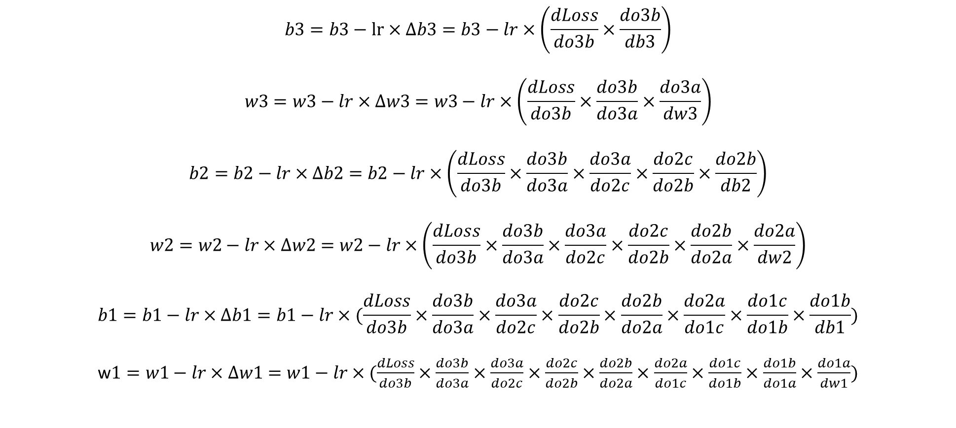
Rough Workflow 3: Gradient Descent (Update Weights)
$$b3=b3−lr×Δb3=b3−lr×\left(\frac{dLoss}{do3b}×\frac{do3b}{db3}\right)$$
$$w3=w3−lr×Δw3=w3−lr×\left(\frac{dLoss}{do3b}×\frac{do3b}{do3a}×\frac{do3a}{dw3}\right)$$
$$b2=b2−lr×Δb2=b2−lr×\left(\frac{dLoss}{do3b}×\frac{do3b}{do3a}×\frac{do3a}{do2c}×\frac{do2c}{do2b}×\frac{do2b}{db2}\right)$$
$$w2=w2−lr×Δw2=w2−lr×\left(\frac{dLoss}{do3b}×\frac{do3b}{do3a}×\frac{do3a}{do2c}×\frac{do2c}{do2b}×\frac{do2b}{do2a}×\frac{do2a}{dw2}\right)$$
$$b1=b1−lr×Δb1=b1−lr×(\frac{dLoss}{do3b}×\frac{do3b}{do3a}×\frac{do3a}{do2c}×\frac{do2c}{do2b}×\frac{do2b}{do2a}×\frac{do2a}{do1c}×\frac{do1c}{do1b}×\frac{do1b}{db1})$$
w$1=w1−lr×Δw1=w1−lr×(\frac{dLoss}{do3b}×\frac{do3b}{do3a}×\frac{do3a}{do2c}×\frac{do2c}{do2b}×\frac{do2b}{do2a}×\frac{do2a}{do1c}×\frac{do1c}{do1b}×\frac{do1b}{do1a}×\frac{do1a}{dw1})$

Slide 6
Rough Workflow 3: What is Gradient Descent ?
Y
Learning Rate, lr
Negative Gradient
Positive Gradient
X1
X1’
Gradient = 0
Minimum Y
(Our goal) is Y = 0
Y = Loss = 0
x
Initialize x = X1
x = X1 – lr * gradient (-ve)
x becomes more positive (goes right)
y tends towards 0, as x is more positive
Initialize x = X1’
x = X1 – lr * gradient (+ve)
x becomes more negative (goes left)
y tends towards 0, as x is more negative

Slide 7
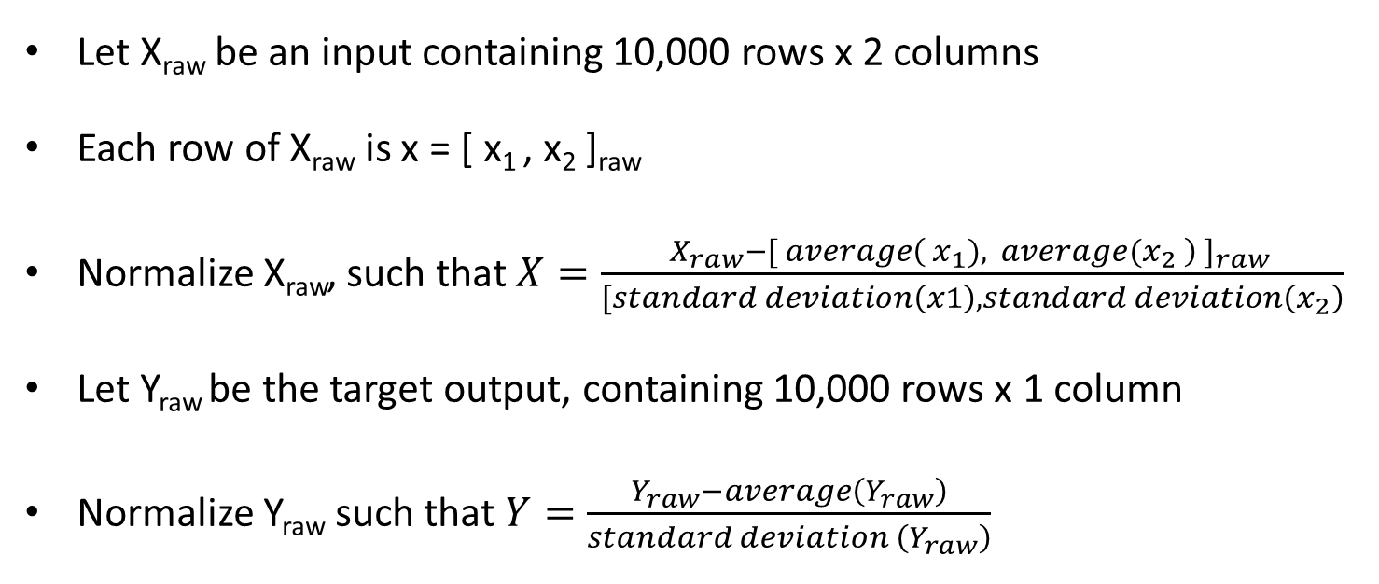
Step 1: Normalization
Let X_{raw} be an input containing 10,000 rows x 2 columns
Each row of X_{raw} is x = [ x₁ , x₂ ]_{raw}
Normalize X_{raw}, such that $X=\frac{X_{raw}−[ average{\left( x_{1}), average(x_{2} \right) ]}_{raw }}{[standard deviation\left(x1\right),standard deviation\left(x_{2}\right)}$
Let Y_{raw} be the target output, containing 10,000 rows x 1 column
Normalize Y_{raw} such that $Y=\frac{Y_{raw}−average\left(Y_{raw}\right)}{standard deviation \left(Y_{raw}\right)}$

Slide 8
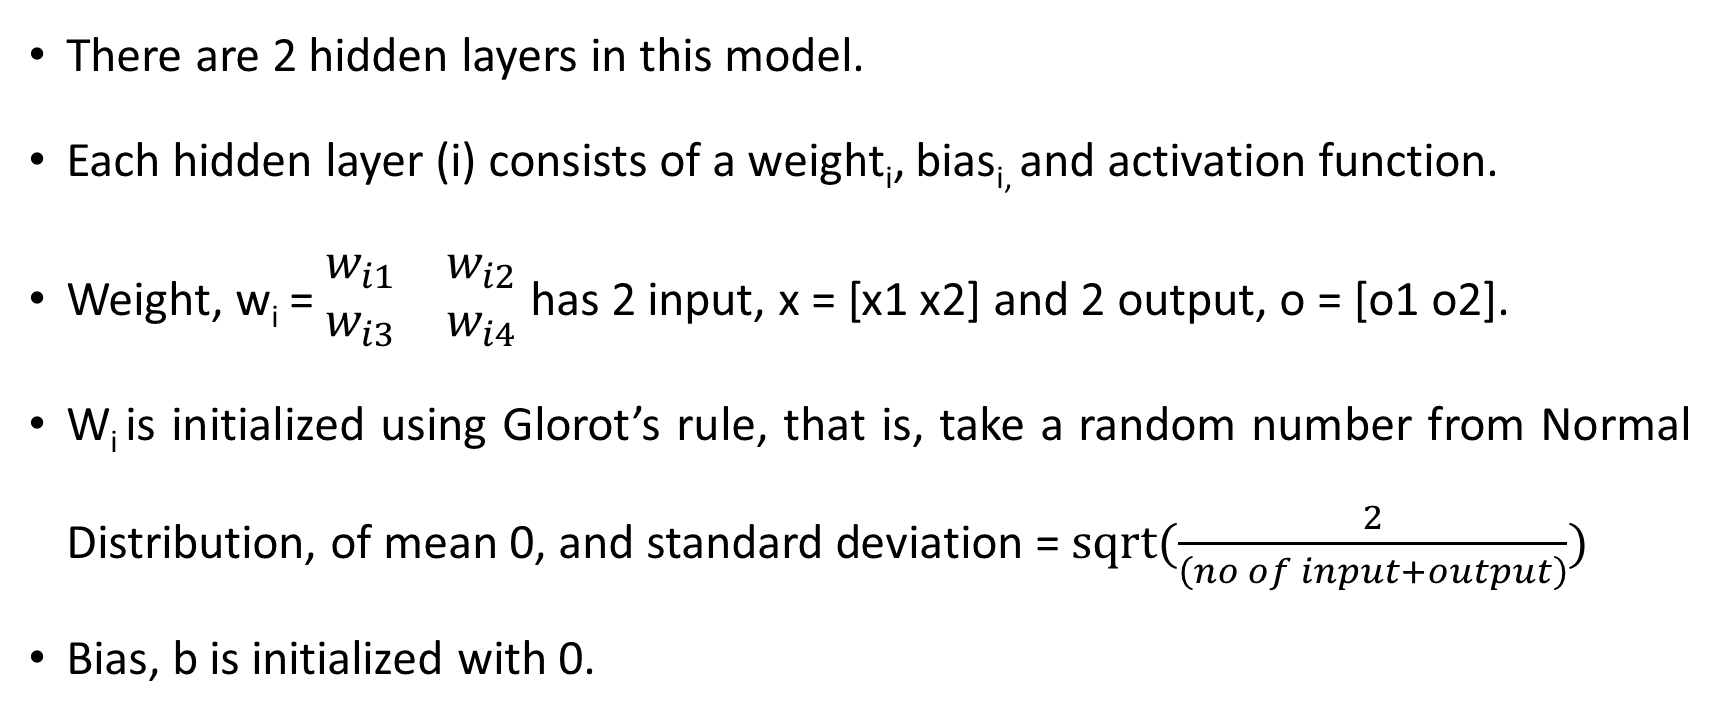
Step 2: Initialize Weights and Bias
There are 2 hidden layers in this model.
Each hidden layer (i) consists of a weight_{i}, bias_{i,} and activation function.
Weight, w_{i} = $\begin{matrix}w_{i1} & w_{i2} \\ w_{i3} & w_{i4}\end{matrix}$ has 2 input, x = [x1 x2] and 2 output, o = [o1 o2].
W_{i} is initialized using Glorot’s rule, that is, take a random number from Normal Distribution, of mean 0, and standard deviation = $sqrt(\frac{2}{\left(no of input+output\right)})$
Bias, b is initialized with 0.

Slide 9
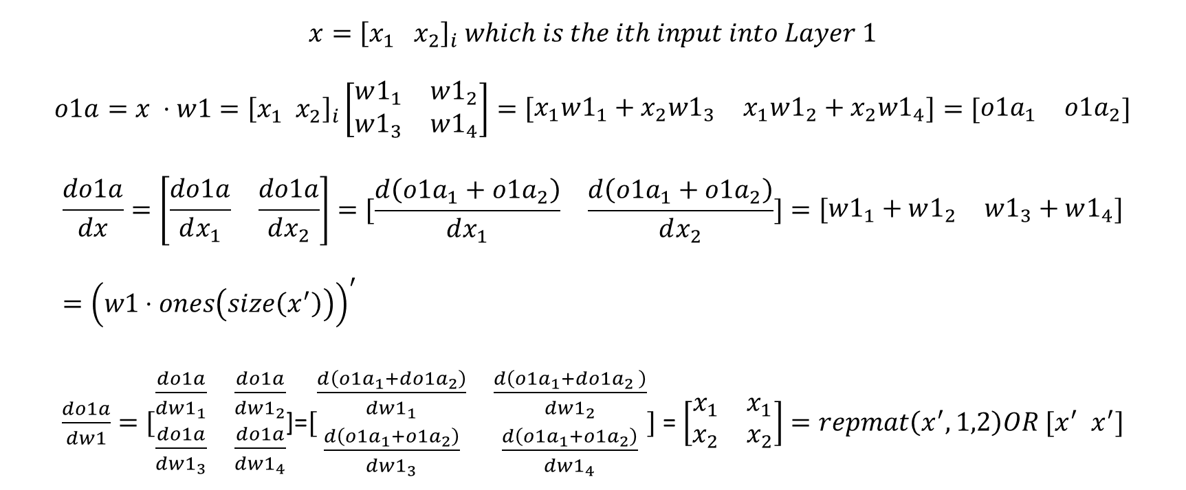
Step 4: Layer 1a – Multiply Weight
$$x={\left[x_{1}{ x}_{2}\right]}_{i} which is the ith input into Layer 1$$
$$o1a=x ⋅w1={\left[x_{1} x_{2}\right]}_{i}\left[\begin{matrix}w1_{1} & w1_{2} \\ w1_{3} & w1_{4}\end{matrix}\right]=\left[\begin{matrix}x_{1}w1_{1}+x_{2}w1_{3} & x_{1}w1_{2}+x_{2}w1_{4}\end{matrix}\right]=[\begin{matrix}o1a_{1} & o1a_{2}\end{matrix}]$$
$$\frac{do1a}{dx}=\left[\begin{matrix}\frac{do1a}{dx_{1}} & \frac{do1a}{dx_{2}}\end{matrix}\right]=[\begin{matrix}\frac{d\left(o1a_{1}+o1a_{2}\right)}{dx_{1}} & \frac{d\left(o1a_{1}+o1a_{2}\right)}{dx_{2}}\end{matrix}]=\left[\begin{matrix}w1_{1}+w1_{2} & w1_{3}+w1_{4}\end{matrix}\right]={\left(w1⋅ones\left(size\left(x^{′}\right)\right)\right)}^{′}$$
$\frac{do1a}{dw1}=[\begin{matrix}\frac{do1a}{dw1_{1}} & \frac{do1a}{dw1_{2}} \\ \frac{do1a}{dw1_{3}} & \frac{do1a}{dw1_{4}}\end{matrix}$]=$[\begin{matrix}\frac{d\left(o1a_{1}+do1a_{2}\right)}{dw1_{1}} & \frac{d\left(o1a_{1}+do1a_{2} \right)}{dw1_{2}} \\ \frac{d\left(o1a_{1}+o1a_{2}\right)}{dw1_{3}} & \frac{d\left(o1a_{1}+o1a_{2}\right)}{dw1_{4}}\end{matrix}]$ = $\left[\begin{matrix}x_{1} & x_{1} \\ x_{2} & x_{2}\end{matrix}\right]=repmat\left(x^{′},1,2\right)OR [x^{′} x^{′}]$

Slide 10
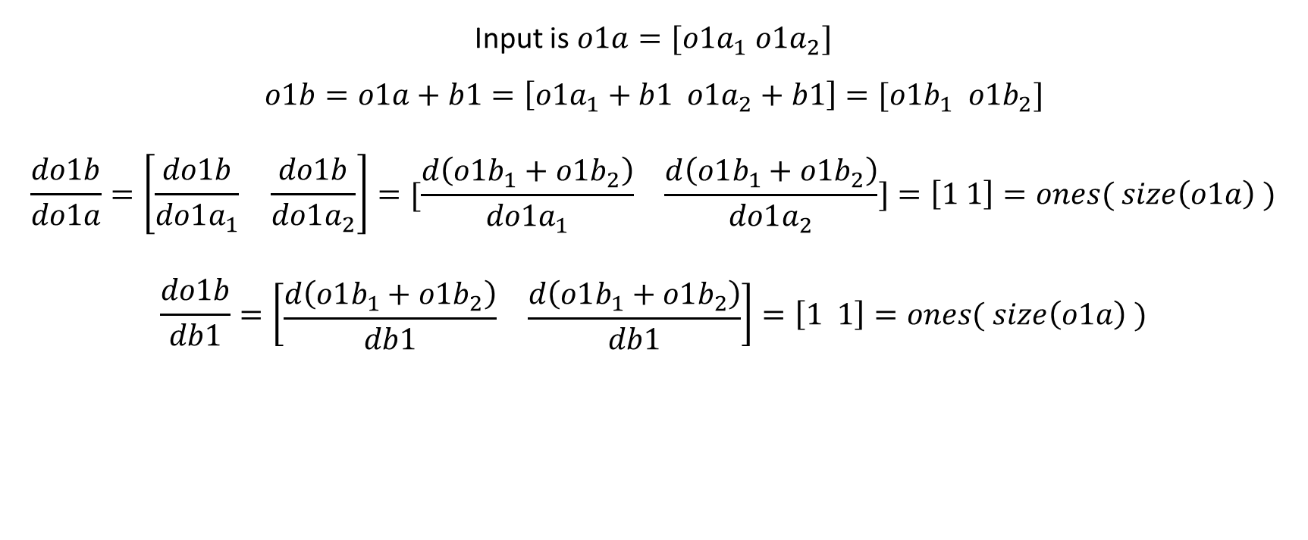
Step 5: Layer 1b – Add Bias
Input is $o1a=[o1a_{1} o1a_{2}]$
$$o1b=o1a+b1=\left[o1a_{1}+b1 o1a_{2}+b1\right]=[o1b_{1} o1b_{2}]$$
$$\frac{do1b}{do1a}=\left[\begin{matrix}\frac{do1b}{do1a_{1}} & \frac{do1b}{do1a_{2}}\end{matrix}\right]=\begin{matrix}[\frac{d\left(o1b_{1}+o1b_{2}\right)}{do1a_{1}} & \frac{d\left(o1b_{1}+o1b_{2}\right)}{do1a_{2}}\end{matrix}]=\left[1 1\right]=ones( size\left(o1a\right) )$$
$$\frac{do1b}{db1}=\left[\begin{matrix}\frac{d\left(o1b_{1}+o1b_{2}\right)}{db1} & \frac{d\left(o1b_{1}+o1b_{2}\right)}{db1}\end{matrix}\right]=\left[1 1\right]=ones( size\left(o1a\right) )$$

Slide 11

Step 6: Layer 1c – Tanh Activation
Adds non-linear prediction.
Input is o1b = [ o1b₁ o1b₂ ]
o1c = tanh ( o1b )
$\frac{do1c}{do1b }=1−\tanh\left(o1b\right)2$

Slide 12
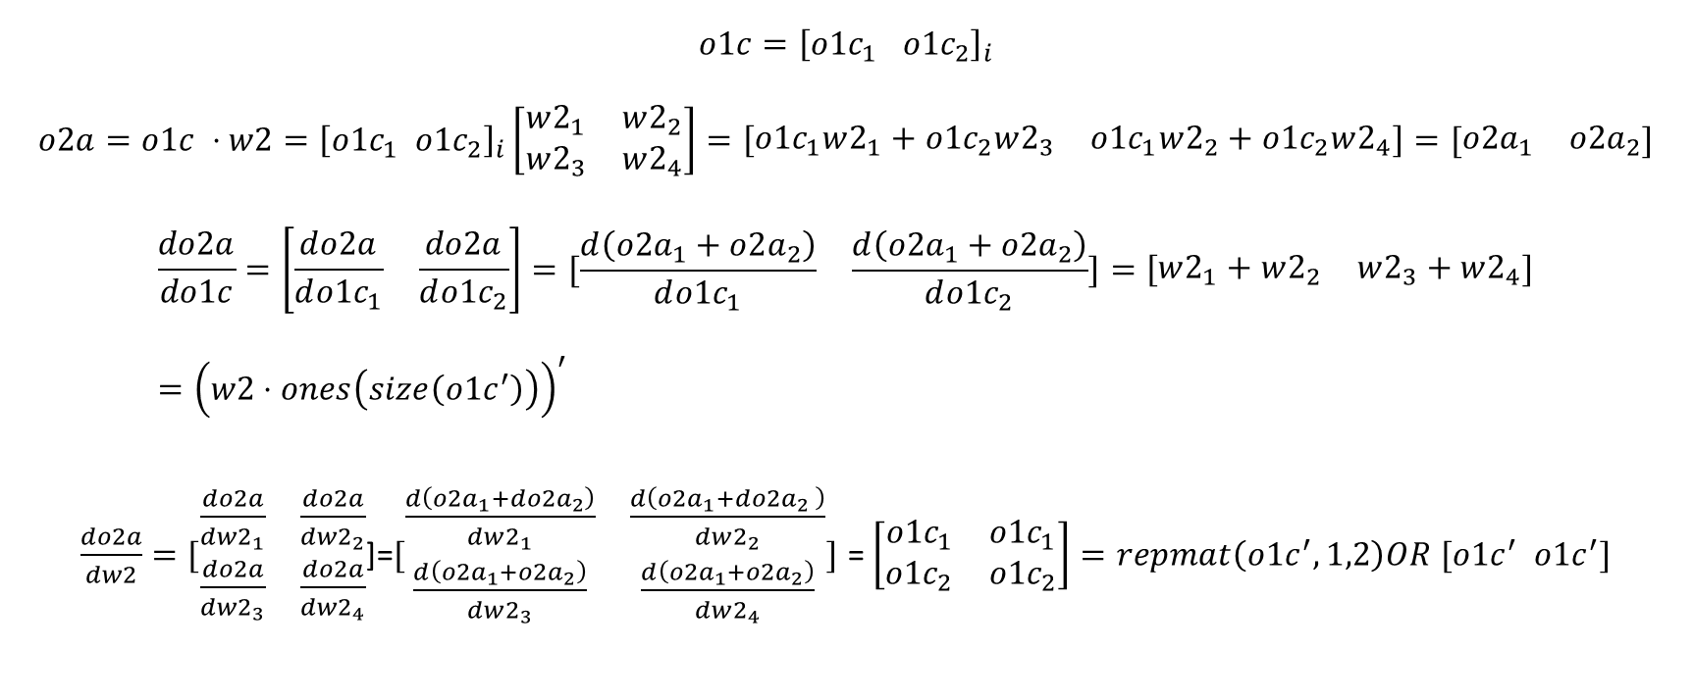
Step 7: Layer 2a – Multiply Weight
$$o1c={\left[{o1c}_{1}{ o1c}_{2}\right]}_{i}$$
$$o2a=o1c ⋅w2={\left[{o1c}_{1} {o1c}_{2}\right]}_{i}\left[\begin{matrix}w2_{1} & w2_{2} \\ w2_{3} & w2_{4}\end{matrix}\right]=\left[\begin{matrix}{o1c}_{1}w2_{1}+{o1c}_{2}w2_{3} & {o1c}_{1}w2_{2}+{o1c}_{2}w2_{4}\end{matrix}\right]=[\begin{matrix}o2a_{1} & o2a_{2}\end{matrix}]$$
$$\frac{do2a}{do1c}=\left[\begin{matrix}\frac{do2a}{d{o1c}_{1}} & \frac{do2a}{d{o1c}_{2}}\end{matrix}\right]=[\begin{matrix}\frac{d\left(o2a_{1}+o2a_{2}\right)}{d{o1c}_{1}} & \frac{d\left(o2a_{1}+o2a_{2}\right)}{d{o1c}_{2}}\end{matrix}]=\left[\begin{matrix}w2_{1}+w2_{2} & w2_{3}+w2_{4}\end{matrix}\right]={\left(w2⋅ones\left(size\left({o1c}^{′}\right)\right)\right)}^{′}$$
$\frac{do2a}{dw2}=[\begin{matrix}\frac{do2a}{dw2_{1}} & \frac{do2a}{dw2_{2}} \\ \frac{do2a}{dw2_{3}} & \frac{do2a}{dw2_{4}}\end{matrix}$]=$[\begin{matrix}\frac{d\left(o2a_{1}+do2a_{2}\right)}{dw2_{1}} & \frac{d\left(o2a_{1}+do2a_{2} \right)}{dw2_{2}} \\ \frac{d\left(o2a_{1}+o2a_{2}\right)}{dw2_{3}} & \frac{d\left(o2a_{1}+o2a_{2}\right)}{dw2_{4}}\end{matrix}]$ = $\left[\begin{matrix}{o1c}_{1} & {o1c}_{1} \\ {o1c}_{2} & {o1c}_{2}\end{matrix}\right]=repmat\left({o1c}^{′},1,2\right)OR [{o1c}^{′} {o1c}^{′}]$

Slide 13
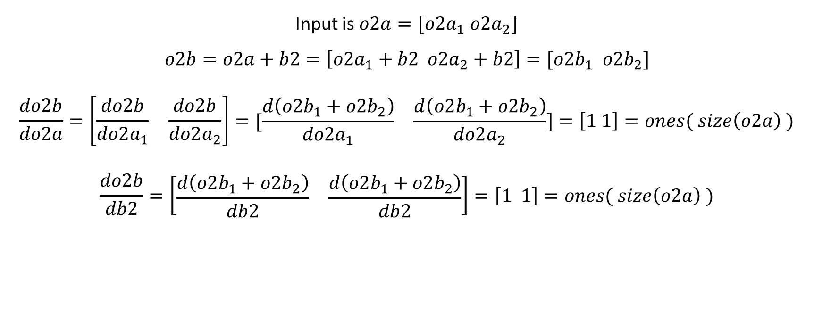
Step 8: Layer 2b – Add Bias
Input is $o2a=[o2a_{1} o2a_{2}]$
$$o2b=o2a+b2=\left[o2a_{1}+b2 o2a_{2}+b2\right]=[o2b_{1} o2b_{2}]$$
$$\frac{do2b}{do2a}=\left[\begin{matrix}\frac{do2b}{do2a_{1}} & \frac{do2b}{do2a_{2}}\end{matrix}\right]=\begin{matrix}[\frac{d\left(o2b_{1}+o2b_{2}\right)}{do2a_{1}} & \frac{d\left(o2b_{1}+o2b_{2}\right)}{do2a_{2}}\end{matrix}]=\left[1 1\right]=ones( size\left(o2a\right) )$$
$$\frac{do2b}{db2}=\left[\begin{matrix}\frac{d\left(o2b_{1}+o2b_{2}\right)}{db2} & \frac{d\left(o2b_{1}+o2b_{2}\right)}{db2}\end{matrix}\right]=\left[1 1\right]=ones( size\left(o2a\right) )$$

Slide 14

Step 9: Layer 2c – Tanh Activation
Adds non-linear prediction.
Input is o2b = [ o2b₁ o2b₂ ]
o2c = tanh ( o2b )
$\frac{do2c}{do2b }=1−\tanh\left(o2b\right)2$

Slide 15

Step 10: Layer 3a – Multiply Weight
$$o2c={\left[{o2c}_{1}{ o2c}_{2}\right]}_{i}$$
$$o3a=o2c ⋅w3={\left[{o2c}_{1} {o2c}_{2}\right]}_{i}\left[\begin{matrix}w3_{1} \\ w3_{2}\end{matrix}\right]=\left[o2c_{1}w3_{1}+o2c_{2}w3_{2}\right]$$
$$\frac{do3a}{do2c}=\left[\begin{matrix}\frac{do3a}{d{o2c}_{1}} & \frac{do3a}{d{o2c}_{2}}\end{matrix}\right]=\left[\begin{matrix}w3_{1} & w3_{2}\end{matrix}\right]={w3}^{′}$$
$\frac{do3a}{dw3}=[\begin{matrix}\frac{do3a}{dw3_{1}} \\ \frac{do3a}{dw3_{2}}\end{matrix}$]= $\left[\begin{matrix}o2c_{1} \\ o2c_{2}\end{matrix}\right]=o2c′$

Slide 16

Step 11: Layer 3b – Add Bias
Input is $o3a$
$$o3b=o3a+b3$$
$$\frac{do3b}{do3a}=1$$
$$\frac{do3b}{db3}=1$$

Slide 17

Step 12 – Loss Layer
Loss = ( o3b – y_{true} )²
$$\frac{dLoss}{do3b}=2×\left(o3b−y_{true}\right)$$

Slide 18

Step 13: Update Weights: Batch Size 10
Update Weights AFTER 10 data points (averaged $ΔWeight or ΔBias$)
Ensures numerical stability
Weight or Bias = Weight or Bias – 0.0001 x $average10(ΔWeight or ΔBias)$

Slide 19

Step 14: Momentum
Model reaches Minimum Loss earlier.
$Weight or Bias={\left(ΔWeight or ΔBias\right)}_{i}×μ+{\left(ΔWeight or ΔBias\right)}_{i−1}×μ^{2}+…{\left(ΔWeight or ΔBias\right)}_{i−4}×μ^{4}$

Slide 20
Glossary
Epoch means 1 pass through the entire dataset.
Model Loss is calculated Each Epoch.
Weight / Bias at minimum Model Loss Epoch is taken.
Validation is done, using separate dataset, NOT used in calculating model.

Slide 21
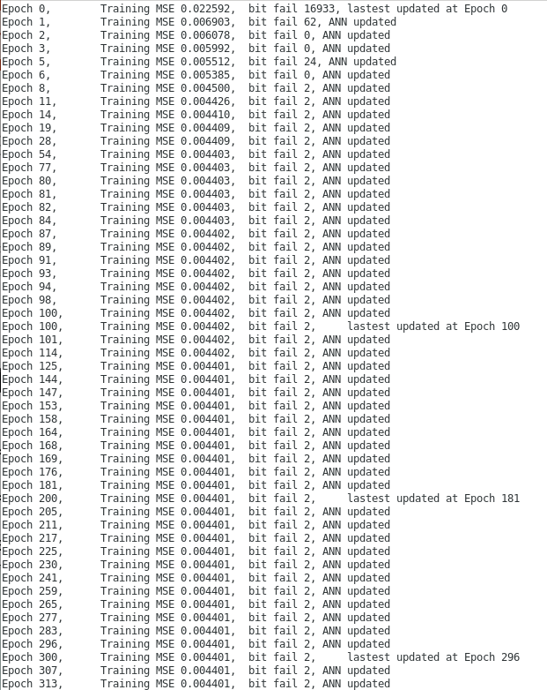
Example of FANN to train Satellite Derived Reflectivity

