Slide 1



Synthesizing Geometry Constructions
Sumit Gulwani
MSR, Redmond
Vijay Korthikanti
UIUC
Ashish Tiwari
SRI

Slide 2
Ruler/Compass based Geometry Constructions
Given a triangle XYZ, construct circle C such that C passes through X, Y, and Z.
C
L1
L2
N
Z
X
Y

Slide 3
Why Geometry Constructions?
Good platform for teaching logical reasoning.
Visual Nature:
Makes it more accessible.
Exercises both logical/visual abilities of left/right brain.
Fun Aspect:
Ruler/compass restrictions make it fun, as in sports.
Application in dynamic geometry or animations.
“Constructive” geometry macros (unlike numerical methods) enable fast re-computation of derived objects from free (moving) objects.

Slide 4
Outline
Problem Formulation (as Program Synthesis)
Synthesis Algorithm (based on inter-disciplinary ideas)
Idea 1: from Theory
Idea 2: from PL
Idea 3: from AI
Experiments
Future Vision

Slide 5
Programming Language for Geometry Constructions
Types: Point, Line, Circle
Methods:
Ruler(Point, Point) -> Line
Compass(Point, Point) -> Circle
Intersect(Circle, Circle) -> Pair of Points
Intersect(Line, Circle) -> Pair of Points
Intersect(Line, Line) -> Point
Geometry Program: A straight-line composition of the above methods.

Slide 6
Example Problem: Program
Given a triangle XYZ, construct circle C such that C passes through X, Y, and Z.
C1 = Compass(X,Y);
C2 = Compass(Y,X);
<P1,P2> = Intersect(C1,C2);
L1 = Ruler(P1,P2);
D1 = Compass(Z,X);
D2 = Compass(X,Z);
<R1,R2> = Intersect(D1,D2);
L2 = Ruler(R1,R2);
N = Intersect(L1,L2);
C = Compass(N,X);
C
L1
L2
N
C1
C2
P1
D1
Z
R1
X
Y
R2
D2
P2

Slide 7
Specification Language for Geometry Programs
Conjunction of predicates over arithmetic expressions
Predicates p := e₁ = e₂
| e₁ ≠ e₂
| e₁ · e₂
Arithmetic Expressions e := Distance(Point, Point)
| Slope(Point, Point)
| e₁ § e₂
| c

Slide 8
Example Problem: Precondition/Postcondition
Given a triangle XYZ, construct circle C such that C passes through X, Y, and Z.
Precondition:
Slope(X,Y) ≠ Slope(X,Z) Æ Slope(X,Y) ≠ Slope(Z,X)
Postcondition:
LiesOn(X,C) Æ LiesOn(Y,C) Æ LiesOn(Z,C)
Where LiesOn(X,C) ´
Distance(X,Center(C)) = Radius(C)

Slide 9
Verification/Synthesis Problem for Geometry Programs
Let P be a geometry program that computes outputs O from inputs I.
Verification Problem: Check the validity of the following Hoare triple.
Assume Pre(I);
P
Assert Post(I,O);
Synthesis Problem: Given Pre(I), Post(I,O), find P such that the above Hoare triple is valid.

Slide 10
Outline
Problem Formulation (as Program Synthesis)
Synthesis Algorithm (based on inter-disciplinary ideas)
Idea 1: from Theory
Idea 2: from PL
Idea 3: from AI
Experiments
Future Vision

Slide 11
Approaches to Verification Problem
Pre(I), P, Post(I,O)
Existing decision procedures are complex.
New efficient approach: Random Testing!
Choose I’ randomly from the set { I | Pre(I) }.
Compute O’ := P(I’).
If O’ satisfies Post(I’,O’) output “Verified”.
Correctness Proof of (b):
Objects constructed by P can be described using polynomial ops (+,-,*), square-root & division operator.
The randomized polynomial identity testing algorithm lifts to square-root and division operators as well !

Slide 12
Idea 1 (from Theory): Symbolic Reasoning -> Concrete
Synthesis Algorithm:
// First obtain a random input-output example.
Choose I’ randomly from the set { I | Pre(I) }.
Compute O’ s.t. Post(I’,O’) using numerical methods.
// Now obtain a construction that can generate O’ from I’ (using exhaustive search).
S := I’;
While (S does not contain O’)
S := S [ { M(O₁,O₂) | O_{i} 2 S, M 2 Methods }
Output construction steps for O’.

Slide 13
Error Probability of the algorithm is extremely low.
Given a triangle XYZ, construct circle C such that C passes through X, Y, and Z.
C
L1
…
L1 = Ruler(P1,P2);
…
L2 = Ruler(R1,R2);
N = Intersect(L1,L2);
C = Compass(N,X);
L2
N
Z
X
Y
For an equilateral 4XYZ, incenter coincides with circumcenter N.
But what are the chances of choosing a random 4XYZ to be an equilateral one?
12

Slide 14
Idea 2 (from PL): High-level Abstractions
Synthesis algorithm times out because programs are large.
Identify a library of commonly used patterns (pattern = “sequence of geometry methods”)
E.g., perpendicular/angular bisector, midpoint, tangent, etc.
S := S [ { M(O₁,O₂) | O_{i} 2 S, M 2 Methods }
S := S [ { M(O₁,O₂) | O_{i} 2 S, M 2 LibMethods }
Two key advantages:
Search space: large depth -> small depth
Easier to explain solutions to students.

Slide 15
Use of high-level abstractions reduces program size
Given a triangle XYZ, construct circle C such that C passes through X, Y, and Z.
C1 = Compass(X,Y);
C2 = Compass(Y,X);
<P1,P2> = Intersect(C1,C2);
L1 = Ruler(P1,P2);
D1 = Compass(Z,X);
D2 = Compass(X,Z);
<R1,R2> = Intersect(D1,D2);
L2 = Ruler(R1,R2);
N = Intersect(L1,L2);
C = Compass(N,X);
L1 = PBisector(X,Y);
L2 = PBisector(X,Z);
N = Intersect(L1,L2);
C = Compass(N,X);

Slide 16
Idea 3 (from AI): Goal Directed Search
Synthesis algorithm is inefficient because the search space is too wide and hence still huge.
Prune forward search by using A* style heuristics.
S := S [ { M(O₁,O₂) | O_{i} 2 S, M 2 LibMethods }
S := S [ {M(O₁,O₂) | O_{i}2S, M2LibMethods, IsGood(M(O₁,O₂)) }
Example: If a method constructs a line L that passes through a desired output point, then L is “good” (i.e., worth constructing).

Slide 17
Effectiveness of Goal-directed search
Given a triangle XYZ, construct circle C such that C passes through X, Y, and Z.
C
L1
L2
N
Z
X
Y
L1 and L2 are immediately constructed since they pass through output point N.
On the other hand, other lines like angular bisectors are not eagerly constructed.
16

Slide 18
Outline
Problem Formulation (as Program Synthesis)
Synthesis Algorithm (based on inter-disciplinary ideas)
Idea 1: from Theory
Idea 2: from PL
Idea 3: from AI
Experiments
Future Vision

Slide 19
Experimental Results
25 benchmark problems.
such as: Construct a square whose extended sides pass through 4 given points.
18 problems less than 1 second.
4 problems between 1-3 seconds.
3 problems 13-82 seconds.
Idea 2 (high-level abstractions) reduces programs of size 3-45 to 3-13.
Idea 3 (goal-directedness) improves performance by factor of 10-1000 times on most problems.

Slide 20
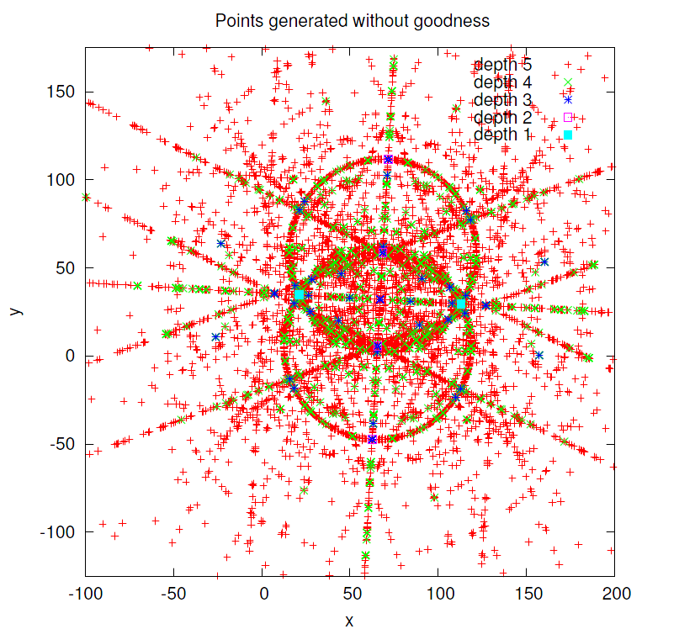
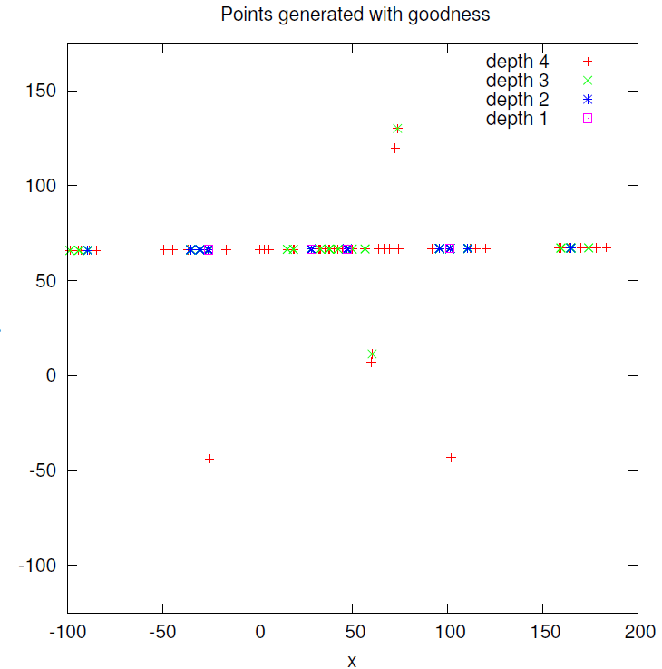
Search space Exploration: With/without goal-directness

Slide 21
Outline
Problem Formulation (as Program Synthesis)
Synthesis Algorithm (based on inter-disciplinary ideas)
Idea 1: from Theory
Idea 2: from PL
Idea 3: from AI
Experiments
Future Vision

Slide 22
Problem Solving Engine with Natural Interfaces
Problem Description in English/Ink
Natural Language Processing/
Sketch Recognition
Problem Description as Logical Relation
Program Synthesis Engine
Solution as Straight-line Program
Paraphrasing
Solution in English
Joint work: Umair Ahmed, Kalika Bali, Monojit Chaudhuri (MSR India)
Salman Cheema, Joseph LaViola (Univ of Central Florida)

Slide 23
GeoSynth Demo
Construct a triangle ABC with AB = 7 cm, angle B = 60 degree and BC + CA = 10 cm.

Slide 24
Various Aspects of an Intelligent Tutoring System
Goal: Make Education Interactive and Fun.
Education Studio | PL Connection
Automated Solving Hint Generation | Program Synthesis Interpolants
Education Studio | PL Connection
Automated Solving | Program Synthesis
Automated Grading Pointing Mistakes Suggesting Fixes | Program Verification Bug Isolation Program Repair
Problem Generation | Test Input Generation
Content Creation | Visual Studio Intellisense

Slide 25
Conclusion
Dimensions in Program Synthesis (PPDP 2010)
Intent: Logic or Natural language/Ink
Language: Geometry programs
Search: Exhaustive search made efficient by property testing, high-level abstractions, goal-directedness.
Who benefits? Students/Teachers
What is the value addition? Towards making education interactive, fun, and accessible anytime/anywhere.
Education is a new important application area for PL.
Motivation: Classroom size and costs rising, repetitive tasks.
Technology Trends: new devices, social networking.
PL has central role: 100 researchers may be busy for 20 years.
If you share this vision too, please get in touch!

