Slide 1
Counter Ghost
VR Horror Game Project
SHVFS GD12
2025.4.24

Slide 2
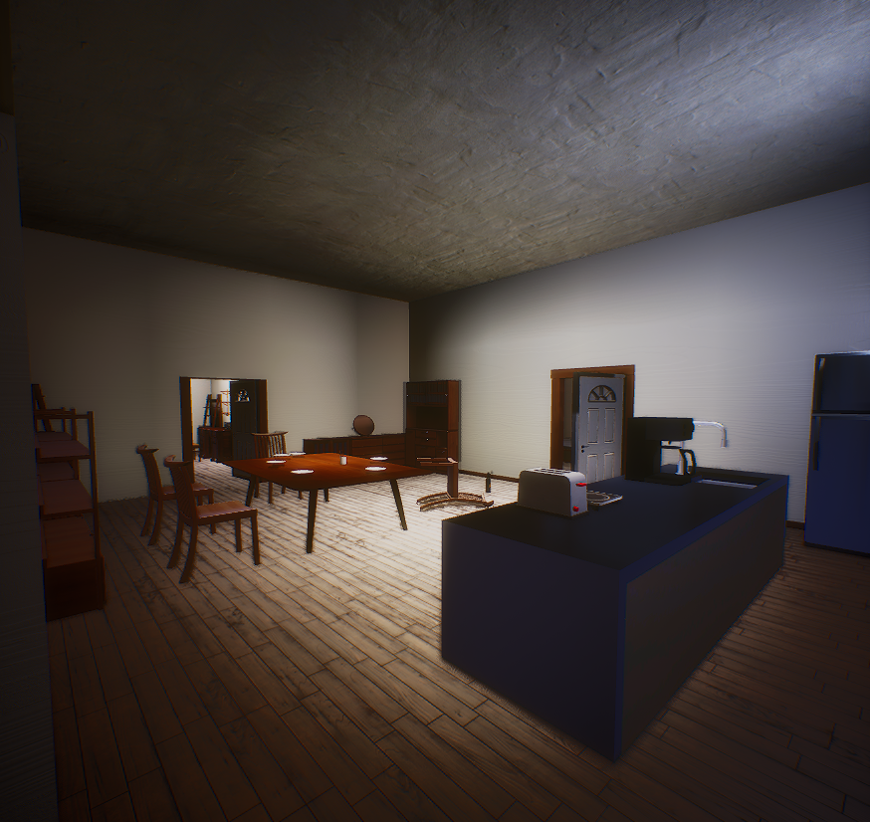
Game Experience
Play as a paranormal investigator assigned to investigate a haunted house.
Collect as much evidence as possible of ghostly activity, and then perform the appropriate exorcism to banish the entity.

Slide 3
STORRRRY
Jarrett Jackson
As an experienced paranormal investigator, power is not always the most important factor.
The key is identifying the type of entity. So is performing the correct exorcism.
Company Handbook:
Do not let the ghosts find you.
Do not stay in the dark.
Come back alive.

Slide 4
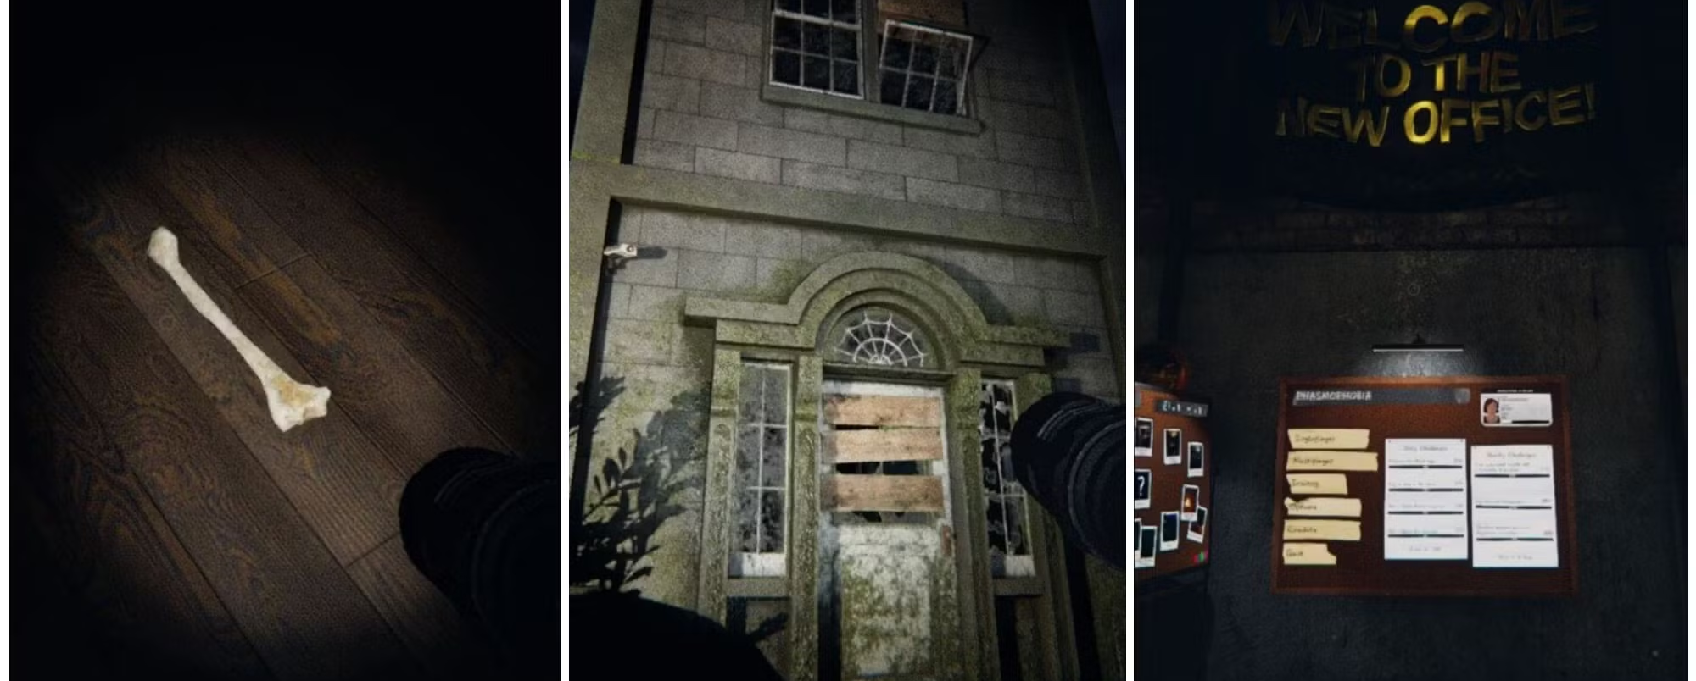
Phasmophobia
Reference Game
Reference: Game Loop & Mechanics

Slide 5
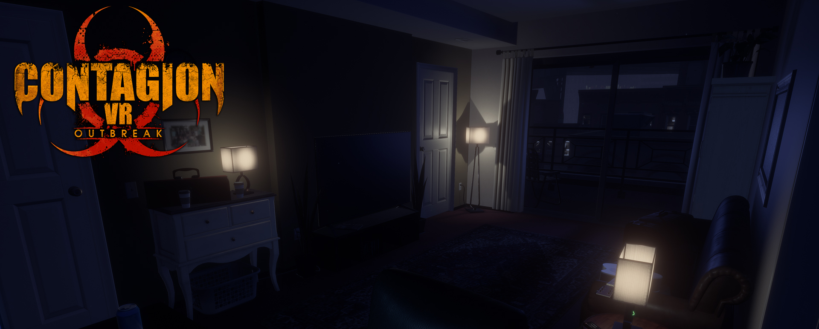
Contagion VR: Outbreak
Reference Game
Reference: Level & Environment Art

Slide 6

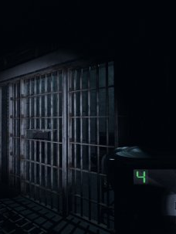
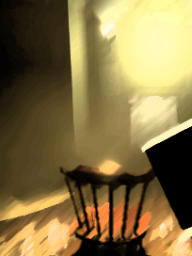
Game Pillars
VR Sensory Hiding
Collect Evidence
Exorcism Performance
6

Slide 7
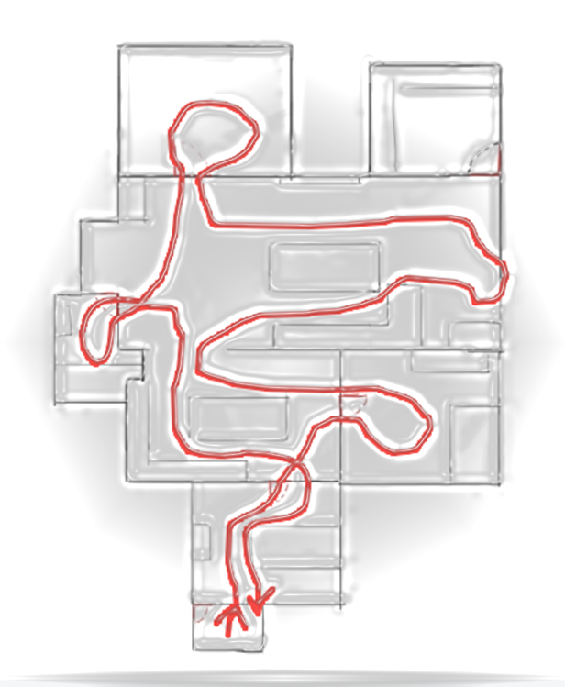
Gameplay Flow
Tutorial: Learn how to move around and interact with different types of items.
Beginplay: Acknowledge the mission goal.
Detection phase: Use equipment to determine the location of the haunted room and collect as much information as possible to identify the type of ghost.
Hunting Phase: Stay away from the ghost or evacuate to the safe zone to avoid being killed.
Exorcism Phase: Once the haunted room and ghost type have been determined, use the corresponding exorcism method to banish it and win the game..
*Being killed by the ghost in the hunt phase or performing the incorrect exorcism will result in a game failure.

Slide 8
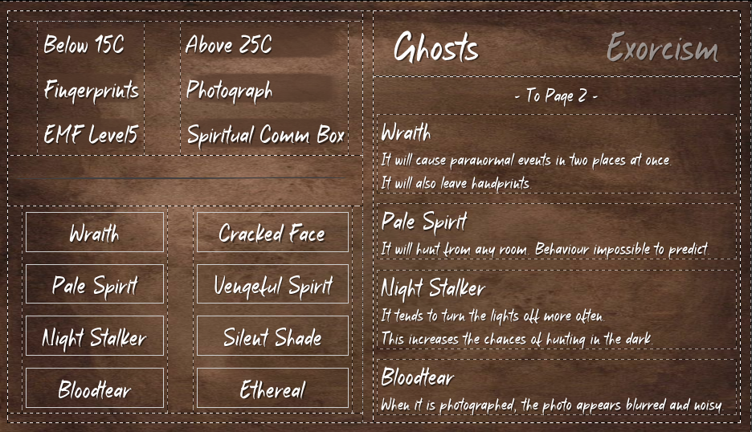
Core Gameplay – Detection phase
Determine the haunted location + Collect info to identify the ghost type.
Evidence
In-game Booklet
Information | Equipments
Abnormal Temperature (T > 25 or T < 15) | Thermometer
Ghost Handprints | UV Light
Abnormal electromagnetic field intensity | EMF
Ghost being photographed | Camera
Ghost answering questions | Spirit Box

Slide 9
Core Gameplay – Ghost ai
Normal State
Pre-hunting State
Hunting State
The ghost will randomly appear in a room, but will not attack.
5-6 minutes after the tutorial, the ghost will roar, indicating it is hunting.
It will flicker and search for the player in 10 seconds.
If the player is spotted by a ghost, it will chase him/her.
Hide in the wardrobes before the ghost finds the player.
The hunting state lasts 20-30 seconds.

Slide 10
Core Gameplay – Detection phase
Ghost Features
Wraith
Cause paranormal events in two places at once.
Leave Handprints.
Pale Spirit
Hunt from any room.
Behaviour impossible to predict.
Night Stalker
Tend to turn the lights off more often, increasing the chances of hunting in the dark.
Bloodfog
When photographed, photo appears blurred & noisy.
Cracked Face
Speed up if there is electrical or electronic equipment nearby.
Vengeful Spirit
Body flashes more frequently in Hunting Phase.
Silent Shade
Only faint footsteps can be heard at close range when hunting.
Ethereal
Too timid, barely interacting with items in the scene.

Slide 11
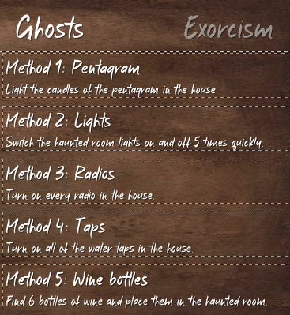
Core Gameplay – Exorcism Phase
Five exorcism methods, each of which is useful for a particular ghost type.
Correct exorcism leads to ghost banishment and game success.
Incorrect exorcism leads to a deadly ghost hunt and game failure.

Slide 12
Controls
Basic Movements
Basic Interactions
Character Abilities
Interact with the equipment to obtain the parameters of the ghost activity.
Evacuate to the safe zones to avoid the ghost hunt.
Use the incense to prevent the ghost from hunting you (only once).
Continuous Move
Teleport
Smooth Turn
Snap Turn
Crouch
Grab Items
“Telekinesis” (Grab items remotely)
Use Equipment
Touch Switches/Buttons
Toggle Game Menu
12

Slide 13
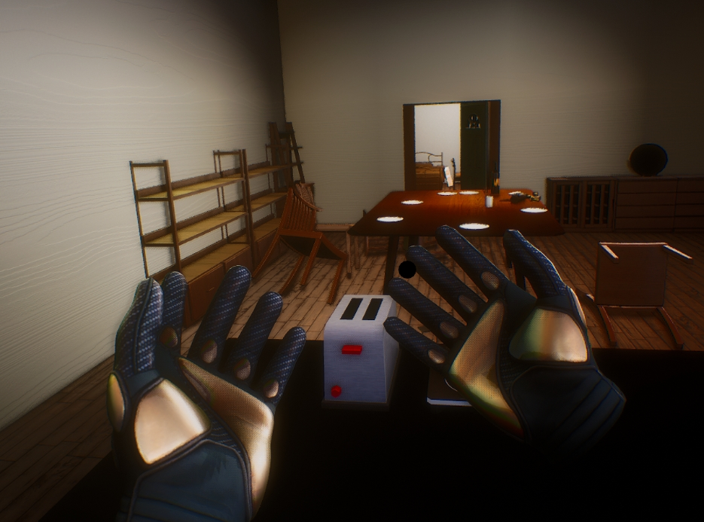
Camera
13

Slide 14
Core Mechanics
Progression
What is it?
Scientific instruments are devices help the player to gain more information about paranormal activites
Determine the historical background
These include Infrared Cameras, EMF detector, thermometer etc.
How to play?
These tools enhance players' sense of operation in VR games through knobs and buttons.
And these operations will be taught to players in the guidance phase

Slide 15
LOOOOOOOOP

Slide 16
Game Art
Progression
What is it?
Scientific instruments are devices help the player to gain more information about paranormal activites
Determine the historical background
These include Infrared Cameras, EMF detector, thermometer etc.
How to play?
These tools enhance players' sense of operation in VR games through knobs and buttons.
And these operations will be taught to players in the guidance phase

Slide 17
Marketing
Target Audience
Age 16+
VR Players
Detetive Game Enthusiasts
Horror Genre
Players who already own the VR device and are willing to purchase VR games.
Players who like detective game and solving cases by searching clues.

Slide 18
Thank You
Counter Ghost
SHVFS GD12
2025.4.24

Slide 19
Dev Info
Counter Ghost
Genre
Engine
Key Concepts
Horror Puzzle Game
Unreal Engine 5.4.4
Haunting
Paranormal Investigation
Exorcism

