Slide 1
[1] https://xiaohuiliu.medium.com/peer-to-peer-tokens-6508986d9593 [2] https://medium.com/@buildonbsv/back-to-genesis-simplest-explanation-7a9264ca6aed
How to solve “back to genesis” problem^{[1-2]} for
L1 Token Contract in BSV Blockchain Author: ZWS, ZGQ

Slide 2
Background Tech of issue：preimage structure (version 1)
The proposed digest algorithm computes the double SHA256 of the serialization of:
nVersion of the transaction (4-byte little endian)
hashPrevouts (32-byte hash)
hashSequence (32-byte hash)
outpoint (32-byte hash + 4-byte little endian)
scriptCode of the input (serialized as scripts inside CTxOuts)
value of the output spent by this input (8-byte little endian)
nSequence of the input (4-byte little endian)
hashOutputs (32-byte hash)
nLocktime of the transaction (4-byte little endian)
sighash type of the signature (4-byte little endian)

Slide 3
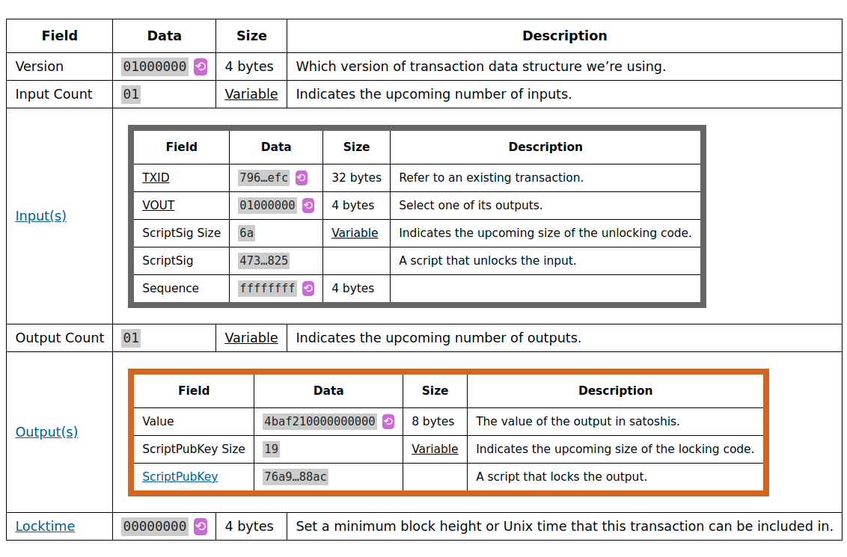
Background Tech of issue：preimage structure (version 2)
1. nVersion
5. scriptCode
=
Lock Script
2. hashPrevouts
4. outpoint
the UTXO
Key Size
balance
Key
3. hashSequence
6. value spent
7. Sequence
tail of signature
10. signhash
Amount
8. hashOutputs
Lock Size
Lock
9. nLocktime
Data structure of Tx and its relationship with 10 elements in Preimage data

Slide 4
Reason for L1 token tx inflation issue：having to verify a transaction’s parents’ parents
The actual requirement is to transfer the output data A.OutputXX or Hash(A.OutputXX ) of a transaction A to the input unlock script (C.InputX) of the sub-tx C of TxA’s sub-tx B, and keep the data-immutability during this process.
Key points:
The preimage does not need to be calculated with all the data of the current transaction. The preimage can be calculated with 10 certain data with finite length, which can be uniquely fixed by Hash locks , and the most important data is the hashPrevouts, which can be used to make the unlock data of the transaction input currently being verified include all the inputs TXID&VOUT of the current transaction data, excluding other data that can cause tx size expansion.
Using the partialHash technology, the correctness of B.data.part2 can be determined only by hash(B.data.part1) and B.data.part2 of txB. that is, it is indeed the ture latter part of the raw data of txB.

Slide 5
The core of solution to L1 Token inflation issue：construct a suitable B Tx ( suppose Tx Chain: TxA -> TxB -> TxC )
Below is the data for TxB, the date will be divided into two parts: B.data.part1 and B.data.part2
data of TxB (N inputs & M outputs)
Version， InputCount | Input1 | ... | InputFormTxA | ... |  | OutputCount | Output1 | ... | OutputM | locktime
InputN.txid
InputN.vout
InputN.unlocksize
InputN.unlockdata
InputN.sequence
B.data.part1
B.data.part2
The size of B.data.part1 is an integer multiple of 512bit; B.data.part2 includes InputN, according to the size of the previous part of B.data.part1 limit, may also contain limited size data of the previous transaction Input(N-1), to ensure the integrity of hash chunks containing InputN.
The data in InputN.unlockdata includes the txid&vout of all the inputs of the TxB, the reliability of this data is given by InputN.txid.getOutputLockscript(InputN.vout) applies the unlock script of OP_PUSH_TX and writes the corresponding check code to ensure it.

Slide 6
The process of solve data expansion when verify a transaction’s parents’ parents
To verify one input of TxC (TxC.InputX), it applies OP_PUSH_TX, and the corresponding script uses preimage (TxC) to write code to obtain the data TxC.InputX.txid which is TXID(TxB). Then, according to the acquisition TXID(TxB), verify the input partialHash(B.data.part1) and B.data.part2 by the correctness of eq: TXID(TxB)=Hash(partialHash(B.data.part1)||B.data.part2).
According to the obtained B.data.part2 that is verified to be correct, get TxB.InputN.txid and TxB.InputN.vout that are verified to be correct, mark the transaction pointed to by these two data as TxD, and according TxB.InputN.txid=Hash(partialHash(TxD.frontpart) || TxD.lastpart) to get the correct TxD.lastpart, and verify that the Lockscript pointed to by TxB.InputN.txid and TxB.InputN.vout does apply the OP_PUSH_TX, which does write the corresponding checking code to ensure "The data in InputN.unlockdata includes the txid&vout of all inputs of the TxB"
According to the trusted InputN.unlockdata in the B.data.part2 of TxB, obtain the txid&vout of all inputs of the TxB, that is, get the TXID of the TxA, and use the given partialHash(B.data. Part1), B.data.part2, partialHash (TxD.frontpart), TxD.lastpart and other data all of which have a definite size.
According to the obtained TXID(TxA), all output data in TxA can be obtained by TXID(TxA)=Hash(partialHash(TxA.frontpart) || TxA.lastpart), and it can be verified that the content of LockScript complies with Requirements for Contract contracts such as L1 Token. Make sure to complete the "verify a transaction's parents' parents" required for "back to genesis"

Slide 7
To Be Continued
To Be Continued

