Slide 1
Introduction of UHI and SEB
WU TONG

Slide 2
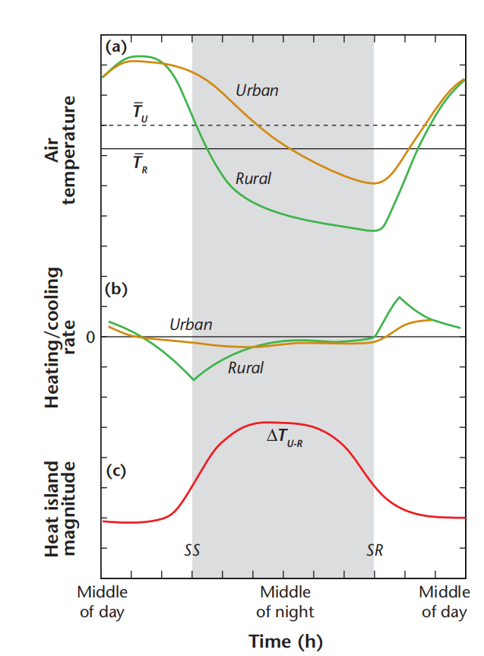
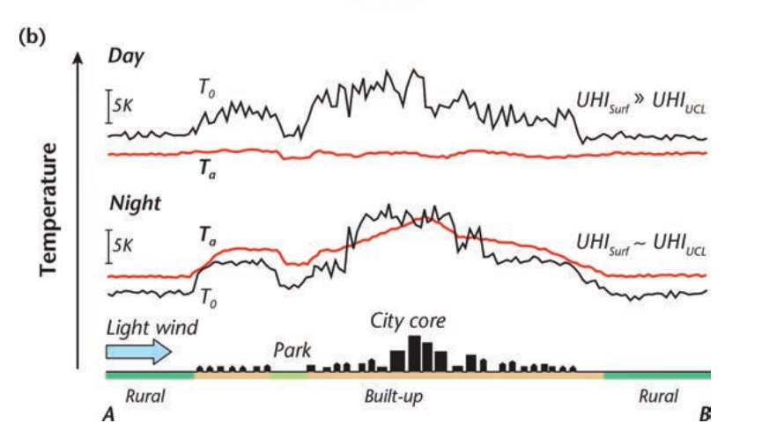
Urban Heat Islands
1. 4 types
2. Weather can effect the UHI (wind, clouds)
3. Stronger at night than during the day
4. Cities tend to cool more slowly than their surroundings
Surface Energy
Fig2.1 surface and air temperature in a 2-D section
Figure 2.2 Schematic of (a) urban and rural air temperature on days with fine weather, (b) warming/cooling rates, and
(c) the UHIUCL.(Modified after: Oke, 1982).
Oke et al 2017: Urban Climates

Slide 3
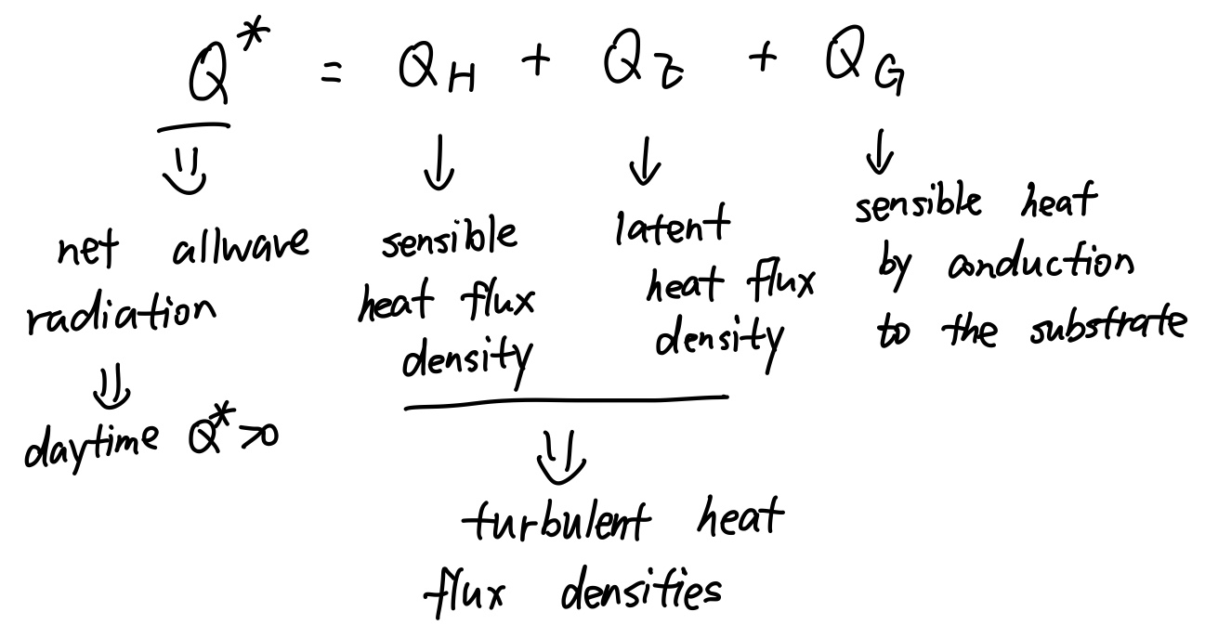
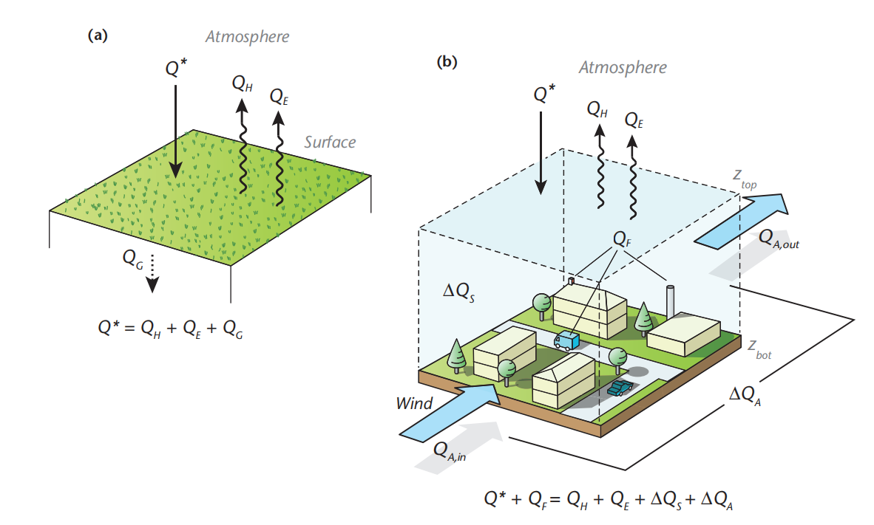
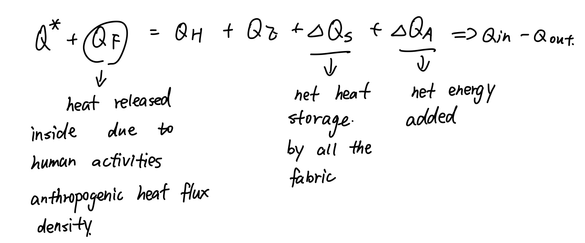
The Surface Energy Balance
Oke et al 2017: Urban Climates

Slide 4
The Surface Energy Balance
The amount of heat released by human activities can increase the anthropogenic heat flux
Artificial structures lose heat more slowly, cities can store more heat than rural surroundigs
Turbulent heat flux can be influenced by the surfacce and the atmosphere

Slide 5
Thank you!

