Slide 1
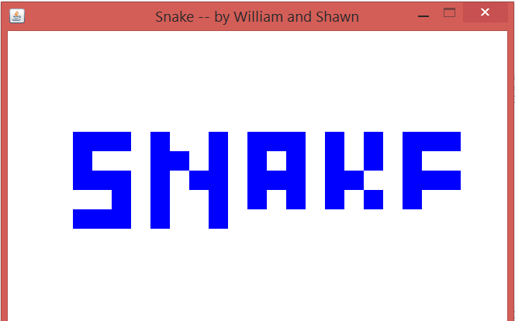
The Ominous Flashing
A Simplistic Snake game
…Or is it?

Slide 2
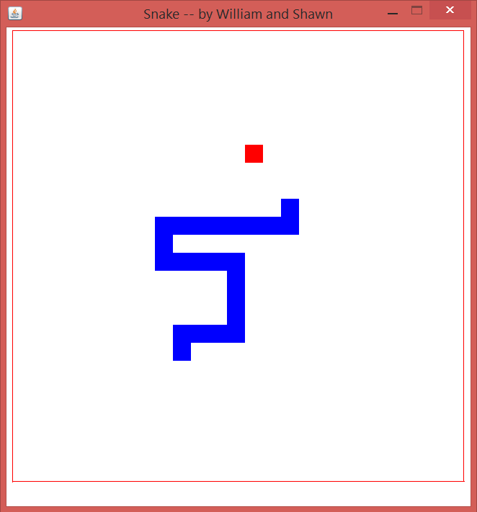
Objectives
A Simple Basic Snake Game
Possible features of varying speeds and varying screen/ box sizes
Level progression
Cool new features like Jumping, shooting existing blocks to create holes, or multiplaying
Convert to Andriod!!

Slide 3
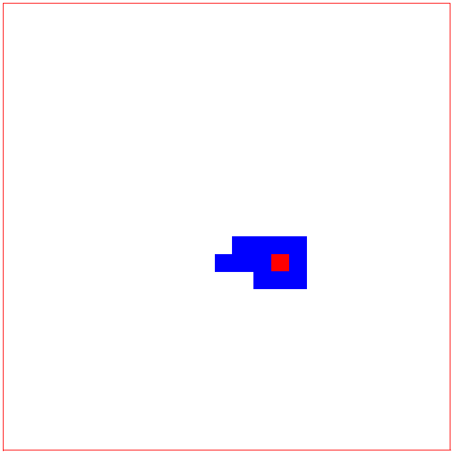
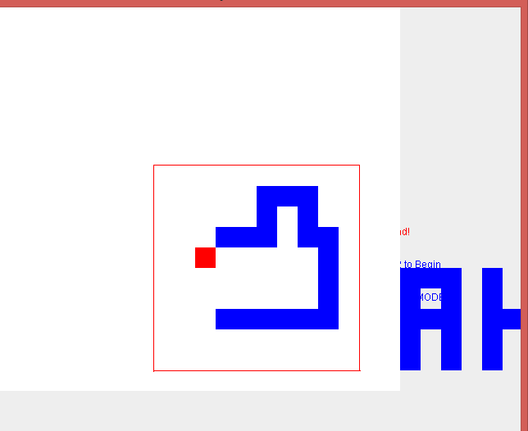
Challenges
FLASHING!!!
Working with partner from China
Converting from different formats
Speed control
Screen Size control
STILL FLASHING!!
No mobile ☹

