Slide 1
Project Passcode Dataset To Identify Users
Presenters:
Supriya Jadhav
Wisdom Takumah
Yugeen chaulagain
South Dakota State University
5/1/2018

Slide 2
Outline
Problem Statement
Dataset Introduction
Data Exploration
Model Building
Multinomial logistic regression
LDA
PCA + LDA
Random forest , Bagging and Boosting
Support Vector Machine
Model Performance Comparison
Recommended Model
Model implementation and Results of final set of dataset
Conclusion

Slide 3
Problem Statement
We are given passcode dataset which consists of passcode related information of 51 different users. It is a multi-class classification problem with 51 levels. We are provided with three sets of different file:
Known.csv
Unknown.csv
Questioned.csv
We are expected to perform following three tasks:
Task 1 : Design a method.
Task 2 : Predict the individual user.
Task 3 : Provide method’s accuracy and reasons of selecting particular method(s).

Slide 4
Dataset Introduction
Dataset consists of typing speed of 51 different individuals who have access to a passcode.
Passcode used: .tie5Roanl
Only one user can use system at a time.
Variables Information:
Subject
sessionIndex
Reps
Hold time
Up-Down Time: some values are negative
Down-Down Time: H time + DD time

Slide 5
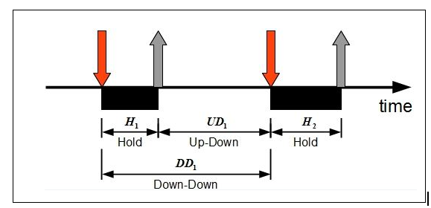
Continued..
Understanding dataset..
Applications: Biometric Identification for user authentication

Slide 6
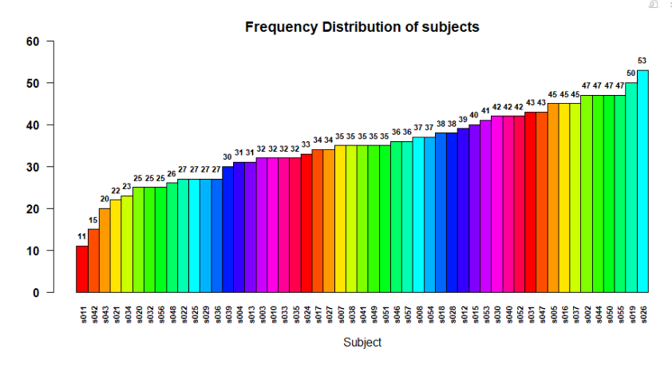
Dataset Exploration
1.Subjects
Brief look up at number of reps in each class.

Slide 7
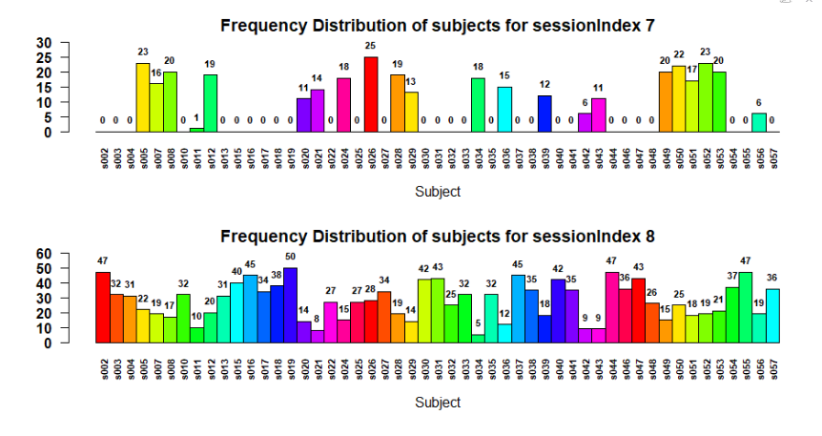
Dataset Exploration
1.Subjects’ frequency by session Index
All users participate in session 8 but fewer users do not participate in session 7.

Slide 8
Dataset Exploration
Does sessionIndex makes any difference in measurements of passcode for users?
We performed independence test:
Null hypothesis: The true mean of a user in session 7 and session 8 are same.
Alternative hypothesis: The true mean of a user in session 7 and session 8 are different.
We found out that most of the p-values are greater than 0.05. Below are the results:
Conclusion: Fail to reject the null hypothesis at 0.05 significance level.. Hence we conclude that session index does not make any difference in individual user’s passcode typing measurements.

Slide 9
Dataset Exploration
Results:
 | user005 | user7 | user8 | user12 | user20 | user21 | user24 | user26 | user28 | user29 | user34
H.period | 0.22558 | 0.070875 | 0.401364 | 0.333915 | 0.008443 | 0.617655 | 1.66E-05 | 0.003525 | 0.166662 | 0.810744 | 0.128712
H.t | 0.545273 | 0.572557 | 0.139963 | 0.286604 | 0.001626 | 0.892035 | 0.189375 | 0.000255 | 0.055067 | 0.894316 | 0.475706
H.i | 0.476874 | 0.064504 | 0.013446 | 0.073455 | 8.42E-05 | 0.486586 | 0.148054 | 0.011379 | 0.000712 | 0.111389 | 0.408814
H.e | 0.021308 | 0.577593 | 0.812484 | 0.207009 | 9.52E-05 | 0.838601 | 0.007585 | 0.0053 | 0.847163 | 0.745852 | 0.946886
H.five | 0.092423 | 0.509626 | 0.876419 | 0.154206 | 0.368844 | 0.255342 | 0.724476 | 0.000357 | 0.323317 | 0.030873 | 0.852987
H.Shift.R | 0.306291 | 0.434302 | 9.82E-06 | 0.817933 | 0.011611 | 0.010197 | 0.343774 | 0.02851 | 0.430445 | 0.08391 | 0.185055
H.o | 0.052772 | 0.381314 | 9.82E-06 | 0.467882 | 9.63E-05 | 0.666246 | 0.143579 | 0.000337 | 0.162843 | 0.473781 | 0.007729
H.a | 0.540384 | 0.247489 | 0.334021 | 0.699722 | 1.34E-09 | 0.715201 | 0.410568 | 0.049965 | 0.08626 | 0.270655 | 0.489089
H.n | 0.279286 | 0.573592 | 0.000471 | 0.435506 | 0.059262 | 0.954181 | 0.378406 | 4.67E-05 | 0.000103 | 0.23273 | 0.550514
H.l | 0.014553 | 0.001354 | 0.046309 | 0.08532 | 0.680544 | 0.545242 | 0.00018 | 0.036118 | 0.006329 | 0.063066 | 0.980235
H.Return | 0.833146 | 0.318247 | 2.19E-05 | 0.6096 | 0.000543 | 0.085534 | 0.040487 | 2.32E-05 | 0.562728 | 0.033085 | 0.076637
 | user36 | user39 | user42 | user43 | user49 | user50 | user51 | user52 | user53 | user56
H.period | 1.02E-06 | 0.850255 | 0.064621 | 0.571335 | 0.286719 | 0.241956 | 0.197131 | 0.466629 | 0.385896 | 0.177237
H.t | 0.146213 | 0.224381 | 0.35323 | 0.604635 | 0.85046 | 0.694386 | 0.187092 | 0.06278 | 0.457726 | 0.779771
H.i | 0.013558 | 0.044472 | 0.003793 | 0.495184 | 0.108352 | 0.288225 | 2.27E-05 | 0.035277 | 0.613285 | 0.089666
H.e | 0.532598 | 0.951016 | 0.371261 | 0.514576 | 0.571753 | 0.675431 | 0.851728 | 0.000231 | 0.115192 | 0.745837
H.five | 0.029566 | 0.660126 | 0.355681 | 0.128655 | 0.313712 | 0.014698 | 0.016902 | 0.003075 | 0.474973 | 0.350143
H.Shift.R | 0.020389 | 0.004974 | 0.017987 | 0.261091 | 0.217576 | 0.677843 | 0.349891 | 0.000194 | 0.034887 | 0.288389
H.o | 0.023945 | 0.004808 | 0.230416 | 0.68656 | 0.805239 | 0.567196 | 0.008677 | 0.00537 | 0.914344 | 0.952611
H.a | 0.822092 | 0.760694 | 0.025073 | 0.594762 | 0.896879 | 0.012831 | 6.97E-05 | 0.424 | 0.521743 | 0.396817
H.n | 0.042141 | 0.532461 | 0.703658 | 0.234484 | 0.173834 | 0.931966 | 0.086017 | 0.186752 | 0.771885 | 0.385719
H.l | 0.016113 | 0.479575 | 0.903009 | 0.882438 | 0.206707 | 0.154537 | 0.004321 | 0.634069 | 0.508921 | 0.946364
H.Return | 0.000895 | 0.870791 | 0.326938 | 0.058007 | 0.228832 | 0.654337 | 0.411127 | 0.794953 | 0.932185 | 0.158846

Slide 10
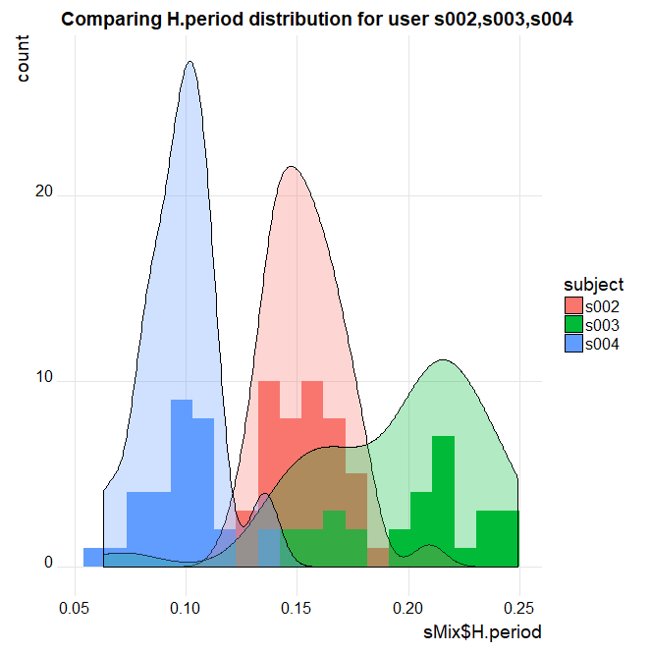
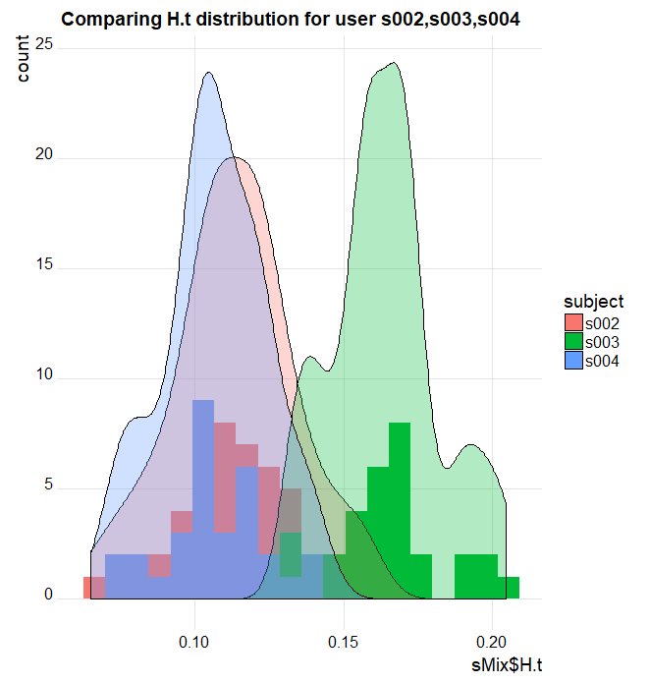
Dataset Exploration
Let us look at the distribution of hold time for 3 users:
s003, s004, s005.

Slide 11
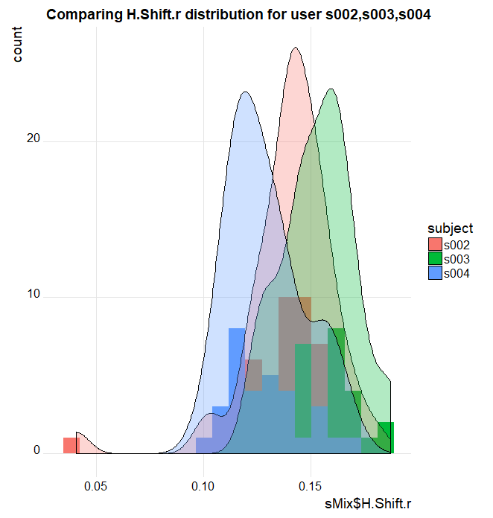
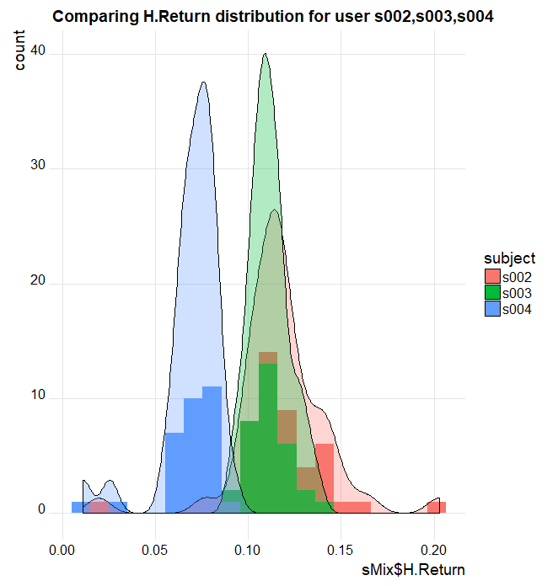
Dataset Exploration
Continued..

Slide 12
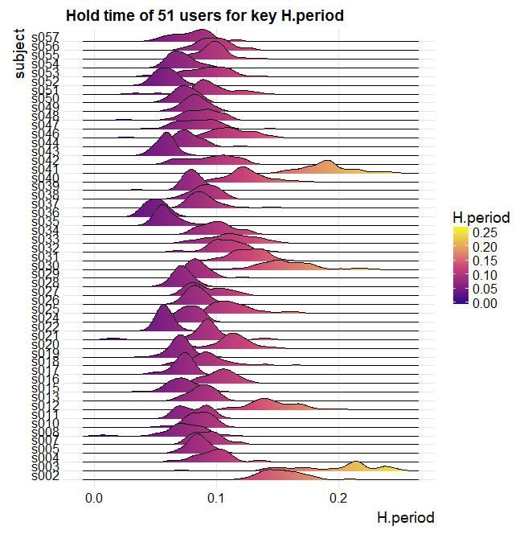
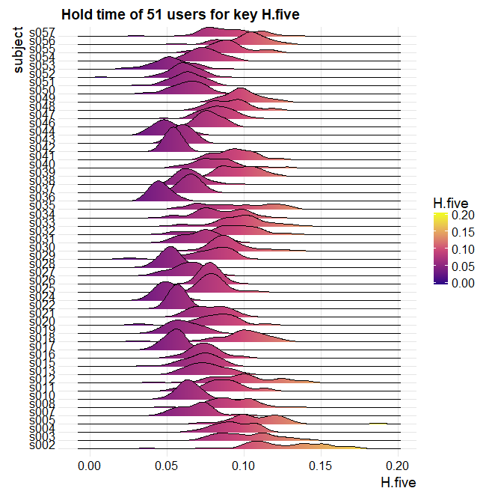
Dataset Exploration
We looked at the distribution of each user’s hold time for typing passcode.

Slide 13
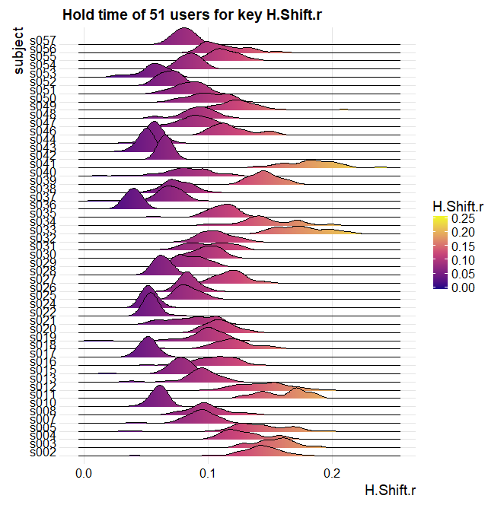
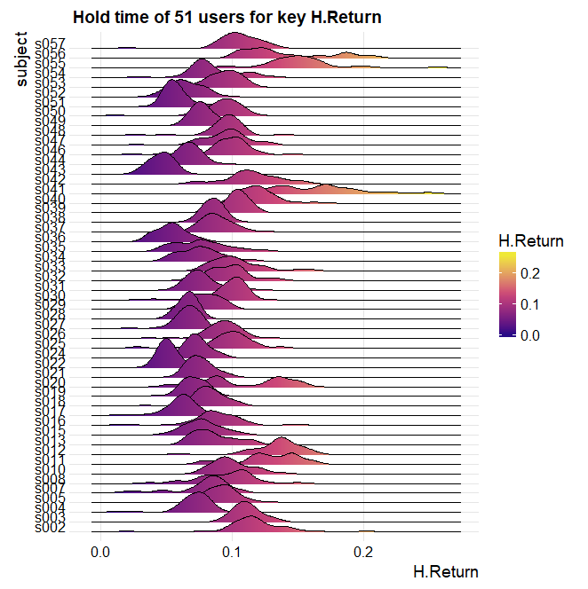
Dataset Exploration
Continued. We looked at the distribution of each user’s hold time for typing passcode.

Slide 14
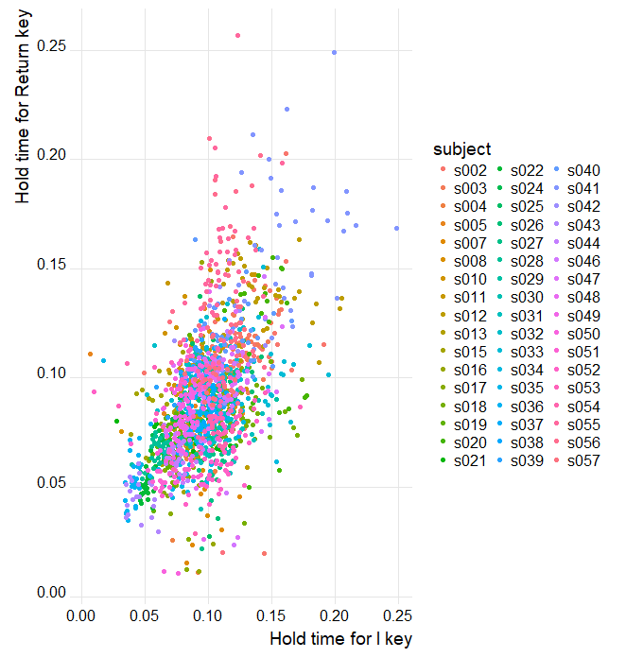
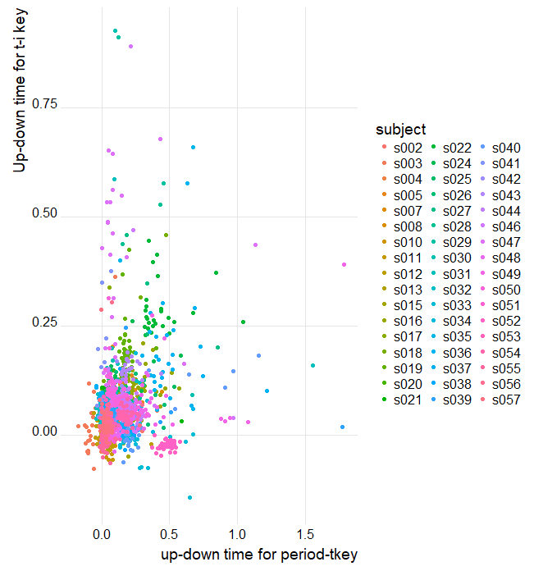
Data Exploration :
Scatter plot: Hold time and Up-Down time

Slide 15
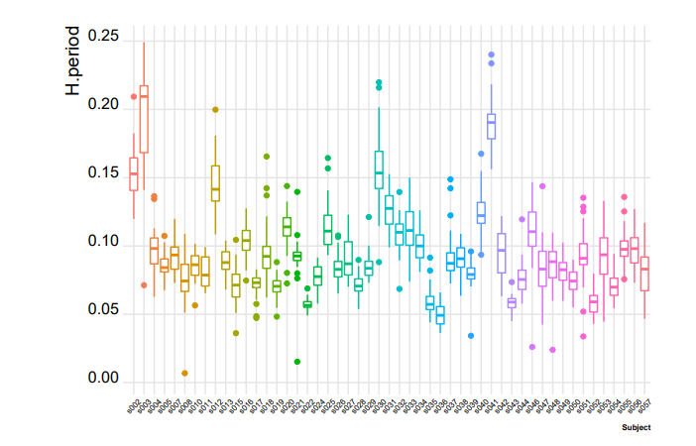
Data Exploration :
Boxplots:

Slide 16
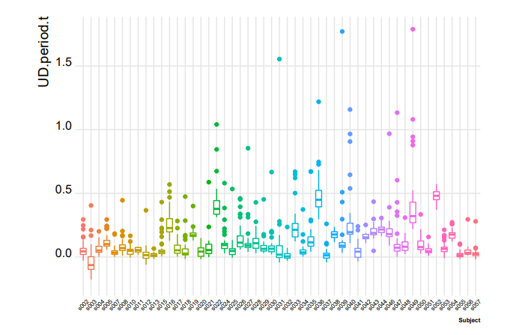
Data Exploration :
Boxplots:

Slide 17
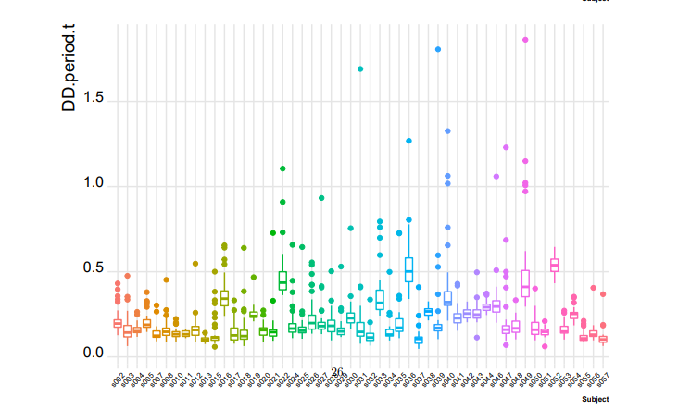
Data Exploration :
Boxplots:

Slide 18
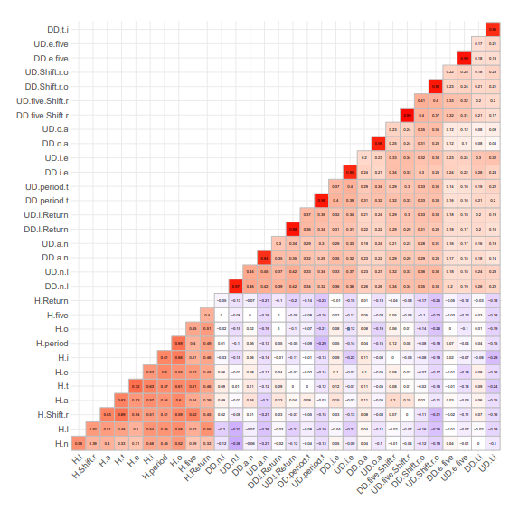
Data Exploration :
Looking at Correlation Matrix of variables: UD and DD variables are highly correlated.

Slide 19
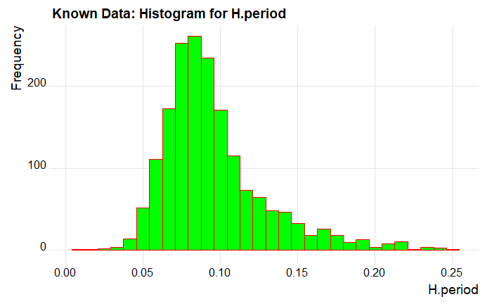
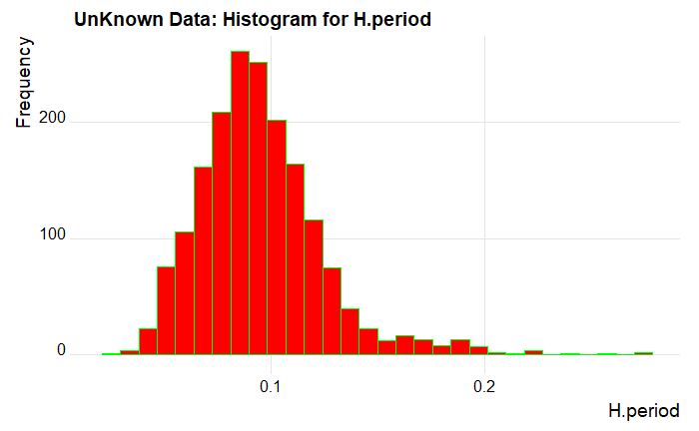
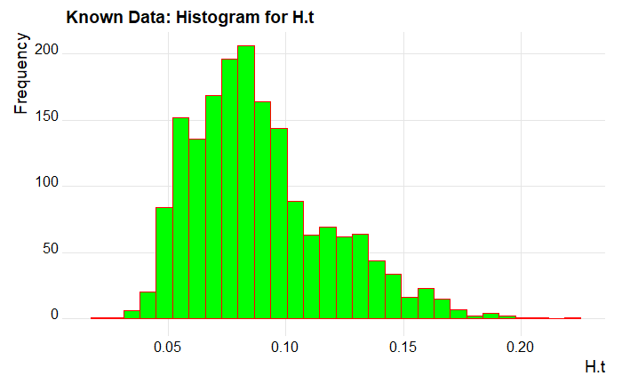
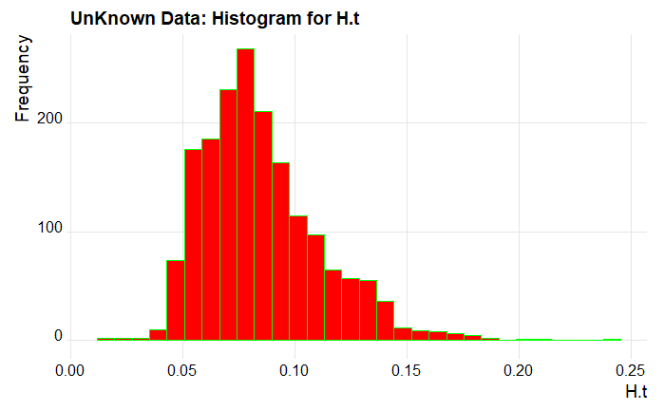
Data Exploration :
Looking at Distribution of H variables. We looked at distribution of H variables from known and unknown datasets:

Slide 20
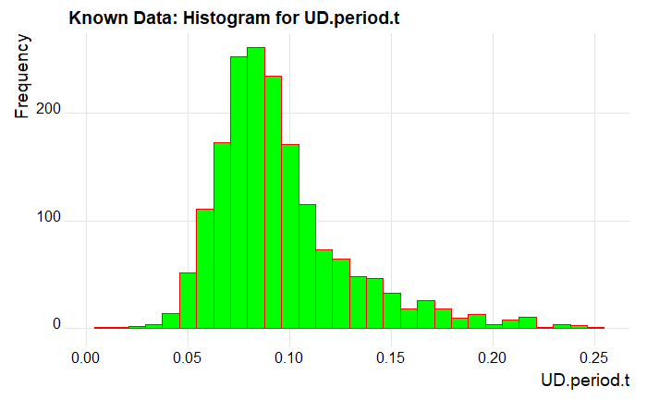
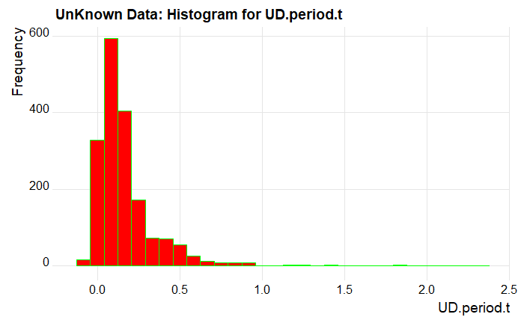

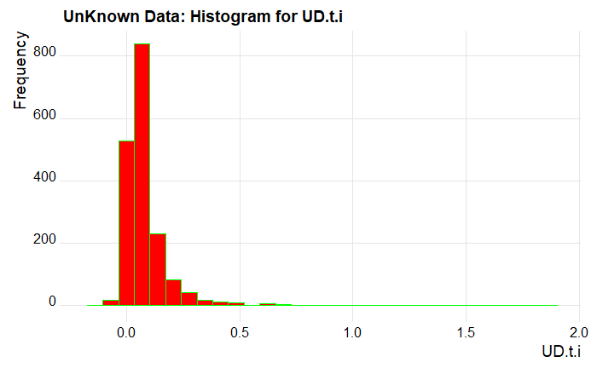
Data Exploration :
Looking at Distribution of UD variables. We looked at distribution of UD variables from known and unknown datasets:

Slide 21
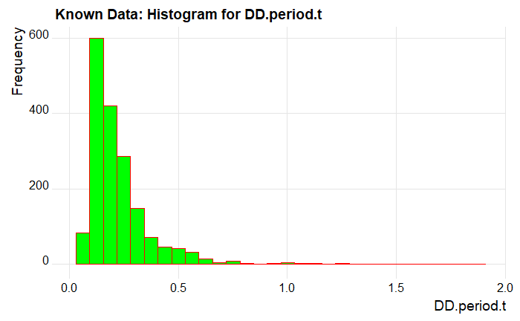
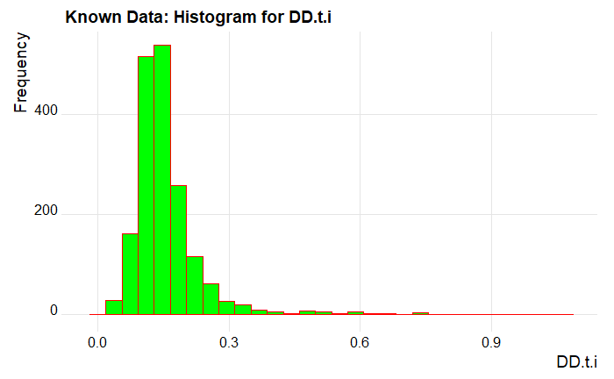
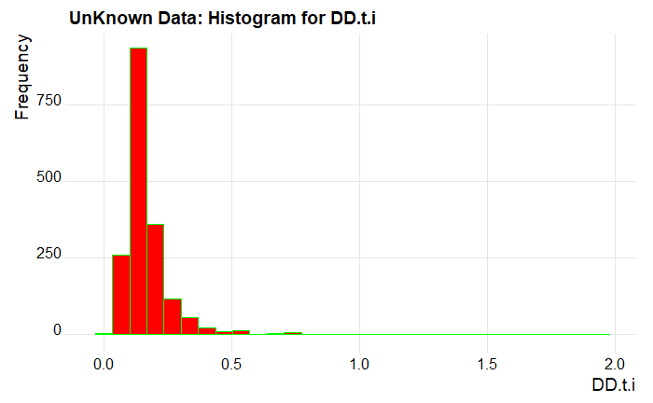
Data Exploration :
Looking at Distribution of DD variables. We looked at distribution of DD variables from known and unknown datasets:

Slide 22
Data Exploration: Variable selection
X
Row id
Rep
Repetition of passcode within each session. It takes value from 1 to 50.
Variables Removed:
X, Rep, SessionIndex, DD variables
Variables Included:
Only H
H and UD
H, UD and DD (For random forest and SVM)

Slide 23
Obtaining Classifies
We used createDataPartition method that creates balanced splits of the data. The random sampling occurs within each class and it preserves the overall class distribution of the data.
 | Original.freq | Train.Freq | Test.Freq
s002 | 47 | 29 | 18
s003 | 32 | 20 | 12
s004 | 31 | 19 | 12
s005 | 45 | 27 | 18
s007 | 35 | 21 | 14
s008 | 37 | 23 | 14
s010 | 32 | 20 | 12
s011 | 11 | 7 | 4
s012 | 39 | 24 | 15
s013 | 31 | 19 | 12
s015 | 40 | 24 | 16
 | Original.freq | Train.Freq | Test.Freq
s016 | 45 | 27 | 18
s017 | 34 | 21 | 13
s018 | 38 | 23 | 15
s019 | 50 | 30 | 20
s020 | 25 | 15 | 10
s021 | 22 | 14 | 8
s022 | 27 | 17 | 10
s024 | 33 | 20 | 13
s025 | 27 | 17 | 10
s026 | 53 | 32 | 21
s027 | 34 | 21 | 13
s028 | 38 | 23 | 15
s029 | 27 | 17 | 10
s030 | 42 | 26 | 16

Slide 24
Obtaining Classifies
 | Original.freq | Train.Freq | Test.Freq
s031 | 43 | 26 | 17
s032 | 25 | 15 | 10
s033 | 32 | 20 | 12
s034 | 23 | 14 | 9
s035 | 32 | 20 | 12
s036 | 27 | 17 | 10
s037 | 45 | 27 | 18
s038 | 35 | 21 | 14
s039 | 30 | 18 | 12
s040 | 42 | 26 | 16
s041 | 35 | 21 | 14
s042 | 15 | 9 | 6
s043 | 20 | 12 | 8
s044 | 47 | 29 | 18
 | Original.freq | Train.Freq | Test.Freq
s046 | 36 | 22 | 14
s047 | 43 | 26 | 17
s048 | 26 | 16 | 10
s049 | 35 | 21 | 14
s050 | 47 | 29 | 18
s051 | 35 | 21 | 14
s052 | 42 | 26 | 16
s053 | 41 | 25 | 16
s054 | 37 | 23 | 14
s055 | 47 | 29 | 18
s056 | 25 | 15 | 10
s057 | 36 | 22 | 14

Slide 25
Model Building: 1. GLM
Multinomial Logistic Model
Test data: 95%Confidence Interval
(74.39, 80.74)
Model Name | Method | Accuracy
Multinomial Logistic Method | Train | 84.89%
 | Test | 77.68%
 | 5-fold | 78.21%

Slide 26
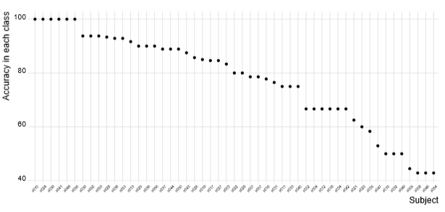
Class Specific Accuracy

Slide 27
Model Building: 2. LDA using only H variables
Test data: 95%Confidence Interval
(78.5, 84.42)
Model Name | Method | Accuracy
LDA having only H predictors | Train | 81.86%
 | Test | 81.59%
 | 5-fold | 81.03%
 | LOOCV | 81.13%

Slide 28
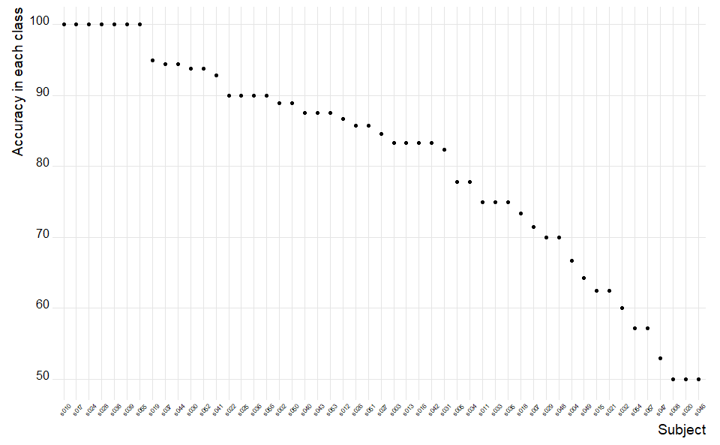
Class Specific Accuracy

Slide 29
Model Building: 3. LDA Using H and UD variables
Test data: 95%Confidence Interval
(85.31, 90.3)
Model Name | Method | Accuracy
LDA having H and UD predictors | Train | 90.147%
 | Test | 87.971%
 | 5-fold | 88.067%
 | LOOCV | 87.387%

Slide 30
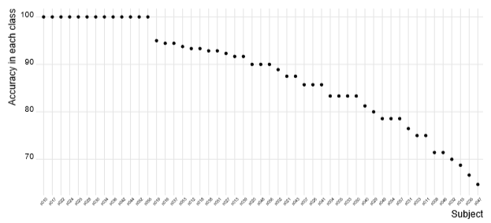
Class Specific Performance:

Slide 31
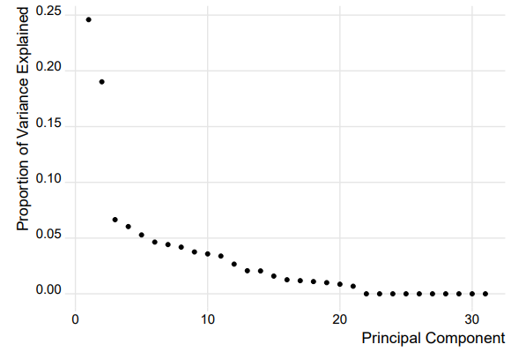
Model Building: 4. PCA+LDA
We selected to include 21 Principal Components.

Slide 32
Model Building: 4. PCA+LDA
PCS + LDA
Test data: 95%Confidence Interval
(85.31, 90.3)
Model Name | Method | Accuracy
PCA + LDA | Train | 90.63%
 | Test | 85.73%

Slide 33
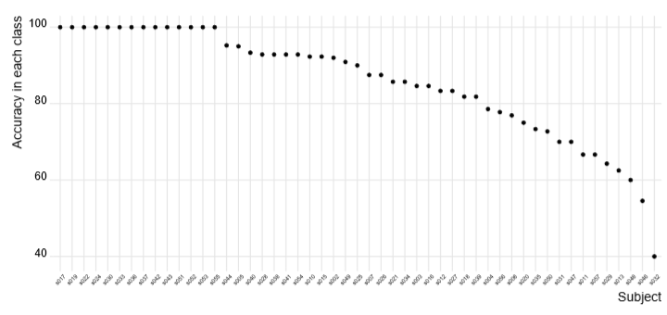
Class Specific Performance:

Slide 34
Model Building: 5.Random Forest, Bagging, Boosting
Random Forest Test data: 95%Confidence Interval
(92.83, 97.51)
Model Name | Method | Accuracy
Bagging | Train | 100%
 | Test | 92.17%
Random Forest | Train | 100%
 | Test | 95.797%
Boosting | Train | 91.069
 | Test | 82.318%

Slide 35
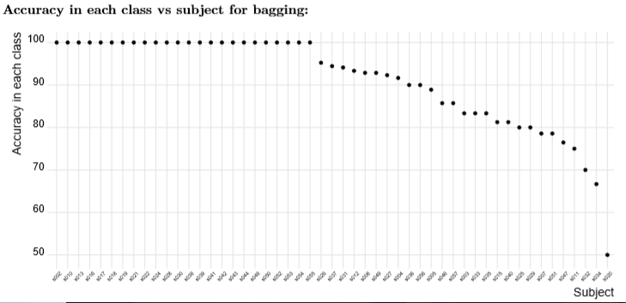
Class Specific Performance: Bagging

Slide 36
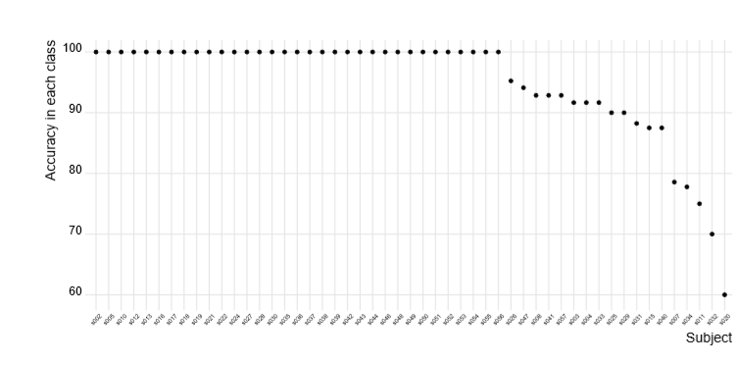
Class Specific Performance: Random Forest

Slide 37
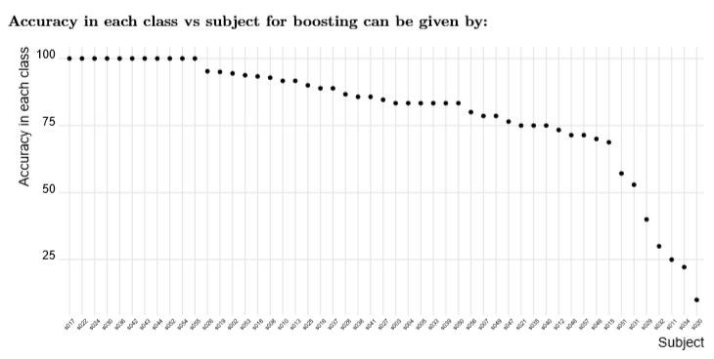
Class Specific Performance: Boosting

Slide 38
Model Building: 6.SVM using linear, poly and radial kernel
SVM radial Test data: 95%Confidence Interval
(84.98, 91.97)
Model Name | Method | Accuracy
SVM Linear | Train | 97.42%
 | Test | 85.29%
SVM Poly | Train | 97.42%
 | Test | 85.58%
SVM radial | Train | 99.30%
 | Test | 88.82%

Slide 39
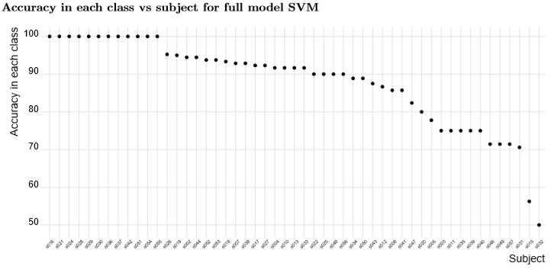
Class Specific Performance

Slide 40
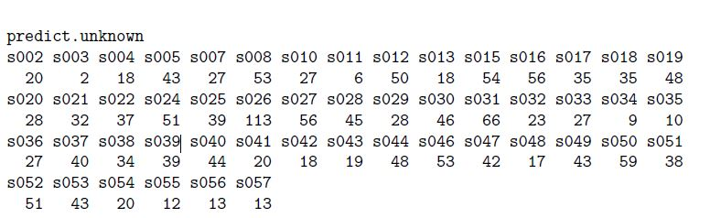
Predictions on Unknown Data

Slide 41
Model Comparisons
Methods | Createdatapartition | Patition Bases on sessionIndex
 | Test Accuracy | Test Accuracy
GLM using H | 77.61% | 67.18%
GLM using H: 5 fold CV | 78.21% | 78.21%
LDA using H | 81.59% | 71.65%
LDA using H: 5 fold CV | 81.03% | 81.13%
LDA using H: LOOCV | 81.13% | 80.86%
LDA + PCA | 85.73% | 83.1
Bagging | 92.17% | 83.21%
Bagging 5 fold | 91.44% | 91.45%
Bagging LOOCV | 90.89% | 92.98%
Random Forest | 95.87% | 91.90%
Random Forest 5 fold | 95.28% | 96.17%
Random Forest LOOCV | 95.17% | 95.10%
Boosting | 82.31% | 66.41%
SVM full Model: Linear | 87.24% | 81.97%
SVM full Model: Poly | 87.24% | 81.81%
SVM full Model: Kernel | 88.26% | 83.66%
SVM radial using H and UD | 88.84% | 84.09%

Slide 42
Recommended Model:
Random Forest
Reasons:
Random Forest is intrinsically suited for multiclass problems
Over all model accuracy is good.
Class specific accuracy is good.
Class specific accuracy for classes with fewer reps is good.
We can data use as they are.
It reduces overfitting and is therefore more accurate.
Let us look the results of random forest on passcode data set know file.

Slide 43
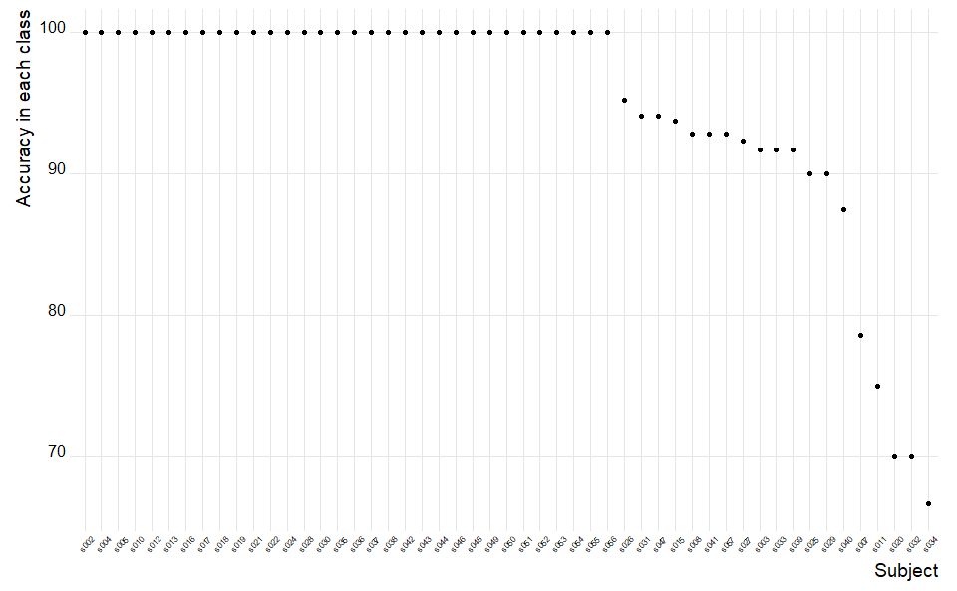
Recommended Model:
Random Forest

Slide 44
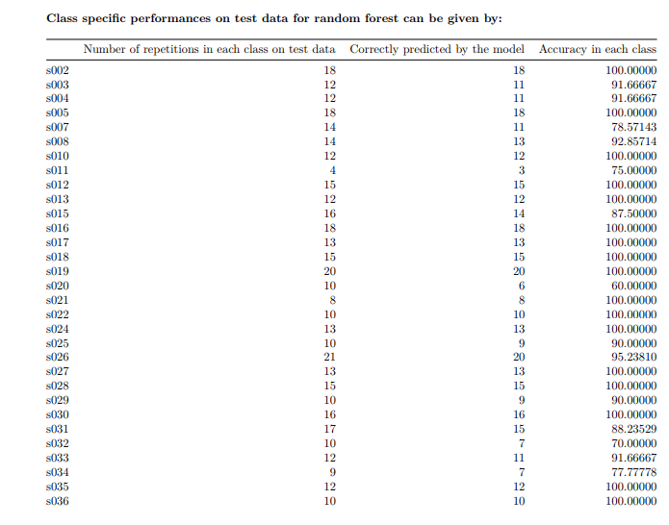
Recommended Model:

Slide 45
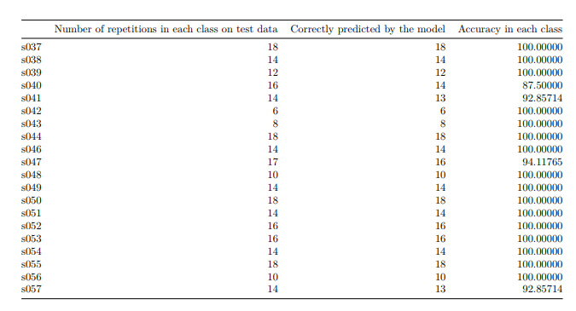
Recommended Model:

Slide 46
User Information on12 files on 12 sessions associated
Method Implementation and Results:
Session | User | Accuracy
1 | s012 | 44.44%
2 | s08 or s056 | 33.33%
3 | s020 | 0.60%
4 | s024 | 93.75%
5 | s027 | 30%
6 | s036 | 100%
7 | s039 | 68.42%
8 | s042 | 0.80%
9 | s026 | 33.33%
10 | s022 | 85.71%
11 | s044 | 80.05%
12 | s048 | 32.14%

