Slide 1
Predicting Bad Customers in Credit Dataset
Wisdom Takumah

Slide 2
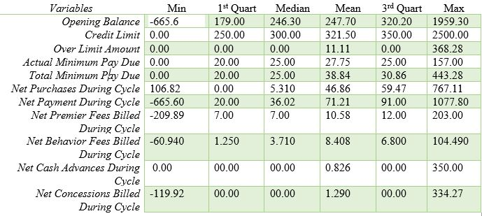
Descriptive Statistics of Numerical Variables

Slide 3
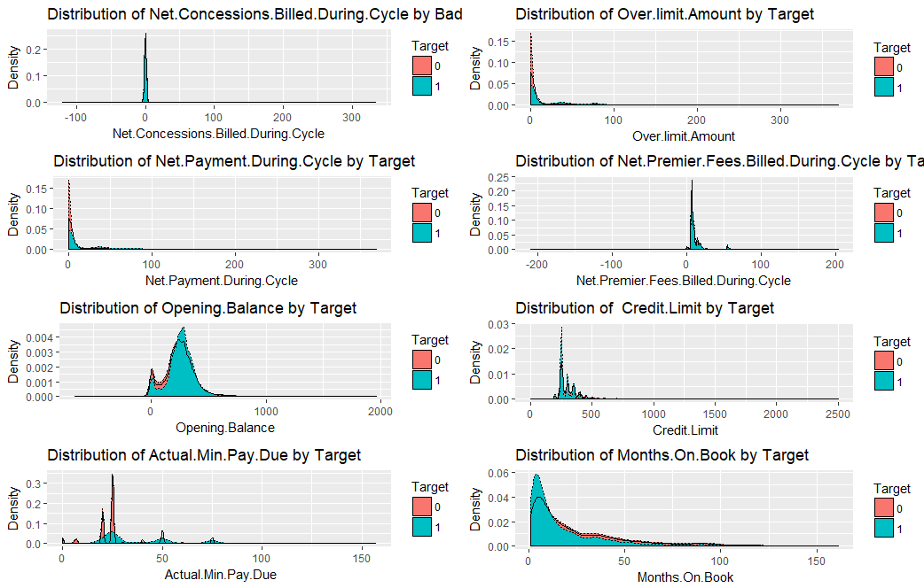
Density Plot of Continuous Variables VS Target

Slide 4
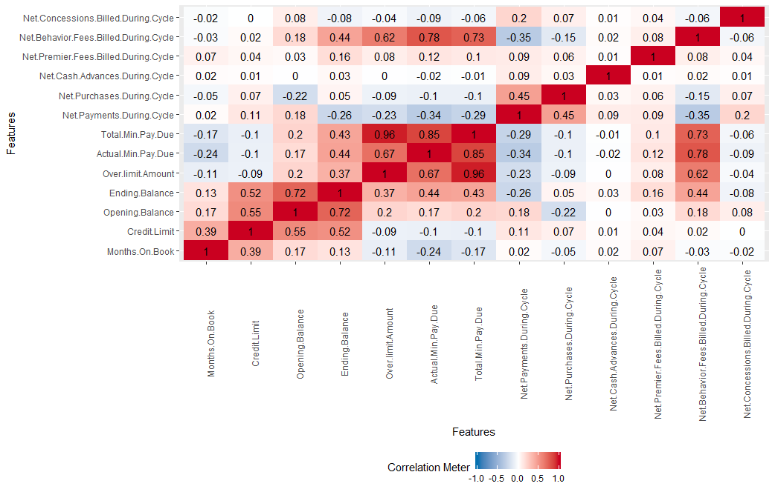
Correlation Matrix of selected variables

Slide 5
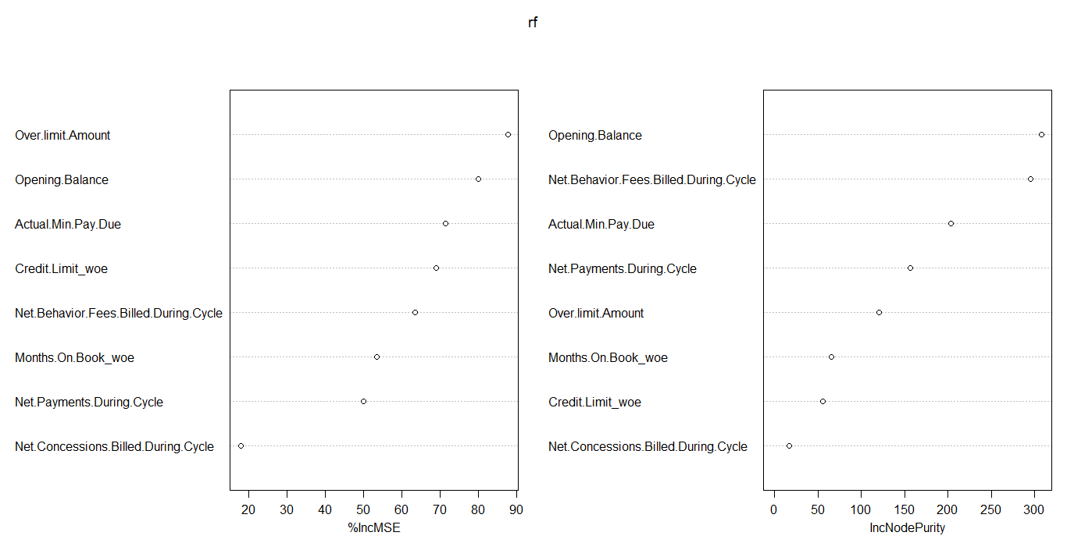
Random Forest Variable Importance

Slide 6
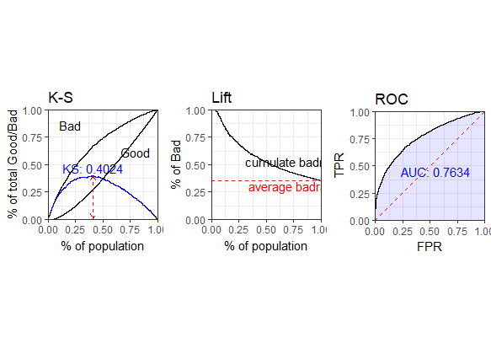
KS plot, ROC plots and Lift Plot for Random Forest Model

Slide 7
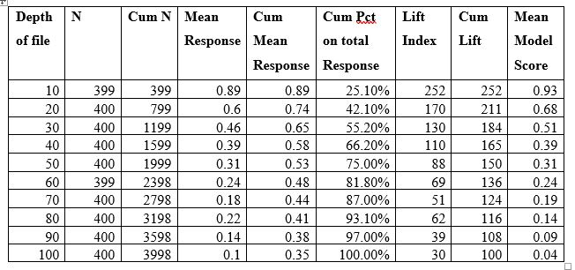
Gains Table for Random Forest Model

Slide 8
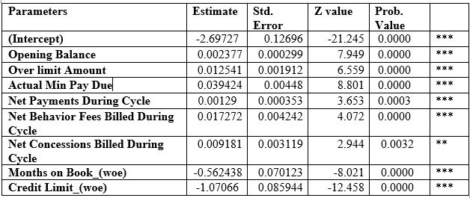
Logistics Model Parameters

Slide 9

KS plot, ROC Curve and Lift plot for Logistics Model (Train)

Slide 10

KS plot, ROC Curve and Lift plot for Logistics Model (test)

Slide 11
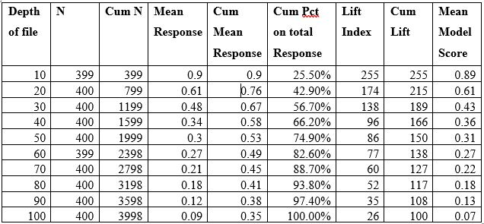
Gains Table for Logistic Model

Slide 12
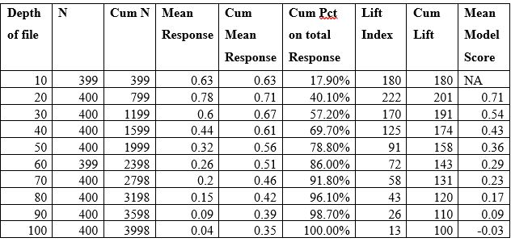
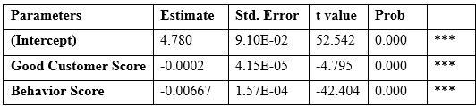
Good Customer Score Model and Gains Table

Slide 13
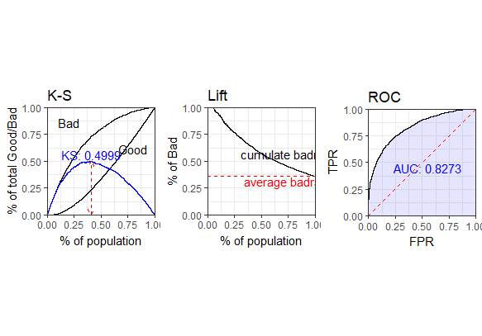
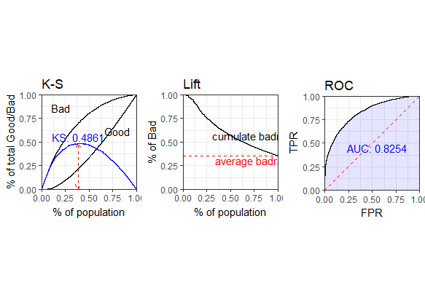
KS, ROC and Lift plot for Good Customer Score Model(Train and Test)

Slide 14
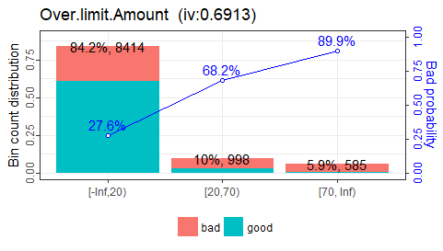
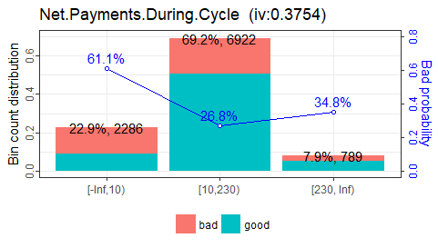
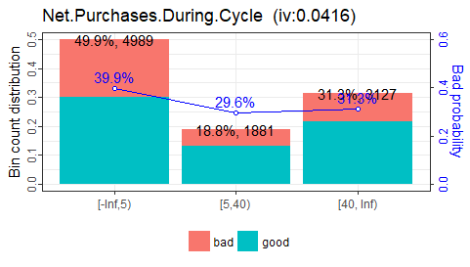
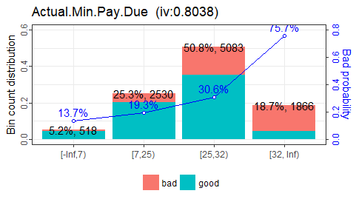
Bad rate of some Variables

Slide 15
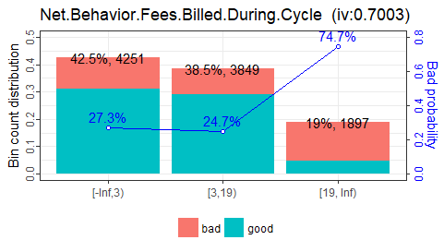
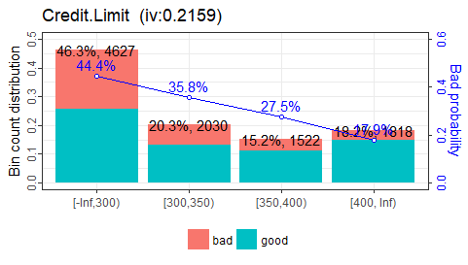
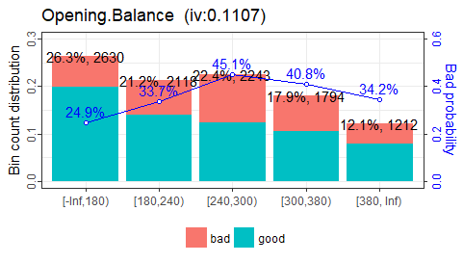
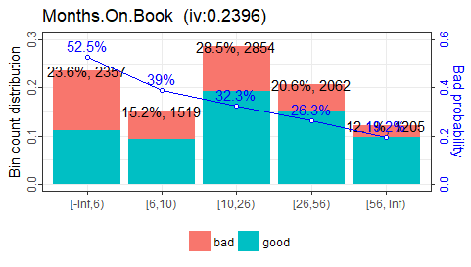
Bad rate of some Variables

Slide 16

Conclusion
Random forest model performs better at predicting bad customers than the logistics model.
Good Customer Score Model performs better than logistics and Random forest Models

