Slide 1


Counterfactual Approximations for Audio Data Using Deep Generative Models
Will Taylor-Melanson
March 2023
Presented to: Dalhousie Big Data Analytics Lab

Slide 2
Background
Ladder of causality
Structural Causal Models (SCMs)
Interventions and Counterfactuals
Approximate Abduction using DeepSCM and ImageCFGen

Slide 3
Ladder of Causality (Pearl, 2009)
Common statistical modeling approaches focus on learning associations between one or more variables
“is smoking associated with lung cancer?”
Often it is also of interest to consider interventions, which require knowledge of causal relationships between variables in order to find the outcome of a potential action
“if I quit smoking today, how is the probability of contracting lung cancer influenced?”
Even more complex are counterfactual statements, which require knowledge of causal relationships as well as accounting for observed influences of exogeneous factors
“would the patient have lived longer if they had been convinced to quit smoking 10 years earlier?”
This work focuses on approximation of counterfactual statements made about audio data, and compares recently proposed approaches for counterfactual inference

Slide 4
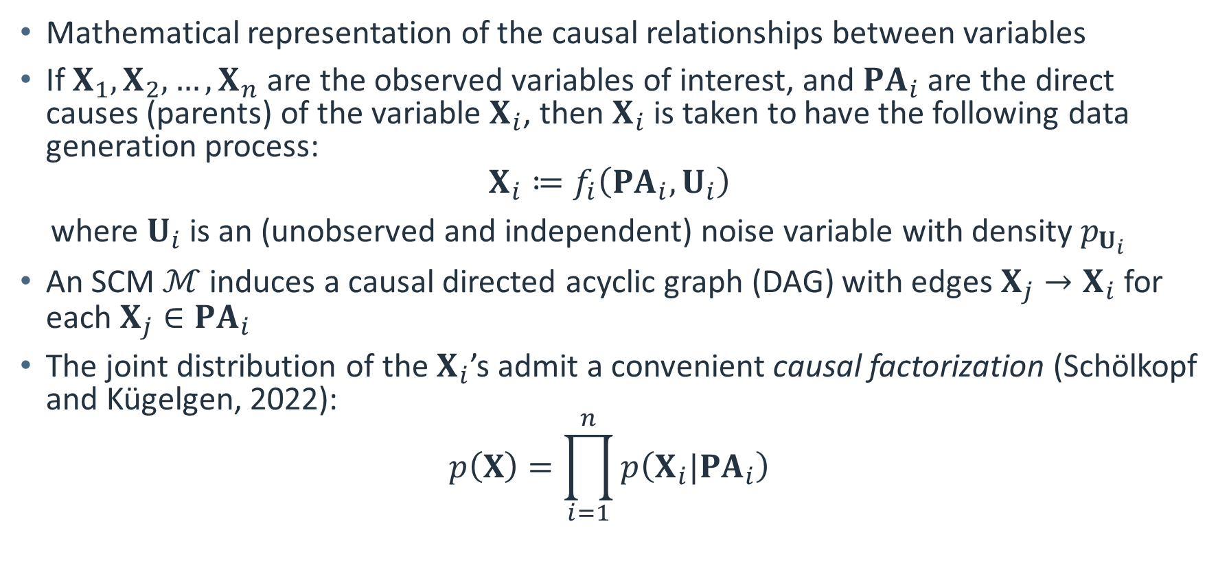
Structural Causal Models
Mathematical representation of the causal relationships between variables
If $X_{1},X_{2},…,X_{n}$ are the observed variables of interest, and $PA_{i}$ are the direct causes (parents) of the variable $X_{i}$, then $X_{i}$ is taken to have the following data generation process:
$$X_{i}≔f_{i}\left(PA_{i},U_{i}\right)$$
where $U_{i}$ is an (unobserved and independent) noise variable with density $p_{U_{i}}$
An SCM $ℳ$ induces a causal directed acyclic graph (DAG) with edges $X_{j}→X_{i}$ for each $X_{j}∈PA_{i}$
The joint distribution of the $X_{i}$’s admit a convenient causal factorization (Schölkopf and Kügelgen, 2022):
$$p\left(X\right)=\prod_{i=1}^{n}{p\left(X_{i}|PA_{i}\right)}$$

Slide 5
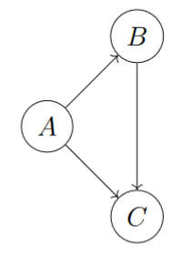

Causal DAG Example
$PA_{A}=∅$
$PA_{B}=\left\{A\right\}$
$PA_{C}=\left\{A,B\right\}$

Slide 6
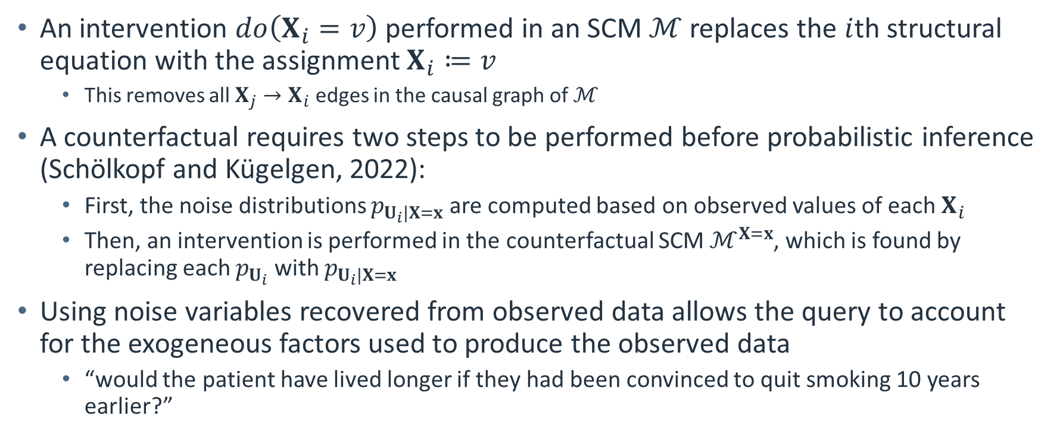
Interventions and Counterfactuals
An intervention $do\left(X_{i}=v\right)$ performed in an SCM $ℳ$ replaces the $i$th structural equation with the assignment $X_{i}≔v$
This removes all $X_{j}→X_{i}$ edges in the causal graph of $ℳ$
A counterfactual requires two steps to be performed before probabilistic inference (Schölkopf and Kügelgen, 2022):
First, the noise distributions $p_{U_{i}|X=x}$ are computed based on observed values of each $X_{i}$
Then, an intervention is performed in the counterfactual SCM $ℳ^{X=x}$, which is found by replacing each $p_{U_{i}}$ with $p_{U_{i}|X=x}$
Using noise variables recovered from observed data allows the query to account for the exogeneous factors used to produce the observed data
“would the patient have lived longer if they had been convinced to quit smoking 10 years earlier?”

Slide 7
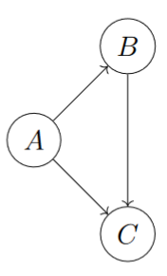
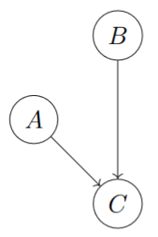

Intervention Modifying a Causal DAG
Before
After
The intervention $do\left(B=b\right)$ performed in an SCM causes the $A→B$ edge to be removed from the causal graph
This is because when $B$ is held constant in its assignment, $A$ can no longer influence $B$
In fact, $A$ and $B$ are now independent (intervention $≠$ conditioning)

Slide 8
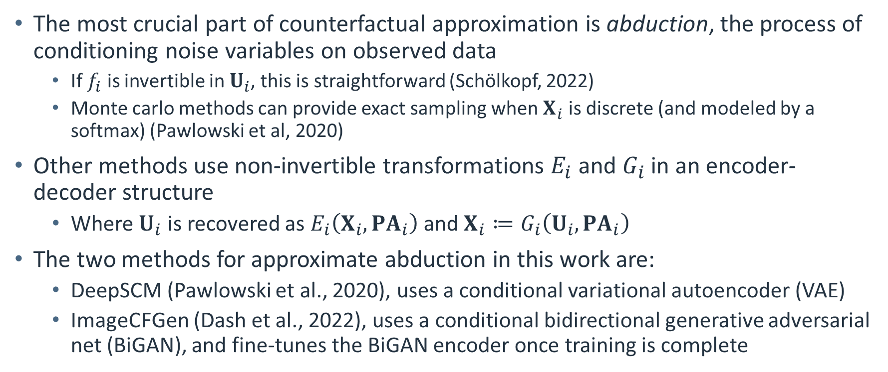
Approximate Abduction
The most crucial part of counterfactual approximation is abduction, the process of conditioning noise variables on observed data
If $f_{i}$ is invertible in $U_{i}$, this is straightforward (Schölkopf, 2022)
Monte carlo methods can provide exact sampling when $X_{i}$ is discrete (and modeled by a softmax) (Pawlowski et al, 2020)
Other methods use non-invertible transformations $E_{i}$ and $G_{i}$ in an encoder-decoder structure
Where $U_{i}$ is recovered as $E_{i}\left(X_{i},PA_{i}\right)$ and $X_{i}≔G_{i}\left(U_{i},PA_{i}\right)$
The two methods for approximate abduction in this work are:
DeepSCM (Pawlowski et al., 2020), uses a conditional variational autoencoder (VAE)
ImageCFGen (Dash et al., 2022), uses a conditional bidirectional generative adversarial net (BiGAN), and fine-tunes the BiGAN encoder once training is complete

Slide 9
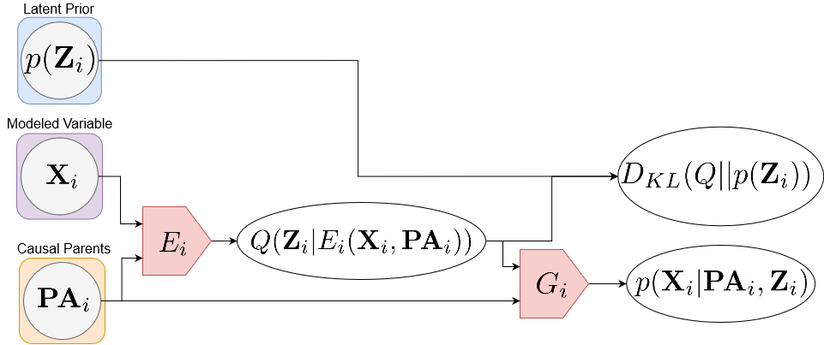
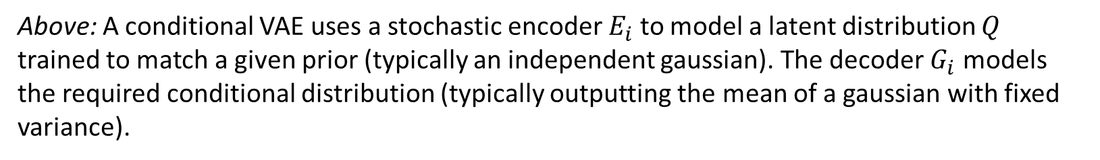
DeepSCM Architecture
Above: A conditional VAE uses a stochastic encoder $E_{i}$ to model a latent distribution $Q$ trained to match a given prior (typically an independent gaussian). The decoder $G_{i}$ models the required conditional distribution (typically outputting the mean of a gaussian with fixed variance).

Slide 10
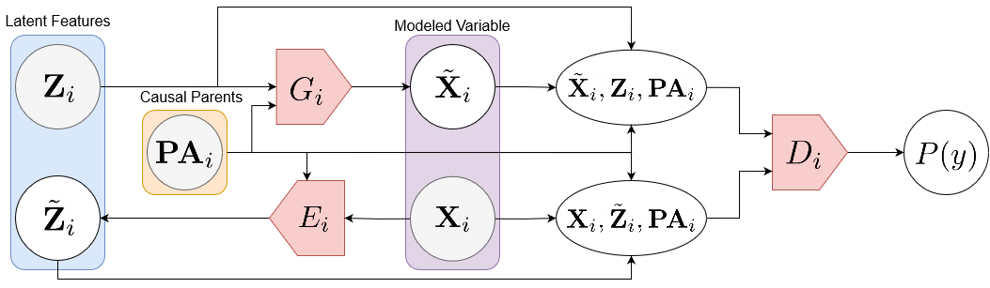
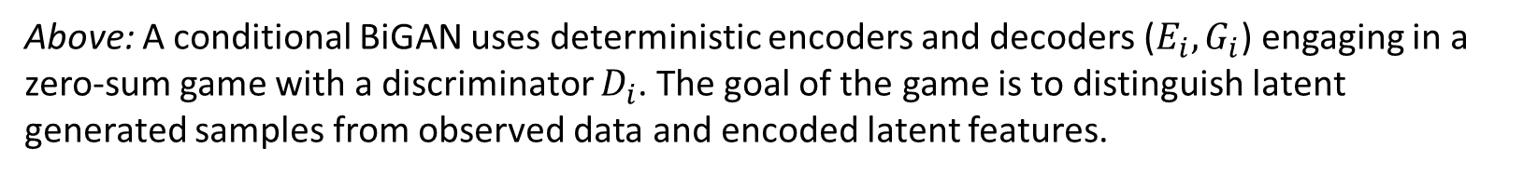
ImageCFGen Architecture
Above: A conditional BiGAN uses deterministic encoders and decoders ($E_{i},G_{i}$) engaging in a zero-sum game with a discriminator $D_{i}$. The goal of the game is to distinguish latent generated samples from observed data and encoded latent features.

Slide 11
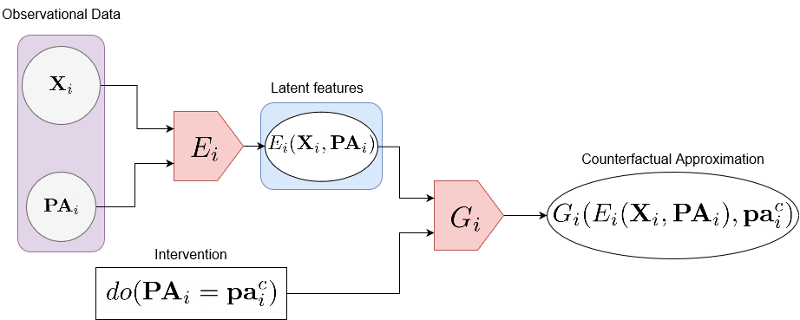
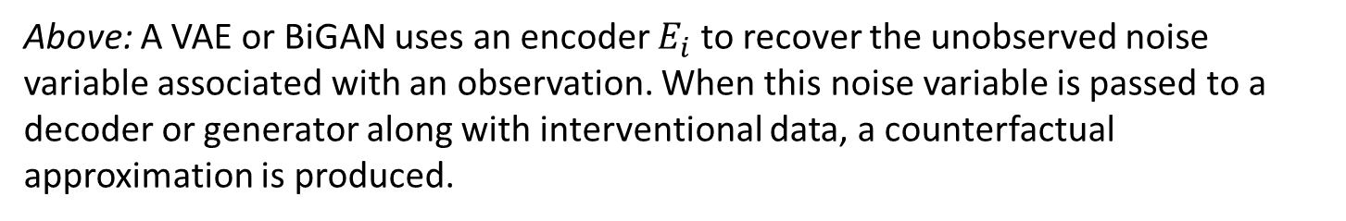
Counterfactual Approximation
Above: A VAE or BiGAN uses an encoder $E_{i}$ to recover the unobserved noise variable associated with an observation. When this noise variable is passed to a decoder or generator along with interventional data, a counterfactual approximation is produced.

Slide 12
Methods
Audio-MNIST dataset and causal structure
Data processing and attribute SCM
Network details
Evaluation by classifiers

Slide 13
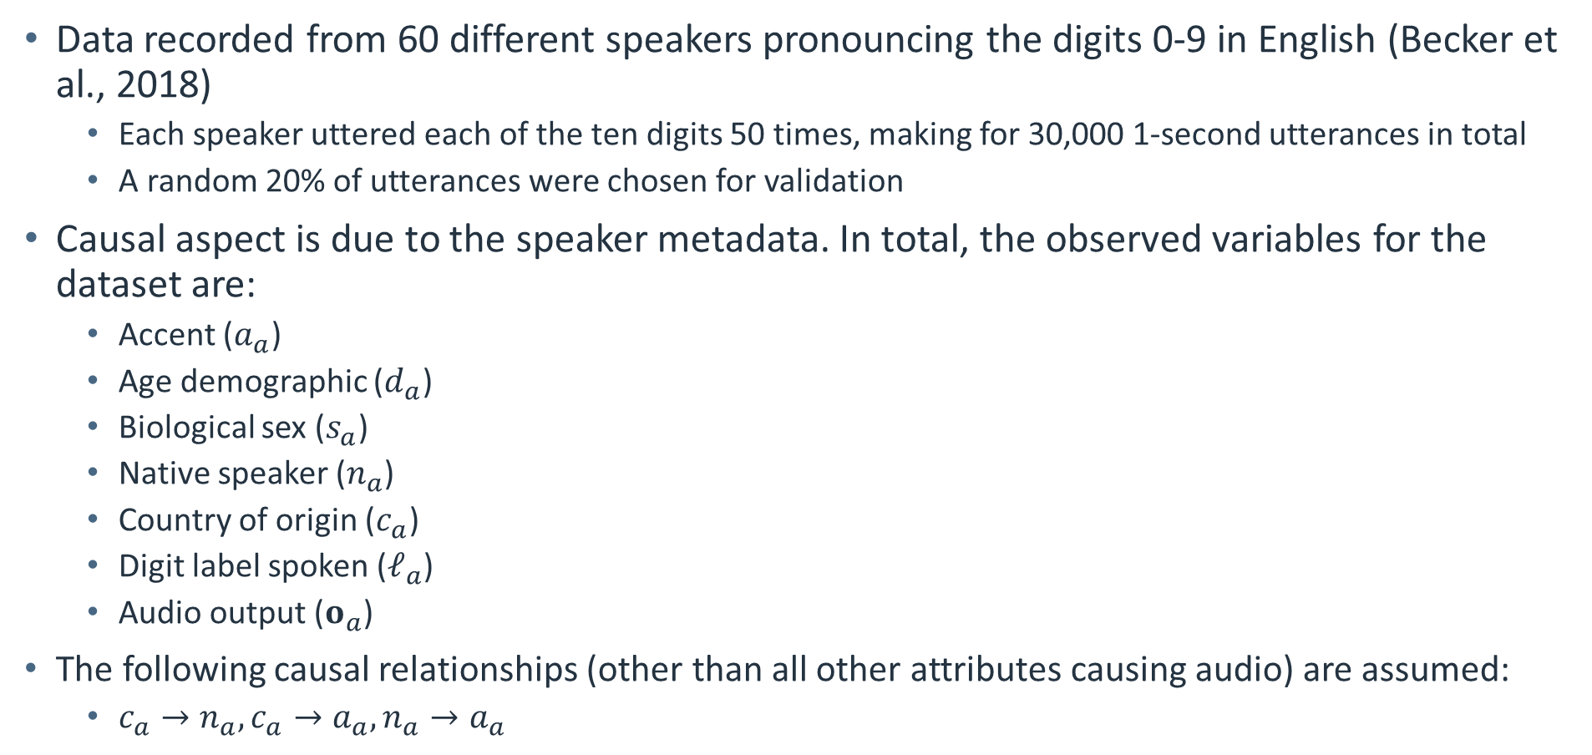
Audio MNIST Dataset
Data recorded from 60 different speakers pronouncing the digits 0-9 in English (Becker et al., 2018)
Each speaker uttered each of the ten digits 50 times, making for 30,000 1-second utterances in total
A random 20% of utterances were chosen for validation
Causal aspect is due to the speaker metadata. In total, the observed variables for the dataset are:
Accent ($a_{a}$)
Age demographic ($d_{a}$)
Biological sex ($s_{a}$)
Native speaker ($n_{a}$)
Country of origin ($c_{a}$)
Digit label spoken ($ℓ_{a}$)
Audio output ($o_{a}$)
The following causal relationships (other than all other attributes causing audio) are assumed:
$c_{a}→n_{a},c_{a}→a_{a},n_{a}→a_{a}$

Slide 14
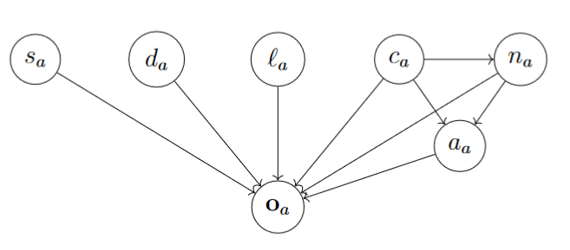
Audio MNIST Causal Graph
Above: The assumed causal graph for the Audio MNIST dataset. Country of origin influences native speaker, and country of origin and native speaker both influence accent.

Slide 15
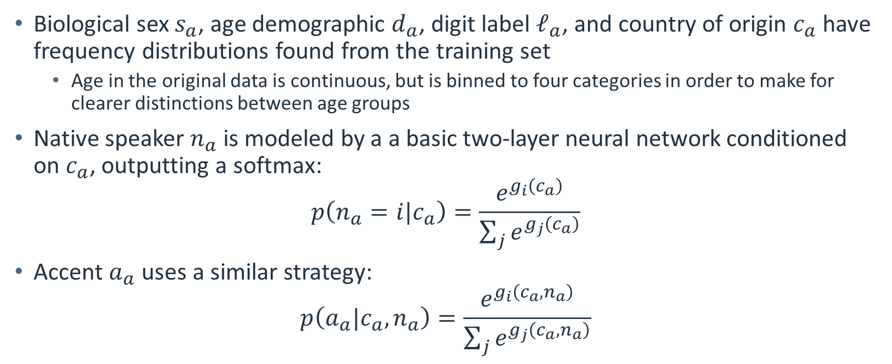
Data Processing and Attribute SCM
Biological sex $s_{a}$, age demographic $d_{a}$, digit label $ℓ_{a}$, and country of origin $c_{a}$ have frequency distributions found from the training set
Age in the original data is continuous, but is binned to four categories in order to make for clearer distinctions between age groups
Native speaker $n_{a}$ is modeled by a a basic two-layer neural network conditioned on $c_{a}$, outputting a softmax:
$$p\left(n_{a}=i|c_{a}\right)=\frac{e^{g_{i}\left(c_{a}\right)}}{\sum_{j}{e^{g_{j}\left(c_{a}\right)}}}$$
Accent $a_{a}$ uses a similar strategy:
$$p\left(a_{a}|c_{a},n_{a}\right)=\frac{e^{g_{i}\left(c_{a},n_{a}\right)}}{\sum_{j}{e^{g_{j}\left(c_{a},n_{a}\right)}}}$$

Slide 16
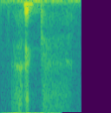
Data Processing (contd.)
Audio is converted to power spectrograms and scaled using a log transform
Spectrogram features are clipped to three standard deviations
Models generate spectrograms which are approximately inverted using a Griffin-Lim approach (Perraudin et al., 2013) to recover audio
The discrete attributes of the image are passed to NN models through reshaped embeddings converted to image channels

Slide 17
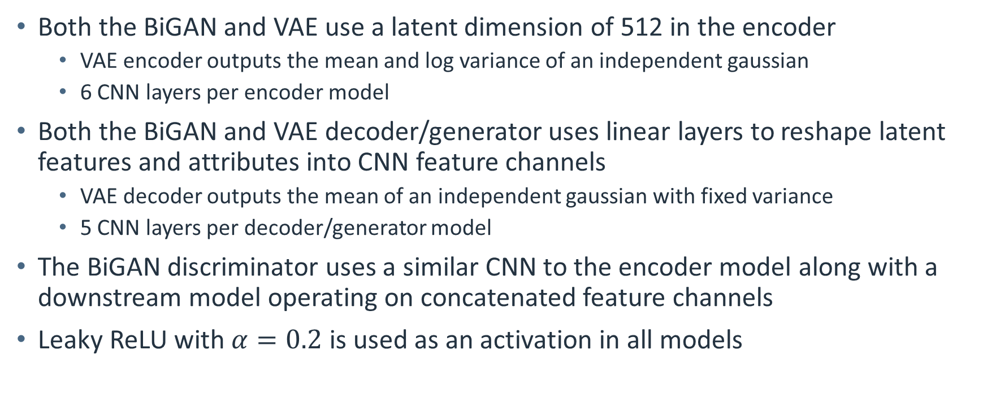
Network Details
Both the BiGAN and VAE use a latent dimension of 512 in the encoder
VAE encoder outputs the mean and log variance of an independent gaussian
6 CNN layers per encoder model
Both the BiGAN and VAE decoder/generator uses linear layers to reshape latent features and attributes into CNN feature channels
VAE decoder outputs the mean of an independent gaussian with fixed variance
5 CNN layers per decoder/generator model
The BiGAN discriminator uses a similar CNN to the encoder model along with a downstream model operating on concatenated feature channels
Leaky ReLU with $α=0.2$ is used as an activation in all models

Slide 18
Evaluation by Classifiers
To compare the performance of DeepSCM and ImageCFGen to generate both observational and counterfactual data, CNN classifiers were trained to predict the following attributes from an audio spectrogram:
Biological sex
Digit spoken
Accent
The agreement of these attributes between the generative models and the classifier is used to evaluate the validity of generated data
E.g., if a VAE or BiGAN generates audio with a German accent, the resulting audio should be classified as such
Evaluation is performed for counterfactuals using noise variables recovered from the Audio MNIST test set

Slide 19
Results/Wrap Up
Generated speech
Counterfactual speech synthesis
Classifier accuracy
Classifier evaluation on Audio-MNIST
Conclusions
Future work (time allowing): embedding interpolation on handwritten digits, explanations in the attribute space

Slide 20
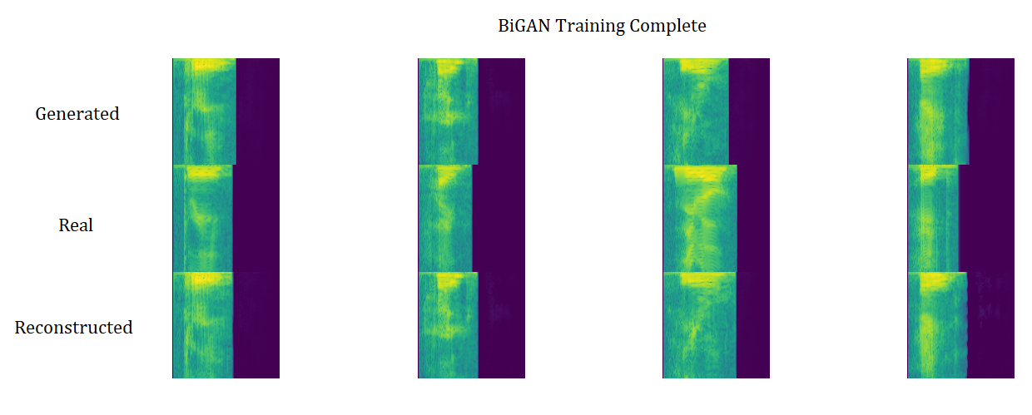
Training Results (Spectrograms)

Slide 21

Generated Speech Examples
German male, “seven”
Chinese male, “five”
Indian male (British accent), “four”
German female, “nine”

Slide 22
Counterfactual Speech Examples
Original speech, “two”
ML generated counterfactual, “five”
Original speech, male “nine”
ML generated counterfactual, female

Slide 23
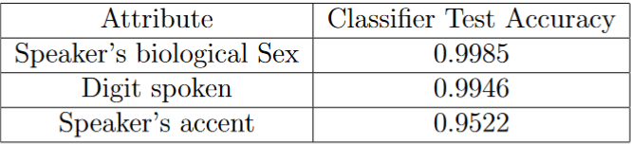
Classifier Accuracy
Above: Test accuracy of the CNN classifiers trained on audio MNIST data

Slide 24
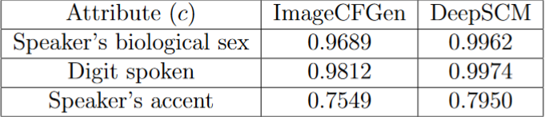
Classifier-Based Evaluation (Generation)
Above: Agreement with trained classifiers on generated data from VAE and BiGAN models. Data is generated by using 10k randomly sampled attribute configurations (from the trained attribute SCM), with latent vectors sampled from the gaussian prior.

Slide 25
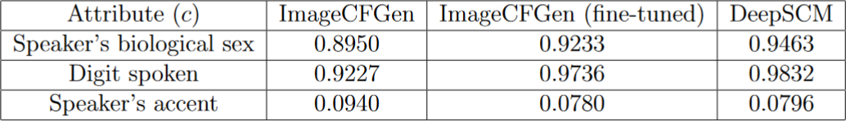
Classifier-Based Evaluation (CFs)
Above: Agreement between generative models and classifiers on counterfactual data. Counterfactual attributes (e.g. accent) are sampled from the trained attribute SCM, and original attributes and latent representations are taken from the test set (and encoder models).

Slide 26
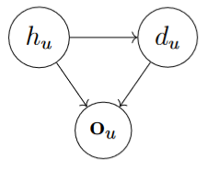
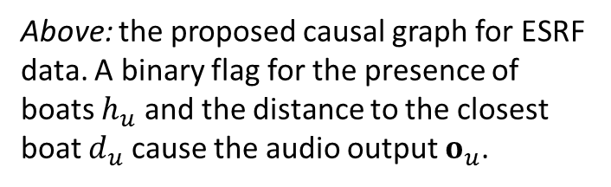
Conclusions
Classifiers produce high accuracy, suggesting suitability for automated evaluation of generative models
Audio generation successfully produces recordings of human speech
Counterfactual approximation possible using audio data with both BiGAN and VAE, though accuracy is lacking on accent CFs
Future Work
Underwater acoustic data (ESRF)
Explanation of classifiers using VAE/BiGAN and CFs
Above: the proposed causal graph for ESRF data. A binary flag for the presence of boats $h_{u}$ and the distance to the closest boat $d_{u}$ cause the audio output $o_{u}$.

Slide 27
References
Pearl, Judea. Causality. Cambridge university press, 2009.
Schölkopf, Bernhard, and Julius von Kügelgen. "From statistical to causal learning." arXiv preprint arXiv:2204.00607 (2022).
Pawlowski, Nick, Daniel Coelho de Castro, and Ben Glocker. "Deep structural causal models for tractable counterfactual inference." Advances in Neural Information Processing Systems 33 (2020): 857-869.
Dash, Saloni, Vineeth N. Balasubramanian, and Amit Sharma. "Evaluating and mitigating bias in image classifiers: A causal perspective using counterfactuals." Proceedings of the IEEE/CVF Winter Conference on Applications of Computer Vision. 2022.
Becker, Sören, et al. "Interpreting and explaining deep neural networks for classification of audio signals." arXiv preprint arXiv:1807.03418 (2018).
Perraudin, Nathanaël, Peter Balazs, and Peter L. Søndergaard. "A fast Griffin-Lim algorithm." 2013 IEEE Workshop on Applications of Signal Processing to Audio and Acoustics. IEEE, 2013.

