Slide 1


W. T. Choga Ph.D. (UB), MSc(Med) UCT, Hons (NUST)
Bioinformatics, AI,
Data Science (16-17, July, 2026)
Welcome to the workshop

Slide 2

Goals for this session
Get to know your instructors and neighbors
Set expectations for the day
Install softwares
Join Our AI groups
Get excited!

Slide 3
Workshop materials are at:
https://github.com/wtchoga/bioinformatics-series-Botswana/

Slide 4
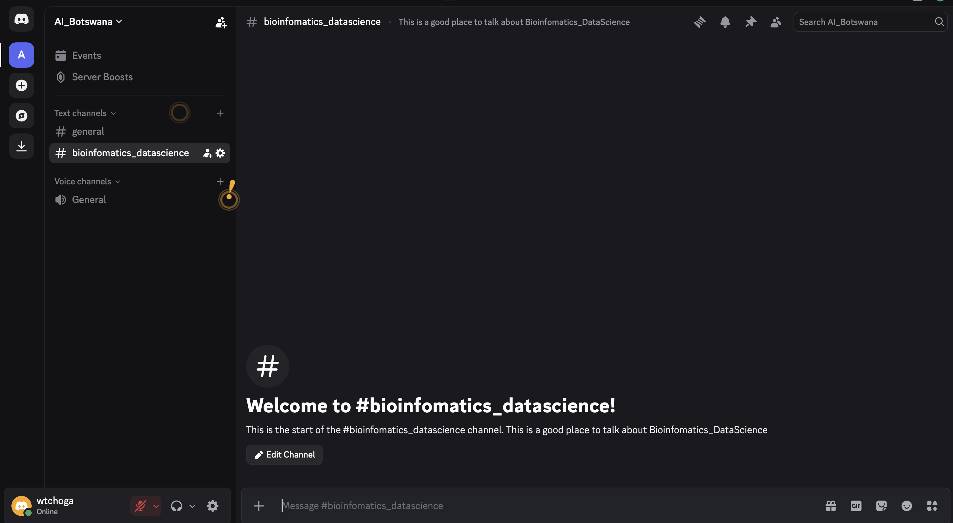
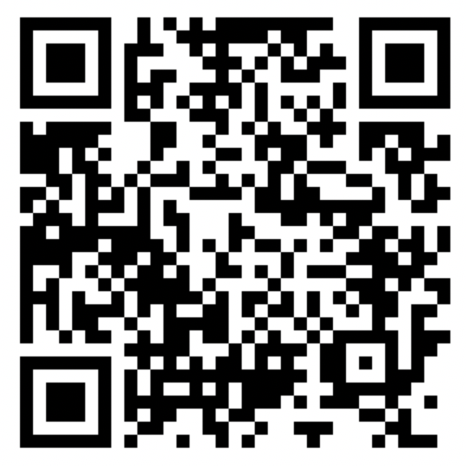
Discussions: discord
Ask questions at #workshop-questions on https://discord.com/channels/1527062497729974342/1527062564121346278

Slide 5
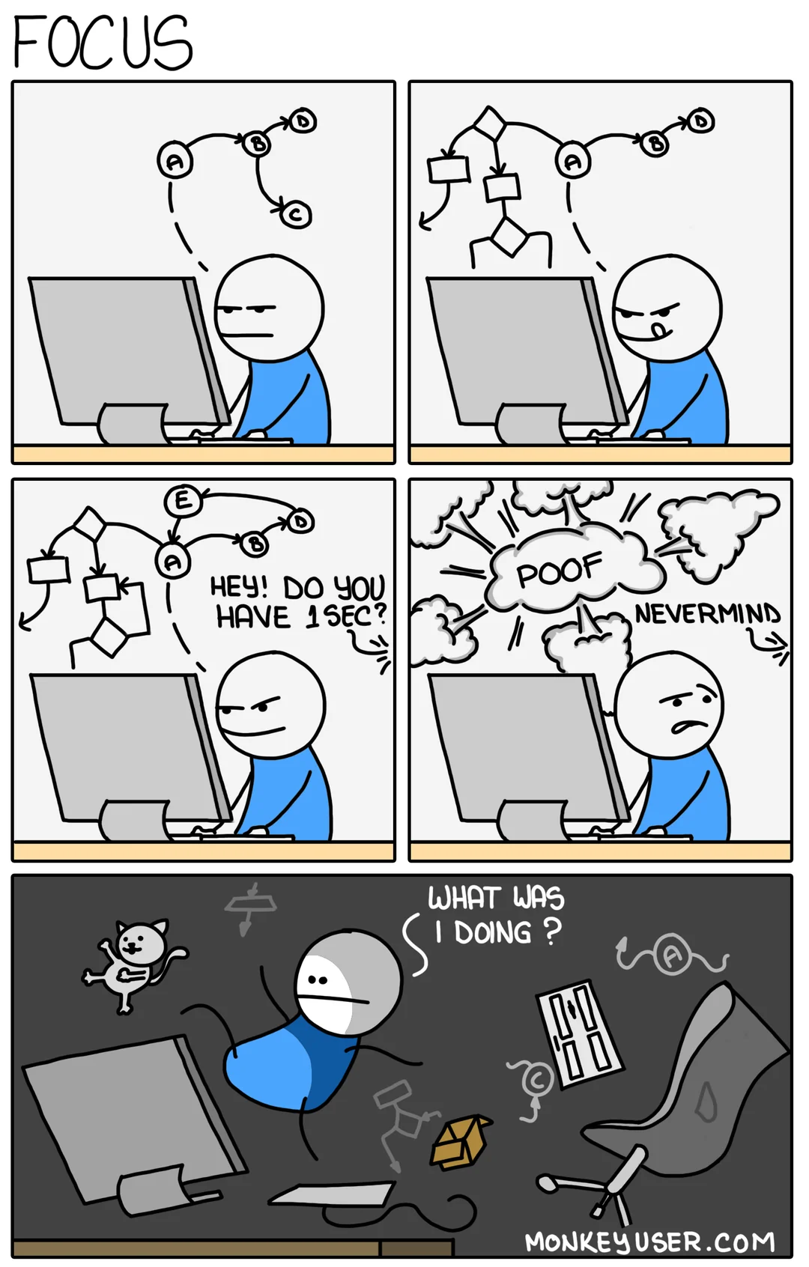
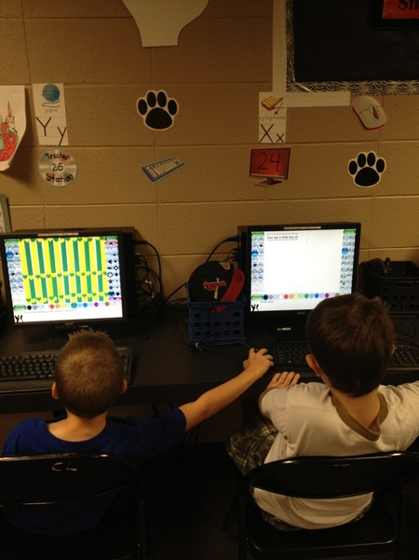
I’m Stuck & Frustrated

Slide 6
Practicalities
WiFi: Network:
Password:

Slide 7
Introductions
Take 10 secs to introduce yourself.
Please share … - Your name - Where you work
Your current go-to method for analyzing data

Slide 8
Let’s make this workshop work for all
You belong here. This workshop is intended for a wide-audience with a focus on beginners. If you feel out of place - it’s our problem, not yours!
Stay committed. This week-long workshop is intended to build each day and leave you with skills you can really use. Commit to stay engaged for best results, for you and your group!
This is a challenging but friendly environment. We are here to learn and grow.

Slide 9
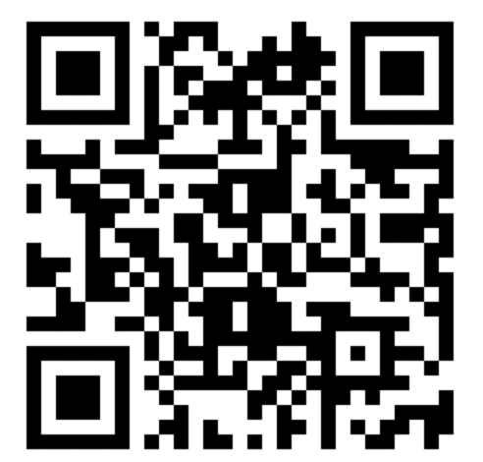
Let’s take a poll
https://www.menti.com/al8fjkaovx38

Slide 10
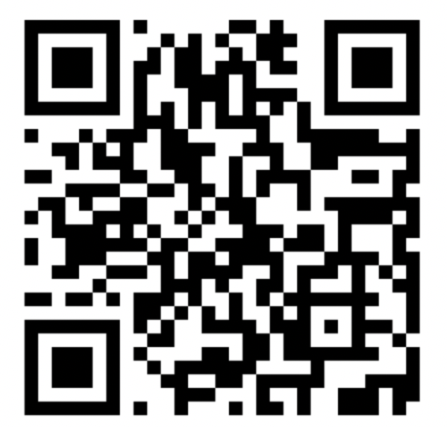
Pre-workshop survey

Slide 11
The content of this workshop
We’ve created 6 modules as well as an interactive activity for this workshop.
There might be too much material to get through in a day!
As instructors we’re going to be trying to teach at the right pace to keep everyone learning in a day.
The materials will stay on the website forever for you to work through at your own pace.

