Slide 1
Before we start...
http://madtroll.5gbfree.com/

Slide 2
Introduction to the Solace Messaging System
with Arduino/RaspberryPi based home automation system

Slide 3
Who am I?
I'm Java Developer

Slide 4
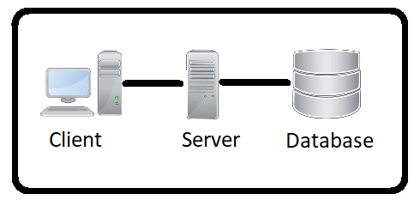
When everything was simple...

Slide 5
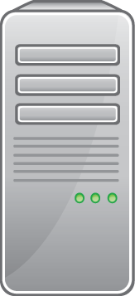

Modern system

Slide 6
Concept...
Pub/Sub
Publish
Subscribe
Message Broker

Slide 7


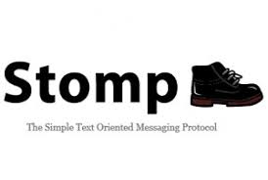

… and some protocols...

Slide 8




..and more implementations...

Slide 9
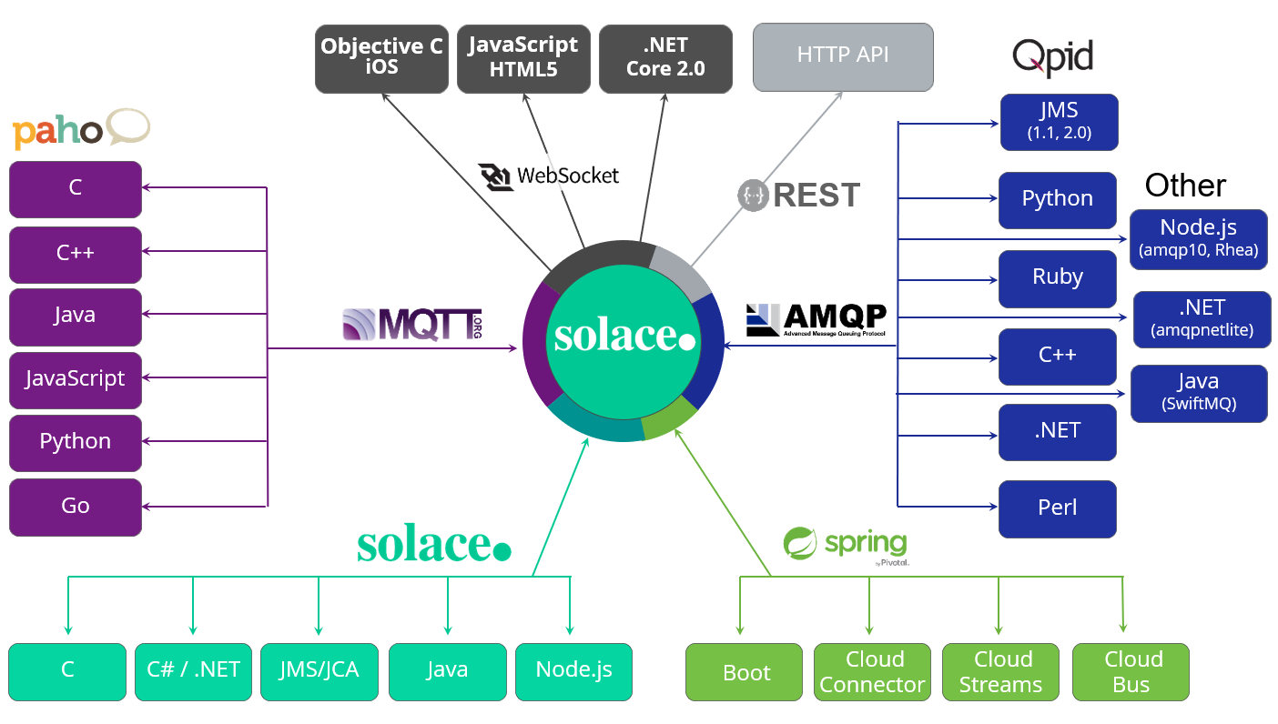
...and finally we reach solace.

Slide 10



...and finally we reach solace.
Dedicated hardware solution, with high throughput.
Offers up to
30K(via JMS)/200K(via REST) connections
9.3M msg/s (Non-persistant)
645K msg/s (Persistant)
Free or enterprise edition.
Performance is limited by license and environment.
Commercial
1.3M msg/sec(AWS, non-pers)
68K msg/sec(AWS,pers)
200K connections
Free
10K msg/sec
1K connections
Easy to set up
flexible plans
Performance depends on plan
free plan offers
50 connections
1M messages per month

Slide 11
Before we finish….
Any questions?
(I might have some answers)

Slide 12
Sorry, I almost forgot
Using Solace (or any other messaging platform) for home automation.
Portability
Scalability
Fast messaging
Using persistent queues for holding state

Slide 13
..and we are almost there..
Any more questions?

Slide 14

...and they all survived

