Slide 1

SENTRI
Project Name: SENTRI-AI
Tagline: Outsmart hackers. Automatically
Team Name: LNC
Event: DevCraft: Simon’s Command Line
Date: 6/04/2026
Domain: CYBERSECURITY

Slide 2
Problem Statement
Every startup building on the web is a target. Yet the security tools available today force founders to choose between two bad options: pay enormous sums for manual experts, or use noisy automated scanners that generate more confusion than clarity.
Budget Constraints: Startups face critical security vulnerabilities but often lack the capital for full-time security teams or expensive manual penetration tests.
Development Velocity vs. Security: High-paced agility and deployment cycles lead to overlooked logic flaws, injection points, and misconfigurations.
Actionability Gap: Developers often receive generic vulnerability scan reports filled with false positives, lacking clear, actionable code remediations. This stalls security fixes.

Slide 3
Target Audience
Early-Stage Startups | Pre-Series A companies building their first production product. They handle real user data but have no dedicated security engineer. SENTRI AI acts as their first line of defence.
Solo Founders | Technical founders wearing every hat — developer, product manager, and now security officer. SENTRI AI automates the security function so they can stay focused on shipping.
Small Dev Teams (2–10) | Fast-moving engineering teams without a dedicated DevOps or SecOps resource. SENTRI AI integrates into their workflow without slowing them down.
Security Consultants | Freelance penetration testers and security auditors who want to scale their service capacity. SENTRI AI acts as a powerful force-multiplier, letting them cover more clients simultaneously.
Growth-Stage Companies | Companies scaling rapidly who need continuous security coverage as their attack surface expands with every new feature and integration.

Slide 4
Existing Solutions
Legacy SAST/DAST Tools (e.g., OWASP ZAP, SonarQube): Often noisy, produce high false-positive rates, and require manual verification.
Enterprise Scanners (e.g., Tenable, Qualys): Complex onboarding processes, bloated feature sets, and highly expensive for startups.
Bug Bounty Platforms (e.g., Hacker One): Reactive approaches that depend on external availability; you only find out you are vulnerable when someone else finds it.
Shortcoming: None of these solutions offer real-time, zero-latency AI deductive reasoning coupled with direct, copy-paste remediation generation.

Slide 5
Gaps & Opportunities
The Gap in Automation: Traditional automated scanners only look for known CVEs (signatures) and lack contextual understanding of business application logic.
The Gap in Manual Testing: Manual pentesting is cost-prohibitive and time-consuming, offering only a point-in-time snapshot of security.
The Opportunity (AI): Leveraging LLMs (Large Language Models) provides human-level deductive reasoning combined with the relentless speed and availability of a machine.
The Opportunity (DevSecOps): Delivering pinpoint code-remediation instantly bridges the gap between finding a flaw and actually fixing it.

Slide 6
Your Solution
An intelligent, automated vulnerability scanning dashboard built specifically to protect startup infrastructure.
Deep Crawling: Integrates Playwright for deep structural web crawling to map live forms, inputs, and routing topologies.
Zero-Latency AI: Employs Groq's Llama 3 models for near-instant, deductive security reasoning to hypothesize and discover vulnerabilities autonomously.
Developer-First: Delivers developer-ready remediation payloads instead of merely raising alerts, acting as an automated Security Engineer.

Slide 7
Key Features
Automated Attack Surface Discovery: Deep-crawls target web apps to extract topologies without tedious manual configuration.
AI-Driven Vulnerability Engine: Utilizes heavily constrained, low-temperature LLMs (Llama-3.3-70b-versatile) trained on hacker methodologies to identify logic flaws.
Remediation Guru: Automatically architects deterministic, copy-paste ready code fixes for every vulnerability discovered.
Dynamic Risk Grading: Calculates and grades overall application risk scores in real-time.
PDF Intelligence Reports: Seamlessly export a complete, multi-page security audit directly from the dashboard.
Cyberpunk UI: A visually stunning, highly-responsive hacker aesthetic interface.

Slide 8
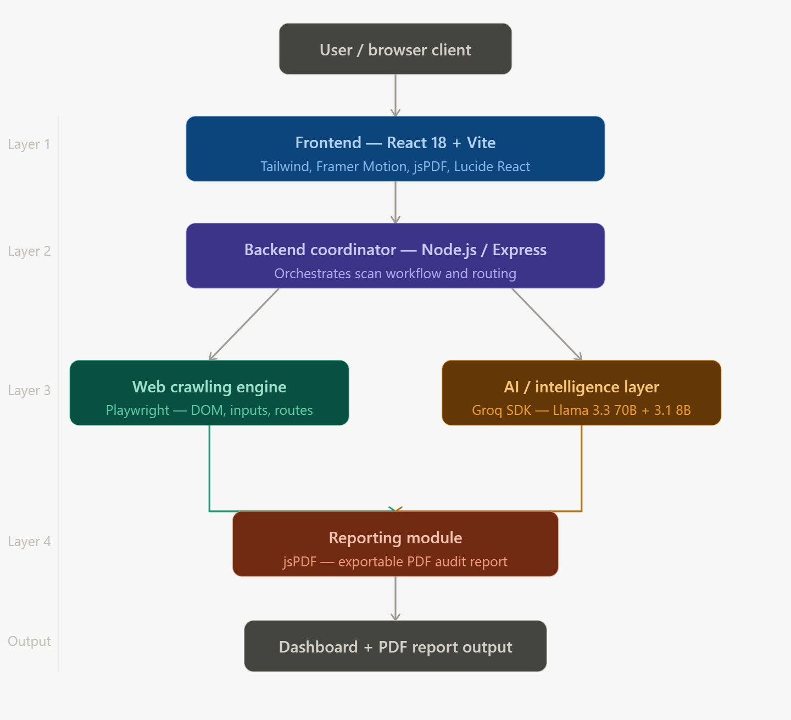
System Architecture

Slide 9
Tech Stack
Frontend: React 18, Vite, Tailwind CSS v4, Framer Motion, Lucide React, jsPDF
Backend: Node.js, Express.js, Playwright
Artificial Intelligence Engine: Groq SDK
AI Models: Llama 3.3 70B & Llama 3.1 8B

Slide 10
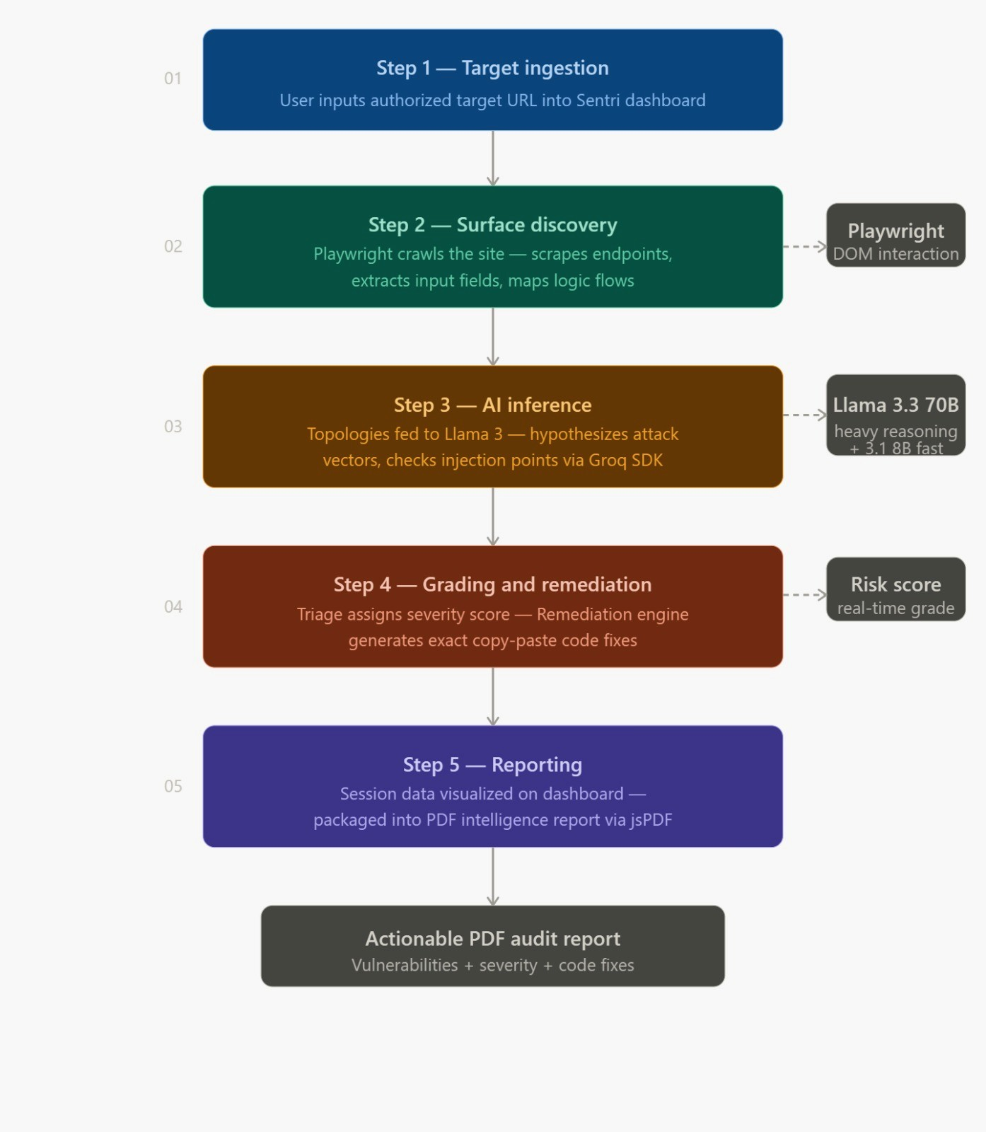
Workflow

Slide 11
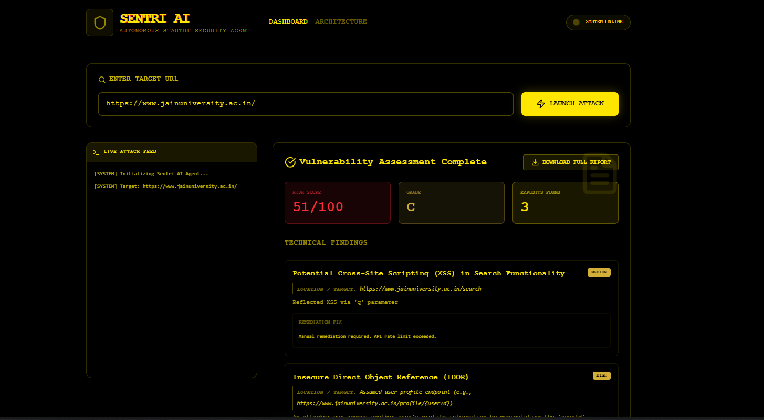
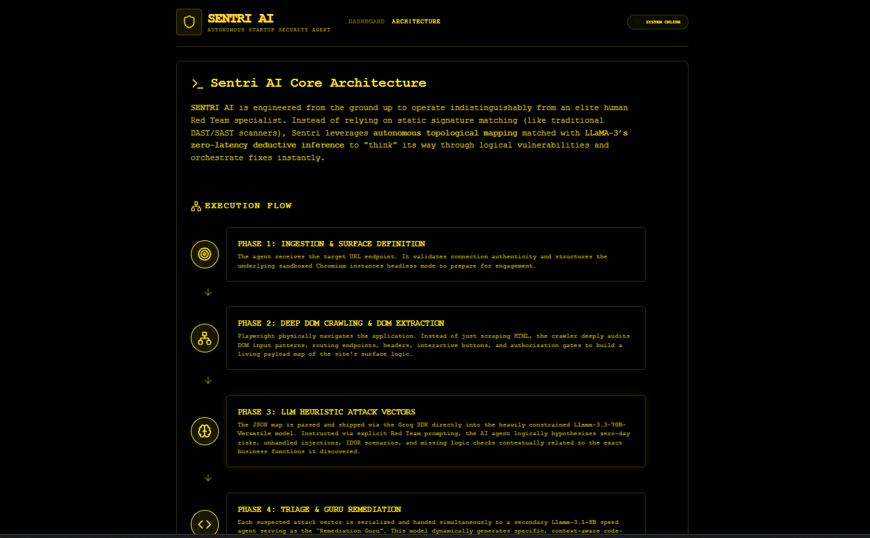
Workflow

Slide 12
Impact
Drastically reduces penetration testing and security auditing costs by upwards of 90% for startups.
Shrinks vulnerability mean-time-to-remediation (MTTR) from weeks down to minutes through reliable copy-paste code fixes.
Democratizes enterprise-grade security intelligence, making it accessible to solo founders and small engineering teams.
Encourages a proactive, continuous security posture over reactive, point-in-time audits.

Slide 13
Future Scope
CI/CD Pipeline Integration: Embedding Sentri directly into GitHub Actions or GitLab CI to block vulnerable PR commits before they hit production. (Next 3 Months)
Multi-Agent Orchestration: Spawning specialized "sub-agents" dedicated to specific vulnerability classes (e.g., an agent strictly for Auth flaws, another for SQLi). (3–9 Months)
Safe Auto-Exploitation Mode: Generating and executing harmless payloads to verifiably prove a vulnerability exists before reporting it, driving false positives to zero. (9–18 Months)
Compliance Mapping: Automatically cross-referencing found vulnerabilities with SOC2, GDPR, and HIPAA compliance frameworks.

Slide 14
Team Info
NITIN :Backend
Arsh Saiyed:Frontend
Rithanya: AI - Intergration
Dhruv Mehta: Github / Logics

