Slide 1
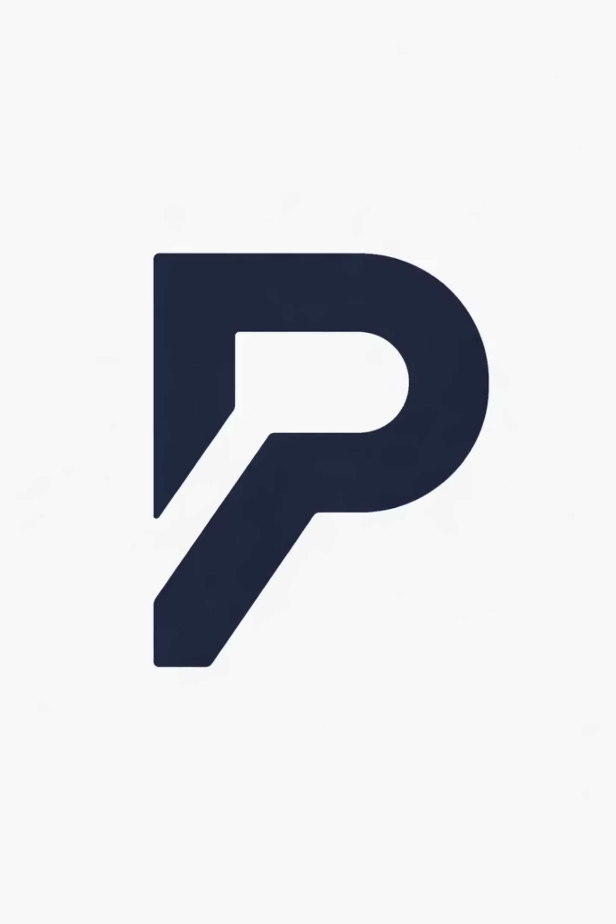
ProjectVault — Academic Version Control System
Simple, visual version tracking for student projects
M. Manaswini - 24BTRCT160
Diya J - 24BTRIS057
Krish Sakaria - 24BTLCC003
D Nitin Kumar - 24BTRCM008
Guide1 - Dr. Srinivasa Rao
Guide 2 - Dr. Tamilvelan M

Slide 2
Table of Contents
Problem Statement
Research and Literature
Drawbacks and Limitations
Proposed Solution
Tech Stack
Comparison
Expected Outcomes
Future Addons
Conclusion

Slide 3
Problem Statement
01
02
Lost Versions
Too Complex
Students often lose track of project versions
GitHub is too complex for non-CS users
03
04
Limited Features
Missing Solution
Google Drive/Dropbox lack structured rollback
No platform exists that is made for academic project versioning with rollback and timeline

Slide 4
Market Research & Literature Review
Platforms Reviewed
Key Finding
GitHub
GitLab
Google Drive
Dropbox
Notion
Word
Overleaf
ProjectBuddy
TimeTravel
Docu-Pile
Shapehub
Freedcamp
Google Docs
GitHub & GitLab: Offer robust code versioning and collaboration tools, but their steep learning curve and command-line interface make them too complex for many non-CS academic users who primarily work with documents and diverse file types.
Google Drive & Dropbox: Provide easy file sharing and basic version history, allowing users to revert to previous file states. However, they lack structured rollback capabilities for entire projects and a clear, detailed timeline view of changes.
Notion & Overleaf: Excel in organization, knowledge management, and collaborative document creation (especially for LaTeX in Overleaf's case). Yet, they are not primarily designed for comprehensive academic project versioning with the specific rollback and visual timeline features needed for all project components.
None of the reviewed platforms currently offer a truly user-friendly, academic-focused solution that combines intuitive visual timelines and structured rollback mechanisms, making them suitable for diverse project types and non-technical users.

Slide 5
Our Research Conclusion
After deep feature analysis, no single platform matches our system exactly
GitHub
Drive
Notion
Developer-focused, no visual rollback, too complex
No full project versioning, only per-file
No file rollback or structured project views
ProjectBuddy
Google Docs
Docu-Pile
Project submission tracker, lacks version history and timeline rollback
Real-time collaboration, but no structured project versioning or rollback capabilities
Document organization tool, but lacks version control and automated rollback features
ProjectVault stands unique in addressing academic project workflows

Slide 6

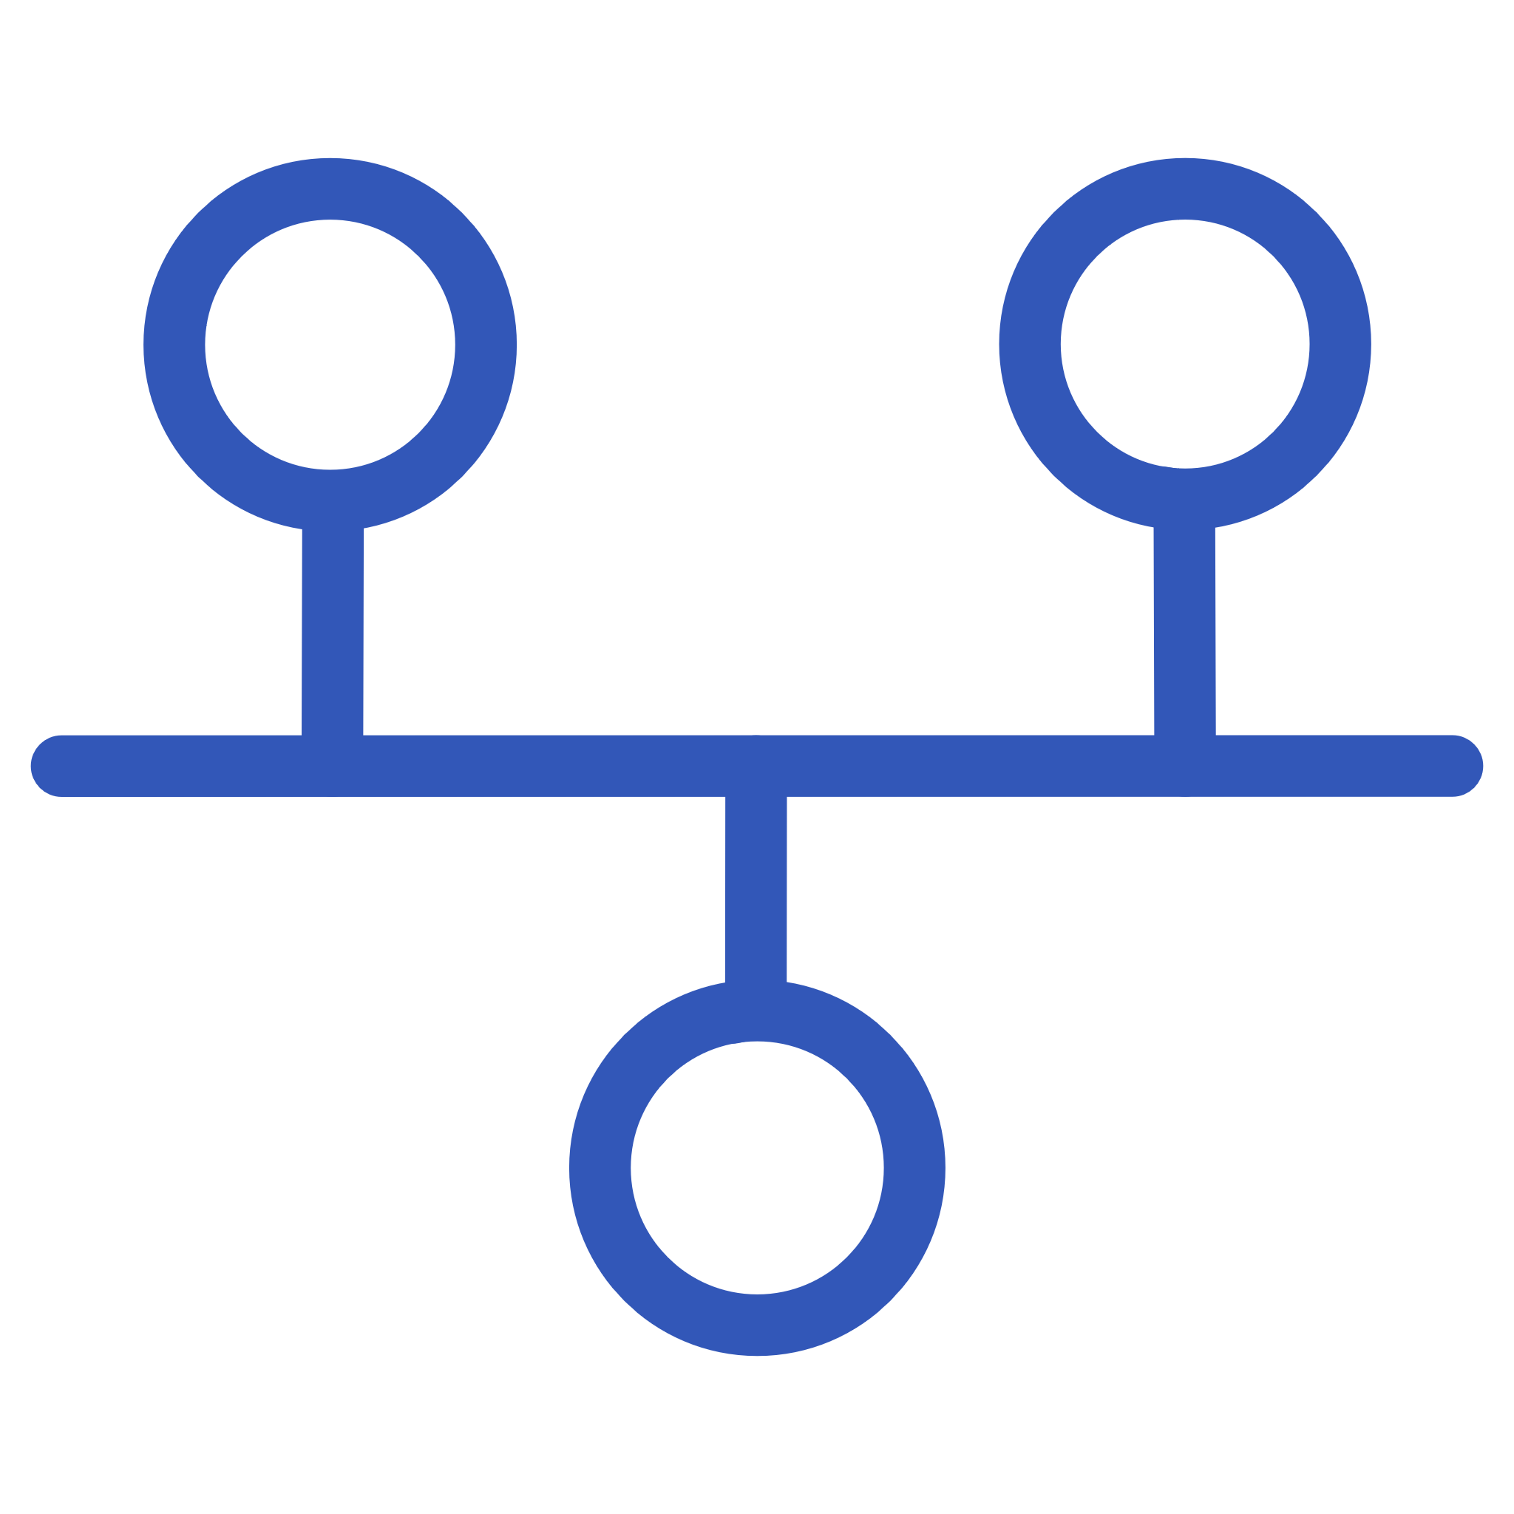
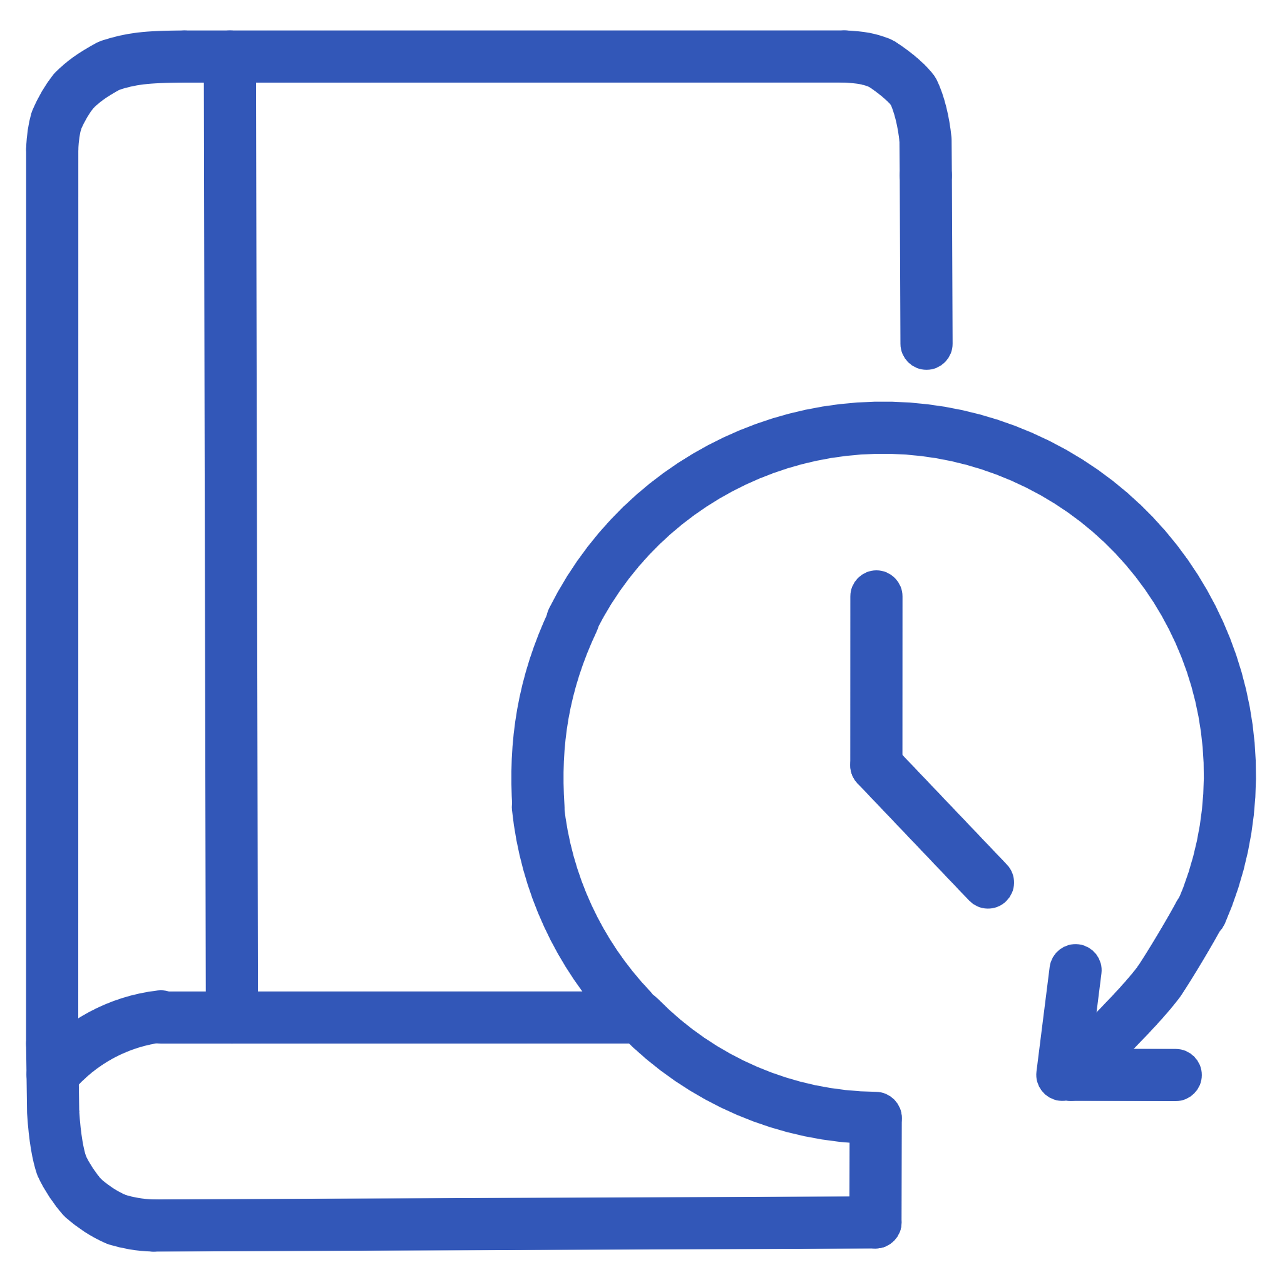


Our Solution — ProjectVault
What it does:
Auto-saves every change
Visual timeline of versions
Allows rollback to any previous state
Automatically captures all modifications in real-time
Prevents data loss from crashes or accidental closures
See a clear graphical history of all changes
Track project evolution and identify key milestones
Instantly revert to any past version
Experiment freely without fear of permanent mistakes
Supports any file types: Docs, PDFs, Code
Simple UI built for students
Works with documents, presentations, code files, Pdf, word, GIF, Jpg/Png etc…
Centralize all project assets in one place
Intuitive interface designed for non-technical users
Focus on studies, not learning complex software

Slide 7
Tech Stack
Layer
Tool
Frontend
React / React Native
Styling
TailwindCSS
Backend
Python (FastAPI/Flask)
Database
SQLite
Storage
Local / Cloud bucket (In Future)
Hosting
Render / Vercel

Slide 8
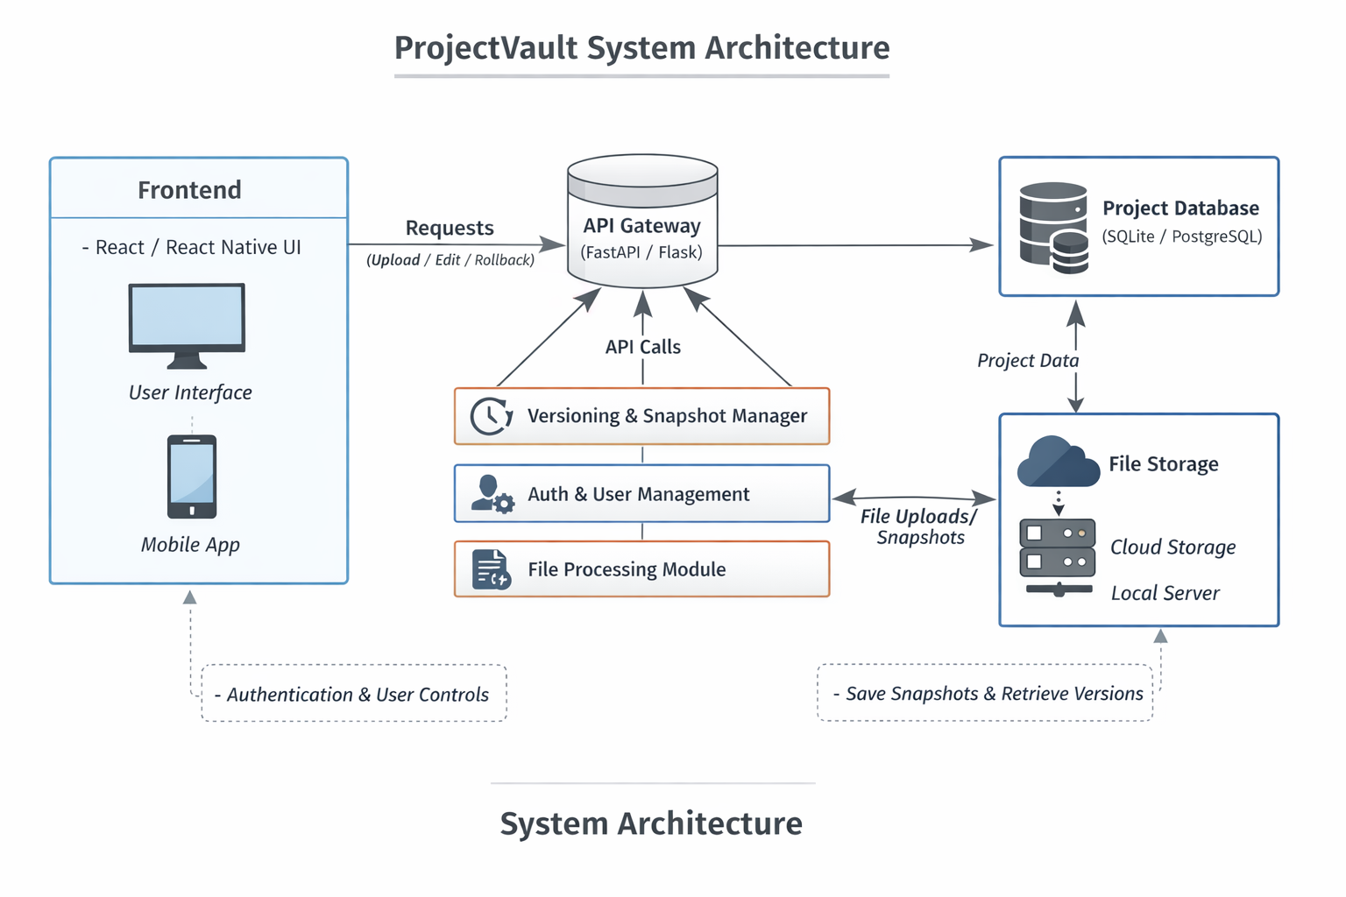

Slide 9
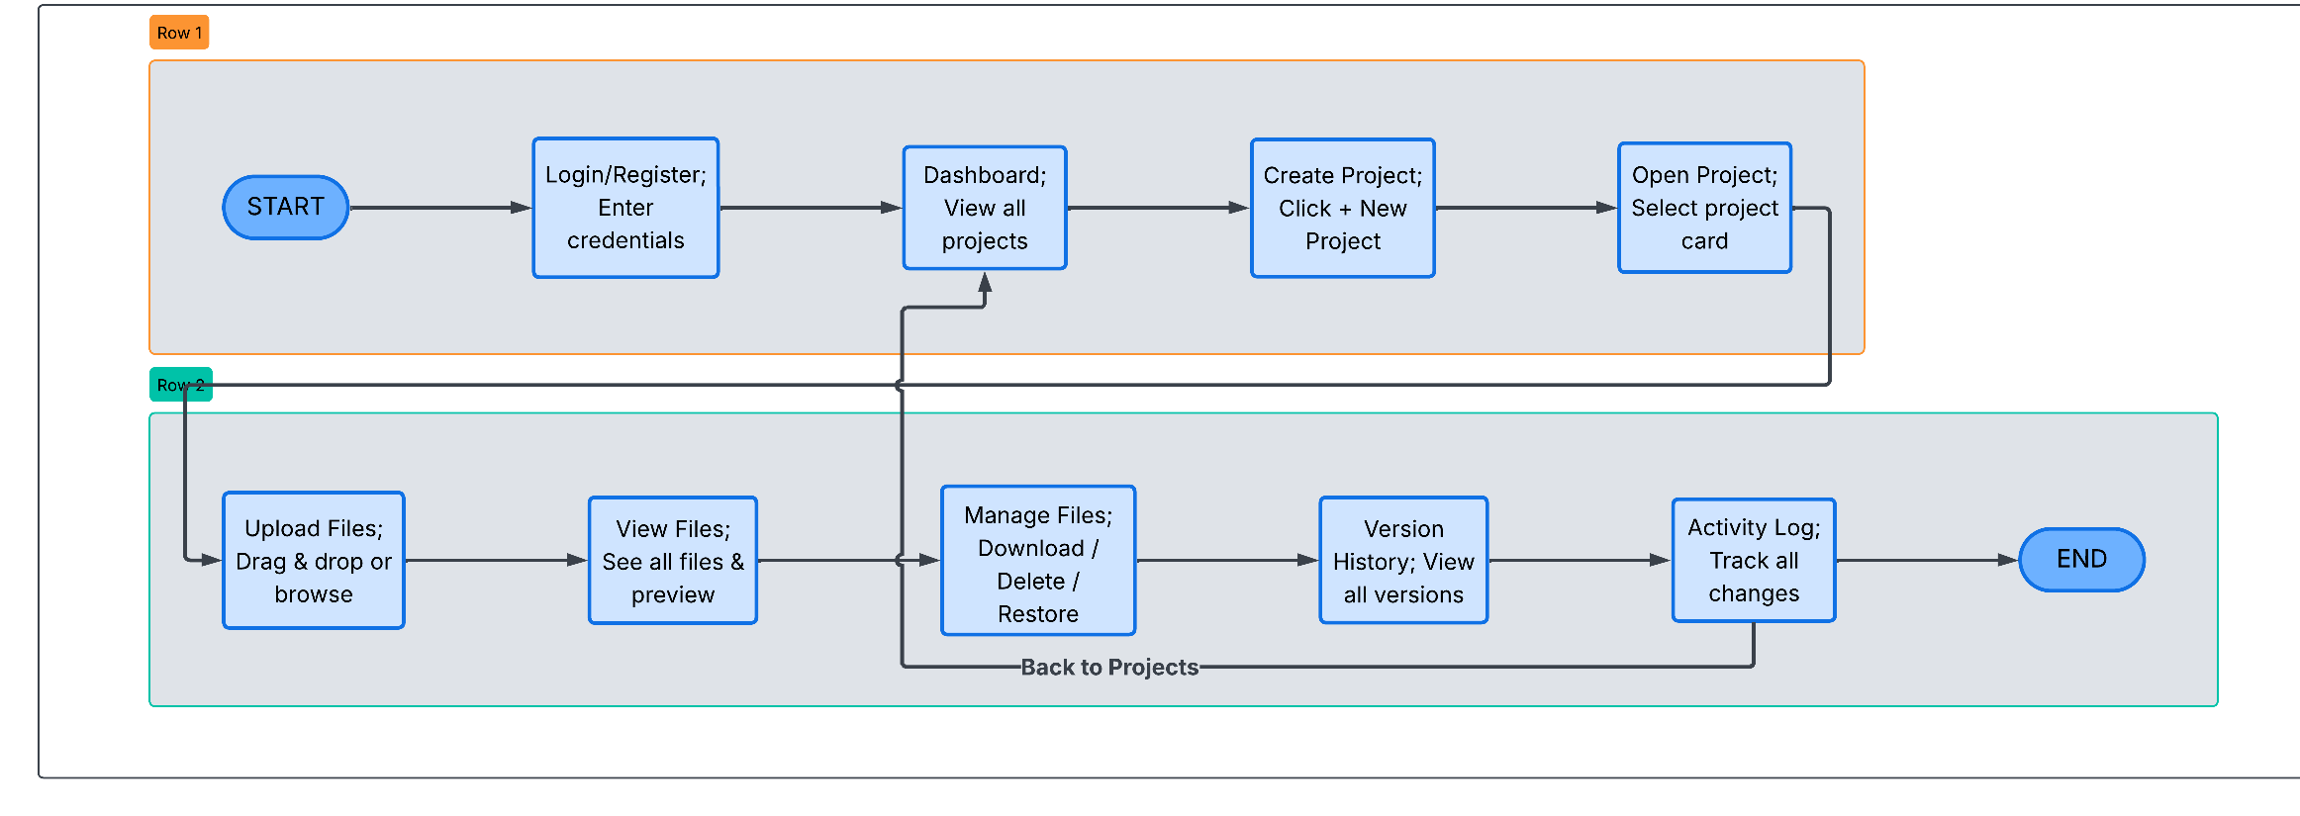
Working Flow of ProjectVault

Slide 10
Comparison Table
Tabular format showing comparison of ProjectVault vs GitHub, Drive, Notion, etc.
Feature
ProjectVault
GitHub
Drive
Notion
ProjectBuddy
Academic Focus
✓
✗
✗
✗
✗
Visual Timeline
✓
✗
✗
✗
✗
Auto Rollback
✓
Manual
Limited
✗
✗
Simple UI
✓
✗
✓
✓
✓
Project Versioning
✓
✓
Per-file only
✗
✗
Highlight ProjectVault's unique combo of academic focus + visual timeline + auto rollback

Slide 11

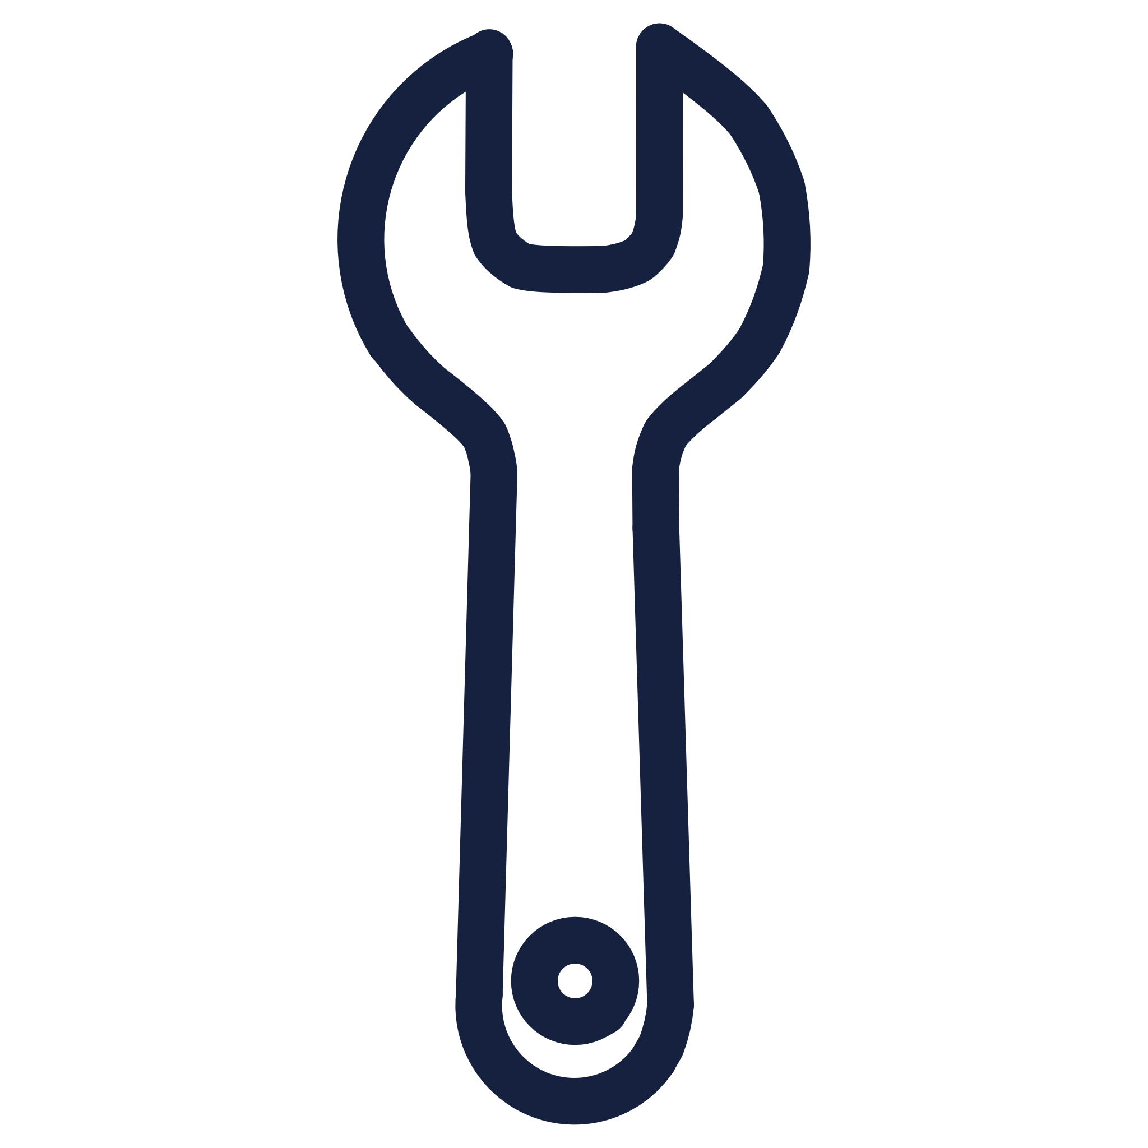


Learning Outcomes / Personal Benefit
Full-Stack Experience
Technical Skills
Full-stack product dev experience
Hands-on with backend systems, databases, deployment
Problem Solving
Career Growth
Solving a real academic problem = confidence boost
Great for portfolio + internships + open source exposure

Slide 12
Future Scope
01
02
Instructor Portal
Collaboration Features
Instructor portal for version-based grading
Commenting & collaboration within versions
03
04
LMS Integration
Public Profiles
LMS plugins for Canvas/Moodle integration
Public project profiles (academic GitHub style)

Slide 13
Conclusion
ProjectVault is the missing link in academic project workflows offering Git-like control with Google Drive-like simplicity.
It eliminates version confusion, prevents data loss, and streamlines collaboration.
Our system brings together the best aspects of file tracking, rollback, and version visualization tailored to academia.
We’re confident ProjectVault can be adopted by students, teams, and academic institutions at scale.

