Slide 1

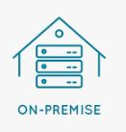
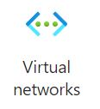

VPN Gateways
send and receive encrypted traffic between
encrypted tunnel across the Microsoft network backbone
encrypted tunnel across the Microsoft network backbone

Slide 2
VPN gateway three architectures Point to site over the internet Site to site over the internet Site to site over a dedicated network, such as Azure ExpressRoute
VPN Gateway types
PolicyBased
RouteBased
Local Network Gateway

Slide 3
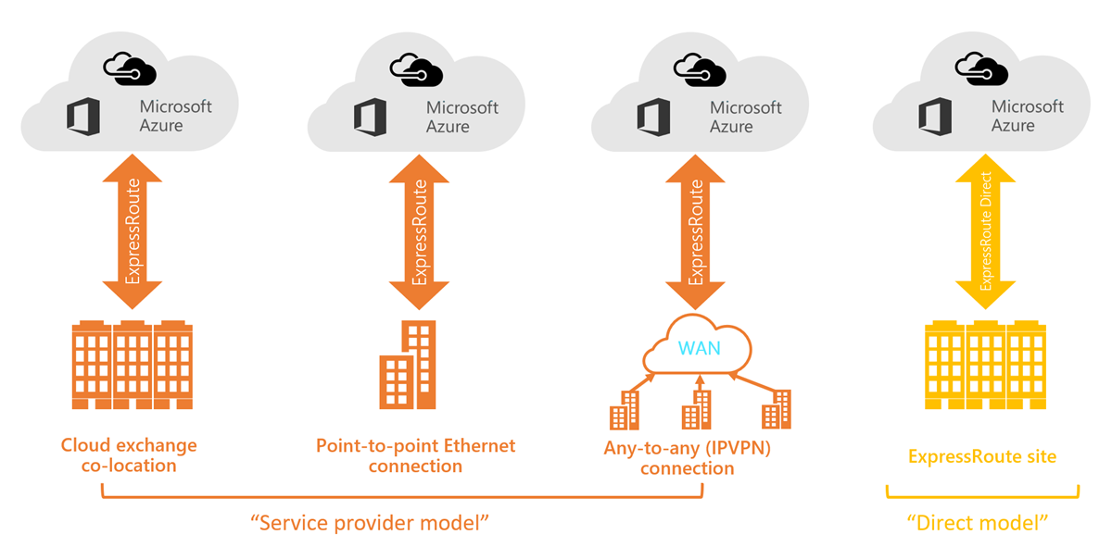
Azure ExpressRoute

