Slide 1
Flask Authentication Workflow
Notes:
The Tools of the Trade, Password Hashing with Bcrypt, Database Helpers and Initialization, The User Class and UserMixin, The User Loader Mechanism, The Login Logic, Access Control and Logout

Slide 2
The Tools of the Trade
Flask Web Framework
Flask manages HTTP requests, URL routing, and responses, forming the backbone of user flow in web applications.
SQLite3 Database
SQLite3 stores usernames and hashed passwords securely in a lightweight, file-based database ideal for small deployments.
Flask-Login Session Manager - Flask-Login 0.7.0 documentation
Flask-Login manages user sessions, tracking login status via session cookies tied to user identities.
Bcrypt Password Hashing
Bcrypt secures passwords by applying strong one-way hashing with unique salts, protecting against data breaches.
Notes:
This slide explores the foundational components that make up the Flask authentication stack, each playing a vital role in ensuring smooth and secure user management. Flask operates as the core web framework responsible for handling HTTP requests, routing URLs, and returning responses, making it the backbone of the application's user flow. SQLite3 serves as the lightweight and file‑based database engine used to store sensitive user information—specifically usernames and hashed passwords—in a compact and portable manner, ideal for development and small‑scale deployments. Flask‑Login functions as the session and authentication manager, seamlessly keeping track of whether a user is logged in by associating session cookies with active user identities. Finally, Bcrypt provides the crucial security layer by hashing passwords using strong one‑way hashing algorithms combined with unique salts, ensuring stored passwords cannot be reversed or exploited even if the database is compromised. Together, these tools form a cohesive authentication stack that balances simplicity, security, and performance while adhering to industry‑standard best practices for user identity management.

Slide 3

Password Hashing with Bcrypt
One-way Password Hashing
Bcrypt hashes passwords in a one-way process, preventing retrieval of the original password.
Salting for Security
Unique salts are added to each password to ensure even identical passwords have different hashes.
Secure Password Verification
Bcrypt compares typed passwords with stored hashes securely without exposing the original password.
Protection Against Attacks
Using bcrypt strengthens resistance to brute-force and rainbow table attacks through expensive hashing.
Notes:
This slide details how password security is enforced through hashing using the Bcrypt library. Unlike encryption—which is reversible—hashing is a one‑way transformation, meaning the original password cannot be retrieved from its hashed output. During user registration or password updates, the bcrypt.hashpw function processes the supplied plaintext password by applying a computationally expensive hashing algorithm combined with a unique salt; this produces a hash string resembling patterns like $2b$12$7k.... This salt ensures that even identical passwords yield different hash values, significantly increasing resistance to brute‑force and rainbow table attacks. When a user attempts to log in, bcrypt.checkpw is employed to compare the typed password with the database’s stored hash. Importantly, the application never stores raw passwords such as "password123"—only salted and hashed representations, aligning with modern cybersecurity standards and minimizing the impact of potential database leaks. This approach establishes a robust defense against unauthorized access and strengthens overall system integrity.

Slide 4
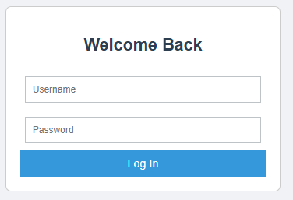
Database Helpers and Initialization
Reusable Database Connection
The get_db_connection() function opens the users.db connection for data operations, enhancing reliability.
Improved Data Access
Using sqlite3.Row row_factory allows accessing query results with dictionary-like keys for clarity.
Database Initialization
The init_db() function creates the users table if missing and inserts a default admin account at startup.
Notes:
This slide explains how the application interacts with the SQLite database using helper functions designed for convenience and reliability. The get_db_connection() function acts as a reusable gateway for opening a connection to the users.db file each time data must be read or written. By configuring row_factory to sqlite3.Row, database results become accessible using dictionary‑like keys (e.g., user['username']), eliminating confusion associated with numeric index lookups and improving code readability. The init_db() function is executed once during system startup to guarantee that the required users table exists; if it does not, the function automatically creates it. Additionally, the initialization process inserts a default administrator account, ensuring that the application always has at least one valid login available immediately after setup. Together, these components simplify database operations while maintaining consistency and preventing common schema‑related errors during early stages of application deployment.

Slide 5
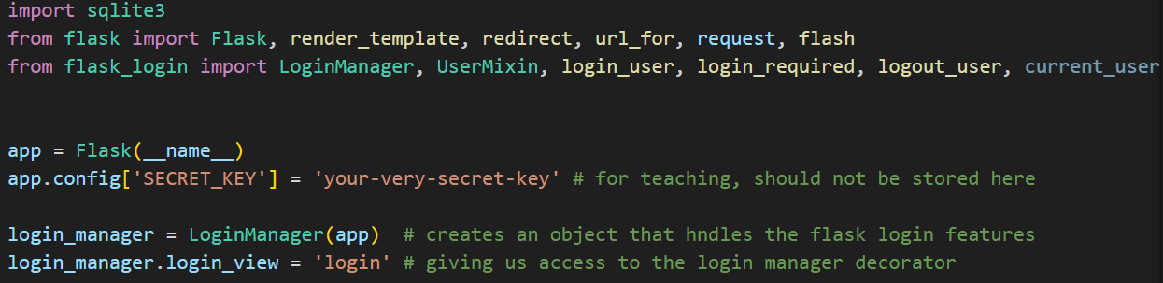
Configure the app
Notes:
This slide focuses on how Flask‑Login expects a user object to encapsulate identifying and authentication‑related attributes. Since SQLite returns raw data rows, the application uses a dedicated User class to convert these rows into Python objects that better integrate with the framework. By inheriting from Flask‑Login’s UserMixin, the User class automatically acquires essential methods and properties such as is_authenticated, is_active, is_anonymous, and get_id(). These attributes allow Flask‑Login to determine whether a user is logged in, manage session persistence, and identify the active user across requests without requiring custom logic for each function. The User class effectively bridges the gap between database representation and application‑level identity management, ensuring smooth interaction with session handlers and route protection mechanisms.

Slide 6
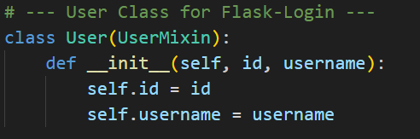
The User Class and UserMixin
User Class Purpose
This specific block of code is the blueprint for the User object that Flask-Login uses to track who is currently signed into your website.
Think of it this way: Your database stores a row of text (like 1, admin, $2b$...), but Python needs an object with attributes (like user.id and user.username) to actually run logic in your code.
Role of UserMixin
This is the most important part of that line. UserMixin is a helper class provided by Flask-Login. By including it in the parentheses, your User class "inherits" four specific methods that Flask-Login requires to manage sessions:
is_authenticated: Returns True if the user has provided valid credentials.
is_active: Returns True if the account is active (not banned/suspended).
is_anonymous: Returns True only for "fake" users who aren't logged in.
get_id(): Returns a unique string to identify the user (usually the primary key from your DB).
Session and Identity Management
These attributes enable Flask‑Login to handle user sessions and identify active users seamlessly.
Notes:
This slide focuses on how Flask‑Login expects a user object to encapsulate identifying and authentication‑related attributes. Since SQLite returns raw data rows, the application uses a dedicated User class to convert these rows into Python objects that better integrate with the framework. By inheriting from Flask‑Login’s UserMixin, the User class automatically acquires essential methods and properties such as is_authenticated, is_active, is_anonymous, and get_id(). These attributes allow Flask‑Login to determine whether a user is logged in, manage session persistence, and identify the active user across requests without requiring custom logic for each function. The User class effectively bridges the gap between database representation and application‑level identity management, ensuring smooth interaction with session handlers and route protection mechanisms.

Slide 7
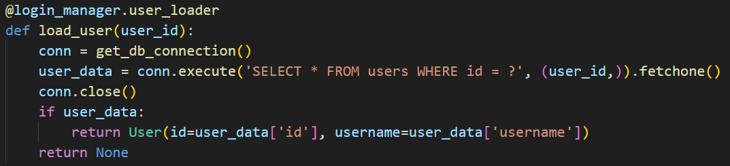
The User Loader Mechanism
Session Persistence Challenge
HTTP is stateless, so identification must be restored after each request to maintain user sessions.
User ID in Secure Cookie
Flask stores a user_id in a secure session cookie on the client's browser to track user identity.
Database Query for User
The @user_loader function queries the database using the stored user_id to retrieve user records.
User Object Rehydration
The user_loader rebuilds a User object to maintain authentication across page loads without re-login.
Notes:
This slide describes the user_loader callback that Flask‑Login invokes to rebuild user objects from stored session data. Because HTTP is stateless, browsers forget who the user is after each request unless a method exists for restoring identity. Flask solves this by storing a simple user_id value inside a secure session cookie on the client’s browser. When the user accesses a new route—such as /dashboard—Flask‑Login automatically calls the registered @user_loader function, passing it the stored user_id. The loader then queries the SQLite database, retrieves the corresponding user record, and reconstructs the appropriate User object, enabling the application to recognize the current visitor. This process, often described as re‑hydration, ensures seamless authentication continuity across page loads without requiring users to repeatedly log in or revalidate credentials.

Slide 8
The Login Logic
User Authentication Flow
The login process begins with submitting credentials and verifying the username in the database.
Password Verification
Plaintext password is securely compared against the stored hash using bcrypt for authentication.
Session Creation
Upon successful login, a session is created and user_id stored in a cookie for persistent access.
Notes:
This slide outlines the sequence of events that occur when a user attempts to sign in. When the login form is submitted, the browser issues a POST request containing the provided username and password. The application first queries the SQLite database to verify whether an account with the supplied username exists. If a matching user is found, the plaintext password entered is validated using bcrypt.checkpw, which compares it securely to the stored hashed password. Upon successful authentication, the login_user(user_obj) function is invoked; this instructs Flask‑Login to create a session for the authenticated individual and store their user_id in a session cookie. This session persists across page loads, enabling the application to recognize the user until they choose to log out or their session expires. This pipeline ensures a secure, validated, and persistent login experience.

Slide 9

Access Control and Logout
Route Protection
The @login_required decorator ensures sensitive pages are accessible only to authenticated users.
User Session Access
The current_user proxy provides access to active user details for personalized experiences.
Logout Functionality
logout_user() clears user session data to prevent unauthorized access after signing out.
Notes:
This slide introduces route protection and logout functionality within the Flask authentication system. The @login_required decorator safeguards sensitive pages—such as dashboards or admin panels—by verifying that a valid authenticated session exists before allowing access. If a non‑authenticated visitor attempts to access such a route, Flask‑Login automatically redirects them to the login page. Meanwhile, the current_user proxy provides template and backend access to the active user's details, allowing features like personalized greetings (e.g., “Welcome, admin!”). When the user decides to sign out, logout_user() is executed to remove their user_id from the session and clear authentication data, preventing unauthorized use of their session and effectively returning the application to a secure default state. Together, these mechanisms ensure strong access control and proper session termination.

