Slide 1

The problem of choosing the location of a coffee shop in the Toronto Neighborhood
Author:Tao wang
Date:2021-06-01

Slide 2
The description of the problem and a discussion of the background
Question: Which place is more appropriate to open a coffee shop in the Toronto Neighborhood? A coffee shop owner wants to open a new coffee shop in the Toronto Neighborhood. He needs to know where to choose and will have a higher probability of getting customers?
Background: First explain that everything is hypothetical. On a train, I had a communication with a coffee shop owner. I learned from the communication that the coffee shop owner wanted to expand his store in the Toronto Neighborhood, and he wanted to know which communities in Toronto are more suitable for opening coffee shops. Because the boss is more anxious and has no cost considerations, professional data such as passenger flow, regional economy, and regional population types cannot be obtained, and can only be analyzed with the help of Internet information.

Slide 3
The description of the data and how it will be used to solve the problem
Data description: Considering the time and cost issues, I chose to obtain data from the Internet. The composition of the data is mainly divided into two parts:
Toronto Neighborhood information, which mainly includes community name and community Geo information.
Toronto Neighborhood venue distribution information, the main information includes: the venue belongs to the Neighborhood information, place type, place name
Problem-solving ideas:
Through statistical analysis of the distribution of coffee shops in all communities in Toronto, we look for communities with relatively few coffee shops for selection. While selecting objects, it is also necessary to observe the actual number of shops in the community to avoid the validity of the calculated data in the real environment.

Slide 4
Introduction where you discuss the business problem and who would be interested in this project
Business question: Which place to open a coffee shop in the Toronto Neighborhood is more appropriate. A coffee shop owner wants to open a new coffee shop in the Toronto Neighborhood. He needs to know where to choose and will have a higher probability of getting customers?
Understanding of the problem: According to the conventional understanding, choosing a Neighborhood with a small number of coffee shops to open a store will have a higher probability of acquiring customers. Therefore, the business problem can be simply understood as: looking for a Neighborhood with a relatively small number of coffee shops.
Concerned about the problem: The owner who seeks to open a coffee shop in the Toronto Neighborhood.

Slide 5
Data where you describe the data that will be used to solve the problem and the source of the data
Toronto Neighborhood Data
Data source:
https://en.wikipedia.org/wiki/List_of_postal_codes_of_Canada:_M
Data structure:
Number of data: 103 rows
Toronto Neighborhood venue Data
Data source:
https://api.foursquare.com/v2/venues/explore
Data structure:
Number of data: 1096 rows
Field | Type
PostalCode | object
Borough | object
Neighborhood | object
Field | Type
Neighborhood | object
Neighborhood Latitude | object
Neighborhood Longitude | object
Venue | object
Venue Latitude | float64
Venue Longitude | float64
Venue Category | object

Slide 6
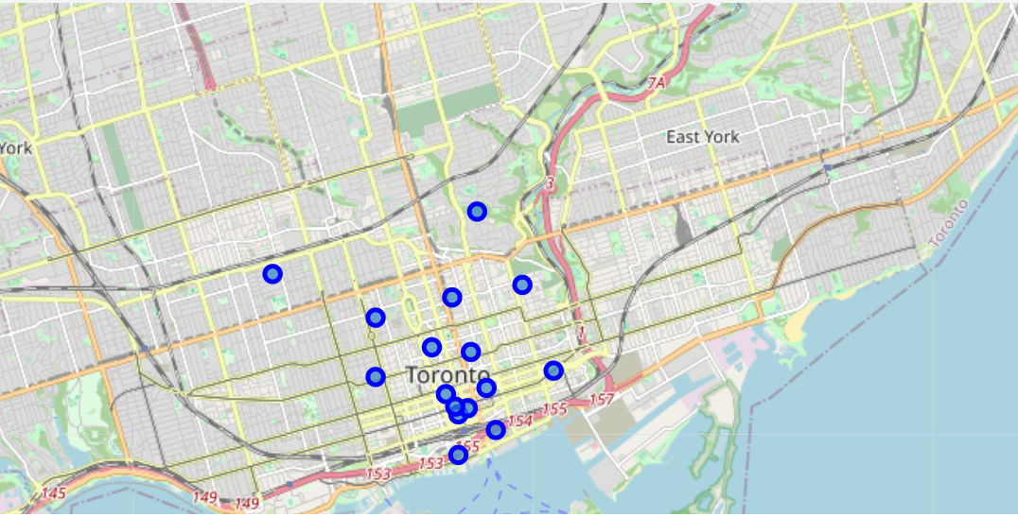
Methodology section
Index | Neighborhood | Venue | CoffeeShop | Percent
0 | BerczyPark | 59 | 6 | 10%
1 | CNTower,KingandSpadina,RailwayLands,Har... | 14 | 0 | 0%
2 | CentralBayStreet | 61 | 11 | 18%
3 | Christie | 16 | 1 | 6%
4 | ChurchandWellesley | 80 | 6 | 8%
5 | CommerceCourt,VictoriaHotel | 100 | 14 | 14%
6 | FirstCanadianPlace,Undergroundcity | 100 | 12 | 12%
7 | GardenDistrict,Ryerson | 100 | 9 | 9%
8 | HarbourfrontEast,UnionStation,TorontoIslands | 100 | 13 | 13%
9 | KensingtonMarket,Chinatown,GrangePark | 64 | 4 | 6%
10 | RegentPark,Harbourfront | 45 | 8 | 18%
11 | Richmond,Adelaide,King | 92 | 10 | 11%
12 | Rosedale | 4 | 0 | 0%
13 | St.JamesTown | 83 | 6 | 7%
14 | St.JamesTown,Cabbagetown | 46 | 4 | 9%
15 | TorontoDominionCentre,DesignExchange | 100 | 11 | 11%
16 | UniversityofToronto,Harbord | 32 | 0 | 0%
The First: on the basis of business understanding, determine the use of descriptive statistical analysis as a method to solve the problem, and then build the model.
The second step: complete the preparation of the data, clarify and reconstruct the content of the acquired data, the goal is to facilitate the establishment of the model.
The third step: find out the algorithm that can solve the problem and complete the model establishment. The key to the problem is to find out which Neighborhood has fewer coffee shops. There are two levels of understanding of less: one is that the number of specific coffee shops is small, and the other is that the proportion of coffee shops to the total number of venue in the area is small. . Both levels have practical significance, so it is necessary to find algorithms to solve them separately.

Slide 7
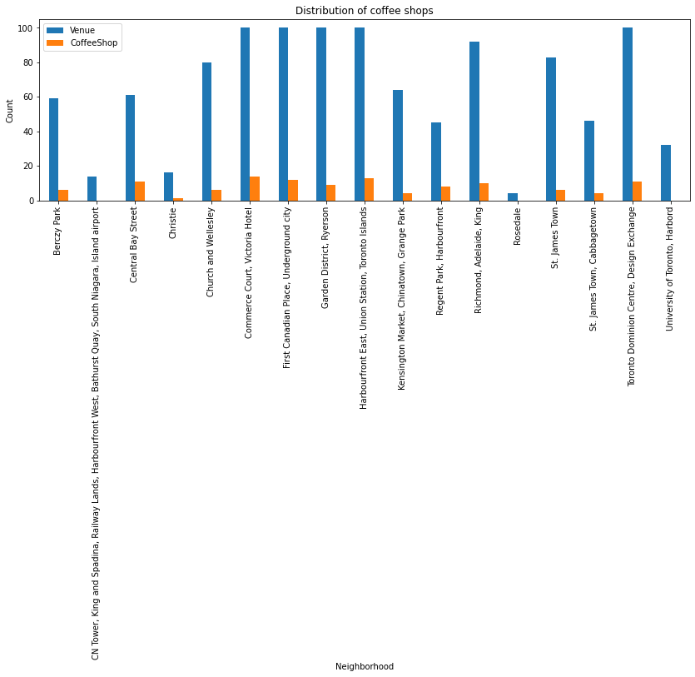
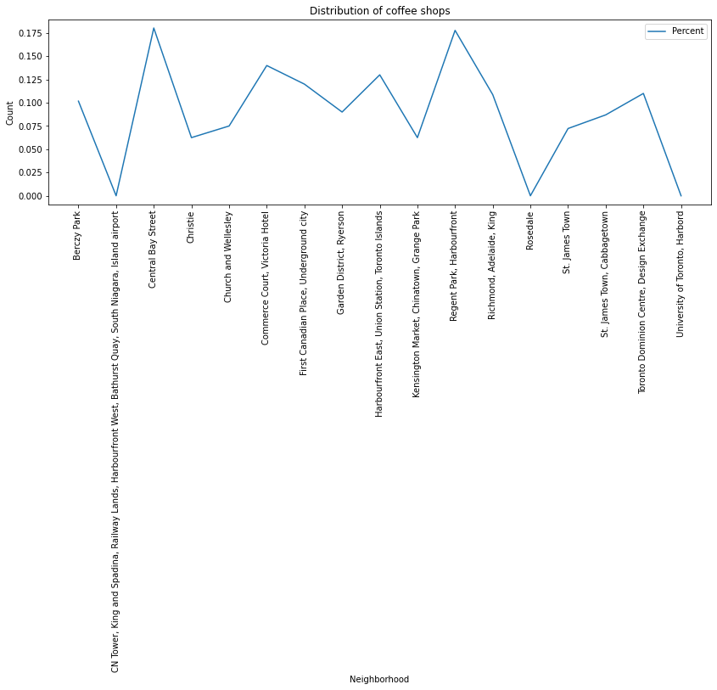
Results section where you discuss the results
There are Neighborhoods without coffee shops:"Rosedale","CN Tower, King and Spadina, Railway Lands,AirPort","University of Toronto, Harbord"
Except for the Neighborhoods without coffee shops, the Neighborhoods with the fewest coffee shops is:"Christie", the number is: 1.
Except for the Neighborhoods without coffee shops, the Neighborhoods with the least proportion of coffee shops are:"Christie" and "Kensington Market, Chinatown, Grange Park", and the proportion is:6.25%.
Except for the Neighborhoods without coffee shops, the Neighborhoods where the number and proportion of coffee shops are relatively small are:"Christie","Church and Wellesley","Kensington Market, Chinatown, Grange Park","St. James Town","St. James Town, Cabbagetown", number:<=6 & proportion:<10%.

Slide 8
Discussion and Recommendations section
For Neighborhoods without coffee shops, it is necessary to consider whether there is any inaccurate data acquisition. If data issues are excluded, it is recommended to choose to open coffee shops in Neighborhoods without coffee shops, unless the Neighborhood does not allow them to be established.
Comparing the analysis of "small number and small proportion", The small proportion can more accurately describe the unsaturation of the coffee shop in the Neighborhood, so priority is given to opening a coffee shop in "Christie" and "Kensington Market, Chinatown, Grange Park" Neighborhoods
Neighborhoods with relatively small numbers and proportions can also be used as candidate Neighborhoods to focus on.

Slide 9
Through the study of the course, I learned about the meaning and methods of data science. With regard to the location of the Toronto community coffee shop, I used the knowledge of data science to try to solve the problem in accordance with the steps of business understanding, data understanding, data preparation, modeling, evaluation and description. Although many unfamiliar places were encountered during the homework, they all tried to solve them. In the follow-up, I will try to continue to learn and use data science methods to solve problems at work.
- I am very happy to learn this course and I have learned a lot

