Slide 1
CSE 10124 Self-Attention

Slide 2
Recurrent Neural
Networks - Training
“like”
“cute”
“...”
“and”
Expected
<1.00, 0.00, 0.00, 0.00, 0.00, 0.00, 0.00, 0.00, 0.00, 0.00>
<0.00, 0.00, 1.00, 0.00, 0.00, 0.00, 0.00, 0.00, 0.00, 0.00>
<...>
<0.00, 0.00, 0.00, 0.00, 0.00, 0.00, 1.00, 0.00, 0.00, 0.00>
ℒ = Cross Entropy Loss
ℒ = Cross Entropy Loss
ℒ = Cross Entropy Loss
ℒ = Cross Entropy Loss
Predicted
<0.18, 0.14, 0.13, 0.12, 0.10, 0.09, 0.08, 0.07, 0.05, 0.04>
<0.11, 0.16, 0.13, 0.21, 0.10, 0.08, 0.07, 0.06, 0.05, 0.03>
<...>
<0.07, 0.15, 0.14, 0.10, 0.09, 0.08, 0.25, 0.05, 0.04, 0.03>
y₁ = softmax(b_{y} + h₁w_{y})
tanh(h₀w_{h}+ ex₀w_{x} + b_{h}) = h₁
y₂ = softmax(b_{y} + h₂w_{y})
tanh(h₁w_{h}+ ex₁w_{x} + b_{h}) = h₂
…
y_{t} = softmax(b_{y} + h_{t-1}w_{y})
tanh(h_{t-2}w_{h}+ ex_{t-1}w_{x} + b_{h}) = h_{t-1}
h₀
ex₀ = embeddings[xt₀]
ex₁ = embeddings[xt₁]
ex_{t-1} = embeddings[xt_{t-1}]
[xt₀, xt₁, …, xt_{t-1}] = tokenizer(X)
X = “I like cute kittens and”

Slide 3
Recurrent Neural
Networks - Inference
Output
“puppies”
tokenizer.decode(6)
yt_{t+1} = 6
<0.07, 0.15, 0.14, 0.10, 0.09, 0.08, 0.25, 0.05, 0.04, 0.03>
…
y_{t+1} = softmax(b_{y} + h_{t}w_{y})
tanh(h_{t-1}w_{h}+ ex_{t}w_{x} + b_{h}) = h_{t}
h₀
tanh(h₀w_{h}+ ex₀w_{x} + b_{h}) = h₁
tanh(h₁w_{h}+ ex₁w_{x} + b_{h}) = h₂
ex₀ = embeddings[xt₀]
ex₁ = embeddings[xt₁]
ex_{t} = embeddings[xt_{t}]
[xt₀, xt₁, …, xt_{t}] = tokenizer(X)
X = “I like cute kittens and”

Slide 4
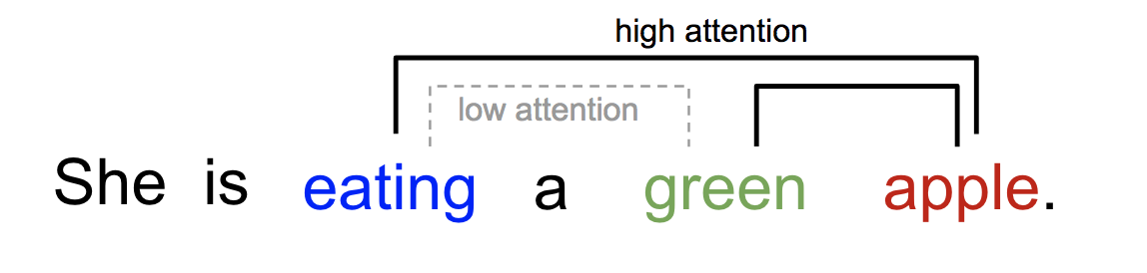
Attention
Some parts of our context are more important than others!

Slide 5
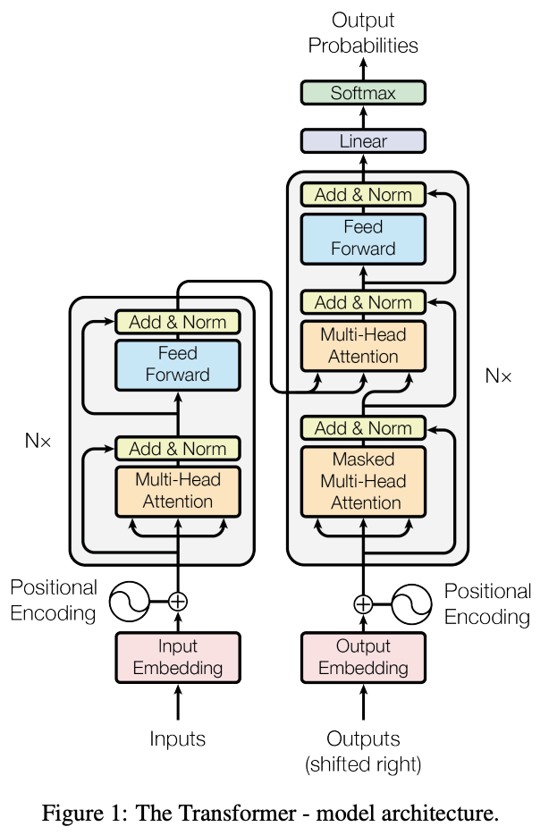
The Transformer

Slide 6
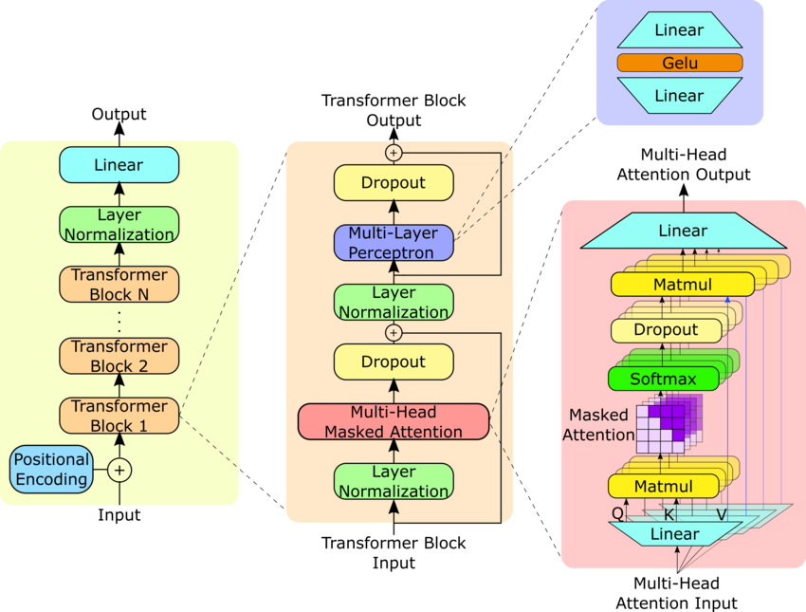
Where are we?
Response: “Certainly, as a large language model I’d be happy to help you cheat on your homework assignment”
Embeddings
Tokenizer
“Please help me with my homework!!”

Slide 7
Self-Attention

Slide 8
Self Attention
Often attention is written as ______________
which stems from the original paper. They model this as a _________________________
Q:
K:
V:

Slide 9
Attention Equation
Attention(Q, K, V) =
To continue with the dictionary lookup analogy (which I find a bit confusing)
Q·K:
Softmax:
Value:

Slide 10
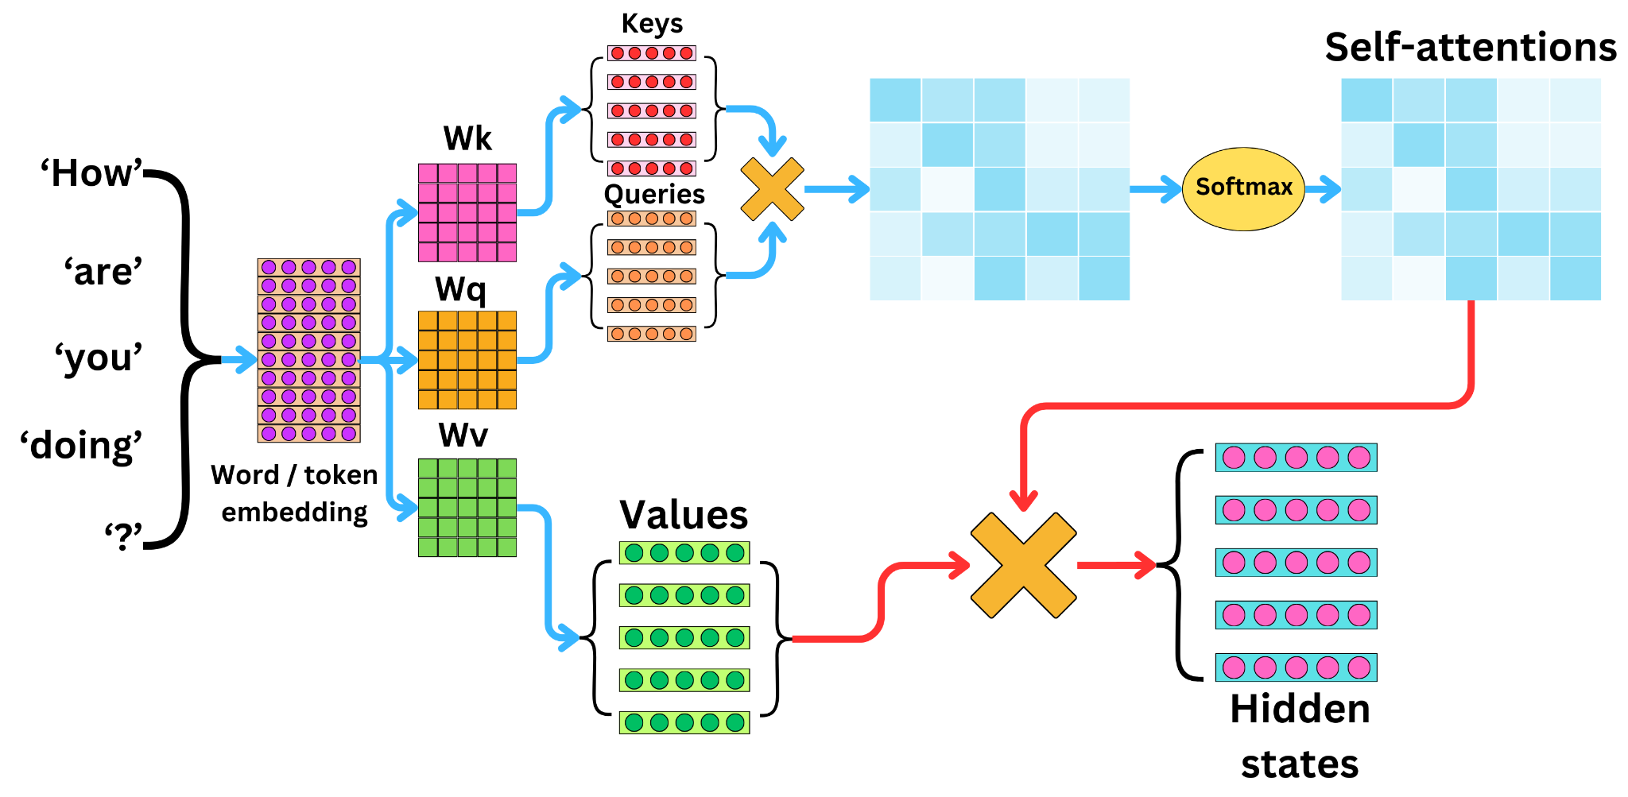

Slide 11
