Slide 1
CSE 10124 Transformer Blocks

Slide 2
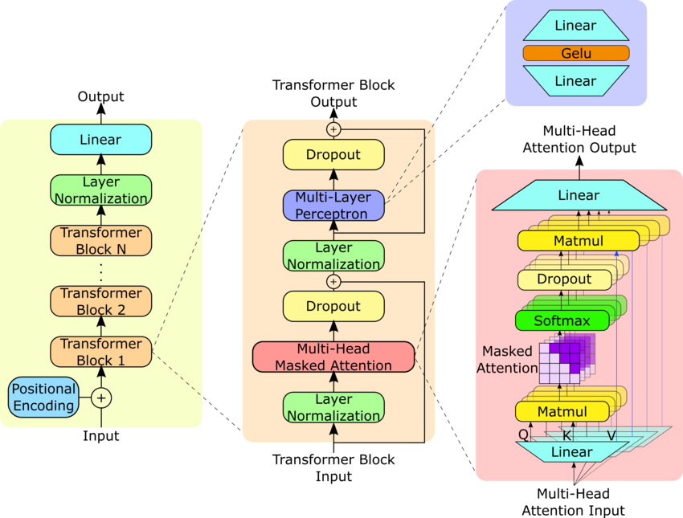
Where are we?
Response: “Certainly, as a large language model I’d be happy to help you cheat on your homework assignment”
Embeddings
Tokenizer
“Please help me with my homework!!”

Slide 3
Self-Attention

Slide 4
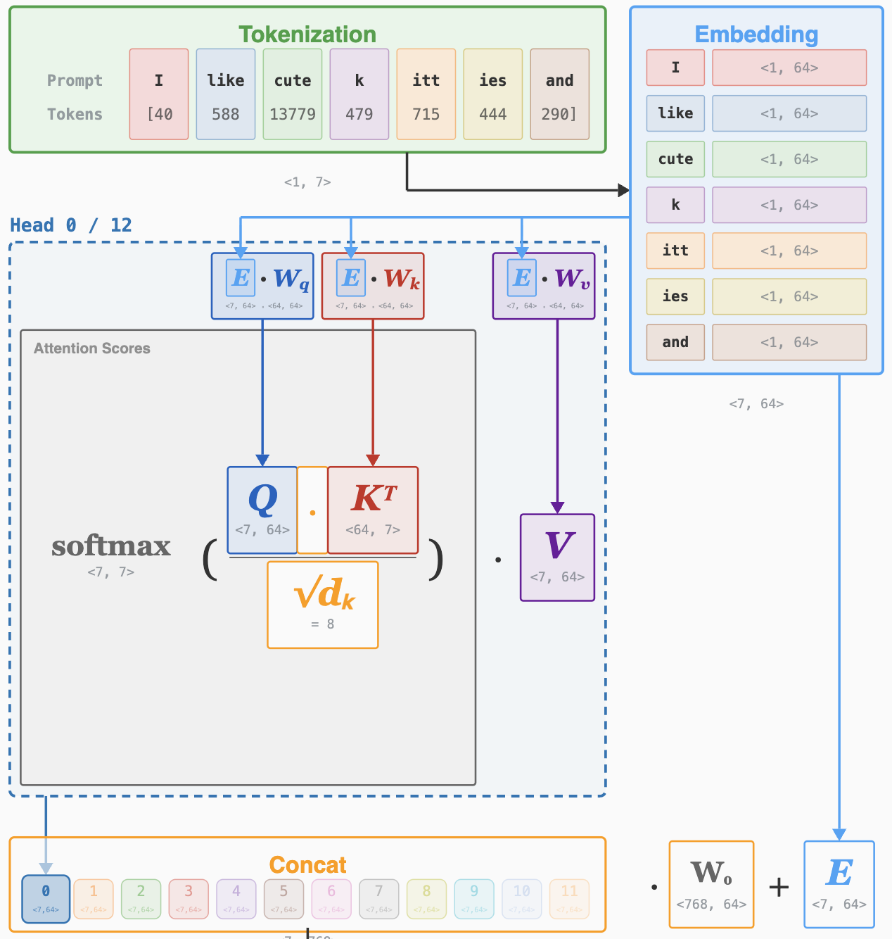
Multi-Head Attention

Slide 5
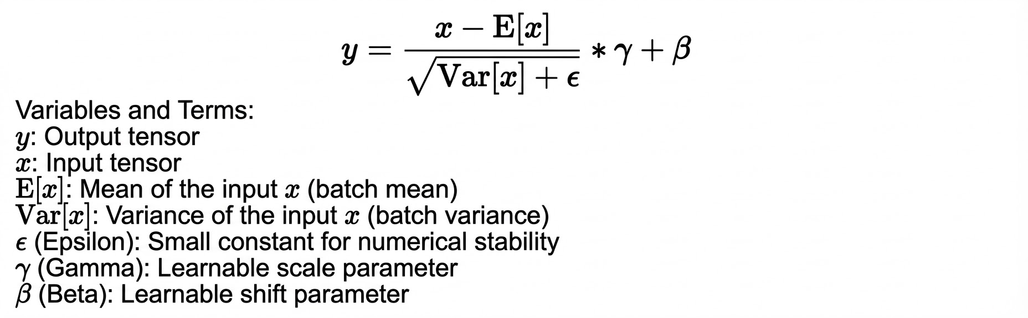
Layer Normalization
The one other piece we need for a full transformer block is called LayerNorm

Slide 6
Where are we?
Response: “Certainly, as a large language model I’d be happy to help you cheat on your homework assignment”
Embeddings
Tokenizer
“Please help me with my homework!!”

