Slide 1
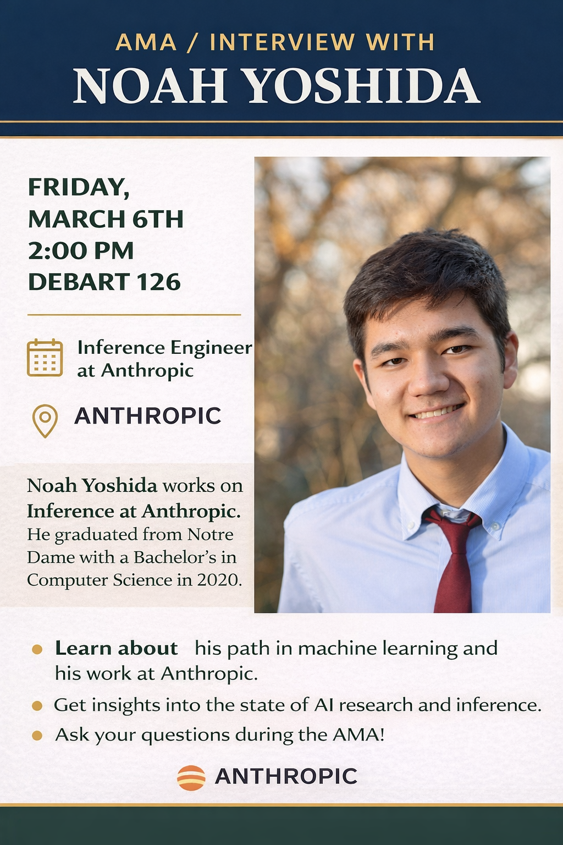

Slide 2
CSE 10124 Building GPT2

Slide 3
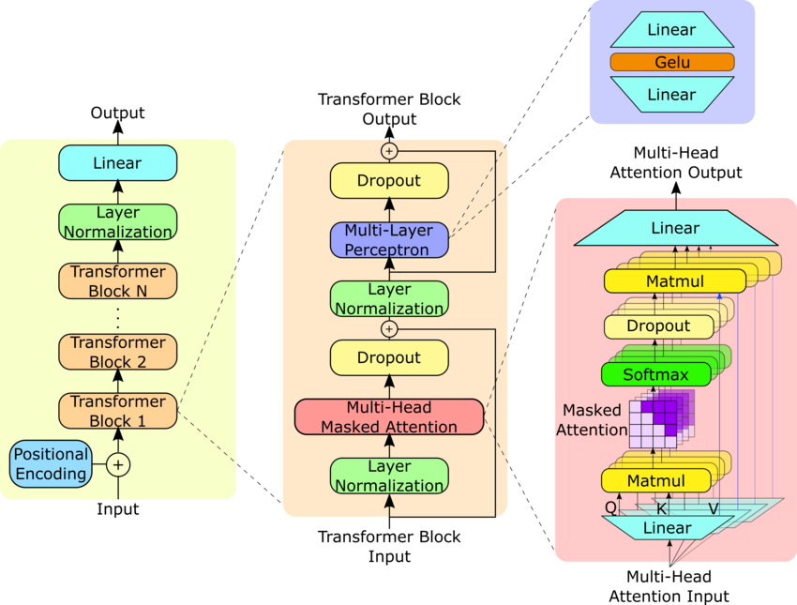
Where are we?
Response: “Certainly, as a large language model I’d be happy to help you cheat on your homework assignment”
Embeddings
Tokenizer
“Please help me with my homework!!”

Slide 4
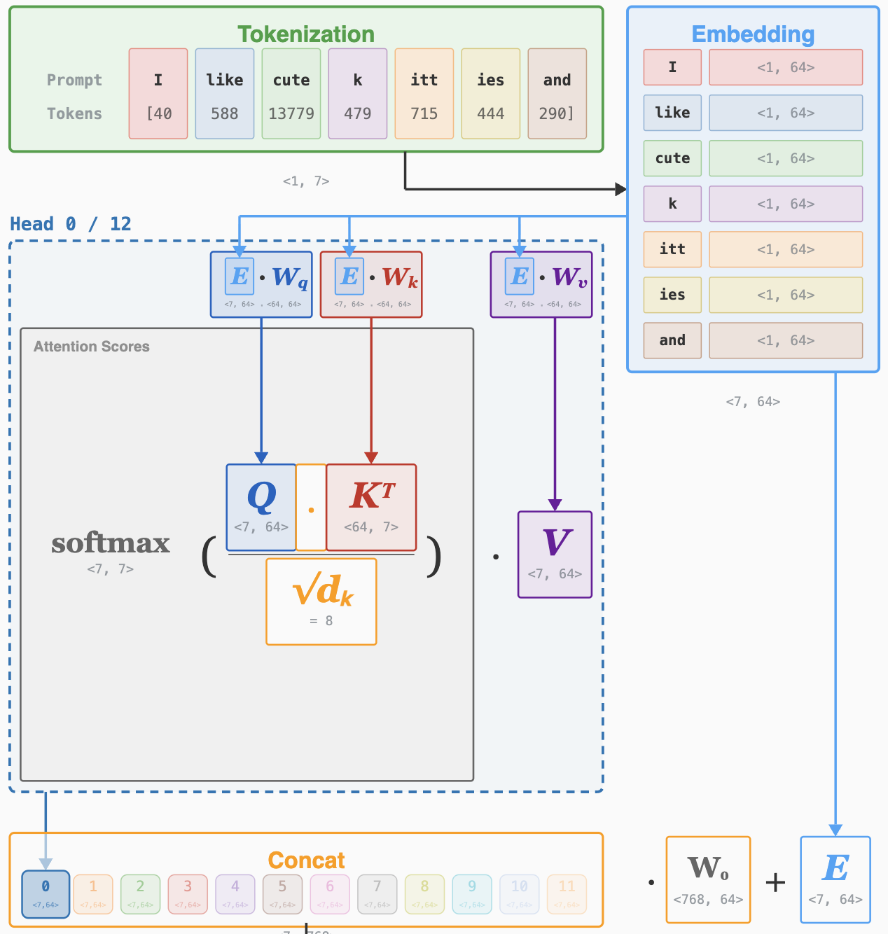
Multi-Head Attention

Slide 5
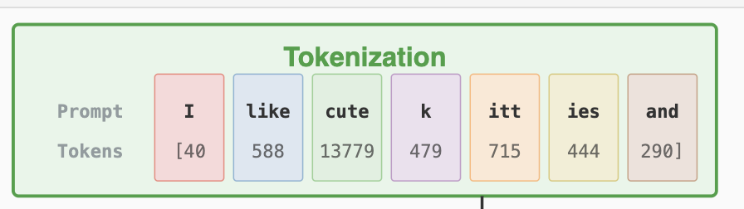
Recurrent Neural
Networks - Inference

