Slide 1
RESTful APIs
William Thomason
WEB-420
Assignment 2.2

Slide 2
What are RESTful APIs?
A RESTful API also referred to as a RESTful web service is based on representational state transfer (REST) technology, an architectural style and approach to communications often used in web service development.

Slide 3
How they are used
A RESTful API breaks down a transactions to create a series of small modules. Each modules addresses a particular underlying part of the transaction. This modularity provides developers with a lot of flexibility, but it can be challenging for developers to design from scratch.
A RESTful API explicitly takes advantage of HTTP methodologies defined by the RFC 2616 protocol. They use GET to retrieve a resource; PUT to change the state of or update a resource, which can be an object, file or block; POST to create that resource ; and DELETE to remove it.

Slide 4
Website communications
Website is communication is relatively simple to understand. When you use a browser and type in a URL the browser sends an HTTP request to the server requesting a resource. The server then sends back a representation of that resource via HTTP. The request can be made by several HTTP methods such as GET, POST, and DELETE, depending on what you are wanting to accomplish. See images on next slide for reference.

Slide 5


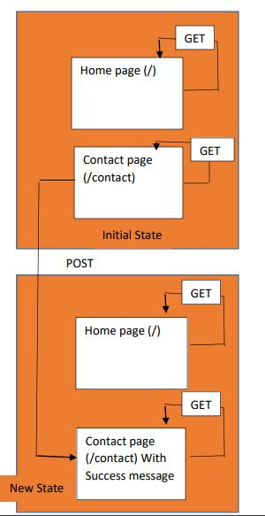
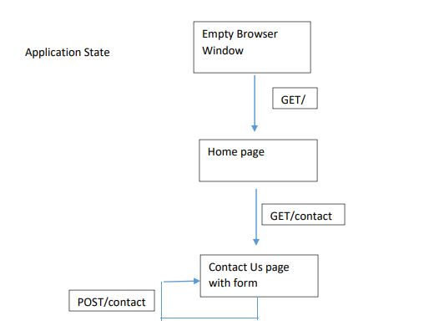


Slide 6
The advantages of RESTful APIs
Separation between the client and the server: the REST protocol totally separates the user interface from the server and the data storage. This has some advantages when making developments. For example, it improves the portability of the interface to other types of platforms, it increases the scalability of the projects, and allows the different components of the developments to be evolved independently.
Visibility, reliability and scalability. The separation between client and server has one evident advantage, and that is that each development team can scale the product without too much problem. They can migrate to other servers or make all kinds of changes in the database, provided the data from each request is sent correctly. The separation makes it easier to have the front and the back on different servers, and this makes the apps more flexible to work with.
The REST API is always independent of the type of platform or languages: the REST API always adapts to the type of syntax or platforms being used, which gives considerable freedom when changing or testing new environments within the development. With a REST API you can have PHP, Java, Python or Node.js servers. The only thing is that it is indispensable that the responses to the requests should always take place in the language used for the information exchange, normally XML or JSON.

Slide 7
The disadvantages of RESTful APIs
It adds negligible latency, but who cares, the web is the platform and everything is client/server.
The client is sending all messages with redundant information. This adds bandwidth and again, negligible latency.
there is no client request language
REST APIs are usually a collection of endpoints, where each endpoint represents a resource. So when a client needs data from multiple resources, it needs to perform multiple round-trips to a REST API to put together the data it needs.

Slide 8
The differences between a URI and URL
What is a URL? Uniform Resource Locator (URL) − a subset of URI that, in addition to identifying where a resource is available, describes the primary mechanism to access it.
What is a URI? Uniform Resource Identifier (URI) − a sequence of characters that allows the complete identification of any abstract or physical resource

Slide 9
URL and URI Continued
Now that we know the definitions of URL and URI. The difference is very simple. The URI is the identifier so google.com for example. The URL is the locator such as a IP address. The IP address is like the address to your house and the URI is like the family name that lives there. For example to find your way to the Thomason house (URI) we use the address to find it 3813 SE 6th Street Des Moines, IA 50315.

Slide 10
References
TechTaraget. (2019, March 13). What is RESTful API? - Definition from WhatIs.com. Retrieved May 12, 2019, from https://searchmicroservices.techtarget.com/definition/RESTful-API
Buna, S. (2017, July 24). REST APIs are REST-in-Peace APIs. Long Live GraphQL. Retrieved May 12, 2019, from https://medium.freecodecamp.org/rest-apis-are-rest-in-peace-apis-long-live-graphql-d412e559d8e4
McG, M. (2019, April 30). What Is The Difference Between A URI And A URL? Retrieved May 12, 2019, from https://dev.to/flippedcoding/what-is-the-difference-between-a-uri-and-a-url-4455

