Slide 1
Open Authentication (OAuth)
By: William Thomason
WEB-420
Presentation 9.2

Slide 2
What is OAuth?
OAuth (Open Authorization) is an open standard for token-based authentication and authorization on the Internet.
OAuth, which is pronounced "oh-auth," allows an end user's account information to be used by third-party services, such as Facebook, without exposing the user's password. OAuth acts as an intermediary on behalf of the end user, providing the service with an access token that authorizes specific account information to be shared. The process for obtaining the token is called a flow
OAuth, which was first released in 2007, was conceived as an authentication method for the Twitter application program interface ( API). In 2010, The IETF OAuth Working Group published OAuth 2.0. Like the original OAuth, OAuth 2.0 provides users with the ability to grant third-party access to web resources without sharing a password. Updated features available in OAuth 2.0 include new flows, simplified signatures and short-lived tokens with long-lived authorizations.

Slide 3
History of OAuth (1.0 versus 2.0)
OAuth 1.0
Security is ensured with the use of cryptography (especially Digital Signatures).
All requests to server would be signed by the client secret provided by the Authorization service (ex. Facebook, Google)
Before signing all request parameters would be sorted and encoded (this annoyed developers as it increased overheads of implementation and debugging also resulted in complex client side implementation).
However if your using it over SSL (HTTPS) you have an option of using "PLAINTEXT" as an OAuth Signature method, which would save you the hassle of all the crypto computing.

Slide 4
OAuth 1.0 Continued
The Flow OAuth 1.0
1. Your App first makes an API call for a request token.
2. Using request token you construct a URL and send the user to authorize your app (on a browser).
3. After user allows/denies, Service redirects to the callback URL for your app to know that the user has approved/disapproved your app, so you can continue.
4. Your App makes a call to convert your request token into an access token:
5. After receiving Access Token, your app can now make normal API requests.

Slide 5
OAuth 2.0
OAuth 2.0
Cryptography was done way with. Security delegated to transport layer (SSL).
Proper Roles were defined- Client (App), Authorization Server, Resources Server(API server), Resource Owner(User) etc.
Introduction of Refresh Tokens.
It also provided for greater flexibility and options by various Grant Types

Slide 6
OAuth 2.0 continued
1. Authorization code grant
Most widely used. Most use-cases are of this type.
Flow:
a. App directs user to authorize page on Authorization Server, the URL contains app’s client id that identifies the app.
b. Server authorizes and redirects to redirect URI with a short lived code.
c. App Server makes call to send code and receive tokens (access and refresh).
d. Now App can make calls to API server for resources

Slide 7
OAuth 2.0 continued
2. Implicit grant
When token is required only for a short while, app Can use this. Example for login via google or Facebook.
token is required only during the present session.
The Authorization Server directly sends token instead of code in step b.
3. Resource owner credentials grant
When App already has access to username and password of user.
It makes a single call to Auth. Server and receives token.
4. Client credentials grant
When the Registered Client wants to obtain token for itself

Slide 8
OAuth 2.0 continued
5. Refresh token grant
To refresh access tokens (obtained in grant type 1,3,4) by passing the refresh token.
Usually access tokens have a expires in time (at the moment some service offer never expiring access tokens)
You can see for yourself that in essence OAuth 2.0 makes it much more easier for a developer to start building API apps by
doing away with cryptography(signatures), lesser steps to receive tokens, role definitions and multiple grant type options.
Due to more standard protocol and definitions governing OAuth 2.0, it is easy to build platforms for them.

Slide 9
Why is OAuth popular?
OAuth 2.0 is a very flexible protocol that relies on SSL (Secure Sockets Layer that ensures data between the web server and browsers remain private) to save user access token.
OAuth 2.0 relies on SSL which is used to ensure cryptography industry protocols and are being used to keep the data safe.
It allows limited access to the user's data and allows accessing when authorization tokens expire.
It has ability to share data for users without having to release personal information.
It is easier to implement and provides stronger authentication.

Slide 10
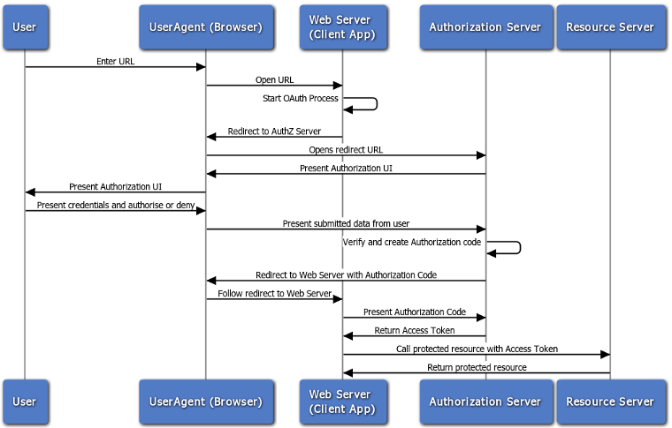
Data flow of an OAuth API

Slide 11
Resources
TechTarget. (2012, June). What is OAuth? - Definition from WhatIs.com. Retrieved June 26, 2019, from https://searchmicroservices.techtarget.com/definition/OAuth
Tutorialspoint.com. (n.d.). OAuth 2.0 Overview. Retrieved June 27, 2019, from https://www.tutorialspoint.com/oauth2.0/oauth2.0_overview.htm
Oracle. (n.d.). Oracle® Fusion MiddlewarePart 22. OAuth. Retrieved June 27, 2019, from https://docs.oracle.com/cd/E39820_01/doc.11121/gateway_docs/content/oauth_flows.html
https://www.quora.com/How-do-OAuth-1.0-and-2.0-differ
Watch this https://www.youtube.com/watch?v=SXDce0e3Ue4

Slide 12
Thank You for joining.
Feel Free to contact me.
William@WilliamThomason.info
https://github.com/wthomason

