Slide 1
SOAP
William Thomason
WEB-420
Assignment 3.3

Slide 2
What is SOAP?
SOAP is an acronym for Simple Object Access Protocol. It is an XML-based messaging protocol for exchanging information among computers. SOAP is an application of the XML specification.

Slide 3
Envelopes
The SOAP envelope indicates the start and the end of the message so that the receiver knows when an entire message has been received. The SOAP envelope solves the problem of knowing when you are done receiving a message and are ready to process it. The SOAP envelope is therefore basically a packaging mechanism.

Slide 4
header
The optional Header element offers a flexible framework for specifying additional application-level requirements. For example, the Header element can be used to specify a digital signature for password-protected services. Likewise, it can be used to specify an account number for pay-per-use SOAP services.

Slide 5
Faults and Fault Codes
If an error occurs during processing, the response to a SOAP message is a SOAP fault element in the body of the message, and the fault is returned to the sender of the SOAP message.
The SOAP fault mechanism returns specific information about the error, including a predefined code, a description, and the address of the SOAP processor that generated the fault.

Slide 6
Faults and Fault Codes
The fault Code values defined below must be used in the fault code element while describing faults.
SOAP-ENV:VersionMismatch = Found an invalid namespace for the SOAP Envelope element.
SOAP-ENV:MustUnderstand = An immediate child element of the Header element, with the must Understand attribute set to "1", was not understood.
SOAP-ENV:Client = The message was incorrectly formed or contained incorrect information.
SOAP-ENV:Server = There was a problem with the server, so the message could not proceed.

Slide 7
End-to-end data flow of a soap api
Credit to TechRepublic
How it works.
The client wraps a method call in SOAP/XML, which is then posted over HTTP to the server. The XML request is parsed to read the method name and parameters passed and delegated for processing. The XML response is then sent back to the client, containing the return value—or fault data—of the method call. Finally, the client may parse the response XML to make use of the return value. See image on next slide

Slide 8
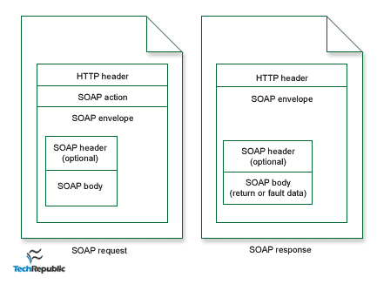
End-to-end data flow of a soap api

Slide 9
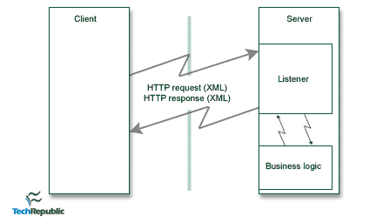
End-to-end data flow of a soap api
The server uses a “listener” to process SOAP requests. The listener is simply the server code at the specified URL for parsing the XML request, making the procedure call, and wrapping the result in XML to send as the response.

Slide 10
References
Tutorialspoint.com. (n.d.). What is SOAP? Retrieved May 15, 2019, from https://www.tutorialspoint.com/soap/what_is_soap.htm
Guest Contributor in Enterprise Software on April 2. (2001, April 2). An introduction to the Simple Object Access Protocol (SOAP). Retrieved May 16, 2019, from https://www.techrepublic.com/article/an-introduction-to-the-simple-object-access-protocol-soap/

