Slide 1
Continuous integration
By: William Thomason
WEB-430
Presentation 4.2

Slide 2
What is continuous integration
Continuous Integration (CI) is a development practice that requires developers to integrate code into a shared repository several times a day. Each check-in is then verified by an automated build, allowing teams to detect problems early.

Slide 3
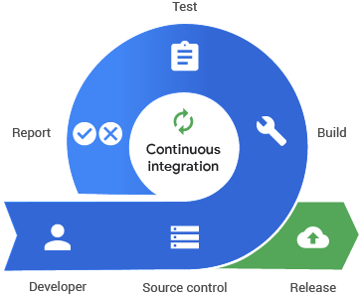
Concept of Continuous Integration

Slide 4
How to get started with Continuous integration
It’s really easy to get you up and running with the right continuous integration service. Here’s a really short list of basics you need to get started with CI.
Implement version control of your choice (Git, Bitbucket, SVN, etc).
Write tests for the critical components in your code base (and treat your tests as production code).
Get a suitable continuous integration and delivery service that will enable you to run those precious tests on every push to the repository and also deploy your builds where you need them.

Slide 5
Benefits of Continuous integration
Realizing the benefits means reducing risks for each build and clearing the way to get your valuable features out to customers faster.
Fast feedback loop. If there’s anything that really slows you down when developing software, it’s the lack of feedback on the quality and impact of the changes you made. Continuous integration tools — when properly used — will remove much of this headache by providing you with quick answers to the question “did I break something?” for each commit.
Increase transparency and visibility. When your CI/CD pipeline is set up, your entire team will know what’s going on with the builds as well as get the latest results of tests, which means they can raise issues and plan their work in context. You can see which changes tend to break builds more often.

Slide 6
Benefits of Continuous integration
Avoid “integration hell”. Set standards for each developer and team so the code they create will integrate with the rest of the application. Continuous integration supports connecting the pieces of your software every day.
Detect and fix issues early. The more bugs pile up, the harder it is to test and find them, resulting in nasty last minute surprises. If various kinds of useful automated tests are run in your continuous integration pipeline, you’ll be able to know what to fix as soon as a test fails. This will help keep issues to a minimum.
Improve quality and testability. The easier it is to test something, the easier it is to determine its quality. Testability has multiple dimensions. On the inside, testability can be characterized by how controllable, observable, unbuggy, and decomposable your product is. Continuous integration and delivery drive both since you will need to write tests and run them, and also deliver builds frequently and reliably.

Slide 7
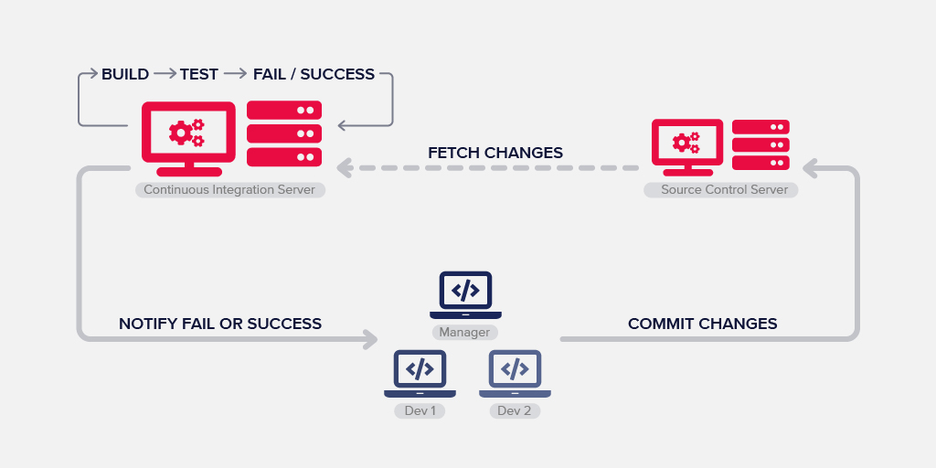
Benefits of Continuous integration

Slide 8
What is the best continuous integration & Deployment tool or service?
There are many solutions out there. If you only want to get a list of tools, you can look at Codeship, TravisCI, SemaphoreCI, CircleCI, Jenkins, Bamboo, Teamcity or many others. You can also find many articles and discussions out there on the topic with valuable information like this one on Quora. There are almost endless opportunities out there. But then the question rises: “How to choose between these?”
Your pick will strongly depend:
on your requirements,
on the techstack you have and
on how you handle your daily workflow.

Slide 9
Resources
ThoughtWorks. (n.d.). Continuous integration. Retrieved August 2, 2019, from https://www.thoughtworks.com/continuous-integration
NeverCode. (n.d.). What Is Continuous Integration and How to Benefit From It? Retrieved August 2, 2019, from https://nevercode.io/blog/what-is-continuous-integration-and-how-to-benefit-from-it/

Slide 10
Thanks For Joining
William@WilliamThomason.info
github.com/wthomason

