Slide 1
The Technology Value Stream
By: William T. Thomason
WEB-430
Presentation 1.2

Slide 2
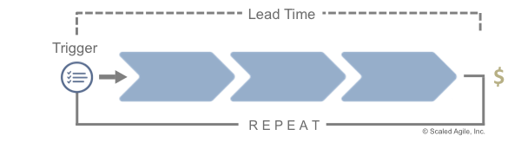
What is the Value Stream
A value stream is a long-lived series of steps used to deliver value, from concept or customer order to delivery of a tangible result for the customer. Figure 1 illustrates the anatomy of a value stream.
A significant event triggers the flow of value, perhaps a customer purchase order or a new Feature request. It ends when some value has been delivered—a shipment, customer purchase, or solution deployment. The steps in the middle are the activities the enterprise uses to accomplish this feat. A value stream contains the people who do the work, the systems they develop or operate, and the flow of information and materials. The time from the trigger to the value delivery is the lead time. Shortening the lead time reduces the time-to-market. That is the focus.

Slide 3
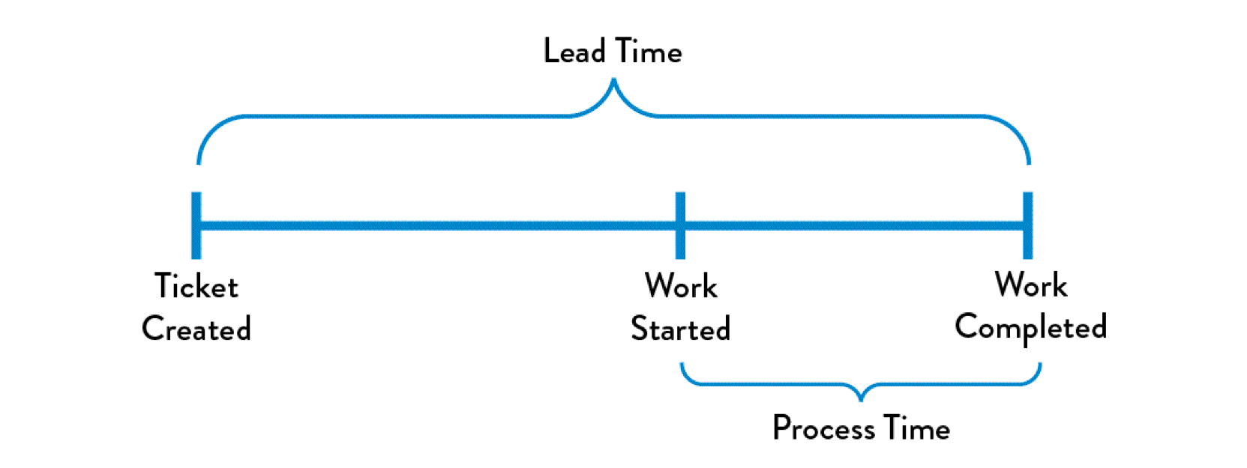
Defining Lead Time vs. Processing Time
Lead and Processing time are two measures commonly used to measure performance in value streams.
Lead time clock starts when the request is made and ends when it is fulfilled.
Process time clock starts only when we begin work on the customers request. Specifically, it omits the time that the work is in queue, waiting to be processed.

Slide 4
The Common Scenario: Deployment Lead Timers Requiring Months
The Common Scenario: Deployment Lead Timers Requiring Months (page 10 of the courses textbook)

Slide 5
Our DevOps Ideal: Deployment Lead Times of Minutes (page 10 of the courses textbook)

Slide 6
References
Scaled Agile. (2018, October 4). What's new in SAFe 4.6? Retrieved July 12, 2019, from https://www.scaledagileframework.com/value-streams/
THORPE, S. (2019, February 06). DevOps Handbook Series Part 1: The Three Ways. Retrieved July 12, 2019, from https://caylent.com/devops-handbook-part-1-the-three-ways-2/

Slide 7
William@williamthomason.info
Thank you for Joining!
https://github.com/wthomason

