Slide 1
The Technology Value Stream
By: William T. Thomason
WEB-430
Presentation 1.2

Slide 2
What is the Value Stream
A value stream is a long-lived series of steps used to deliver value, from concept or customer order to delivery of a tangible result for the customer. Figure 1 illustrates the anatomy of a value stream.
A significant event triggers the flow of value, perhaps a customer purchase order or a new Feature request. It ends when some value has been delivered—a shipment, customer purchase, or solution deployment. The steps in the middle are the activities the enterprise uses to accomplish this feat. A value stream contains the people who do the work, the systems they develop or operate, and the flow of information and materials. The time from the trigger to the value delivery is the lead time. Shortening the lead time reduces the time-to-market. That is the focus.

Slide 3
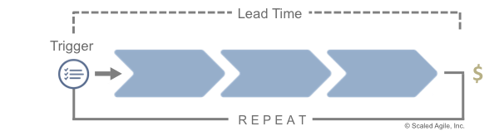
What is the Value Stream

Slide 4
Defining Lead Time vs. Processing Time
Lead and Processing time are two measures commonly used to measure performance in value streams.
Lead time clock starts when the request is made and ends when it is fulfilled.
Process time clock starts only when we begin work on the customers request. Specifically, it omits the time that the work is in queue, waiting to be processed.

Slide 5
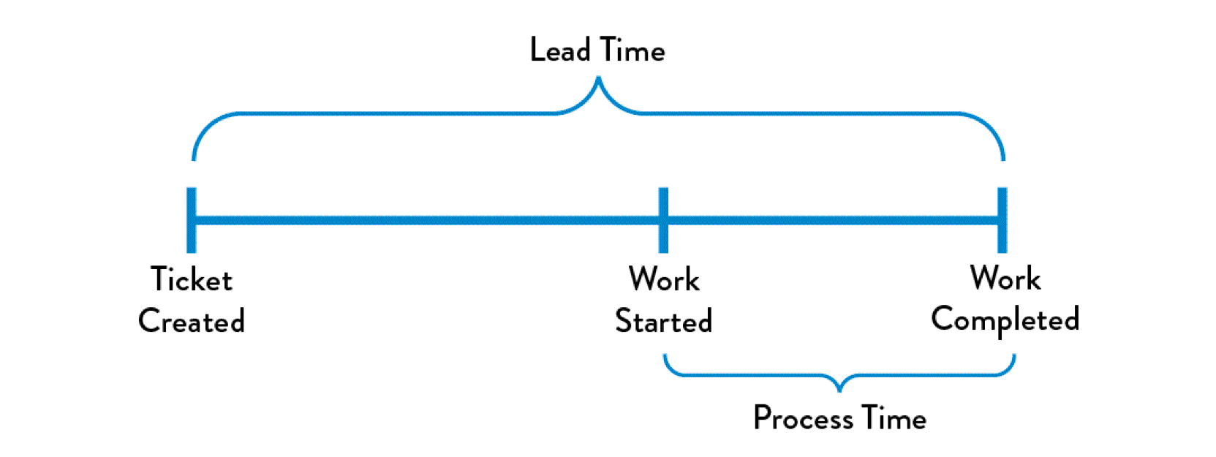
Defining Lead Time vs. Processing Time

Slide 6
The Common Scenario: Deployment Lead Timers Requiring Months
You can often find ourselves in situations where our deployment lead times require months. This is especially common in large, complex organizations that are working with tightly-coupled, monolithic applications, often with scarce integration test environments, long test and production environment lead times, high reliance on manual testing, and multiple required approval processes.
When we have long deployment lead times, we must make miracles happen at every step of the value stream. This can lead to the team discovering that nothing works at the end of the project when the development team merges all the changes together. This results in code that no longer works correctly or passes any of our tests. Fixing each problem requires days or weeks of investigation to determine who broke the code and how it can be fixed, and still results in poor customer outcomes.

Slide 7
Our DevOps Ideal: Deployment Lead Times of Minutes
DevOps ideal, developers receive fast, constant feedback on their work, which enables them to quickly and independently implement, integrate, and validate their code, and have the code deployed into the production environment (either by deploying the code themselves or by others).
We achieve this by continually checking small code changes in to our version control repository, performing automated and exploratory testing against it, and deploying it into production. This enables us to have a high degree of confidence that our changes will operate as designed in production and that any problems can be quickly detected and corrected.

Slide 8
Our DevOps Ideal: Deployment Lead Times of Minutes
This is achieved when we have architecture that is modular, well encapsulated, and loosely-coupled so that small teams failures being small and contained, and without causing global disruptions. Our deployment lead time is measured in minutes or, in the worst case, hours.

Slide 9
References
Scaled Agile. (2018, October 4). What's new in SAFe 4.6? Retrieved July 12, 2019, from https://www.scaledagileframework.com/value-streams/
THORPE, S. (2019, February 06). DevOps Handbook Series Part 1: The Three Ways. Retrieved July 12, 2019, from https://caylent.com/devops-handbook-part-1-the-three-ways-2/

Slide 10
William@williamthomason.info
Thank you for Joining!
https://github.com/wthomason

