Slide 1


JSON JavaScript Object Notation
William Thomason
WEB-335, Presentation 4.2

Slide 2
What are JSON API’s?
When exchanging data between a browser and a server, the data can only be text.
JSON is text, and we can convert any JavaScript object into JSON, and send JSON to the server.
We can also convert any JSON received from the server into JavaScript objects.
This way we can work with the data as JavaScript objects, with no complicated parsing and translations.
An API is a set of functions and procedures allowing the creation of applications that access the features or data of an operating system, application, or other service.

Slide 3
How they differ from SOAP API’s
SOAP only uses XML as the standard data format.
JSON API has no official standard because it is an architectural style.
SOAP API had an official standard because it is a protocol.
SOAP is largely based on HTTP and XML
JSON API depends on HTTP operations
SOAP is Web Services Description language
SOAP defines operations and methods seperately

Slide 4
JSON Request Header
HTTP headers allow the client and the server to pass additional information with the request or the response. An HTTP header consists of its case-insensitive name followed by a colon ‘:’, then by its value (without line breaks). Leading white space before the value is ignored.
Headers containing more information about the resource to be fetched or about the client itself.

Slide 5
JSON Request Body
The request body contains the data the client wants to send the server. However the Request bodies are optional by default.
The Schema Keyword is used to describe the response body.
A schema can define an object or an array – typically used with JSON and XML APIs, a primitive data type such as a number of string used for a plain text responses and a file.

Slide 6
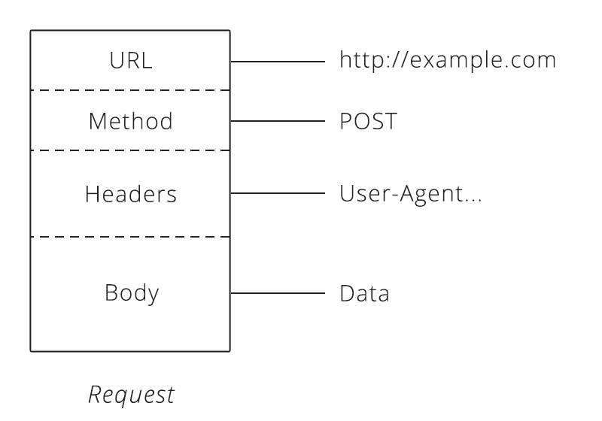

Slide 7
JSON Response Body
A response is defined by its HTTP status code and the data returned in the response body and/or headers.
An API can respond with various media types.
JSON is the most common format for data exchange, but isn’t the only option available.

Slide 8
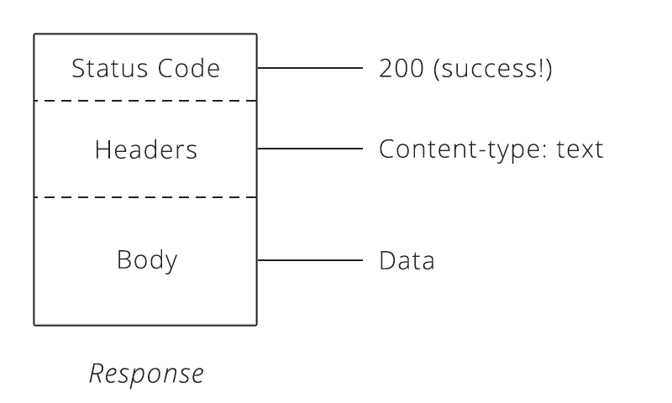

Slide 9
References
Malik, N. (2019, May 14). The Difference Between REST and SOAP APIs - DZone Integration. Retrieved May 26, 2019, from https://dzone.com/articles/difference-between-rest-and-soap-api
Red Hat. (n.d.). What are APIs? Retrieved May 26, 2019, from https://www.redhat.com/en/topics/api/what-are-application-programming-interfaces

Slide 10

Thank You!
William@williamthomason.info

