Slide 1
Performance Enhancements analysis and proposals
Draft 2010-06-21
Adrian Pop
[Adrian.Pop@liu.se]

Slide 2
Testing System
All tests were done on my laptop
HP NC6400, RAM 3Gb, HDD 160 SSD, Core Duo T7200 at 2GHz

Slide 3
General issues
General problems
A lot of unnecessary work (due to additions of new phases in the compiler)
A lot of unnecesarry memory allocation during several phases
A lot of badly designed code (Previous implementation of inner-outer, deleted components, etc).
We need a structure that is passed and returned to/from all the functions
Compiler control (flags, etc)
Symbol table
Caches, Environments, Instance Hierarchy
Could be achieved with external roots (global variables), but is best to pass it along and return it

Slide 4
Analysis
Parsing & AST building
SCode transformation
Static elaboration
Constant evaluation
Instantiation
Inner/Outer
Deleted components
Lookup
Overconstrained Connection Graph
Expandable connectors
Default connections (unconnected flow set to 0)
Array expansion
DAE
Flat structure
DAELow
Incidence matrix
Matching algorithm
Variable replacement
SimCode

Slide 5
Parsing (I)
A class Code is now present in Modelica/ package.mo. We should change our Code(x=y) to $Code(x=y). All clients using the Code API will need to be changed.
Fully qualified starting with dot: .Modelica.X.Y.Z will generate problems because of MetaModelica .+ .-, etc.
Our parser cannot yet handle empty expressions in the output expresion lists (now present in Modelica.Math): (LU,,info) := Modelica.Math.Matrices.LAPACK.dgetrf(A); We should replace ,, with ,_,.

Slide 6
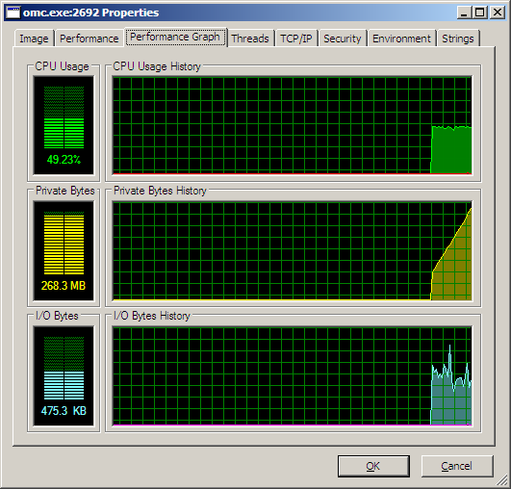
Parsing (II)
23 seconds only for parsing latest Modelica from trunk (Modelica, ModelicaReference, ModelicaSevices, ModelicaTest, Complex.mo, ObsoleteModelica3.mo)
270 Mb RAM consumed while only parsing

Slide 7
Parsing (III)
Action plan
Should move to ANTLR3 ASAP!
3 seconds for parsing latest Modelica from trunk (Modelica, ModelicaReference, ModelicaSevices, ModelicaTest, Complex.mo, ObsoleteModelica3.mo)
402 Mb RAM consumed while parsing

Slide 8
AST building (I)
(36-23)=13 seconds for building the AST for the latest Modelica from trunk (Modelica, ModelicaReference, ModelicaSevices, ModelicaTest, Complex.mo, ObsoleteModelica3.mo)
Should re-enable string sharing in MetaModelica to avoid duplication in the memory (String ”Modelica” should only be present once). Tests of string equality should also go faster (via pointer comparision).

Slide 9
AST building (II)
AST should be redesigned
Smaller memory footprint (i.e. encode more attributes into one integer. We need pattern matching on bits.)
Faster lookup at the AST level (Interactive)
AST building should generate several hash tables
All identifiers should be asigned an integer
A program will be a class. A class will contain:
An optional within statement
A hastable of classes
A hashtable of components
A hashtable of equations
A hashtable of algorithm statements
A component reference is just a reference (integer) into the hashtable of components
Equations and algorithms will contain only component references instead of actual components
Could be beneficial to have a hashtable of expressions (for expression simplification)
Hashtables should be a builtin type in MetaModelica (equivalent :: operator on hashtables for walking)

Slide 10
SCode transformation
Is rather fast 0.5 seconds (5 919 157 transformation function calls) for the entire Modelica standard library from trunk.
Can be done even faster if the list of classes/components/algs/eqs is not walked again for transformation of each.
The SCode representation should be stored in the same hashtable as Absyn (looking up in this structure should be the same for Absyn and SCode), i.e. record ENTRY Absyn.Class absynClass; SCode.Class scodeClass; end ENTRY;
The SCode representation should mirror the new Absyn
The SCode should be build lazily, starting from the class to be instantiated. If we lookup an non-transformed class we transform it on the fly.

Slide 11
Static elaboration
Works in a certain context (environment)
Elaborates an expression to find its type and its corectness
Reports errors in equations/algorithm statements
Should be decoupled from constant evaluation, constant evaluation should be performed after static elaboration
The environment should be redesigned to allow faster lookup.

Slide 12
Constant evaluation (I)
Slow when dynamic loading of functions is needed. Also because function caching is not implemented (same function is compiled and loaded again).
Should be performed only for structural parameters

Slide 13
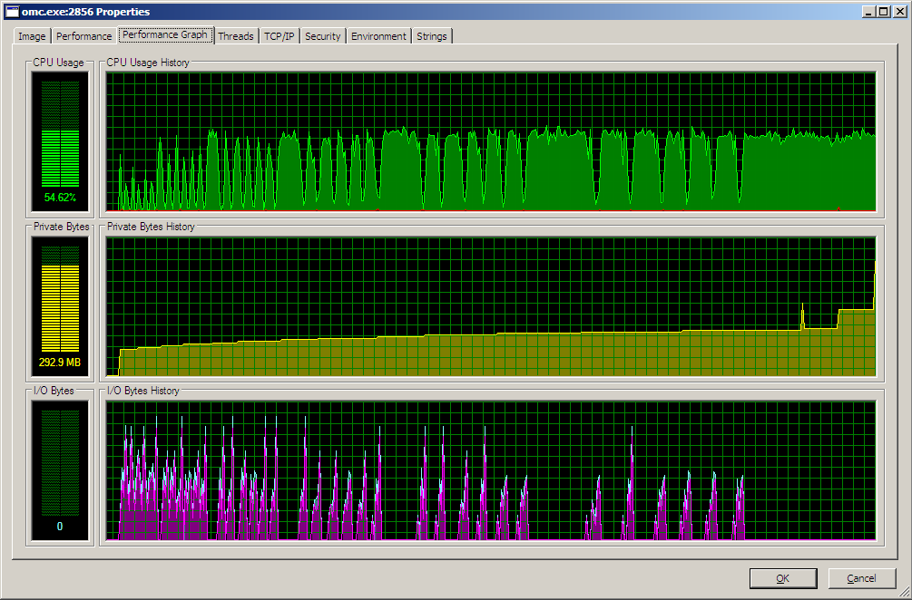
Constant evaluation (II)
EngineV6.mos (checkModel only)
12491 equs/vars, 7 minutes 10.171 seconds, 292 Mb

Slide 14
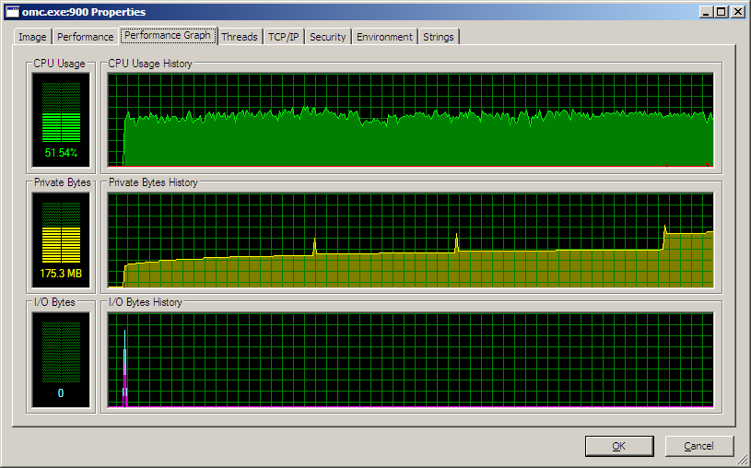
Constant evaluation (III)
EngineV6.mos (checkModel only, +d=nogen,nocevalfunc)
12491 equs/vars, 5 minutes 27.250 seconds, 192 Mb

Slide 15
Instantiation
checkModel-EngineV6.mos
Each sample counts as 0.01 seconds.
% cumulative self self total
time seconds seconds calls s/call s/call name
12.79 52.89 52.89 1 52.89 198.67 rml_prim_once
9.35 91.55 38.66 1518521197 0.00 0.00 Exp__crefPrefixOf
8.09 125.00 33.45 3188891469 0.00 0.00 Exp__crefNotPrefixOf
7.87 157.55 32.55 3199784362 0.00 0.00 Exp__crefEqualNoStringCompare
5.86 181.80 24.25 Exp__crefPrefixOf_5flabel17923
4.41 200.02 18.22 Exp__crefNotPrefixOf_5fsuccessContLam18109
4.10 216.96 16.94 Exp__crefPrefixOf_5ffailureContLam17915
3.81 232.70 15.74 Exp__crefPrefixOf_5fsuccessContLam17922
3.44 246.93 14.23 Util__listSelect1_5fsuccessContLam9078
3.17 260.04 13.11 Exp__crefEqualNoStringCompare_5flabel17482
2.94 272.19 12.15 1699453461 0.00 0.00 Util__listSelect1
2.65 283.15 10.96 Exp__crefNotPrefixOf_5flabel18110
2.46 293.32 10.17 Exp__crefPrefixOf_5ffailureContLam17954
2.23 302.56 9.24 ConnectionGraph__crefConnectNotPrefixOf
1.92 310.50 7.94 ConnectionGraph__crefConnectNotPrefixOf_5fsuccessContLam2127
1.66 317.38 6.88 Exp__crefEqualNoStringCompare_5ffailureContLam17492
1.50 323.57 6.19 292130278 0.00 0.00 Exp__crefEqual
1.49 329.73 6.16 ConnectionGraph__crefConnectNotPrefixOf_5fsuccessContLam2126
1.38 335.45 5.72 DAELow__getVar3
0.97 339.46 4.01 ConnectionGraph__crefBranchNotPrefixOf
0.86 343.02 3.56 246889380 0.00 0.00 Exp__subscriptEqual
0.80 346.34 3.32 ConnectionGraph__crefBranchNotPrefixOf_5fsuccessContLam1929
0.78 349.55 3.21 Util__listSelect1_5fsuccessContLam9077
0.65 352.23 2.68 strcmp
0.64 354.88 2.65 ConnectionGraph__crefBranchNotPrefixOf_5fsuccessContLam1928
0.57 357.25 2.37 Exp__crefPrefixOf_5fsuccessContLam17974
0.48 359.25 2.00 rml_major_collection
0.41 360.95 1.70 57632515 0.00 0.00 RML__string_5fappend
0.33 362.33 1.38 DAELow__getVar3_5ffailureContLam32591
0.32 363.67 1.34 DAELow__getVar3_5fsuccessContLam32598
0.29 364.86 1.19 ConnectionGraph__crefTupleNotPrefixOf
0.27 365.98 1.12 Exp__crefEqual_5flabel17137
0.26 367.04 1.06 37254241 0.00 0.00 Types__elabType
0.24 368.03 0.99 std::string::compare(std::string const&) const
0.23 368.98 0.95 39845109 0.00 0.00 Env__avlTreeGet
0.23 369.92 0.94 3230 0.00 0.00 rml_minor_collection
0.21 370.80 0.88 Exp__crefEqual_5ffailureContLam17229
0.14 371.39 0.59 Types__convertFromTypesToExpVar
0.14 371.96 0.57 34305767 0.00 0.00 Util__listMap_5fimpl_5f2
0.14 372.52 0.56 80329126 0.00 0.00 Exp__printComponentRefStr
0.11 372.99 0.47 18235801 0.00 0.00 Types__arrayElementType
0.11 373.43 0.44 4980969 0.00 0.00 RML__list_5freverse
0.10 373.84 0.41 29973416 0.00 0.00 Exp__isConst
0.10 374.24 0.40 29024311 0.00 0.00 Exp__simplify1
0.09 374.61 0.37 14603778 0.00 0.00 System__strcmp
0.08 374.95 0.34 23603718 0.00 0.00 Env__getEnvPath
0.08 375.29 0.34 11612417 0.00 0.00 ConnectUtil__equations
0.08 375.62 0.33 24572078 0.00 0.00 Types__flattenArrayTypeOpt
0.08 375.95 0.33 4777784 0.00 0.00 RML__list_5fappend
0.08 376.28 0.33 _Unwind_SjLj_Register
0.07 376.59 0.31 20959210 0.00 0.00 Absyn__pathString2
0.07 376.90 0.31 19748719 0.00 0.00 RTOpts__modelicaOutput
0.07 377.21 0.31 Exp__crefEqual_5fsuccessContLam17249
0.07 377.51 0.30 Util__listMap_5fimpl_5f2_5fsuccessContLam8114
0.07 377.79 0.28 87644571 0.00 0.00 rml_prim_alloc

Slide 16
Instantiation
Instantiation does too many things at once. Was patched up with new phases that add complexity and slow the flattening
Instantiation should be broken down into several phases
Simplification
Lookup the given class A.B.C in the symbol table
Transform the class A.B.C into Scode (IH)
Build the IH and the Environment (now based on IH)
Build the IH of the class by adding the local components and the class definitions to it
Build and add the partial IH of B as the enclosing scope of C (containing only constant declarations and class defininitions)
Build and add the partial IH of A as the enclosing scope of B. Stop at B if is encapsulated and add the partial IH of Builtin
Looking up A.B.x will go via partial IH of A, partial IH of B to reach x
Handle modifications
Match the given modifications to the IH components and add them to the IH
Handle extends
Add the entries for the elements of the extends classes with the given outer and local modifications to the local IH
Handle expandable connectors
Walk connects and add the virtual components from expandable connectors to their IHs
Find the best instantiation order
Build a dependency analysis of all components/classes in the IH
Type checking
Build the types of all components in the IH (using the dependency)
Apply the modifications to the IH creating a new IH with new types (if they are changed by modifications)
Apply the redeclarations to the IH
Apply the redeclare model/function extends X to extended entries
Verify the duplicate components and equations
Equation and algorithm handling
Instantiate equations and algorithms and add them to the IH
DAE generation
Walk the final IH and generate the DAE

Slide 17
Instantiation - InnerOuter
Inner/outer still ”slow” because we have to check and prefix each component reference with the inner prefix if is an outer (a lot of calls to Exp.crefPrefixOf)
We need a better way to handle it
A component prefix should know if is an outer or if it has an outer parent. This way calls to crefPrefixOf can be avoided.
Faster crefPrefixOf is needed as it cannot be avioded in some cases

Slide 18
Instantiation – Deleted Components
Deleted components are slow as we check each component reference if it came from a deleted component (a lof of calls to Exp.crefPrefixOf)
We need a better way to handle it
Deleted components should not be instantiated at all (only their type path should be checked) and their conditional. Equations containing deleted components should not be instantiated at all.

Slide 19
Instantiation – Lookup
Is quite fast right now
Lookup is rather complex and does instantiation (it shouldn’t do any)
Could be improved by redesigning Env/IH
Decouple lookup of classes/types/imports from lookup of components
Components and inner classes should only be present in the instance hierarchy (IH)
Imports should be eliminated by fully qualifiying paths

Slide 20
Instantiation – OCG
Overconstrained connection graph
”Slow” handling due to:
deletion of equations for the broken connections (DAE walking and removal of equations that have a certain connect origin)
deleted components (walk of the graph and remove the roots and branches/connects that come from deleted components)

Slide 21
Instantiation – Expandable connectors
Right now is handled by adding the virtual components to the environment during instantiation of connect statements
A lot of lookup (that fails) is required
Ordering of connect equations is required to ensure proper addition of the components the the environment and the DAE
connect(non_expandable, expandable)
connect(expandable, non_expandable)
connect(non_expandable, non_expandable)
Does not handle inner/outer with expandable, i.e. the inner/outer definitions should be unified (extra components from outer added to inner)

Slide 22
Instantiation – Default connections
Default connections (unconnected inside flow set to 0)
Is now implemented as a walk to the final environment and lookup of flow variables in connectors. The looked up variables are then matched against the connection sets to see which ones are not present. The ones that are not present generate set to zero equations (for inside component references).
This should be rewritten to be according to the specification (and way faster) by just adding the flow variables to the connection sets as inside when instantiating the class that contains the connector. See section 9.2 Generation of Connection Equations of the Modelica Specification.

Slide 23
Instantiation – Array expansion
Array expansion is now performed for all arrays
Instantiation is performed for each element of the array and can take a long time for a big array
Only arrays of non-basic types should be expanded and if possible only one element should be instantiated and then the result should be reused and the new prefix and the new modification applied

Slide 24
DAE
Has a flat structure which generates a lot of additional walking
The DAE structure should be a tree, each component should have its own components/equations/algorithms
Searching and replacing expressions that refer to a single component can be performed much faster this way

Slide 25
DAELow
Consumes a lot of memory
Variable replacemens are slow
Matching is implemented with the use of external functions

Slide 26
SimCode
Not analyzed yet

Slide 27
Instance Hierarchy proposal
Draft 2009-11-06
Adrian Pop
[adrpo@ida.liu.se]

Slide 28
Idea
While working on Expandable Connectors
Needed global analysis of models, components, connects and their relations
Needed lookup on SCode for classes, components, connects and inner/outer
Needed easy manipulation of SCode
Imposible to use Env/Lookup
Need of a new structure and functionality
First draft of InstanceHierarchy now available
Extended idea could also be used
During instantiation
To query of inside/outside properties of connectors
To generate stream connectors equations
For balanced model checking
On probably much more other things

Slide 29
InstanceHierarchy definition
We have instances of
Models (top level and inner class definitions) and Components
An Instance is made of (as of now, more things can/should be added later on)
A fully qualified component reference
Attributes, children, relations to other instances (connects, inner/outer)
uniontype Instance "An instance"
record INSTANCE
Absyn.ComponentRef name "the full name of this instance";
InstanceAttributes attributes "the attributes of this instance";
InstanceHierarchy children "the childrens of this instance";
InstanceConnects connects "full connnection info for this instance:
connects that happen in this instance and
what instances this instance connects to";
Option<Absyn.ComponentRef> innerReference "inner reference if existing";
Option<Absyn.ComponentRef> outerReference "outer reference if existing";
end INSTANCE;
end Instance;
uniontype InstanceConnects
record CONNECTS
list<tuple<Absyn.ComponentRef, Absyn.ComponentRef>> connectEquations "the connect equations in this instance";
list<Absyn.ComponentRef> actualConnects "this instance connects to these instances";
end CONNECTS;
end InstanceConnects;

Slide 30
Properties of InstanceHierarchy
Lookup, Query and Manipulation
Straightforward lookup as name lookup was done previously and all instances and references are fully qualified
Easy to store relations between instances such as inner/outer, connects, maybe even use instance references in normal equations
Easy to manipulate classes before going into instantiation
Optimization
InstanceHierarchy could be built lazily
Cashing and Composability
Different InstanceHierarchy trees can be easily combined
Becomes easier as all you need is two fully qualified paths to store/fetch a particular InstanceHierarchy

Slide 31
Possible usage during Instantiation
Algorithm
Start with an InstanceHierarchy (IH) with no modifications
Apply the modifications from top scopes to leaf scopes to the first IH generating a ”new” IH on each scope
The generated IHs are stored in the same tree by extending a tree node to be a list of a scope and a node list<tuple<scope,instance>>
The final instance hierarchy will contain ALL the needed information needed during instantiation
Generate the DAE from the final IH
Example
IH0 –scope1-> IH1 –scope2-> IH2 –scopeN-> IH_FINAL->DAE

Slide 32
Plan using the IH during Instantiation
Keep the current instantiation procedure
Send the IH everywhere (already done)
Some queries (inside/outside) can be used on the current IH directly
In several phases over time
Extend IH functionality
Rewrite the functionality based on Env to be based on IH

Slide 33
Feedback
Is more than welcome
This is the first draft so mistakes can happen ☺
Send an email to adrpo@ida.liu.se
Just let me know any of
Possible problems
Instantiation functionality that IH cannot handle
Further improvements I haven’t thought of
Integration plans and phases

Slide 34
The End
This document is stored in Subversion (not yet, but it will be)
https://openmodelica.ida.liu.se/svn/OpenModelica/trunk/doc/performance
www.OpenModelica.org

