Slide 1
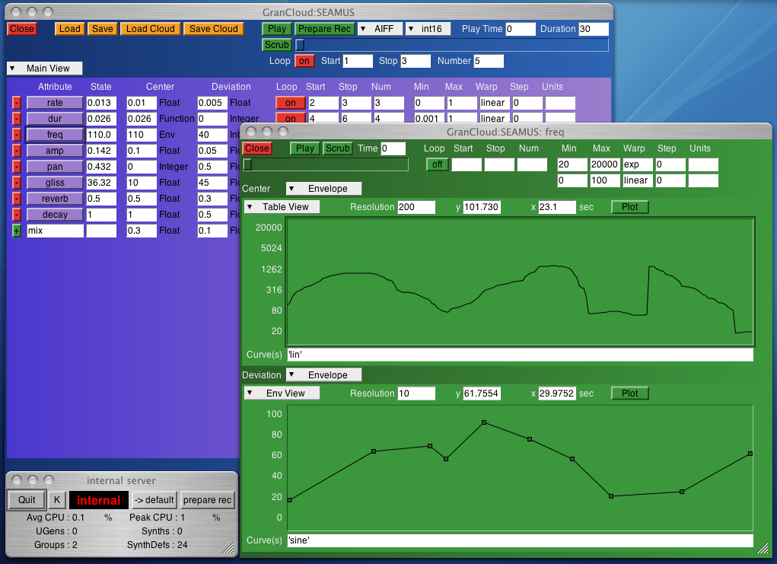
GranCloud
A New SuperCollider Class for Real-time Granular Synthesis
Terry A. Lee tlee@tleestudio.com

Slide 2
GranCloud: The Class
Text file containing code
Defines GranCloud objects
Placed in SC Class Library
Available to any SC application

Slide 3
GranCloud: The Object
Represents a granular cloud
Contains all control data
  Shape
  Characteristics
Simple control interface
Methods to render cloud in real-time
  Built-in rendering engine
  Play/pause/stop methods

Slide 4
GranCloud: Features
Built-in or user-defined grain synth definitions
User-defined grain parameters
Grain parameters defined as center values plus random deviation
Built-in or user-defined distribution functions

Slide 5
GranCloud: Features (cont.)
Many ways control data may be defined
  Numbers
  Functions
  Envelope Objects
  Patterns and Streams
  Bus Mappings
Looping support for time-based control objects
Easy mapping of control parameters to
  Custom graphic interfaces
  External devices (MIDI, OSC, HID)

Slide 6
GranCloud: The Benefits
Render virtually any type of G. S. using the same simple interface
Render complex G. S. with minimal coding
No need for inline code to:
  Declare variables for control data storage
  Perform grain parameter calculations
  Schedule grains on the SC Server

Slide 7
GranCloud: Why Another G. S. Application?
Many different approaches to granular synthesis and existing applications could not “do it all”
Inline implementations became messy
  Many variables required to store control data
  Reuse of nearly identical code for rendering
Makes sense in object-oriented language like SC for a granular cloud to be represented by an object in the code.

Slide 8
GranCloud: How it Works
Define a grain SynthDef (synth definition)
  A signal template for individual grains
  May be as simple or complex as user wishes
  User-defined named parameters for control data
  Should be finite duration
  Should know how to “free” itself

Slide 9
GranCloud: How it Works (cont.)
Instantiate a GranCloud Object
  Use the “new” class method (GranCloud.new)
Set Control Data
  Static data in the “args” array
  Dynamic data in “center” and “dev” dictionaries
  Map data to control buses using the “map” array
Use the “play” method to render the cloud

Slide 10
GranCloud: Static Control Data
Static values set in “args” array as name/value pairs
  a.args = [ \amp, 0.2, \pan, 0 ];
Names should correspond to SynthDef parameter names
Values should be numeric

Slide 11
GranCloud: Dynamic Data
Changing data stored as a center value, deviation value, and distribution function
Stored by parameter name in the “center,” “dev”, and “dist” IdentityDictionaries
  a.center[\rate] = 0.01;
  a.dev[\rate] = 0.003;
  a.dist[\rate] = \sum3rand;
Parameter calculations use formula:
  grainValue = centerValue + distFunc(devValue);

Slide 12
GranCloud: Dynamic Data (cont.)
Names should correspond to grain SynthDef parameter names
Values may be:
  Numbers
  Functions that return numbers
  Envelope objects
  Streams (or patterns converted to streams)

Slide 13
GranCloud: Control Bus Mappings
Map grain parameter to follow control bus data using the “map” array
Bus mappings set as control name/bus index pairs
  a.map = [ \freq, 1, \amp, 2 ];
Names should correspond to SynthDef parameter names
Values should be control bus index numbers.

Slide 14
GranCloud: Where do I get it?
Open Source Download
www.tleestudio.com/grancloud
tlee@tleestudio.com

