Slide 1
Qwen2DecoderLayer #0
Prelude
…
Qwen2DecoderLayer #7
concat
Hidden rep
+
Latent state
New parameters
Linear
Qwen2DecoderLayer #8
Recurrent Block
…
Qwen2DecoderLayer #15
Qwen2DecoderLayer #16
Coda
…
Qwen2DecoderLayer #23
LM head

Slide 2
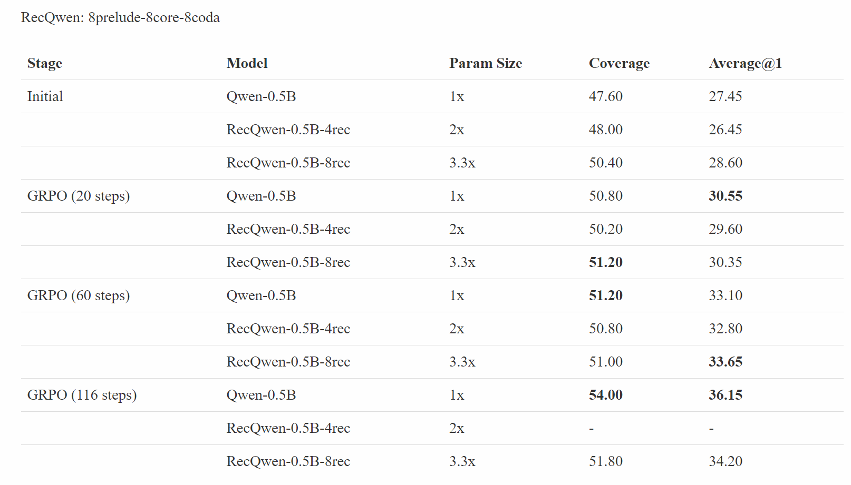

Slide 3
1. Train (data, SFT/RL, …)
2. Linear Initialize (eye+zero)
3. Baselines

