Slide 1
SnapBox Requirements
Weston Odom
Rainer Powell
Mason Volk

Slide 2
Overview
Project description
Functional requirements
Non-functional requirements
Diagrams

Slide 3
Project Description
Scope
Name and sort pictures
Schedules and naming schemes
Purpose
Allow organization and retrieval of pictures with little effort

Slide 4
Project Description (Cont.)
Goal
to create an app that allows users to define a schedule, take pictures, and easily and efficiently browse those images.
Stretch goal
allow users to join groups with synced photos taken during group events synced.

Slide 5
Functional Requirements
Users should be able to
define custom File-naming Schemes.
perform CRUD operations on Schedules and Events.
take pictures with phone’s camera and store conveniently.
browse/view locally saved pictures.
basic image-saving must function with or without Internet connection.
Stretch
search for and manage membership in Groups.

Slide 6
Non-functional Requirements
Intuitive in-app navigation.
Minimal effort required for common tasks.
OS
Must have >= Android 2.3
Hardware
Must have working camera on device

Slide 7
Features
calendar-based scheduling system
basic camera functionality
file browser - view captured images
Stretch
Groups (group organizer)

Slide 8
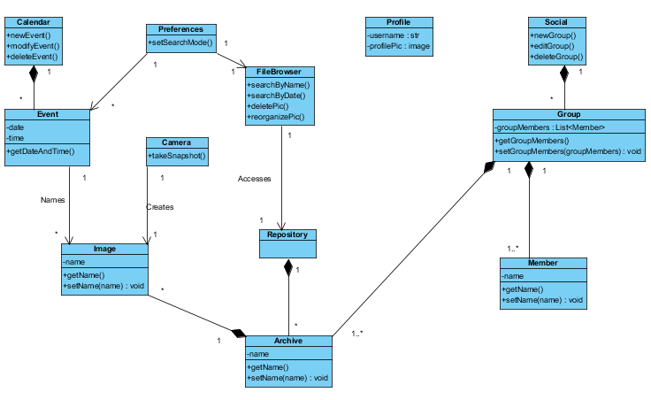
High-Level Class Diagram

Slide 9
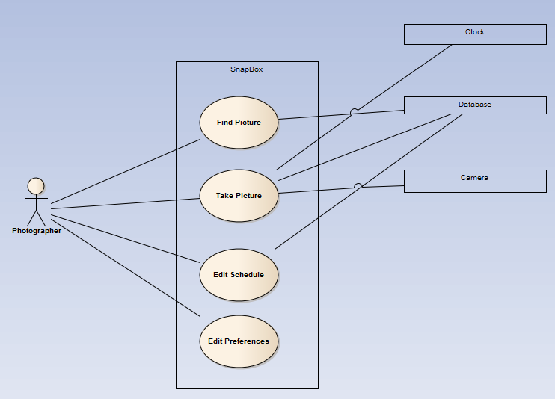
Use Case Diagram

Slide 10
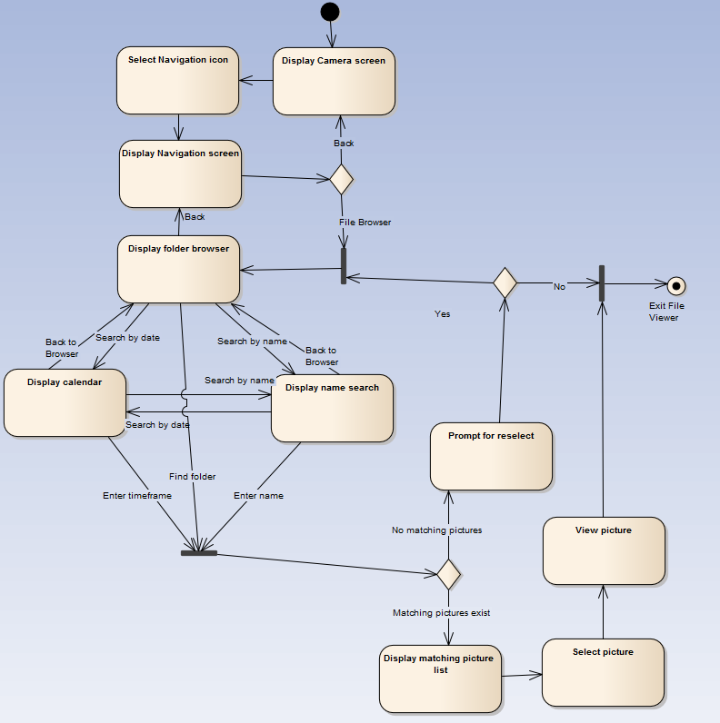
Activity Diagram: Finding a Picture

Slide 11
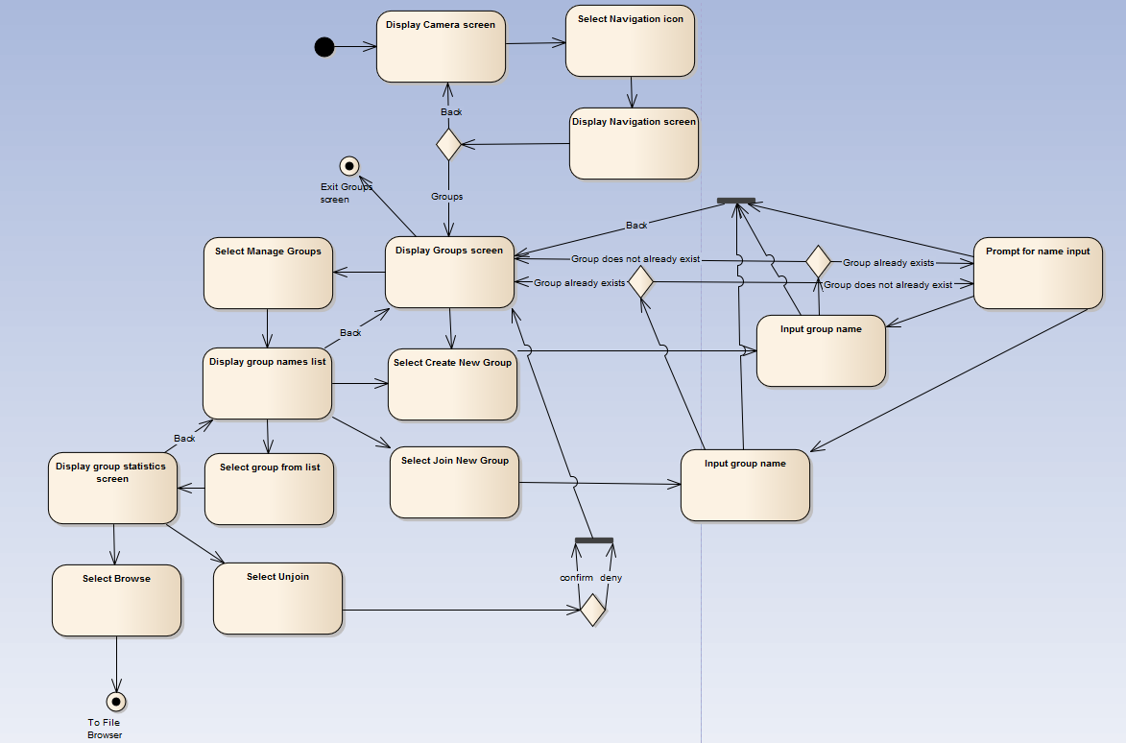
Activity Diagram (Stretch): Groups

