Slide 1
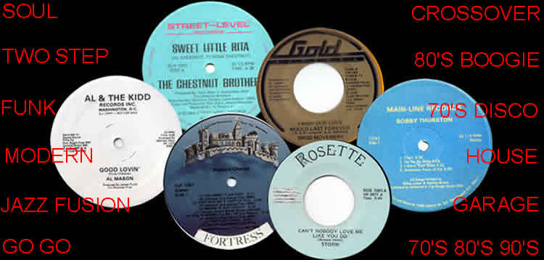
MUSIC COLLECTOR

Slide 2
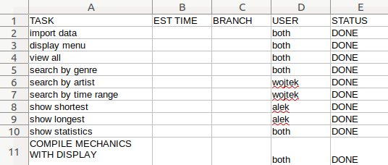
DIVISION OF THE TASK

Slide 3
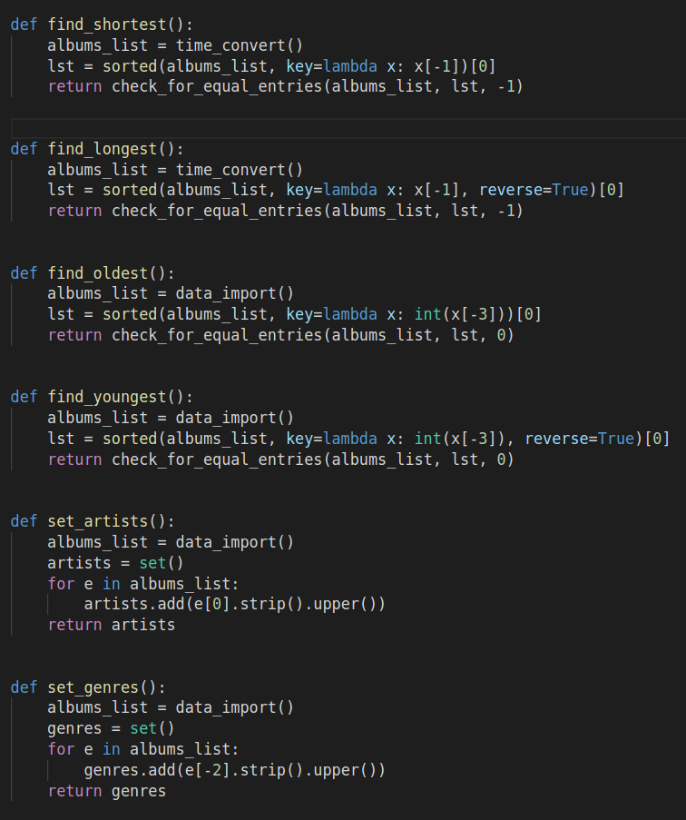

Slide 4
HIGHEST LEVEL LOOP
WAITS FOR
INPUT
MAIN()
DISPLAY_MENU
(show_stat)
DISPLAY
(fun_result)
CHECK_CHOICE_RESULT()
DICTIONARY
WITH
FUNCTION
CALLS
MENU_CHOICE()

Slide 5
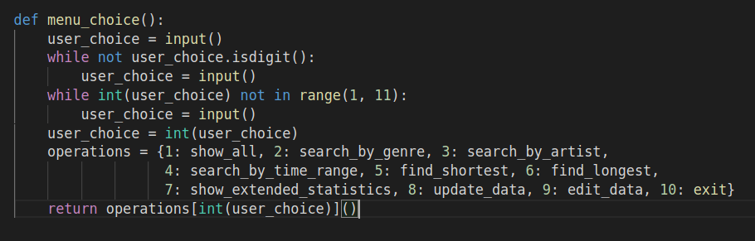
MENU_CHOICE()

Slide 6
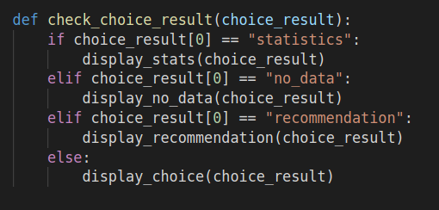
CHECK_CHOICE_RESULT()

Slide 7
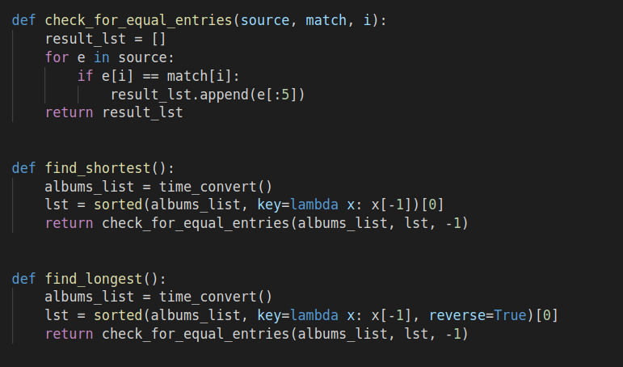
CHECK_FOR_EQUAL_ENTRIES()

