Slide 1
Final Project Azure Search
Trbula, Todd
Deep Azure@McKesson
Dr. Zoran B. Djordjević

Slide 2
Problem Statement
People are always on the internet searching for jobs based on general information such as salary, location, job type, etc. The problem we face is the immediate need to access this information as it’s being produced, ability to sort through the data, and incorporating a great search experience to the end-user. The demo represented is an example of a New York City job website. With the various search methods, we will analyze the data using Azure search service, web applications, storage container, and SQL server 2016 for ingest and storage of searches.

Slide 3
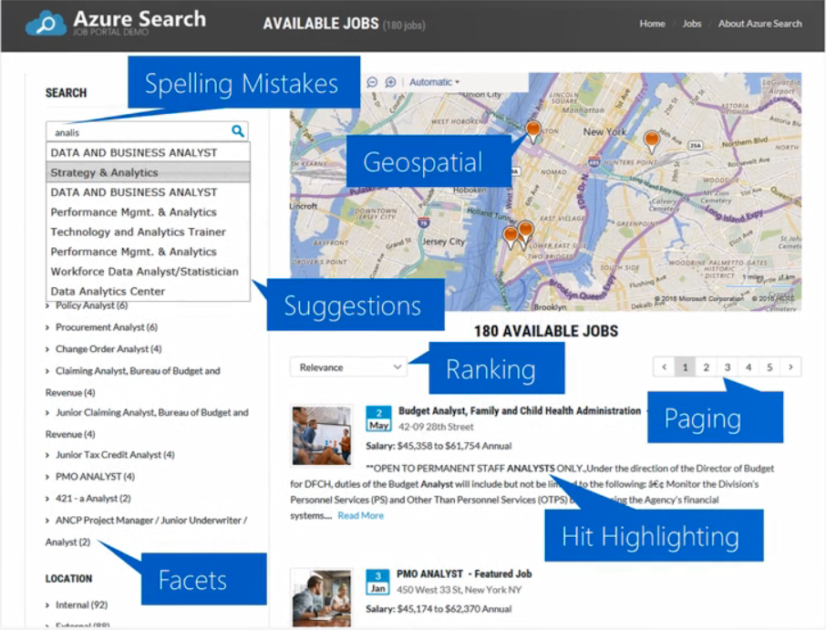
What is Azure Search?
A search-as-a-service solution allowing developers to incorporate great search experiences into applications without managing infrastructure or needing to become search experts.
A component of Microsoft Azure Cloud Platform providing indexing and querying capabilities for data uploaded to Microsoft servers.
Intended to provide developers with complex search capabilities for mobile and web development while hiding infrastructure requirements and search algorithm complexities.

Slide 4
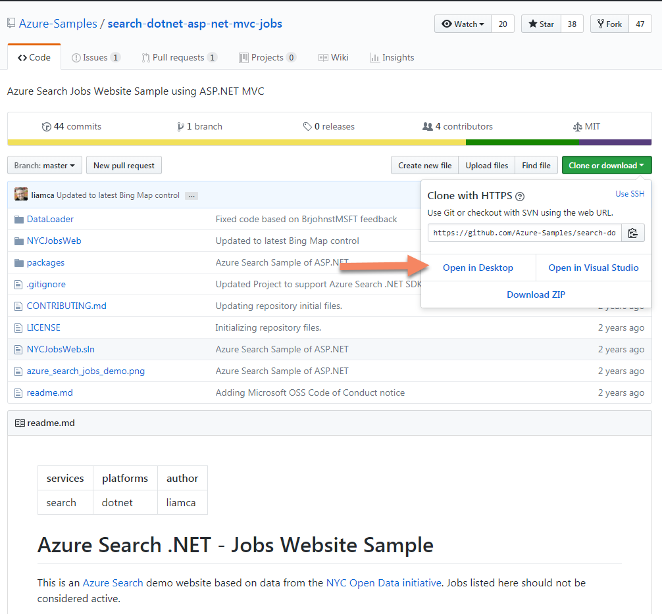
Dataset & GitHub
Research your topic (Azure Search) then look for a dataset. The dataset used was found through GitHub https://github.com/Azure-Samples/search-dotnet-asp-net-mvc-jobs as a sample document with files. Select to clone or download files by the following options (Desktop, Visual Studio, or ZIP). For me I selected desktop saving files to a local drive.

Slide 5
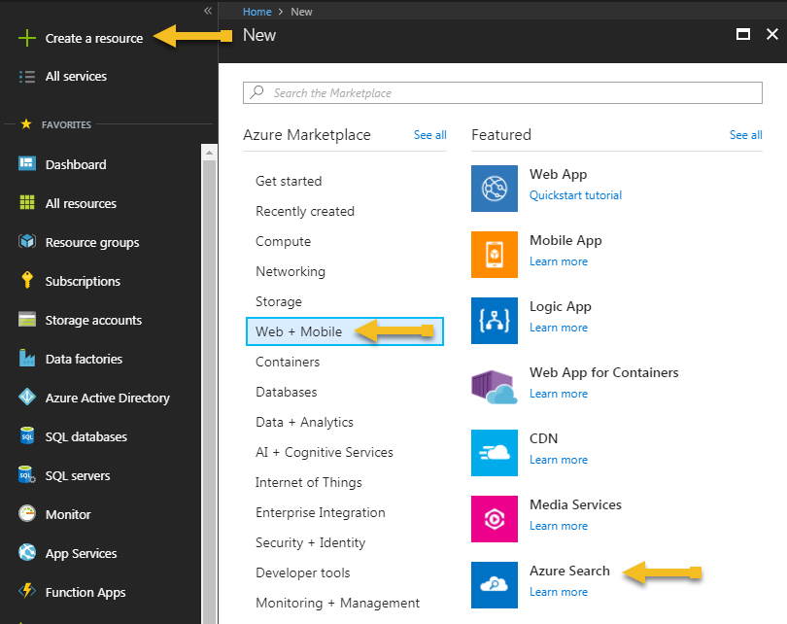
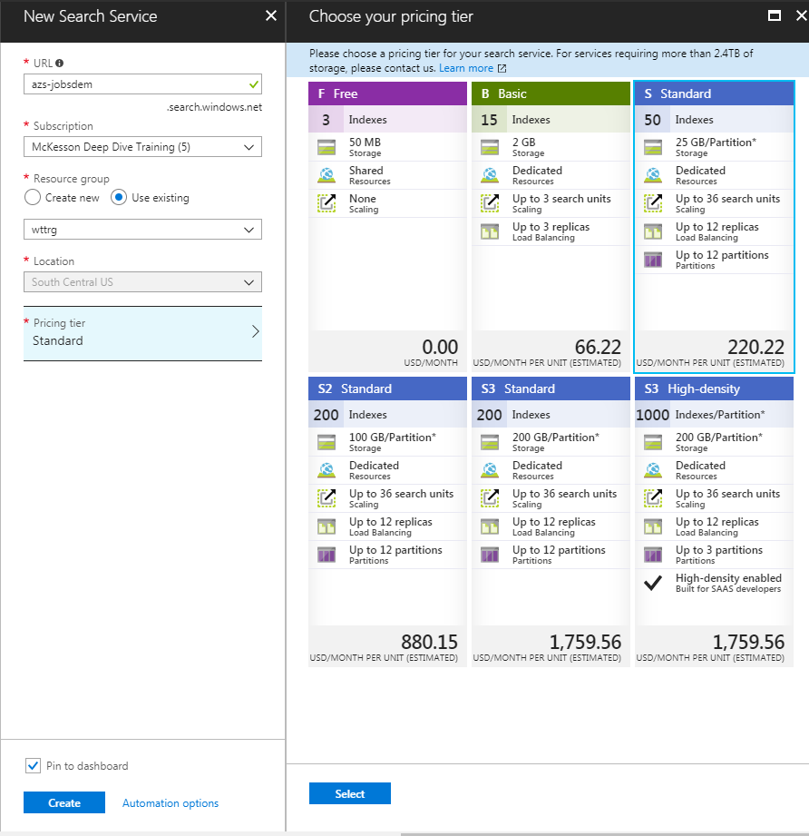
Creating Azure Search
Access Azure portal to create an Azure Search service. To create an Azure Search select create a resource ➔ Web + Mobile ➔ Azure Search.

Slide 6
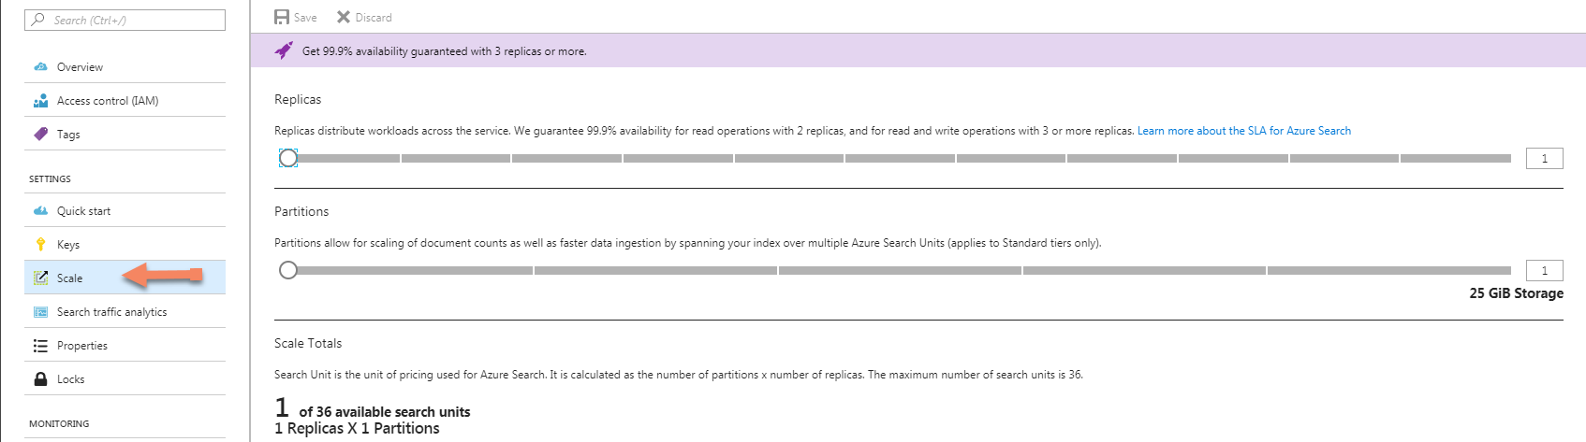
Azure Search Scaling
After Azure Service has been provisioned you can scale the service depending on the tier chosen. You can scale your service in two dimensions: replicas and partitions. Had you chosen the Basic tier, you can only add replicas. If you provisioned the free service, scale is not available.
Partitions allow your service to store and search through more documents.
Replicas allow your service to handle a higher load of search queries.

Slide 7
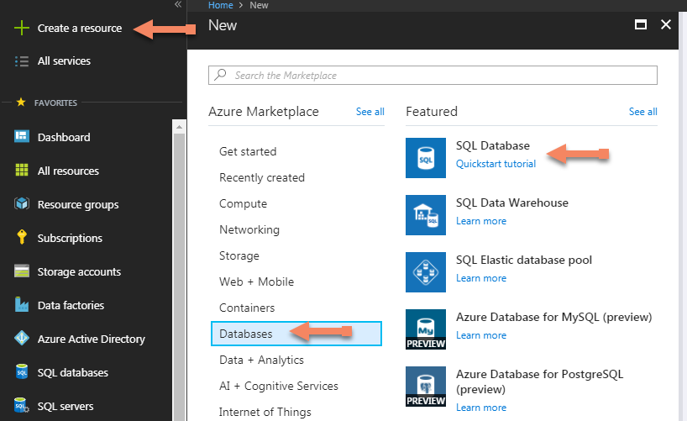
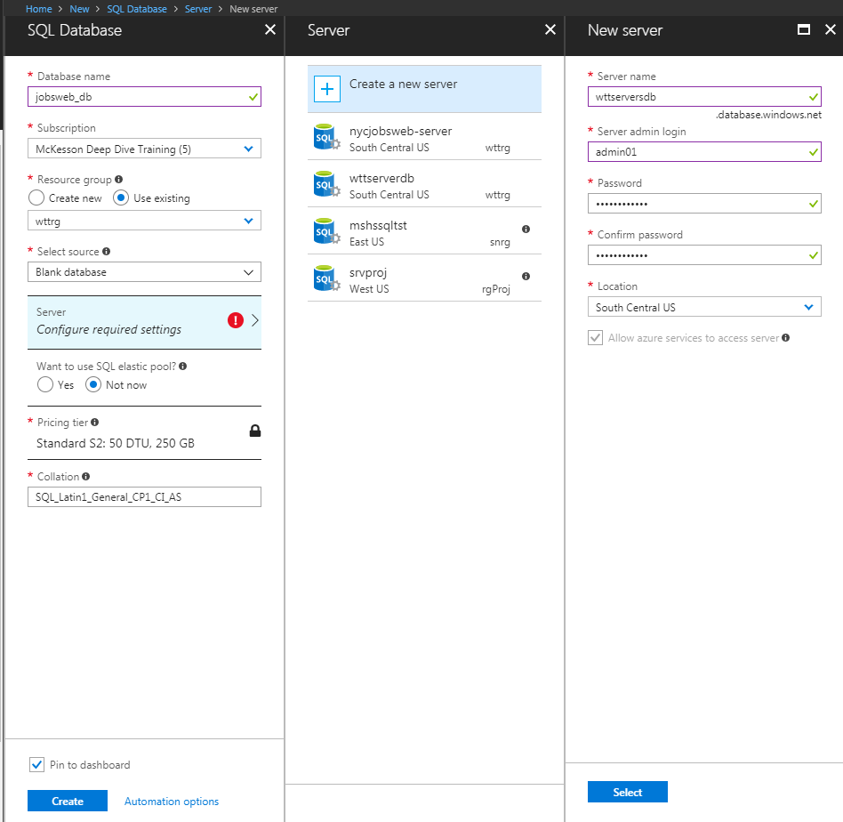
Create SQL DB & Server
Start by selecting Create a resource ➔ Databases ➔ SQL Database.

Slide 8
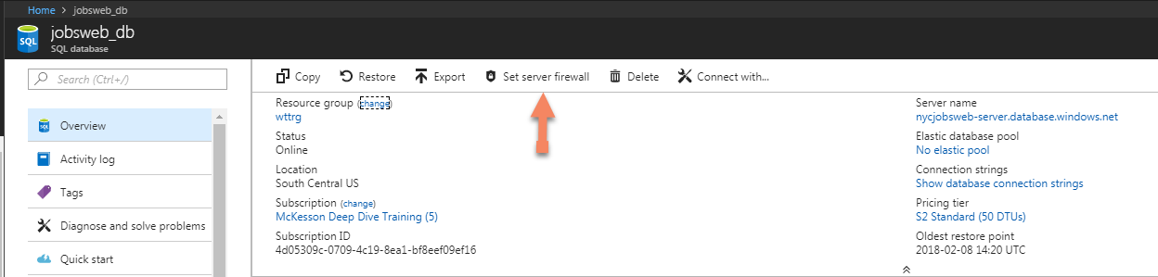
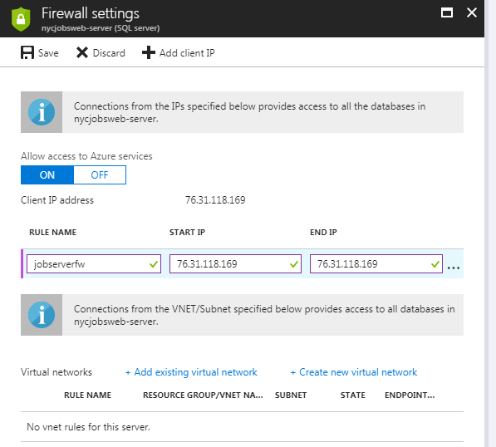
SQL DB Firewall
After SQL Database has been provisioned set the server firewall. At the top click Set server firewall.
Create a rule name, start IP and end IP followed by clicking the Save button. The IP address used was the client IP address.

Slide 9
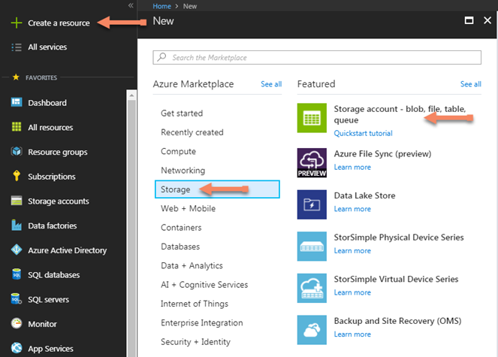
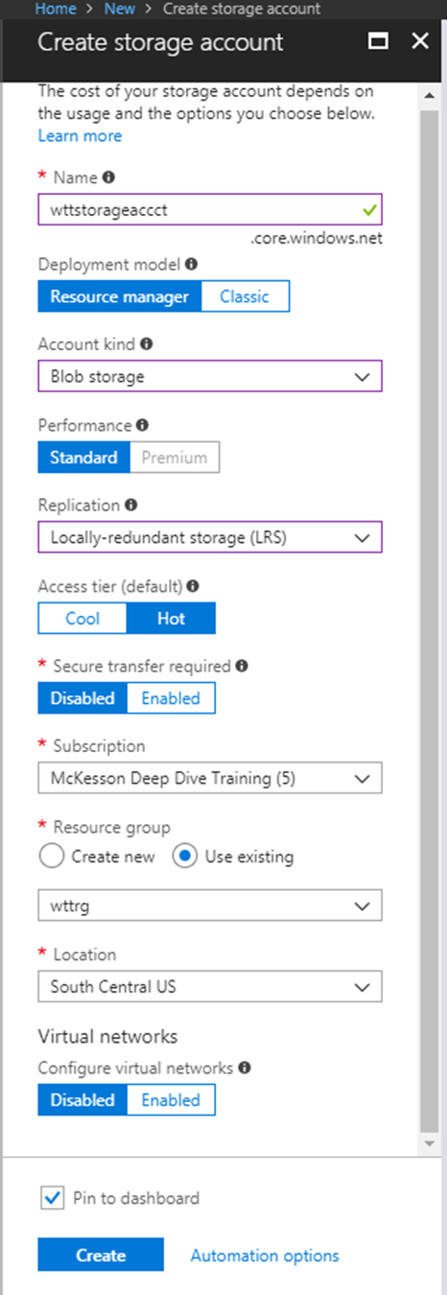
Create Storage Account
Start by selecting Create a resource ➔ Storage ➔ Storage account – blob, file, table, queue.
Create a Name, deployment model, account kind (blob storage), performance, replication (Locally-redundant storage), access tier, Secure transfer required, subscription, resource group, location, virtual networks then check the Pin to dashboard before selecting Create.

Slide 10
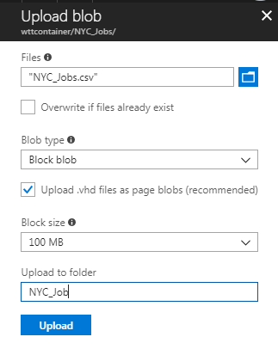
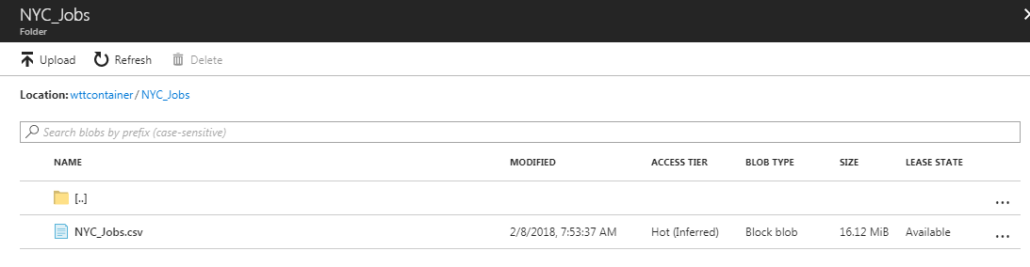
Storage Container
After provisioning the storage account under settings select containers. Select +Container to create a container name and public access level. For the level chose Blob (anonymous read access for blobs only). Next select OK.
Next, upload a blob file (NYC_Jobs.csv). To do this select the container name wttcontainer ➔ upload then select the folder icon to map to the file on local computer. After selecting your file, select a blob type, size, and folder name followed by Upload.

Slide 11
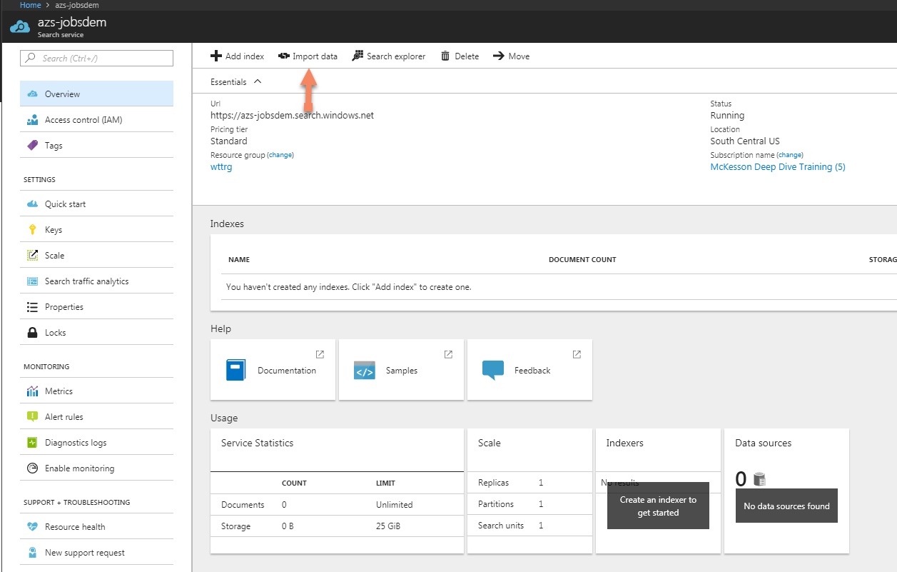
Importing file to Azure Search
With the file uploaded to the container go back to Search serevices to import the data creating an indexer. Open azs-jobsdemo ➔ Import data. Create a data source, Index, and Indexer.
Note to know the storage account name, container name, and name of blob.

Slide 12
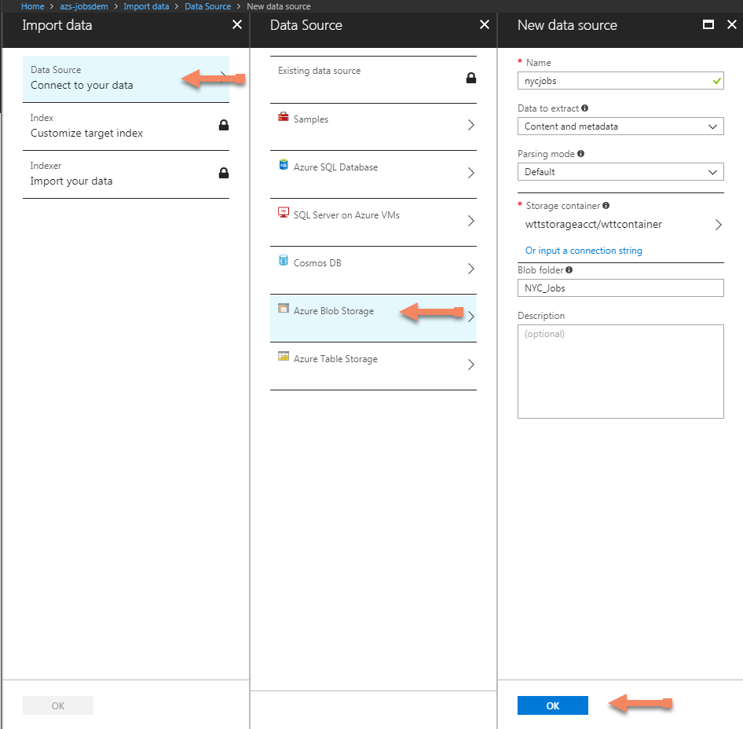
Index Data Source
Under Data Source choose Azure Blob Storage ➔ creating a name, data to extract, parsing mode, storage container, and blob folder followed by OK.

Slide 13
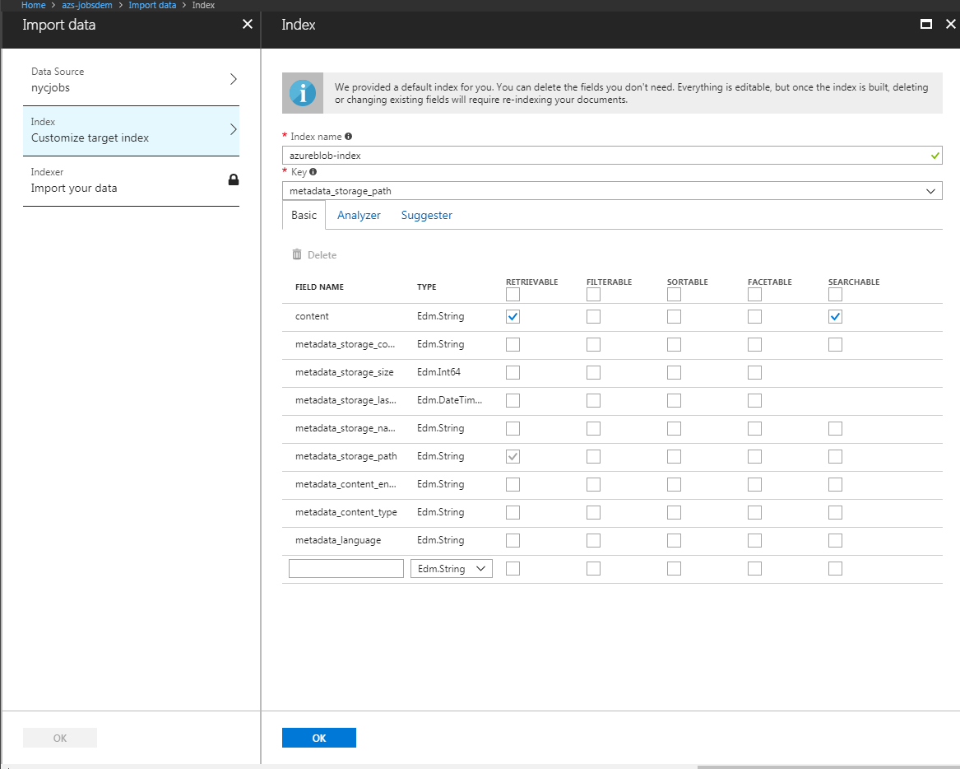
Customize Target Index
Customize target index by creating index name and creating each field name along with checking whether or not fields are retrievable, filterable, sortable, facetable, searchable.
Then select OK.

Slide 14
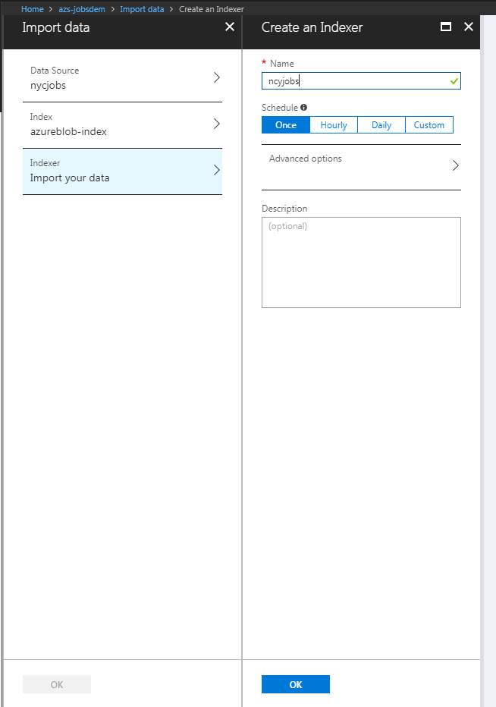
Indexer Name
Last import your data by creating an indexer name and schedule before selecting OK.

Slide 15
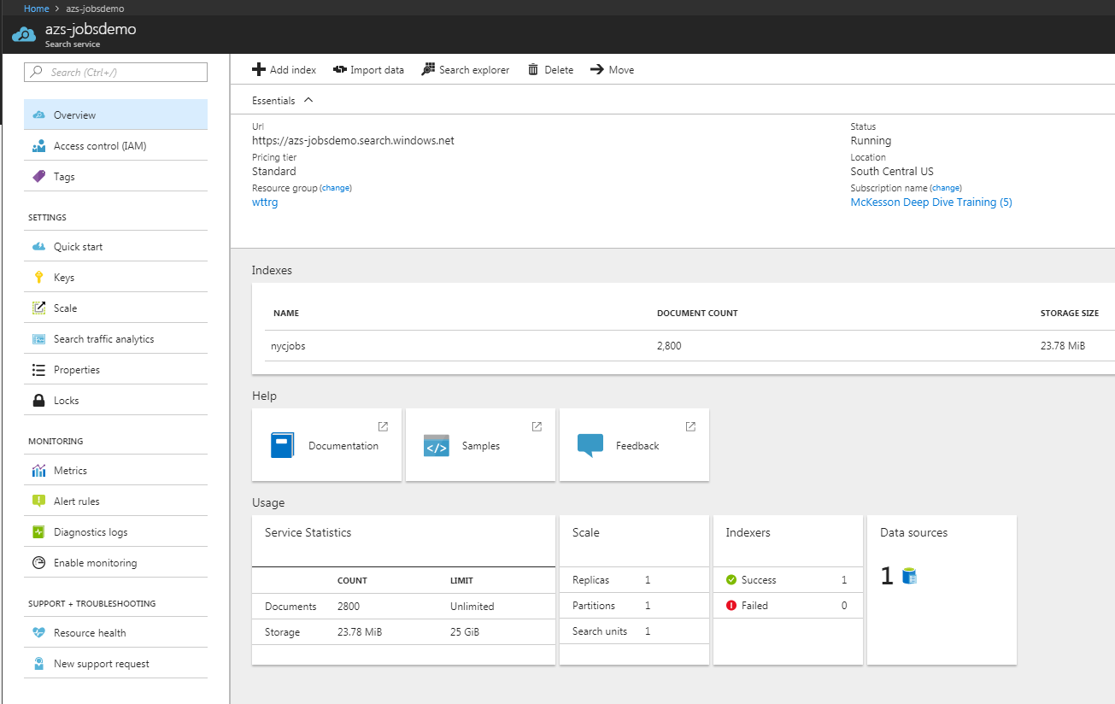
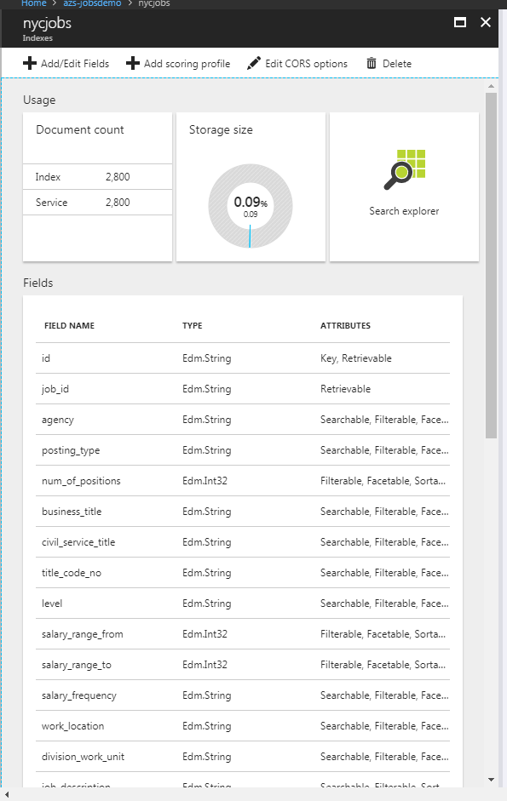
Completed Data Import
With the index created the data will load showing a single data source and whether or not the indexer successfully loaded.
Click on the indexer name to view the document counts, storage size, and fields. From here we can add/edit fields, add scoring profile, edit CORS options, Delete the indexer and even use the search explorer.

Slide 16
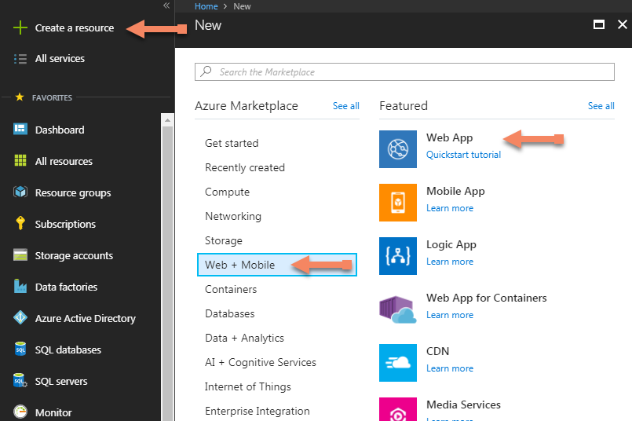
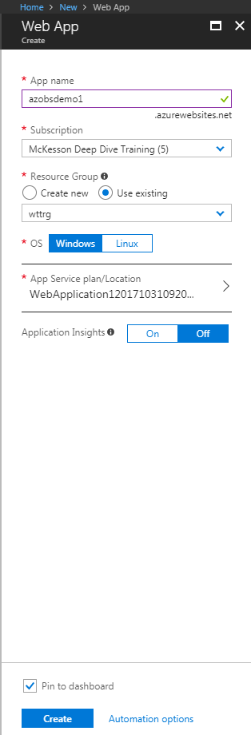
Create A Web Application
Select Create a resource ➔ Web + Mobile ➔ Web App. Create an App name, subscription, resource group, OS type, App Service plan followed by checking Pin to dashboard and selecting Create.
This will be utilized when we get ready to publish our dataset using Visual Studio 2017 later in this exercise.

Slide 17
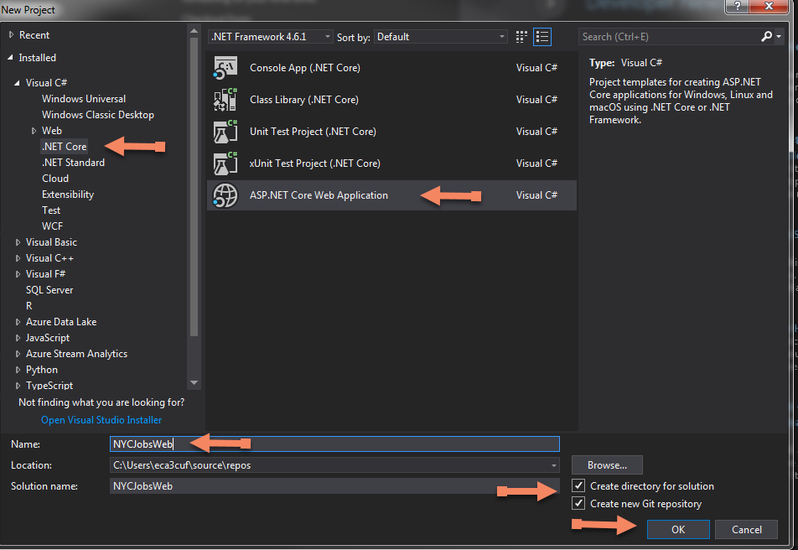
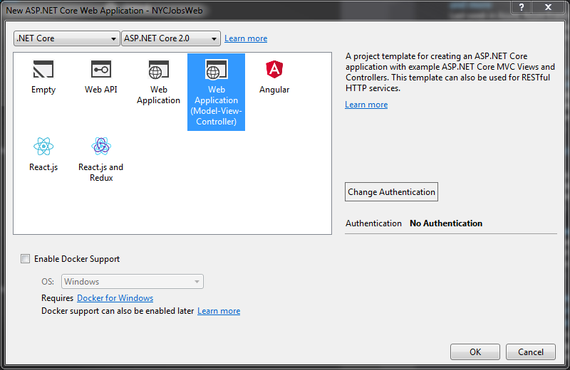
Loading Dataset in Visual Studio 2017
Open Microsoft Visual Studio 2017. Select File ➔ New ➔ Project. Under Visual C#, select .NET Core ➔ ASP.NET Core Web Application. Create a name, checking both create directory for solution and create new Git repository followed by OK.
Choose the Web Application (Model-View-Controller). Leave the authentication as No Authentication. Click OK.

Slide 18
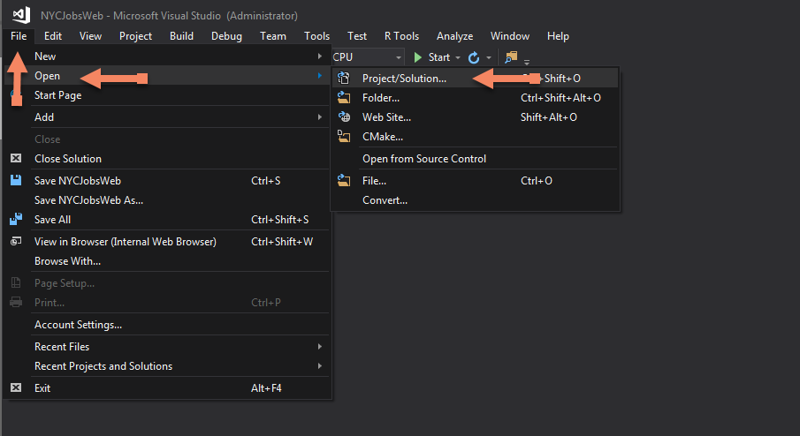
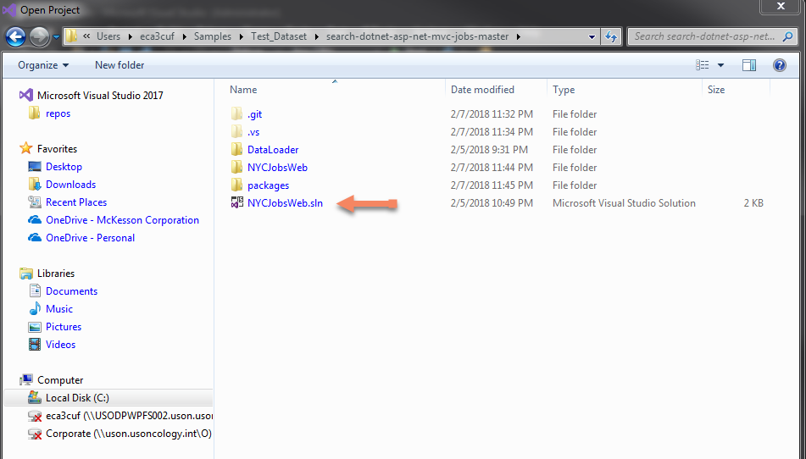
After creating a project, go to File ➔ Open ➔ Project/Solution.
Navigate to your local folder where the dataset exists selecting the VS solution (NTCJobsWeb.sln).
This will then load the dataset to VS and code needed to create a search website.

Slide 19
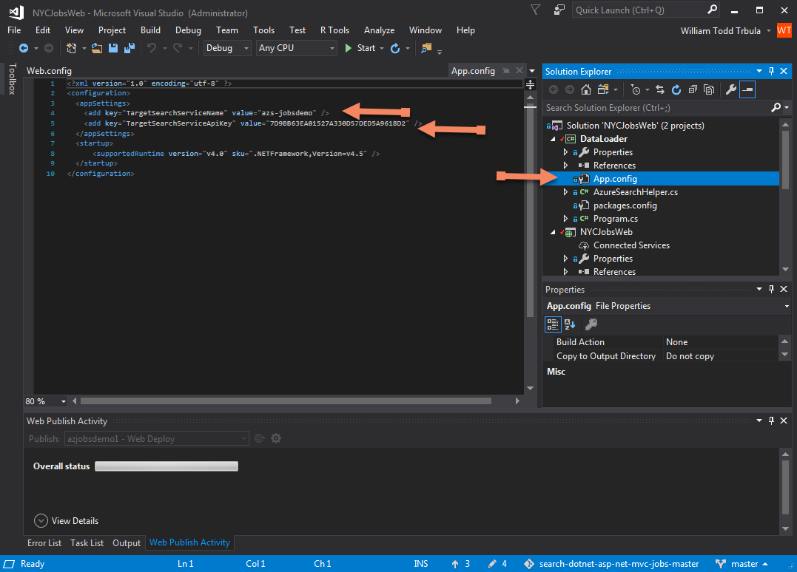
Modifying App.config
Since the code is prebuilt only need to be modify the App.config. Here we need the target search service name and APIkey. To get this information go to Azure portal ➔ Azure Search services ➔ under settings select Keys.
Copy to notepad the name of the Search service (azs-jobsdemo) and primary admin key.
Go back to VS app.config entering the info followed by saving the change.

Slide 20
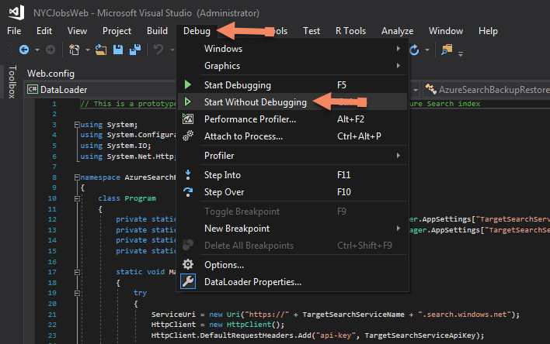
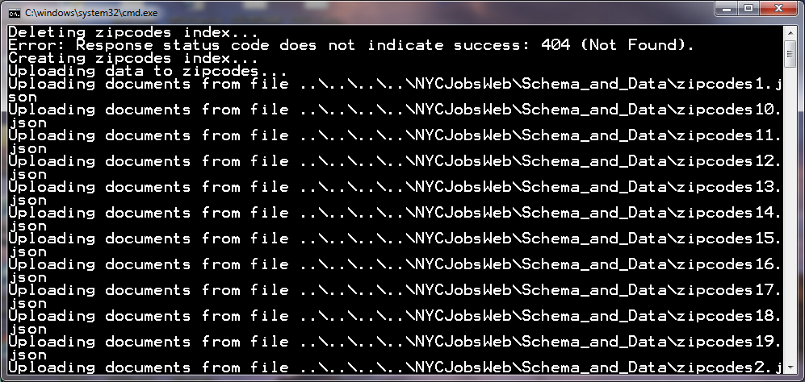
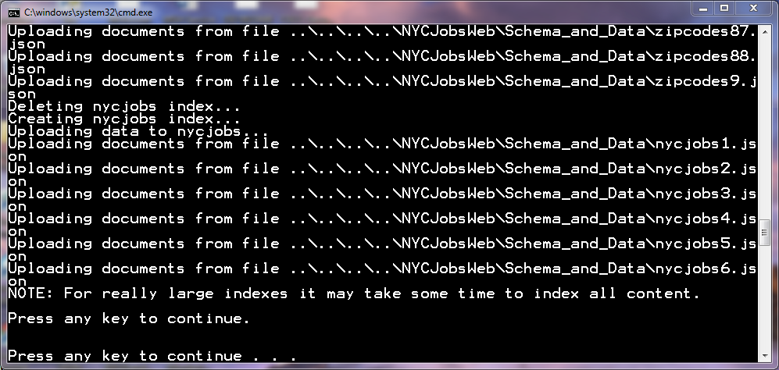
Debug
Select Debug ➔ Start without Debugging to test the solution. As it runs through uploading documents we will get a press any key to continue once completed.

Slide 21
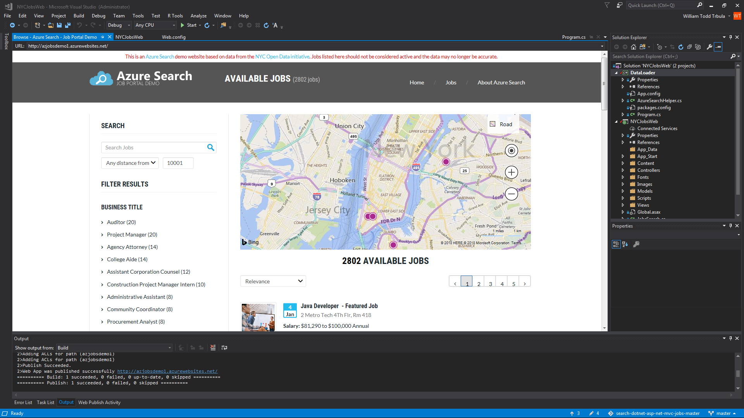
Publishing
Under Solution Explorer right-click on Solution NYCJobsWeb and select Build Solution.
Now we want to right click on NYCJobsWeb selecting Publish. From here we will select existing Web App under the resource group select the name azjobsdemo1. The click Publish.
If everything loads correctly a browser will open displaying our Azure Search demo.

Slide 22
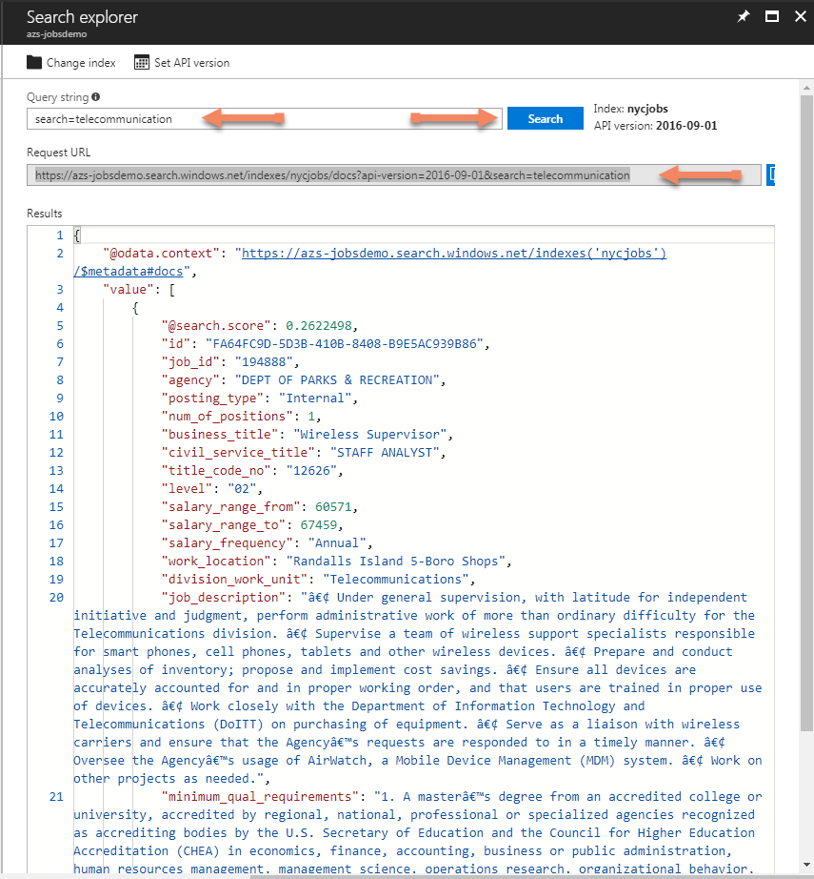
Search Explorer
Going into Azure portal selecting the Azure Search service created early. From here we can see our indexer, document count, and storage size has been populated. Also in the usage area see the service statistics, scale, indexers, and data sources.
Select the index name. From here we see the data within such as usage, fields, scoring profiles, and CORS option. From here select Search explorer.
With the Search explorer open we can do a search query by typing search=telecommunication then selecting the search button. What this will do type in the full URL https://azs-jobsdemo.search.windows.net/indexes/nycjobs/docs?api-version=2016-09-01&search=telecommunication that by REST API will call to get the results. The result will return in a JSON format

Slide 23
Search Feature Summary
Category | Features
Full text search and text analysis | Full text search is a primary use case for most search-based apps. Queries can be formulated using a supported syntax. Simple query syntax provides logical operators, phrase search operators, suffix operators, precedence operators. Lucene query syntax includes all operations in simple syntax, with extensions for fuzzy search, proximity search, term boosting, and regular expressions.
Geo-search | Azure Search processes, filters, and displays geographic locations. It enables users to explore data based on the proximity of a search result to a physical location. Watch this video or review this sample to learn more.
User experience features | Search suggestions can be enabled for type-ahead queries in a search bar. Actual documents in your index are suggested as users enter partial search input. Faceted navigation is enabled through a single query parameter. Azure Search returns a faceted navigation structure you can use as the code behind a categories list, for self-directed filtering (for example, to filter catalog items by price-range or brand). Filters can be used to incorporate faceted navigation into your application's UI, enhance query formulation, and filter based on user- or developer-specified criteria. Create filters using the OData syntax. Hit highlighting applies text formatting to a matching keyword in search results. You can choose which fields return highlighted snippets. Sorting is offered for multiple fields via the index schema and then toggled at query-time with a single search parameter. Paging and throttling your search results is straightforward with the finely tuned control that Azure Search offers over your search results.

Slide 24
Pros & Cons
Pros
Cons
Easy to set up
Managed
Auto-Scaling
More languages
Search-centric apps:
Scoring
Faceting
Suggestions
Synonyms
geo-search
Ability to migrate between price tiers
No redundancy
Up to 25 indexes

Slide 25
YouTube URLs, GitHub URL, Last Page
Two minute (short): https://youtu.be/pvXeqt8IIEk
15 minutes (long): https://youtu.be/_sM-TUtTXIM
GitHub Repository with all artifacts: https://github.com/wtrbula/Final-Project

