Slide 1
C++ Memory Overview
4 major memory segments
  Global: variables outside stack, heap
  Code (a.k.a. text): the compiled program
  Heap: dynamically allocated variables
  Stack: parameters, automatic and temporary variables
Key differences from Java
  Destructors of automatic variables called when stack frame where declared pops
  No garbage collection: program must explicitly free dynamic memory
Heap and stack use varies dynamically
Code and global use is fixed
Code segment is “read-only”
stack
heap
code
global

Slide 2
Illustrating C++ Memory
int g_default_value = 1;
int main (int argc, char **argv) {
Foo *f = new Foo;
f->setValue(g_default_value);
delete f;
return 0;
}
void Foo::setValue(int v) {
this->m_value = v;
}
crt0
main
Foo *f
stack
Foo:
setValue
Foo *this
int v
m_value
heap
code
g_default_value
global

Slide 3
Illustrating C++ Memory
int g_default_value = 1;
int main (int argc, char **argv) {
Foo *f = new Foo;
f->setValue(g_default_value);
delete f;
return 0;
}
void Foo::setValue(int v) {
this->m_value = v;
}
Foo *f
stack
Foo *this
int v
m_value
heap
code
g_default_value
global

Slide 4
Memory, Lifetimes, and Scopes
Temporary variables
  Are scoped to an expression, e.g., a = b + 3 * c;
Automatic (stack) variables
  Are scoped to the duration of the function in which they are declared
Dynamically allocated variables
  Are scoped from explicit creation (new) to explicit destruction (delete)
Global variables
  Are scoped to the entire lifetime of the program
  Includes static class and namespace members
  May still have initialization ordering issues
Member variables
  Are scoped to the lifetime of the object within which they reside
  Depends on whether object is temporary, automatic, dynamic, or global
Lifetime of a pointer/reference can differ from the lifetime of the location to which it points/refers

Slide 5
Direct Dynamic Allocation and De-allocation
#include <iostream>
using namespace std;
int main (int, char *[]) {
int * i = new int; // any of these can throw bad_alloc
int * j = new int (3);
int * k = new int[*j];
int * l = new int[*j];
for (int m = 0; m < *j; ++m) {
l[m] = m;
}
delete i;
delete j;
delete [] k;
delete [] l;
return 0;
}
Array vs. single instance new
Fill in array values with loop
Array vs. single instance delete

Slide 6
A Basic Issue: Multiple Aliasing
int main (int argc,
char **argv) {
Foo f;
Foo *p = &f;
Foo &r = f;
delete p;
return 0;
}
Multiple aliases for same object
  f is a simple alias, the object itself
  p is a variable holding a pointer
  r is a variable holding a reference
What happens when we call delete on p?
  Destroy a stack variable (may get a bus error there if we’re lucky)
  If not, we may crash in destructor of f at function exit
  Or worse, a local stack corruption that may lead to problems later
Problem: object destroyed but another alias to it was then used
Foo &r
Foo f
Foo *p

Slide 7
Memory Lifetime Errors
Foo *bad() {
Foo f;
return &f;
}
Foo &alsoBad() {
Foo f;
return f;
}
Foo mediocre() {
Foo f;
return f;
}
Foo * better() {
Foo *f = new Foo;
return f;
}
Automatic variables
  Are destroyed on function return
  But in bad, we return a pointer to a variable that no longer exists
  Reference from also_bad similar
  Like an un-initialized pointer
What if we returned a copy?
  Ok, we avoid the bad pointer, and end up with an actual object
  But we do twice the work (why?)
  And, it’s a temporary variable (more on this next)
We really want dynamic allocation here

Slide 8
More Memory Lifetime Errors
int main() {
Foo *f = &mediocre();
cout << good()->value() <<
endl;
return 0;
}
Foo mediocre() {
Foo f;
return f;
}
Foo * good() {
return new Foo;
}
Dynamically allocated variables
  Are not garbage collected
  But are lost if no one refers to them: called a “memory leak”
Temporary variables
  Are destroyed at end of statement
  Similar to problems w/ automatics
Can you spot 2 problems?
  One with a temporary variable
  One with dynamic allocation

Slide 9
More Memory Lifetime Errors
int main() {
Foo *f = &mediocre();
cout << good()->value() <<
endl;
return 0;
}
Foo mediocre() {
Foo f;
return f;
}
Foo *good() {
return new Foo;
}
Dynamically allocated variables
  Are not garbage collected
  But are lost if no one refers to them: called a “memory leak”
Temporary variables
  Are destroyed at end of statement
  Similar to problems w/ automatics
Can you spot 2 problems?
  One with a temporary variable
  One with dynamic allocation
Key point
  Incorrect use is the real problem
  Need to examine and fully understand the details

Slide 10
Double Deletion Errors
int main (int argc, char **argv) {
Foo *f = new Foo;
delete f;
// ... do other stuff
delete f;
return 0;
}
crt0
main
Foo *f
stack
f
heap
code
g_default_value
global

Slide 11
Double Deletion Errors
int main (int argc, char **argv) {
Foo *f = new Foo;
delete f;
// ... do other stuff
delete f;
return 0;
}
crt0
main
Foo *f
stack
heap
What could be at this location?
  Another heap variable
  Could corrupt heap
code
g_default_value
global

Slide 12
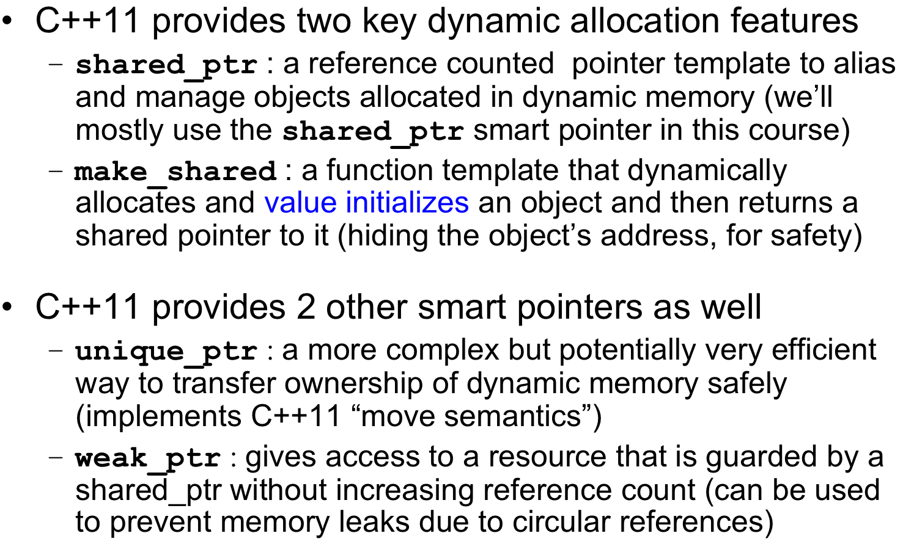
A Safer Approach using Smart Pointers

Slide 13
Resource Acquisition Is Initialization (RAII)‏
Also referred to as the “Guard Idiom”
  However, the term “RAII” is more widely used for C++
Relies on the fact that in C++ a stack object’s destructor is called when stack frame pops
Idea: we can use a stack object (usually a smart pointer) to hold the ownership of a heap object, or any other resource that requires explicit clean up
  Immediately initialize stack object with the allocated resource
  De-allocate resource in the stack object’s destructor

Slide 14
RAII Example: Guarding Newly Allocated Object
RAII idiom example using shared_ptr
  #include <memory>
  using namespace std;
shared_ptr<X> assumes and maintains ownership of aliased X
Can access the aliased X through it (*spf)
shared_ptr<X> destructor calls delete on address of owned X when it’s safe to do so (per reference counting idiom discussed next)
Combines well with other memory idioms
shared_ptr<Foo> createAndInit() {
shared_ptr<Foo> p =
make_shared<Foo> ();
init(p);// may throw exception
return p;
}
int run () {
try {
shared_ptr<Foo> spf =
createAndInit();
cout << “*spf is ” << *spf;
} catch (...) {
return -1
}
return 0;
}

Slide 15
Reference Counting
Basic Problem
  Resource sharing is often more efficient than copying
  But it’s hard to tell when all are done using a resource
  Must avoid early deletion
  Must avoid leaks (non-deletion)
Solution Approach
  Share both the resource and a counter for references to it
  Each new reference increments the counter
  When a reference is done, it decrements the counter
  If count drops to zero, also deletes resource and counter
  “last one out shuts off the lights”
reference
reference
Resource
reference
counter == 3

Slide 16
Reference Counting Example: Sharing an Object
shared_ptr<Foo> createAndInit() {
shared_ptr<Foo> p =
make_shared<Foo> ();
init(p);// may throw exception
return p;
}
int run () {
try {
shared_ptr<Foo> spf =
createAndInit();
shared_ptr<Foo> spf2 = spf;
// object destroyed after
// both spf and spf2 go away
} catch (...) {
return -1
}
return 0;
}
Again starts with RAII idiom via shared_ptr
spf initially has sole ownership of aliased X
  spf.unique() would return true
  spf.use_count would return 1
shared_ptr<X> copy constructor increases count, and its destructor decreases count
shared_ptr<X> destructor calls delete on the pointer to the owned X when count drops to 0

